Slide 1
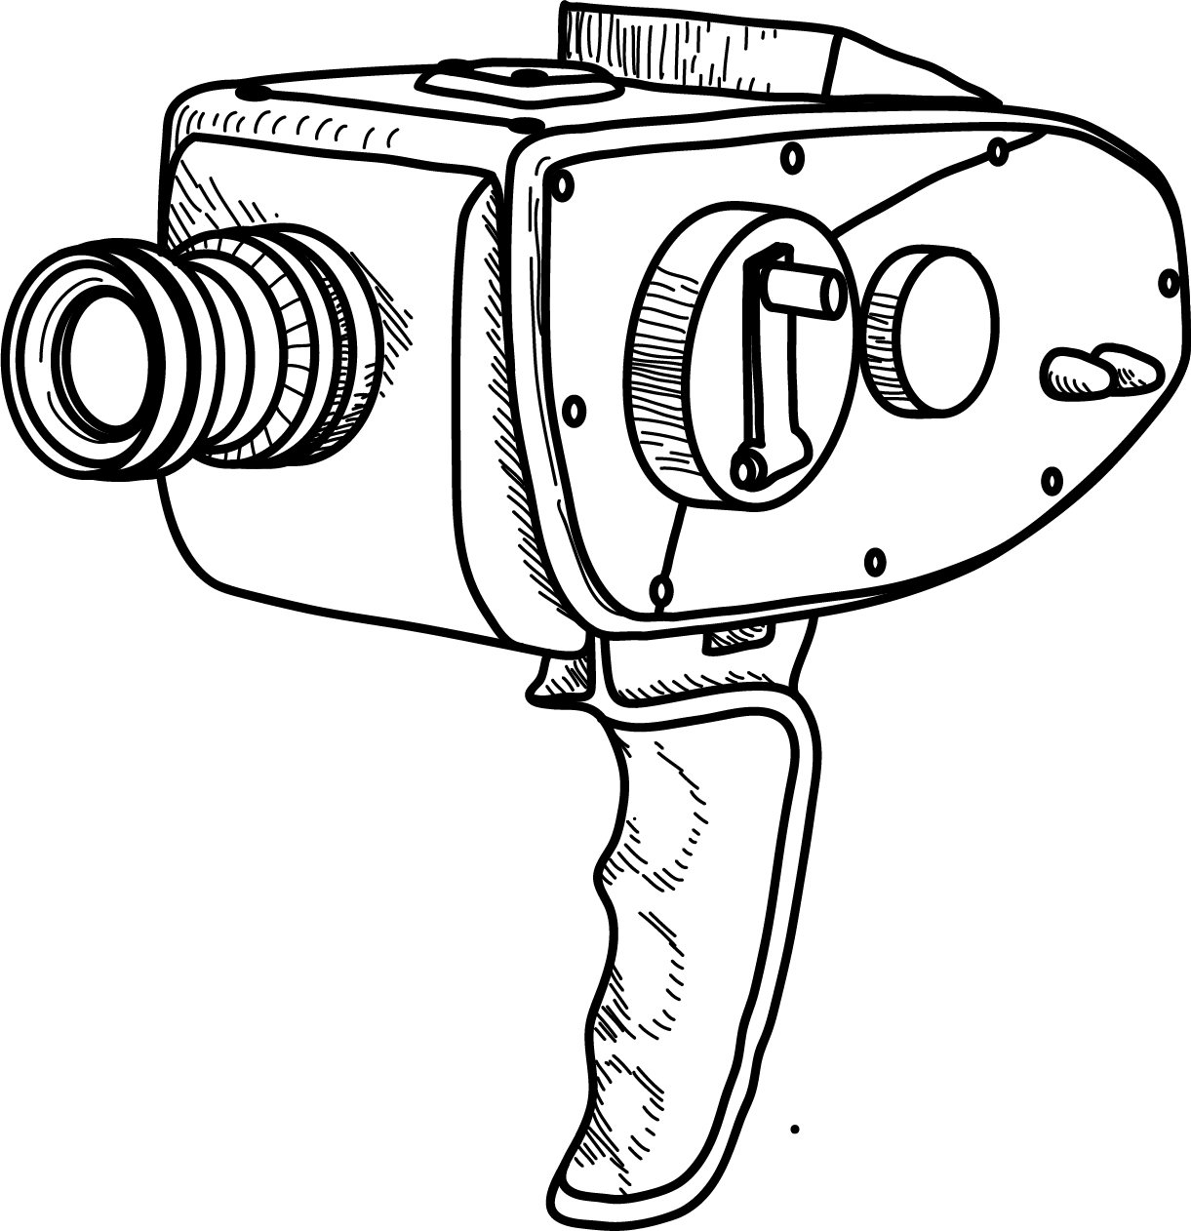
Good Will Mapping
Geospatial knowledge graph of Indian cinema
Mid evaluation · 14 October 2026
Notes:
Source deck: https://docs.google.com/presentation/d/19AJkpIwel35Kh1gxN_7hzznjK3QnWGQlSNvKDjQ14uI/edit. Updated implementation and source snapshots as of 13 October 2026.
Source presentation: https://docs.google.com/presentation/d/19AJkpIwel35Kh1gxN_7hzznjK3QnWGQlSNvKDjQ14uI/edit

Slide 2
Team
Name | Student ID
Vardaan Goel | 2025117001
Vanshrajsinh Chauhan | 2025117003
Soubhagya Ranjan Biswal | 2025117010
Satyendhran L | 2025117006
Abhinav PV | 2025121015
Notes:
Names and IDs follow the supplied team slide. The new integration/GIS refresh and presentation contribution belongs to Satyendhran. Existing collectors, the ontology extensions and heritage evidence include upstream team work.
Source presentation: https://docs.google.com/presentation/d/19AJkpIwel35Kh1gxN_7hzznjK3QnWGQlSNvKDjQ14uI/edit

Slide 3

Project scope
Connect films, songs, credited people, characters, places and heritage sites.
Study geographic associations across the supplied 1970–2025 film corpus.
Keep the source evidence behind every accepted relationship.
Notes:
Implemented entity classes and relation counts: Dataset/integrated/summary.json. Event and Landscape classes are reserved without instances.
Source presentation: https://docs.google.com/presentation/d/19AJkpIwel35Kh1gxN_7hzznjK3QnWGQlSNvKDjQ14uI/edit

Slide 4
Cinema geography
A film can link an audience to a real place, a story setting or a depicted heritage site.
Those links support research and tourism discovery when the evidence and spatial scope are explicit.
Notes:
This slide describes potential uses. No measured causal tourism increase is claimed.
Source presentation: https://docs.google.com/presentation/d/19AJkpIwel35Kh1gxN_7hzznjK3QnWGQlSNvKDjQ14uI/edit

Slide 5
Filming and story settings
Relationship | Meaning
filmedAt | The source identifies a production location
setIn | The source identifies a narrative setting
inFilm | A song belongs to a film
partOfHeritage | A UNESCO component belongs to a property
Notes:
Wikidata definitions: https://www.wikidata.org/wiki/Property:P915 and https://www.wikidata.org/wiki/Property:P840. Current ontology: Queries/cinema_ontology.ttl. A story-setting relationship does not establish a shooting location.
Source presentation: https://docs.google.com/presentation/d/19AJkpIwel35Kh1gxN_7hzznjK3QnWGQlSNvKDjQ14uI/edit

Slide 6
Geographic questions
Which places are associated with Romance-tagged films?
Which UNESCO properties have filming connections across genres?
Which sourced film-location points fall within 5 km of a heritage reference point?
Notes:
Executed queries: Queries/knowledge_graph_queries/romance.sparql, heritage.sparql and the QGIS native spatial pipeline. Romance is a film genre, not a scene-level emotion label.
Source presentation: https://docs.google.com/presentation/d/19AJkpIwel35Kh1gxN_7hzznjK3QnWGQlSNvKDjQ14uI/edit

Slide 7
Tourism discovery
Explore the sourced films linked to a named place.
Inspect each claim before treating the place as a visitor destination.
A broad city coordinate cannot identify an exact scene or camera position.
Notes:
Application proposal only. The current graph is a research demonstration and does not contain permit availability, opening hours, safety or access information.
Source presentation: https://docs.google.com/presentation/d/19AJkpIwel35Kh1gxN_7hzznjK3QnWGQlSNvKDjQ14uI/edit

Slide 8
Research uses
Compare filming geography with narrative geography.
Group accepted heritage connections by film genre.
Trace a relationship to its input file, row and supporting evidence.
Notes:
Queries/build_graph_explorer.py exports reproducible aggregate results. Counts reflect the supplied corpus and unresolved geographic aliases.
Source presentation: https://docs.google.com/presentation/d/19AJkpIwel35Kh1gxN_7hzznjK3QnWGQlSNvKDjQ14uI/edit

Slide 9
Source datasets
Source | Role in the current build
TMDB | Movie IDs, metadata, cast, roles and genres
Wikidata / Wikipedia | Film identity and geographic assertions
Song CSV batches | Song membership and scoped music credits
Filmapia snapshot | Existing filming-place assertions
UNESCO export | Property/component identities and coordinates
Notes:
Input hashes and record counts are retained in Dataset/integrated/summary.json. IMDb IDs are already present as matching keys. Their presence does not imply IMDb location-page scraping.
Source presentation: https://docs.google.com/presentation/d/19AJkpIwel35Kh1gxN_7hzznjK3QnWGQlSNvKDjQ14uI/edit

Slide 10
Collection workflow
Collectors request structured data through source APIs.
They parse JSON or article revisions and flatten records into CSV tables.
Caching, batching and retry delays reduce duplicate requests.
The integration imports those supplied exports without changing them.
Notes:
Repository collectors: Queries/fetch_wikidata_films.py, fetch_wikidata_bollywood.py, pull_tmdb.py and enrich_locations.py. This contribution rebuilds supplied snapshots, rather than claiming a new scraping run for every website.
Source presentation: https://docs.google.com/presentation/d/19AJkpIwel35Kh1gxN_7hzznjK3QnWGQlSNvKDjQ14uI/edit

Slide 11
Wikidata locations
P915 stores a filming-location relationship.
P840 stores a narrative-location relationship.
P625 supplies a place coordinate when one exists.
SPARQL collectors retain film IDs and keep these meanings separate.
Notes:
https://www.wikidata.org/wiki/Property:P915 ; https://www.wikidata.org/wiki/Property:P840 ; https://www.wikidata.org/wiki/Property:P625 . Repository code: Queries/fetch_wikidata_films.py. Missing coordinates stay missing.
Source presentation: https://docs.google.com/presentation/d/19AJkpIwel35Kh1gxN_7hzznjK3QnWGQlSNvKDjQ14uI/edit

Slide 12
Wikipedia and TMDB
Wikipedia enrichment retrieves article revisions and categories through the MediaWiki API. Text candidates retain evidence and review status.
TMDB requests supply movie details, credits and external IDs. Production-country metadata does not establish filming geography.
Notes:
https://www.mediawiki.org/wiki/API:Revisions . Repository code: Queries/enrich_locations.py, location_text.py and pull_tmdb.py. No claim that every article or soundtrack row has been independently reviewed.
Source presentation: https://docs.google.com/presentation/d/19AJkpIwel35Kh1gxN_7hzznjK3QnWGQlSNvKDjQ14uI/edit

Slide 13
IMDb feasibility
A direct fetch of the Jodhaa Akbar filming-locations page returned HTTP 403. No records came from that attempt.
IMDb’s free dataset schemas omit filming locations. Its published guidance restricts automated website scraping.
A future IMDb import needs authorized access and confirmed field coverage.
Notes:
Checked 13 October 2026. Sample: https://www.imdb.com/title/tt0449994/locations/ . Official schemas: https://data.imdb.com/non-commercial-datasets/ . Usage guidance: https://help.imdb.com/article/imdb/general-information/can-i-use-imdb-data-in-my-software/G5JTRESSHJBBHTGX . One failed sample does not establish that all pages are inaccessible.
Source presentation: https://docs.google.com/presentation/d/19AJkpIwel35Kh1gxN_7hzznjK3QnWGQlSNvKDjQ14uI/edit

Slide 14
Film coverage by decade
Source corpus counts. The 2020s period ends in 2025.
Notes:
Exact counts from accepted films.csv rows. The 2020s bar covers 2020–2025 only. Films use their earliest observed release year. The source corpus includes shorts/documentaries and possible non-Bollywood records, so this is not a census of all Bollywood releases.
Source presentation: https://docs.google.com/presentation/d/19AJkpIwel35Kh1gxN_7hzznjK3QnWGQlSNvKDjQ14uI/edit

Slide 15
Current graph
9,509
10,708
Movies
Songs
44,416
218,993
Credited roles
Source assertions
Notes:
Dataset/integrated/summary.json. Period 1970–2025, inscription cutoff 2025. Distinct relationships: 211,297. People/credits: 33,524, genres: 19. Person-name credits are source-and-film scoped and are not a count of unique individuals.
Source presentation: https://docs.google.com/presentation/d/19AJkpIwel35Kh1gxN_7hzznjK3QnWGQlSNvKDjQ14uI/edit

Slide 16
Movie identity resolution
Shared Wikidata, IMDb, TMDB and Wikipedia identities provide the primary joins.
A unique normalized title and year provides a guarded fallback.
Conflicting identifiers and ambiguous titles remain review items.
Notes:
Queries/build_integrated_graph.py and Docs/INTEGRATION_METHOD.md. The constrained merge rejects conflicting identifiers even through transitive links. It preserves source records and observed years.
Source presentation: https://docs.google.com/presentation/d/19AJkpIwel35Kh1gxN_7hzznjK3QnWGQlSNvKDjQ14uI/edit

Slide 17
Evidence and quality
The crosswalk links original records to canonical film IDs.
Accepted assertions retain source file, logical row, URL and evidence where available.
Automatic text candidates remain outside accepted graph edges.
Missing evidence is never replaced with an inferred coordinate.
Notes:
Metadata preservation: film_attributes.csv, film_crosswalk.csv and claims.csv. Some legacy source snapshots lack original URLs or retrieval dates, and these are not invented. No numerical accuracy study or graph-embedding prediction is claimed.
Source presentation: https://docs.google.com/presentation/d/19AJkpIwel35Kh1gxN_7hzznjK3QnWGQlSNvKDjQ14uI/edit

Slide 18
Songs, people and characters
Link | Identity rule
Song to film | Resolve film identity and check release year
Song to music credit | Scope name-only credits to source and film
Person to character | Scope the credited role to performer and film
Film to genre | Use the supplied TMDB genre taxonomy
Notes:
Upstream extensions from original main, plus the current RDF identityScope export and validation. Songs are not assigned all film locations. Credited roles can include self appearances and compound role names.
Source presentation: https://docs.google.com/presentation/d/19AJkpIwel35Kh1gxN_7hzznjK3QnWGQlSNvKDjQ14uI/edit

Slide 19
Knowledge graph example
Jodhaa Akbar: accepted places and genres
Notes:
Actual SVG exported from the current offline graph explorer after selecting Places and genres. The neighbourhood contains 14 visible neighbours and 46 direct film relationships in all categories. The complete graph contains 211,297 distinct assertion-backed relationships.
Source presentation: https://docs.google.com/presentation/d/19AJkpIwel35Kh1gxN_7hzznjK3QnWGQlSNvKDjQ14uI/edit

Slide 20
QGIS joins
Join supported assertions to movies using canonical film IDs.
Join each assertion to its place geometry with a one-to-many field join.
Keep filming and narrative layers separate.
The updated project contains 22 persistent layers and nine linked-table relations.
Notes:
Native QGIS processing executed through PyQGIS: native:joinattributestable. Current project: GIS/Good_Will_Mapping_1970_2025.qgz. Report: GIS/qgis_report.json. https://docs.qgis.org/3.44/en/docs/user_manual/processing_algs/qgis/vectorgeneral.html .
Source presentation: https://docs.google.com/presentation/d/19AJkpIwel35Kh1gxN_7hzznjK3QnWGQlSNvKDjQ14uI/edit

Slide 21
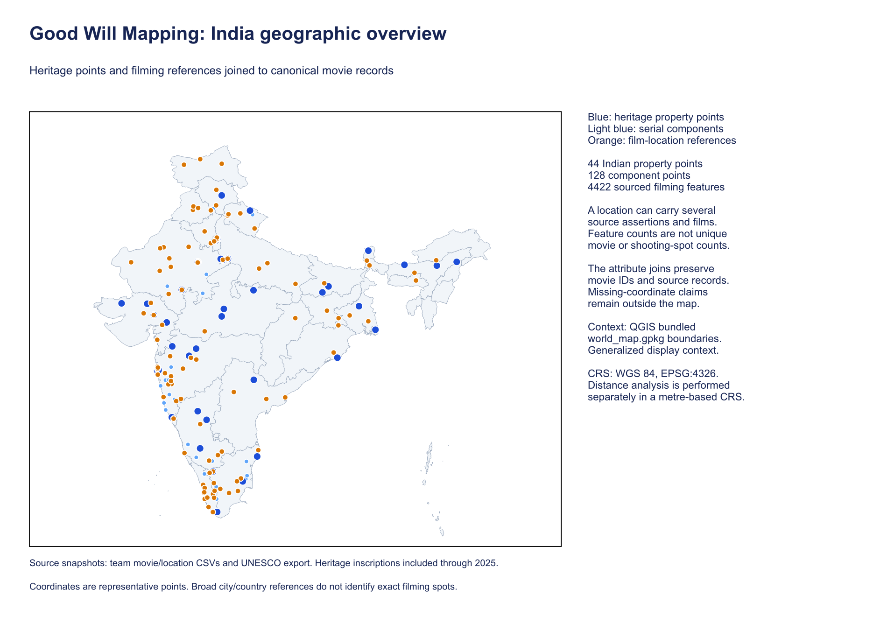
India geographic overview
Heritage and sourced filming-reference points
Notes:
Actual current QGIS print-layout export. 4422 filming features, 44 property points and 128 component points. Features represent assertions and can repeat a place or film. 5039 narrative features are available in a separate QGIS layer. Context boundaries are generalized QGIS bundled data.
Source presentation: https://docs.google.com/presentation/d/19AJkpIwel35Kh1gxN_7hzznjK3QnWGQlSNvKDjQ14uI/edit

Slide 22
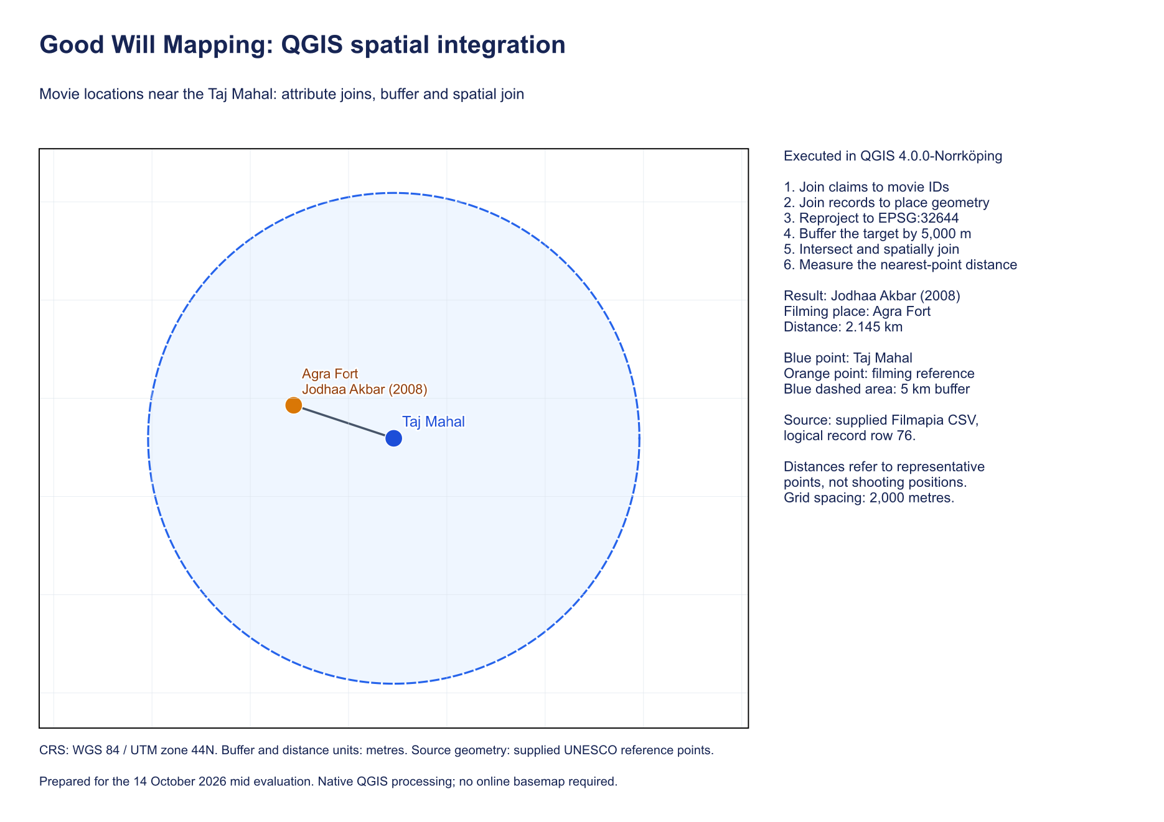
The 5 km spatial query
Projected reference-point analysis in Agra
Notes:
QGIS reprojects Taj Mahal and local named-site filming points to EPSG:32644, buffers 5,000 metres, intersects points and joins target attributes by location. https://docs.qgis.org/3.44/en/docs/user_manual/processing_algs/qgis/vectorgeometry.html . It measures representative-point proximity, not UNESCO boundaries or camera positions.
Source presentation: https://docs.google.com/presentation/d/19AJkpIwel35Kh1gxN_7hzznjK3QnWGQlSNvKDjQ14uI/edit

Slide 23
Agra query result
Jodhaa Akbar
Agra Fort
Film
Filming reference
2.145 km
Filmapia row 76
Distance
Original record
Notes:
QGIS result: GIS/qgis_nearby_movies.csv. Projected distance 2,144.978 m. The independent spherical calculation returns 2,140.626 m and the same film/place pair. Both are reference-point models.
Source presentation: https://docs.google.com/presentation/d/19AJkpIwel35Kh1gxN_7hzznjK3QnWGQlSNvKDjQ14uI/edit

Slide 24
Places in Romance-tagged films
Distinct Romance-tagged films per place and relationship.
Notes:
Data: romance_places.csv. Counts distinct films per accepted place entity and relationship. Filming and narrative counts may overlap. Mumbai has 175 filming-linked Romance films and 129 narrative-linked Romance films. Geographic aliases are not all consolidated. Genre association does not classify scene emotion.
Source presentation: https://docs.google.com/presentation/d/19AJkpIwel35Kh1gxN_7hzznjK3QnWGQlSNvKDjQ14uI/edit

Slide 25
Heritage connections across genres
UNESCO property | Films | Genres
Humayun's Tomb, Delhi | 7 | 7
Hill Forts of Rajasthan | 5 | 5
Fatehpur Sikri | 2 | 5
Qutb Minar and its Monuments, Delhi | 3 | 4
Agra Fort | 1 | 3
Mountain Railways of India | 3 | 3
Notes:
Data: heritage_genres.csv. The graph links nine properties through 25 film/property pairs. A film can link to more than one property and more than one genre. Components are grouped under the corresponding property. Present-day UNESCO classification uses inscription by 2025 and does not imply historical designation at filming time.
Source presentation: https://docs.google.com/presentation/d/19AJkpIwel35Kh1gxN_7hzznjK3QnWGQlSNvKDjQ14uI/edit

Slide 26
Validation and remaining limits
Eight integration regression tests passed.
Full RDF parsing and SHACL validation passed for 2,706,799 triples.
SPARQL results are checked against the exported tables.
Event and landscape instances, scene emotions and embedding predictions remain future work.
Notes:
Full validation: Dataset/integrated/validation.json. Regression tests: Queries/test_integration.py. Aggregate checks: graph_verification.json and validate_graph_queries.py. Structure checks do not establish the historical truth of source assertions. Review queue: 5,365 location candidates, 2,659 suspicious song rows and 335 unresolved song/film rows.
Source presentation: https://docs.google.com/presentation/d/19AJkpIwel35Kh1gxN_7hzznjK3QnWGQlSNvKDjQ14uI/edit

Slide 27

Discussion
Live demonstrations
Knowledge graph explorer
QGIS joins and 5 km analysis
Next: review ambiguous identities and collect precise scene-level geographic evidence
Notes:
Open the packaged graph_explorer.html after extracting Dataset/knowledge_graph/knowledge_graph_1970_2025.zip. Open GIS/Good_Will_Mapping_1970_2025.qgz alongside its matching GeoPackage. Code and outputs prepared for the 14 October mid evaluation. External Google Slides deck remains unchanged.
Source presentation: https://docs.google.com/presentation/d/19AJkpIwel35Kh1gxN_7hzznjK3QnWGQlSNvKDjQ14uI/edit

