Slide 1
BLINKIT
SALES AT A GLANCE
SALES DASHBOARD
$1.20M
8.52K
Total Sales
Items
POWER BI PROJECT PRESENTATION
3.9 / 5
$141
Sales performance • Product categories
Outlet characteristics • Customer ratings
Avg Rating
Avg Sales
Presented by
Saniya Godikat
Power BI | Power Query | Excel

Slide 2
Presentation Roadmap
A concise walkthrough of the project and its findings.
01
Project overview and objective
02
Dataset and data preparation
03
KPIs and dashboard visuals
04
Key business insights
05
Interactivity, learnings and conclusion
02

Slide 3
Project Overview & Objective
Using sales data to understand product and outlet performance.
Project overview
Project objective
An interactive Power BI report analyzing sales across item categories, outlet characteristics, establishment years, and product fat content.
Summarize performance, compare outlet segments, identify leading categories, and let users explore the data through slicers.
Questions this dashboard helps answer
• Which item categories contribute the most sales?
• Which outlet type and outlet size generate the highest sales?
• How are sales distributed between Low Fat and Regular products?
• How do sales differ by establishment year and location tier?
03

Slide 4
Dataset at a Glance
Source: Kaggle • Dataset contains 12 variables.
KEY FIELDS
DATASET PROFILE
• Item Identifier and Item Type
• Item Fat Content, Item Weight and Item Visibility
• Sales and Rating
• Outlet Identifier and Outlet Establishment Year
• Outlet Location Type, Outlet Size and Outlet Type
12 variables
Product • Sales • Outlet • Customer rating
The dataset combines product attributes with sales and outlet information for segment-level analysis.
These fields support comparisons across products and outlet segments.
04

Slide 5
Data Cleaning & Transformation
Data preparation performed in Power Query.
1. Standardize values
2. Handle errors
3. Consistent categories
LF → Low Fat
reg → Regular
Removed data errors identified during data preparation.
Checked and standardized inconsistent categorical values.
WHY IT MATTERS
Consistent categories support reliable grouping, filtering, and visual comparisons.
05

Slide 6
Dashboard KPIs
Four headline metrics summarize the overall performance.
$1.20M
Total Sales
8.52K
Number of Items
Overall sales value
Item count shown in the report
3.9 / 5
Average Rating
$141
Average Sales
Average customer rating
Average sales KPI shown in the report
Currency is shown as displayed in the provided dashboard; confirm the dataset currency convention before presenting.
06

Slide 7
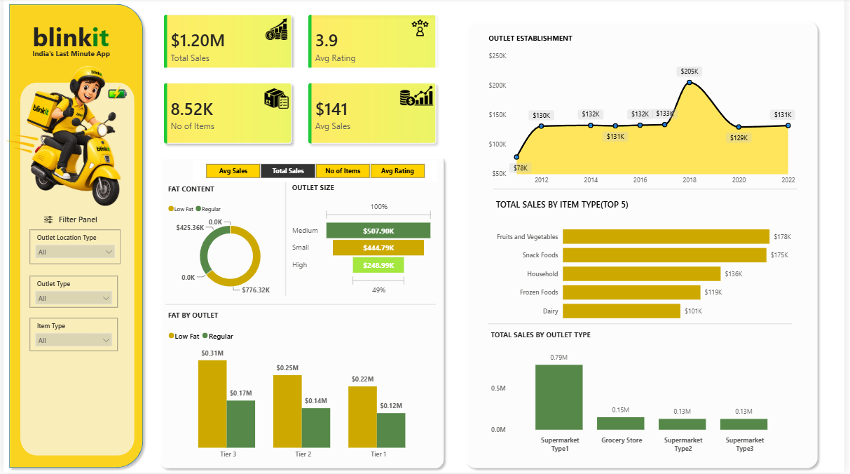
Dashboard Walkthrough
The report combines KPIs, category comparisons, outlet analysis, and slicers.
07

Slide 8
What Each Visual Explains
Each chart answers a different business question.
Outlet Establishment
Top 5 Item Types
Fat Content
Sales associated with outlets by establishment year.
Compares the highest-sales product categories.
Compares sales from Low Fat and Regular products.
Outlet Size
Fat by Outlet Tier
Sales by Outlet Type
Compares sales across Small, Medium, and High outlets.
Compares fat-content sales across Tier 1, Tier 2, and Tier 3.
Highlights sales contribution by supermarket and grocery outlet types.
08

Slide 9
Key Findings
Highlights based on the values displayed in the dashboard.
Top categories
Outlet type
Fruits & Vegetables ($178K) and Snack Foods ($175K) lead the displayed top five.
Supermarket Type 1 contributes approximately $0.79M in sales.
Outlet size
Fat content
Medium outlets lead at $507.90K, followed by Small ($444.79K) and High ($248.99K).
Low Fat products contribute $776.32K versus $425.36K for Regular products.
Establishment year
Location tier
Sales peak at about $205K for outlets established in 2018.
Tier 3 outlets show the highest sales among the three tiers in the displayed chart.
09

Slide 10
Filters & Interactivity
Slicers allow users to explore specific segments.
FILTER 1
FILTER 2
FILTER 3
Outlet Location Type
Outlet Type
Item Type
Filter by Tier 1, Tier 2, or Tier 3.
Focus on a specific outlet format.
Explore sales for a selected product category.
When configured to interact with visuals, slicer selections update the relevant KPI cards and charts.
10

Slide 11
Key Learnings & Conclusion
An end-to-end exercise in turning data into business insights.
WHAT I PRACTISED
• Data cleaning and categorical standardization in Power Query
• Creating KPI cards and DAX-driven metrics
• Building bar, donut, and line/area visualizations
• Designing an interactive report with slicers
• Interpreting sales patterns across products and outlets
CONCLUSION
The dashboard provides a consolidated view of sales performance and helps identify the strongest product and outlet segments for further investigation.
Further analysis could include profit, outlet count, targets, and time-based data if available.
11

Slide 12
THANK YOU!
Questions & Discussion
Blinkit Sales Dashboard | Power BI
Saniya Godikat

