Slide 1

Cookies
Cookies

Slide 2

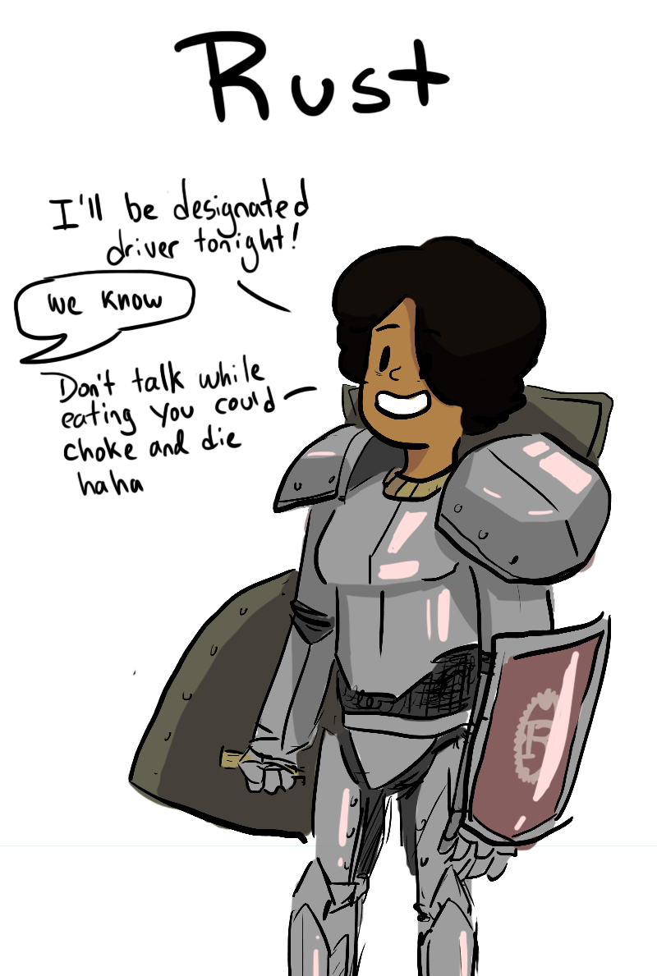
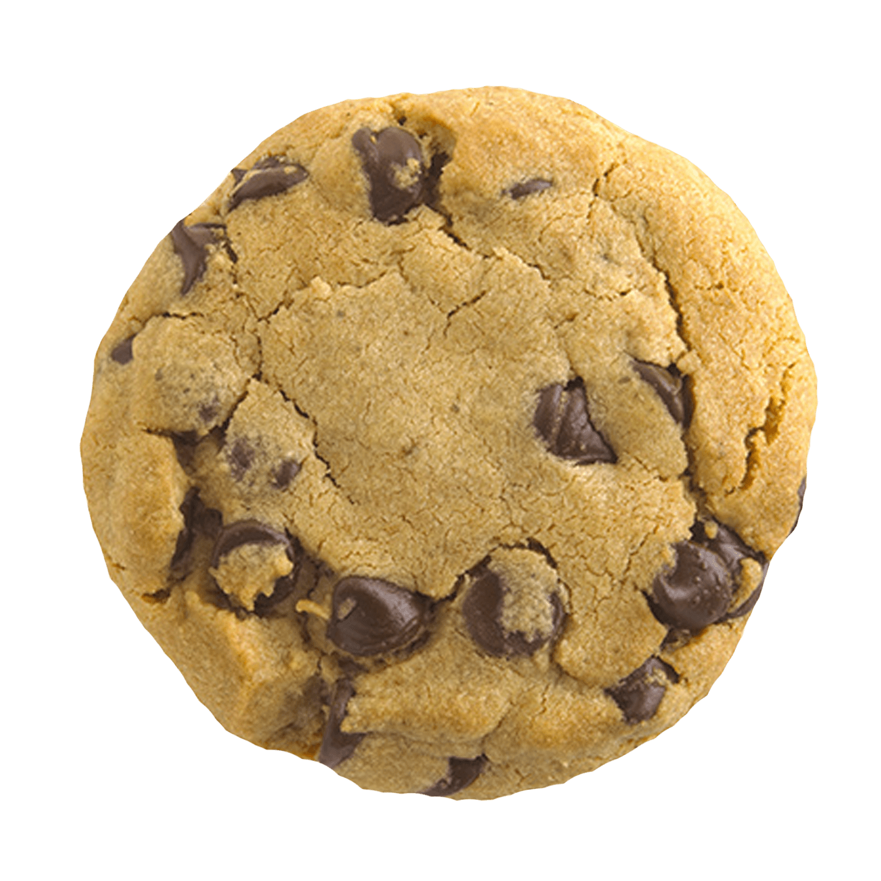

get "/" rank 1
function index(user_guard)
open "/public/index.html"
get "/" rank 2
function login_redirect()
redirect_to "/login"
"/"
LOGIN
INDEX

Slide 3
function user_guard(request)
user_id = request.cookies.get "user_id"
if user_id.exists
user = users.filter(id == user_id)
if user.exists
success
forward_request
LOGIN
INDEX

Slide 4
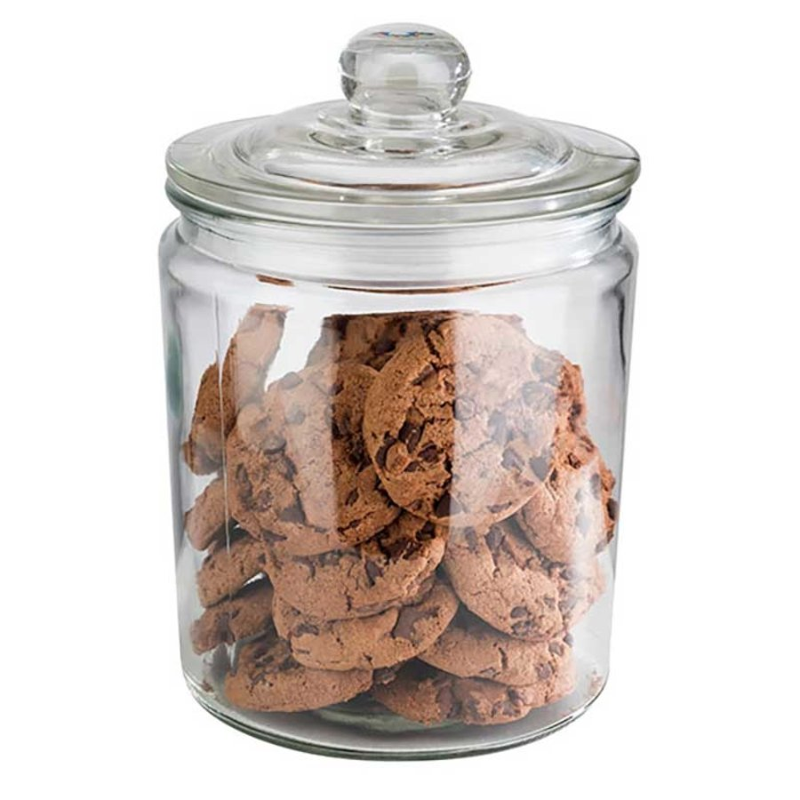
post "/request/login"
function request_login(form, cookie_jar)
user = users
.filter(email == form.email)
.filter(password == form.password)
if user.exists
cookie_jar.add("user_id", user.id)
redirect_to "/"
else
unauthorized // Status code 401
"user_id"

Slide 5

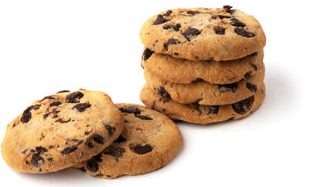
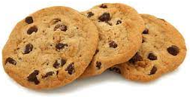
Request
GET /index.html HTTP/2.0
Cookie: user_id=4
Response
HTTP/2.0 200 OK
Set-Cookie: user_id=4; Max-Age=86400; Secure; HttpOnly;...
Expires=31 Oct 2021
Max-Age=86400
Secure
HttpOnly
Path=/docs
/docs/private/bill.pdf
/admin/index.html
SameSite=Strict|Lax|None

Slide 6















