Slide 1
Google Cloud · H2S
AI Builder Cup
Build in JAPAC. Build for the world.
Kirana Mitra — a voice-first AI mentor for India’s corner shops
Team Details
a. Team name: singapuria_innovators
b. Team leader name: Vandana Soni
c. Problem Statement: Retail & Commerce — Intelligent Customer and Business Experiences
Notes:
Open with the product line: Kirana Mitra is a voice-first AI mentor for India's 13 million corner shops. Team singapuria_innovators, Retail & Commerce track.

Slide 2

Brief about the idea
Ramesh Gupta, 44 · Gupta General Store, Indore · 200 sq ft, 14-hour days, a ₹9,000 Android phone is his only computer
~13M
Pain point #1: he finds out Maggi is finished when a customer asks for it. Ordering is a phone call from memory, so he over-buys slow items and runs out of fast ones. Every stock-keeping app expects him to type, usually in English.
kirana stores in India — the total addressable market (Invest India)
~91%
Kirana Mitra is a voice- and photo-first AI mentor for kiranas. He photographs a shelf or says what arrived, in Hindi, Hinglish or any of India’s 22 scheduled languages. Gemini turns it into stock counts, a festival-aware demand forecast and a ready order for his distributor — no typing, no English. Every evening it tells him what sold, what is running low and what to order tomorrow.
of India’s grocery retail still flows through them (Redseer, 2025)
~6M
serviceable: smartphone-owning kiranas that order from a distributor (our estimate)
Scalable (serverless, scales to zero) · High impact (lost sales and dead stock are the two biggest leaks in a kirana) · Easy (two buttons: speak, snap)
Sources: Invest India (store count); Redseer via 36Kr (2025 grocery share); serviceable figure is the team’s estimate
Notes:
Lead with Ramesh and his first pain point. The three numbers: 13M stores is the total addressable market, 91% of grocery still goes through kiranas, and about 6M of them already own a smartphone and order from a distributor, which is who we serve first.

Slide 3






Opportunities
How is it different?
How does it solve the problem?
Why now, and how big
Most retail AI is built for chains and e-commerce. Ledger and billing apps for small shops still expect typing, often in English. Kirana Mitra needs only a phone camera and a voice, and answers in the shopkeeper’s own language.
It turns shelf photos and voice notes into stock records automatically, forecasts demand around India’s festival calendar, and prompts the shopkeeper to place the order with the distributor before the shelf runs empty.
13M stores, ₹200 average bill, smartphones in most shops. Gemini’s native audio and vision make zero-typing input practical for the first time, and serverless GCP keeps cost per shop in paise.
USP
Speaks their language
Zero data entry
Built around India’s calendar
Hindi, Hinglish and the 22 scheduled languages, code-mixing included
Photo and voice in, stock and orders out, with one-tap undo
Demand forecast knows Diwali, Eid, Navratri and wedding season
Notes:
Three judging lenses in one slide: scalability (serverless), impact (the two biggest leaks in a kirana are lost sales and dead stock), ease of use (two buttons).

Slide 4





List of features offered by the solution
Shelf check
Voice ordering & stock entry
Demand & supply forecast
One photo; Gemini counts packs, flags what is low and asks “Update karoon?” before anything changes.
Say “Kal Parle-G ke 3 carton aaye”; stock updates and the next distributor order is one tap away.
BigQuery ML ARIMA_PLUS with Indian holidays: 4 weeks ahead per item, Diwali bump included.
Smart restock
22-language mentor
Evening hisaab & feedback
Top sellers that are low and have run hot for 2 weeks get an order drafted and a WhatsApp nudge to the distributor.
Replies in the shopkeeper’s language and script; mixed Hinglish stays Hinglish.
What sold, what is low, what to order tomorrow — and a thumbs-up or down that reaches the team.
Notes:
Udhaar (credit ledger) is intentionally not in the MVP feature list; it is on the roadmap. The MVP is inventory: see, speak, forecast, restock.

Slide 5
Process flow and use cases
1
2
3
4
5
Shopkeeper
Cloud Run API
Gemini 3.8 Flash
Firestore + BQML
Reply
Shelf photo, voice note or a typed line, in any language
FastAPI service; one prompt per task with a JSON response schema
Vertex AI; reads photos, audio and Indic text with the catalogue in context
Shop, stock and orders saved; ARIMA_PLUS forecast with Indian holidays
Stock update, forecast or order draft, in their language, with Undo
A shopkeeper’s day
9 am · Morning
1 pm · Daytime
9 pm · Evening
Shelf check → “Maggi 6 packet, kam hai (reorder 12). Update karoon?” → Haan
Voice note “Kal Parle-G ke 3 carton aaye” → “Samjha: 3 carton = 72 packet, ab 114”
Hisaab: aaj ki bikri, kam stock, and “Diwali week demand ~1.8x — Parle-G 264 packet mangao?” → Order banao
Notes:
Every quoted reply is a real string from the prototype's evals: the shelf check, the carton-to-packet conversion and the Diwali reorder nudge.

Slide 6
Wireframes of the proposed solution
Morning: shelf check
Daytime: voice ordering
Evening: daily hisaab
Kirana Mitra
Kirana Mitra
Kirana Mitra
[shelf photo]
Voice note · 0:06
Aaj · 18 Oct
Shelf pe dikha: Maggi 6, Parle-G 12, Tata Salt 3. Maggi kam hai (reorder 12). Update karoon?
Samjha: Parle-G 70g, 3 carton stock mein add kiya. Ab total 114 packet (3 carton = 72 packet).
Diwali week demand ~1.8x. Stock mein 42 · mangao 264 packet Parle-G. Aaj kam: Maggi, Amul Taaza.
Haan, update karo
Undo · Order banao
Order banao · 264 packet
Reply strings are live output of the prototype (gemini-3.8-flash, 18 Oct 2026); figures are the demo shop’s
Notes:
These three frames match the three moments of the day on the previous slide. The strings are copied from live replies, not invented.

Slide 7
Architecture diagram of the proposed solution
Gemini 3.8 Flash on Vertex AI
Reads shelf photos, voice notes and Indic text; 40-item catalogue in context; structured JSON output; unknown products offered as new items
Cloud Run
Firestore (Native, asia-south1)
Shopkeeper’s phone
Shops seeded with the catalogue, stock, messages, orders, feedback; transactional updates and undo; survives redeploys
Flutter web app (Cloud Storage; Android APK) · camera · mic
FastAPI + google-genai SDK; one JSON-schema prompt per task; confidence gate → confirm chip; Firestore client; Cloud Scheduler calls the daily restock endpoint
BigQuery + BigQuery ML
Sales history; ARIMA_PLUS forecast with HOLIDAY_REGION = IN and festival uplift; feedback table
Cloud Storage · Firebase project
Serves the Flutter web app today; photos and audio; Firebase Hosting configured as the next web target
Roadmap: Firebase Auth · Vertex AI Search · ADK
Sign-in, catalogue matching for spoken names, multi-agent godown and distributor flows
Notes:
What is live today versus roadmap is marked on the slide. Everything in cream is running in project kirana-mitra-app on asia-south1.

Slide 8
Technologies to be used in the solution
Layer | Technology | What it does here
AI model | Gemini 3.8 Flash on Vertex AI, google-genai Python SDK | Reads shelf photos, voice notes and Hindi, Hinglish or regional text; replies in the same language. Structured JSON output on every call
Prompting | Few-shot + response schema + confidence gate | Hindi/Hinglish/English examples in one system prompt; catalogue in context; low thinking budget; entries under 0.7 confidence wait for a tap
Analytics | BigQuery, BigQuery ML ARIMA_PLUS | Sales history and 4-week demand forecast with Indian holidays; festival uplift; feedback table
Backend | Cloud Run + Cloud Scheduler | FastAPI API on one warm instance; daily 06:00 auto-restock run through a token-gated endpoint
Database | Firestore (Native mode, asia-south1) | Shops seeded with the 40-item catalogue, stock, messages, orders and feedback; transactional updates and undo; data survives redeploys
Hosting / storage | Cloud Storage · Firebase project | Cloud Storage serves the Flutter web build and holds photos and audio; Firebase Hosting configured for the web app
Frontend | Flutter (web live, Android APK built) | Chat-style app: hold-to-talk, camera or sample shelf, real product photos, self-healing shop session, 56 dp targets
Roadmap | Firebase Auth · Vertex AI Search · ADK · on-device model | Sign-in, catalogue matching, multi-agent orchestration, offline image recognition
Notes:
Best prompting practices we used: few-shot in three languages, a strict response schema, the catalogue in context instead of a vector store, low thinking for latency, and a confidence threshold that turns uncertain extractions into a confirm tap.

Slide 9
Estimated implementation cost
Pilot of 100 shops in Indore, per month. Assumes 20 voice or text entries and 2 shelf photos per shop per day.
Component | What drives the cost | Est. per month
Gemini 3.8 Flash on Vertex AI | ≈0.9M tokens per shop per month (prompt + catalogue, audio and image input; short JSON output) | ≈ ₹8,500 (≈ ₹85 per shop)
Cloud Run + Cloud Scheduler | ≈70k requests per month, scales to zero; scheduler job is in the free tier | ≈ ₹0 (free tier)
BigQuery + BigQuery ML | Daily ARIMA_PLUS retrain measured at ₹0.25 per run; queries inside the 1 TB free tier | ≈ ₹10
Cloud Storage | Web app, photos and audio, a few GB | ≈ ₹20
Firestore | Documents per shop; inside the free tier at pilot volume | ≈ ₹0 (free tier)
Total today | ≈ ₹85 per shop per month at Gemini 3.8 Flash introductory pricing to 31 Dec 2026; about double from 2027 | ≈ ₹8,550
Pricing: Gemini 3.8 Flash $0.75 / $3.75 per 1M input / output tokens (introductory), ₹84 per $. Measured items: BQML training ₹0.25 per run and evaluation ₹0.05 (bytes billed, 18 Oct 2026). Gemini figure from the Vertex AI pricing page for Gemini 3.8 Flash at the assumed volume; rerun with the pricing calculator before the pilot. Reduce-cost roadmap: on-device image model for shelf checks, Gemini Flash-Lite for simple intents, caching the catalogue prompt.
Notes:
The only line that moves with scale is Gemini; everything else is free tier or paise at pilot volume. The roadmap's offline image model is also the biggest cost lever.

Slide 10
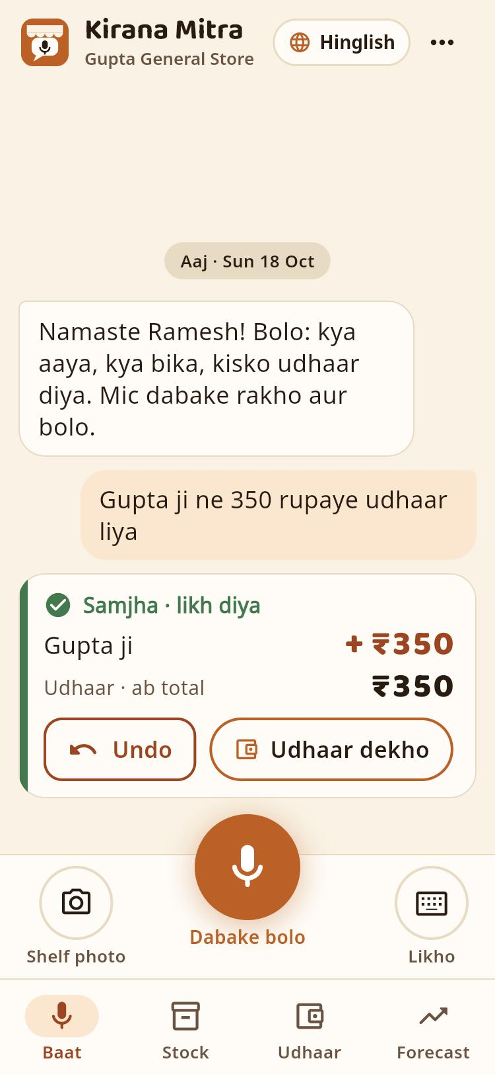
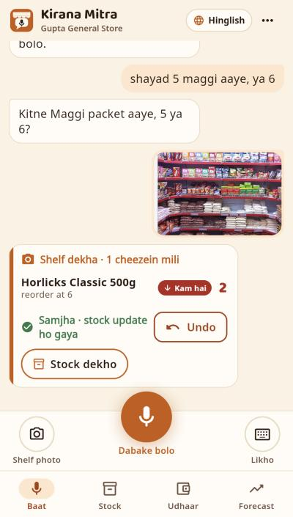
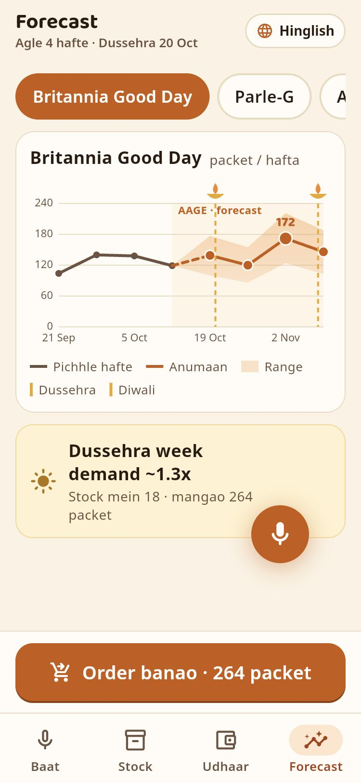
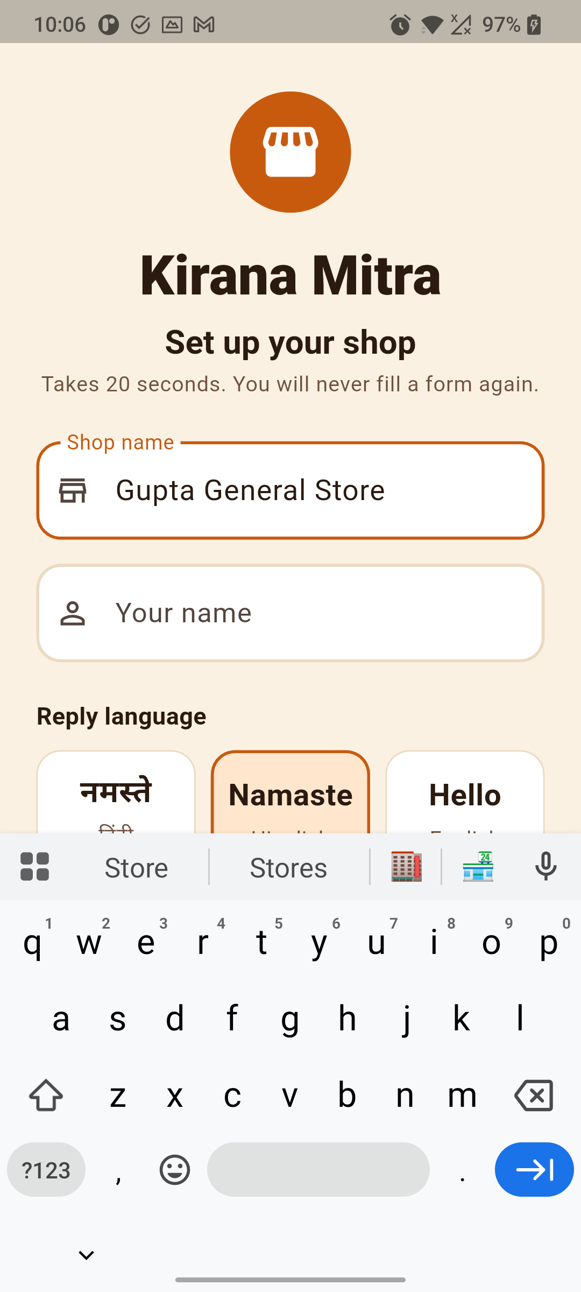
Snapshots of the prototype
Typed or spoken entry → confirmation card with Undo (live)
Shelf photo → counts, low-stock badge, stock updated with Undo
4-week forecast with festival markers, reorder in one tap
The same app on a ₹10k Android phone (OnePlus, Android 11)
Notes:
Left: a Hinglish entry answered by Gemini in 3.3 s on the public web link. Middle: forecast from BigQuery ML with the Diwali bump. Right: the Android build on a budget phone.

Slide 11
Prototype performance report / benchmarking
Metric | Target | Result
Shelf photo item-count accuracy | ≥ 90% | 96.2% exact counts (25 of 26), recall 100%
Voice / text entry accuracy (Hindi, Hinglish, English) | ≥ 90% | 96.2% intent · 100% entities (26 utterances)
Forecast error, 4 weeks ahead | ≤ 20% | 11.0% volume-weighted (19.6% without festival uplift)
Time from photo to reply | < 5 s | 9.0 s median (text entry: 2.5 s median)
Cloud cost per shop per month | < ₹100 | ≈ ₹85 (introductory Gemini pricing; measured BQML ₹0.25 per retrain)
Test set (18 Oct 2026): 5 synthetic shelf images with 26 labelled product counts; 26 Hindi, Hinglish and English utterances; forecast back-tested on a 14-day holdout of 120 days of synthetic sales for 40 items (Navratri inside the window). Photo latency misses target because of Gemini tail latency; a 40 s cap with one retry keeps the app responsive. Real-shelf photos and real sales are the next measurements.
Notes:
Be upfront that the data is synthetic and the photo latency target was missed. The numbers come from the repo's results files and can be rerun with one command each.

Slide 12






Additional details / future development
Godown plugin
Offline image model
Production gaps to close
22 languages in the app
Warehouse stock alongside the shelf: shelf check → godown double-check → then prompt the kirana to place the order with the distributor.
On-device shelf recognition (Gemini Nano or a TFLite model) so counts work without network and Gemini cost drops for the most frequent call.
Sign-in (Firebase Auth) · real pilot sales and shelves · monitoring, rate limits, Gemini cost caps · Firestore rules and backups.
Backend replies in all 22 today; UI strings ship after native-speaker review, largest eight first.
Udhaar ledger & credit
Supply & WhatsApp
Plugin for native apps
Voice-logged credit and reminders; clean sales history can help shops qualify for working-capital loans.
Distributor lead times and stock-outs in the forecast; WhatsApp-first entry so shopkeepers never install anything.
An SDK and share-sheet plugin so existing kirana billing, POS and distributor apps on Android can embed voice entry, shelf scan and forecasts.
Business model: free for shopkeepers; distributors and FMCG brands pay for anonymised, aggregated demand insights and for the restock channel.
Notes:
The top row is the mentor's production roadmap: godown, offline model, and the five concrete gaps between the demo and production. The bottom row is what we deliberately left out of the MVP.

Slide 13



Provide links to your:
GitHub public repository
github.com/CuriousCoder2024/kirana-mitra
Demo video (3 min 41 s)
drive.google.com/file/d/1STU9AMzXKyCT-jfIwJVH8B537z9enzrP/view
Final product
storage.googleapis.com/kirana-mitra-app-web/index.html · API: kirana-mitra-api-396621755403.asia-south1.run.app
Notes:
Repository: github.com/CuriousCoder2024/kirana-mitra. Video on Google Drive, 3:41.

Slide 14
Google Cloud · H2S · AI Builder Cup
Thank you
Kirana Mitra · singapuria_innovators
Vandana Soni, team leader · [email]

