Slide 1
From Punch Cards to Git
A Brief History of Version Control
https://github.com/CuriousCurmudgeon/history_of_vcs
Notes:
Good morning/afternoon. How is everybody doing? Awake? Exhausted?

Slide 2

Brian Meeker
@CuriousCurmudge
Notes:
My name is Brian Meeker. I'm a software developer for InfernoRed Technology. I work as a consultant, mostly in .NET and JS/Typescript, but also a bunch of other things. My official title is Engineering Wizard, but I'm a jack of all trades, master of none kind of guy.

Slide 3

Look for the dragon right outside of Salon A.
Notes:
Stop by the InfernoRed booth if you want to chat about this talk or any other cool stuff you've seen at CodeMash this week.

Slide 4
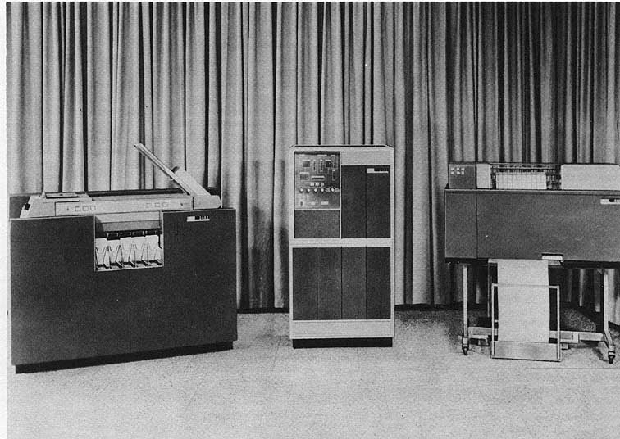
https://en.wikipedia.org/wiki/IBM_1400_series#/media/File:BRL61-IBM_1401.jpg
Notes:
So, you're here for a history talk. What makes me qualified to give a history talk? This is me putting my imaginary history minor to use. You see, I took all the courses to get a history minor, but never actually talked to anybody in the history department about it, so... no minor for me. But I put in all the work, and I think that's the important part. I'm pretty sure that avoiding the paperwork and the human interaction required to complete a task is the most stereotypical software developer behavior you can imagine.
And for the curious, from left to right those are a
IBM 1402 Card Read Punch, Model 1 - $24,800
IBM 1401 Processing Unit, Model A-1 - $70,500
IBM 1403 Printer, Model 1 - $30,300
Total Price $125,600
Apparently, the Computer History Museum has two working 1401’s.
I also want to thank Jenny Manning for doing her talk at last year's CodeMash - Mommy, where do new programming languages come from? last year. Her talk was the inspiration for me submitting this talk and speaking here this year.

Slide 5
What is version control?
…the management of changes to documents, computer programs, large web sites, and other collections of information.
- https://en.wikipedia.org/wiki/Version_control
Notes:
I am not above stooping to Wikipedia for definitions. This one is pretty straightforward and probably matches your intuition about what version control is.

Slide 6
What is version control?
…a system that records changes to a file or set of files over time so that you can recall specific versions later.
- https://git-scm.com/book/en/v2/Getting-Started-About-Version-Control
Notes:
I’m also not above pulling definitions from the official Git book as part of their documentation. I like that this version specifically calls out recalling specific versions later.
You'll notice these definitions don't lay out any specific requirements about what features a version control system needs to have. We would certainly like it to be easy to visualize changes. We would certainly like to have atomic commits. We would certainly like it to be easy to manage releases. But none of these are required. You just need to record changes so you can get back to a specific version if needed. That's it.
There are also a couple of different terms for version control.
VCS = Version Control Software
SCM = Source Control Management/Software Configuration ManagementRevision Control
Revision Control
Sometimes you’ll here VCS. Sometimes SCM. Occasionally revision control. I’m going to try and be consistent here and use the term “version control”, but I could slip up.
Any distinction between these terms is generally meaningless. Software Configuration Management can have a slightly different meaning depending on context, but that isn't important in the context of this talk.

Slide 7
Out of Scope
Hosting services (SourceForge, GitHub, Bitbucket, etc.)
Integrated version control
Wikis
Notes:
We only have so much time, so these items are mostly out of scope.
* Repository hosting services like Sourceforge, GitHub, and BitBucket.
* Integrated version control, like you see in modern word processors, spreadsheets, or content management systems.
* Wikis
These things are all important in the history of version control, but they are out of scope for this talk. We're going to focus on the tools that have been primarily used by development teams.

