Slide 1
DATA STRUCTURES AND ALGORITHMS

Slide 2
RESTAURANT MANAGEMANT SYSTEM
THIS PROJECT IS ABOUT HOW RESTAURANT MENU WORKS USING LINKED LIST DATA STRUCTURE.
THIS PROJECT GIVES YOU A REALIST OVERVIEW OF THE MENU AND ITS WORKING.
COSIDERING ALL REALIST APPROACH OF RESTAURANT MENU
THIS PROJECT IS BEEN IMPLEMENTED.

Slide 3
WHY LINKED LIST?
Linked lists are always preferable when we are not sure about the amount of memory we may end up using for storing data.
Linked lists are often used because of their efficient insertion and deletion.

Slide 4
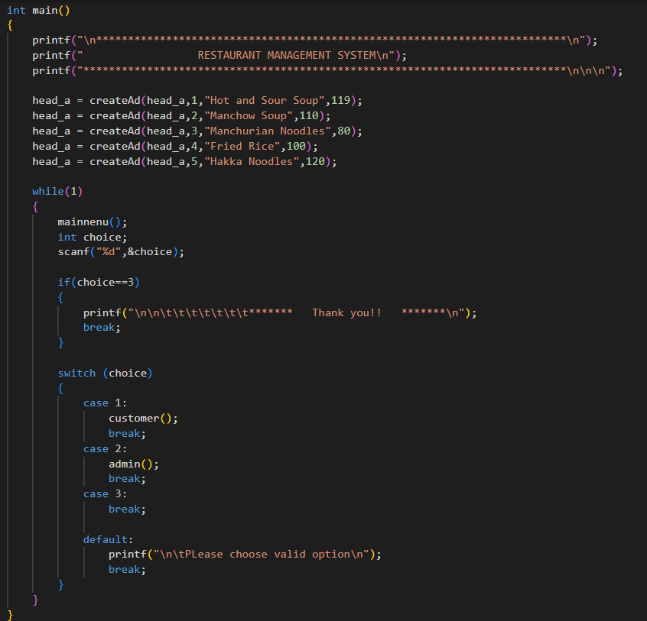
MAIN FUNCTION

Slide 5
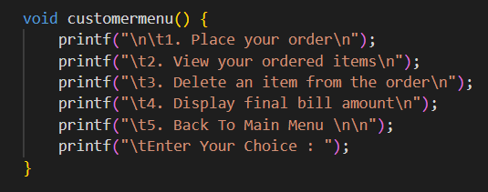
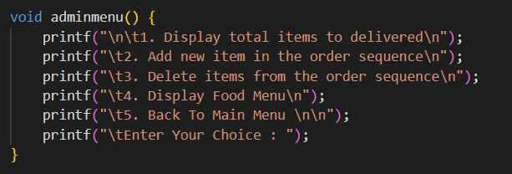
MAJOR PARTS OF CODE
CUSTOMER SECTION
ADMIN SECTION

Slide 6
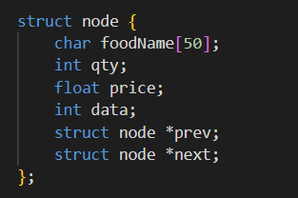
STRUCTURE NODE

Slide 7
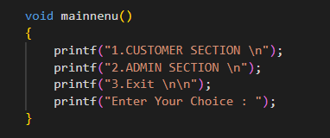
MAIN MENU

Slide 8
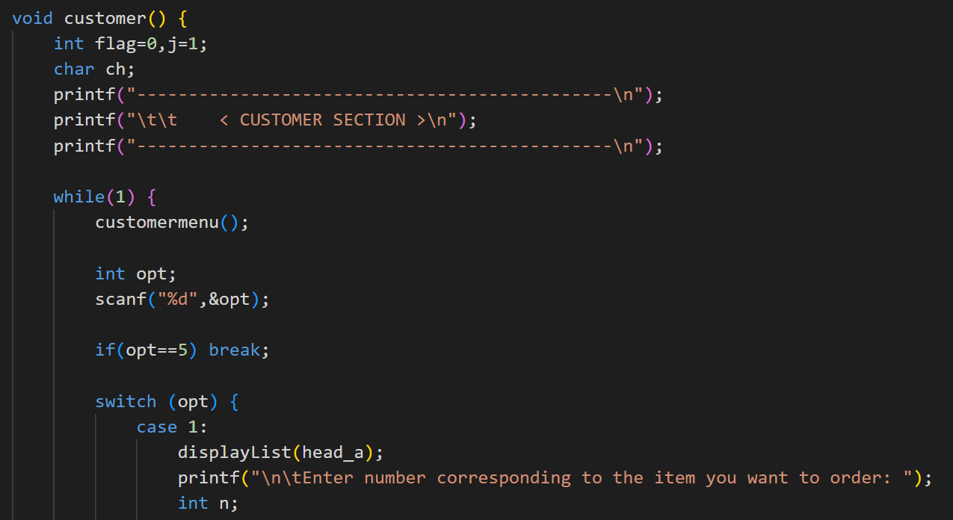
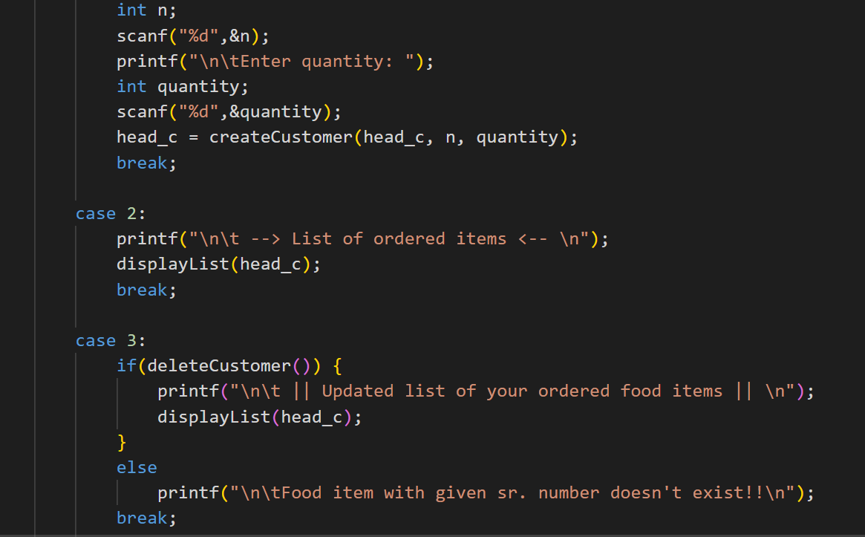
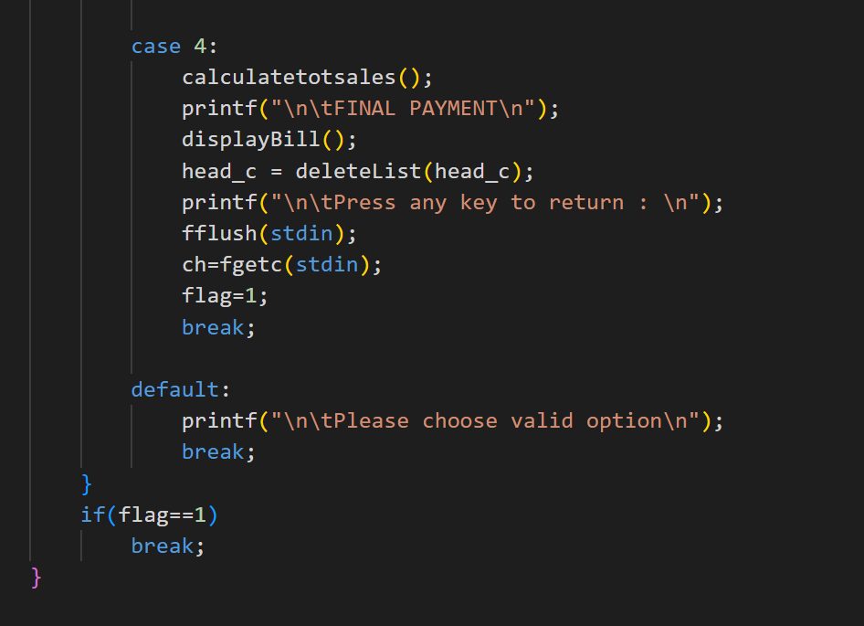
CUSTOMER SECTION

Slide 9
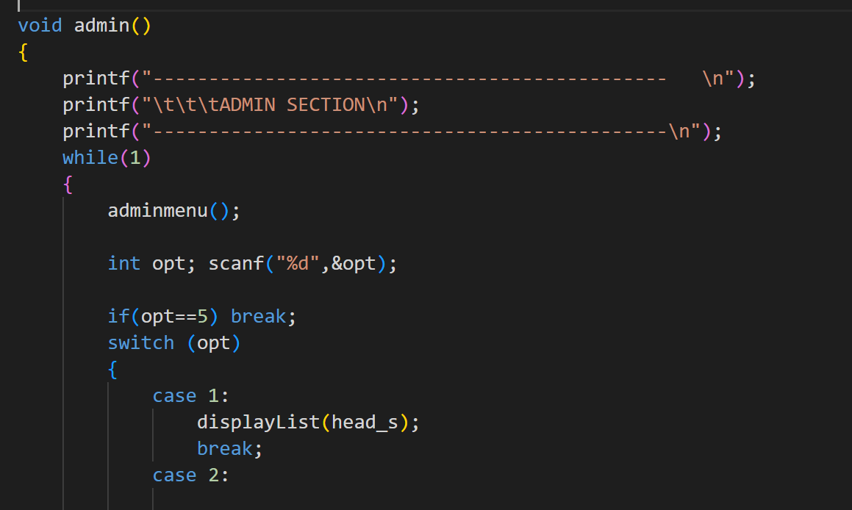
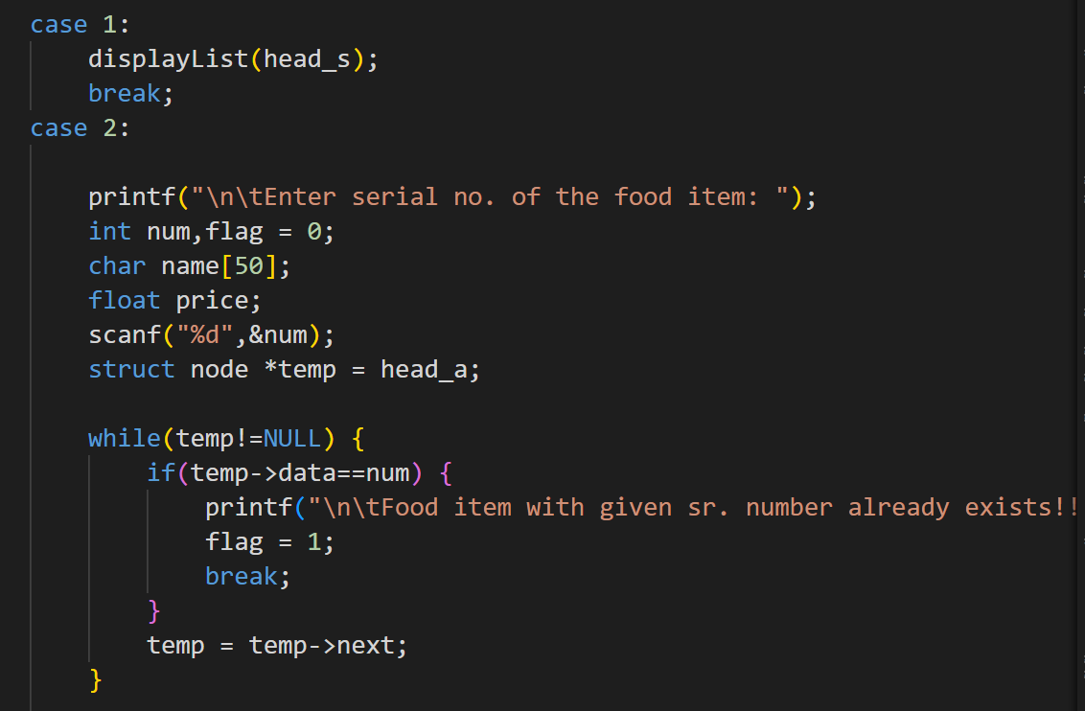
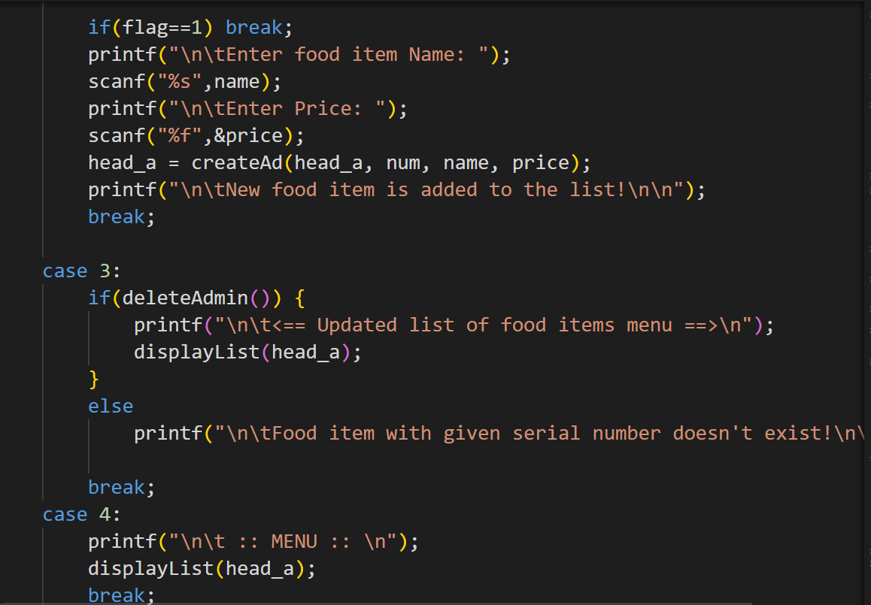
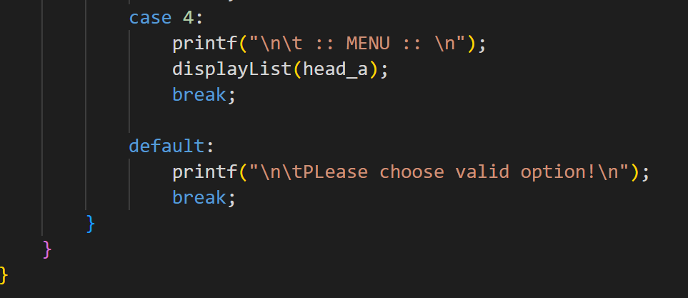
ADMIN SECTION

