Slide 1
Flight Booking System for Airlines Company Using Java Technology

Slide 2
Abstract
Our project introduces a sophisticated web application for airline seat reservation and purchase, incorporating a robust Model-View-Controller (MVC) architecture. With a primary focus on user-friendliness and efficiency, the system seamlessly navigates users through a three-step process: flight search, airline manager approval, and secure payment processing.

Slide 3
Introduction
Flight Search:
Users can meticulously search for available flights using diverse criteria.
Dynamic pricing is displayed for different seat types (First class, Business, and Economy).
Prior to purchase, the approval of selected seats by the airline manager is mandatory, ensuring a controlled booking process.
Airline Manager Approval:
The airline manager plays a pivotal role in reviewing and approving seats added by the admin.
Only seats approved by the manager become available for customer purchase, ensuring strict adherence to regulatory standards.
Customer Approval and Payment:
Customers seamlessly approve their itinerary and proceed to the payment page.
The payment page displays the total price, and upon confirmation, the seat is marked as sold.
Key Features:
Utilizes JavaServer Pages (JSP) for crafting dynamic and responsive user interfaces.
Implements the MyBatis framework to ensure efficient database operations.
Adheres strictly to classic MVC architecture principles.
Introduces a service layer for encapsulating and streamlining business logic.

Slide 4
relate work

Slide 5
relate work
BOOKiiIT - Designing a Venue Booking System (Technical Demo) (Singh & Shah, 2020) introduced VIHARI, a multi-agent system for air ticket booking, suitable for the collaboration and efficiency of our aircraft booking management system.
An Automated Airlines Reservation Prediction System Using BlockChain Technology (Elizabeth Rani et al., 2021) demonstrated a blockchain-based automated airlines reservation prediction system, offering insights for designing booking systems that go beyond specific fields and providing a reference for creating GUI.
VIHARI: An Ontology Service Driven Multi-Agent System for Air Ticket Booking (Lakshmipathi & Lekha T., 2007) showcased the BOOKiiIT venue reservation system, providing important references for the availability and design principles of our aviation booking platform. Lu (2007) introduced intelligent hospital appointments and drug scheduling supported by appointment systems based on near-field communication (NFC) in the context of healthcare, providing inspiration for our optimization scheduling process and greatly aiding the approval priority and processing efficiency of airline managers.

Slide 6
relate work
An Analysis of Airline E-commerce Strategies in Ticket Distribution (Lu, 2007) discussed e-commerce strategies of airlines in ticket distribution, providing a perspective to enhance the user experience and distribution strategies in our booking system. Singh & Shah (2020) introduced VIHARI, a multi-agent system for air ticket booking, suitable for the collaboration and efficiency of our aircraft booking management system.
Intelligent Agent Based Hotel Search & Booking System (McTavish & Sankaranarayanan, 2010) conducted in-depth research on agile parking systems established by the Internet of Things, offering insights into the integration of emerging technologies and agile practices into aviation booking systems by updating the amount of parking spaces owned or occupied by customers through cloud servers. Sakthimohan et al. (2021) explored an intelligent agent based hotel search and booking system that provides users with the highest priority targets by collecting detailed information such as available facility lists, prices, customer experiences, and transportation. This reveals the role of collaborative systems and airline managers in seat approval, providing a reference for our system retrieval.

Slide 7
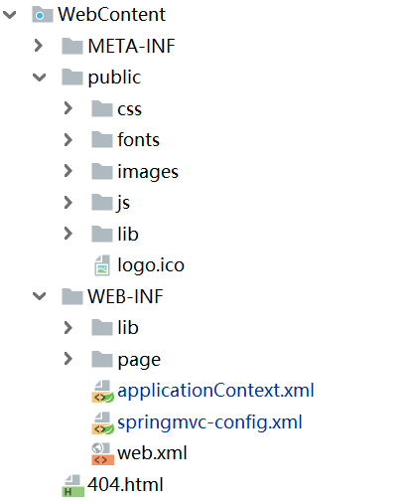
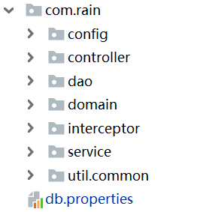

Slide 8
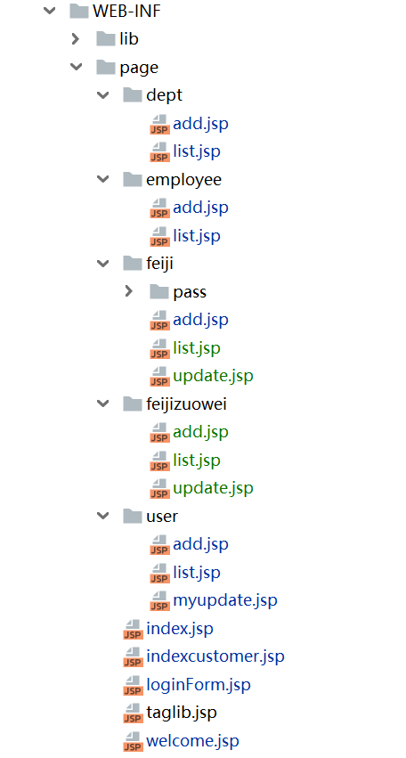
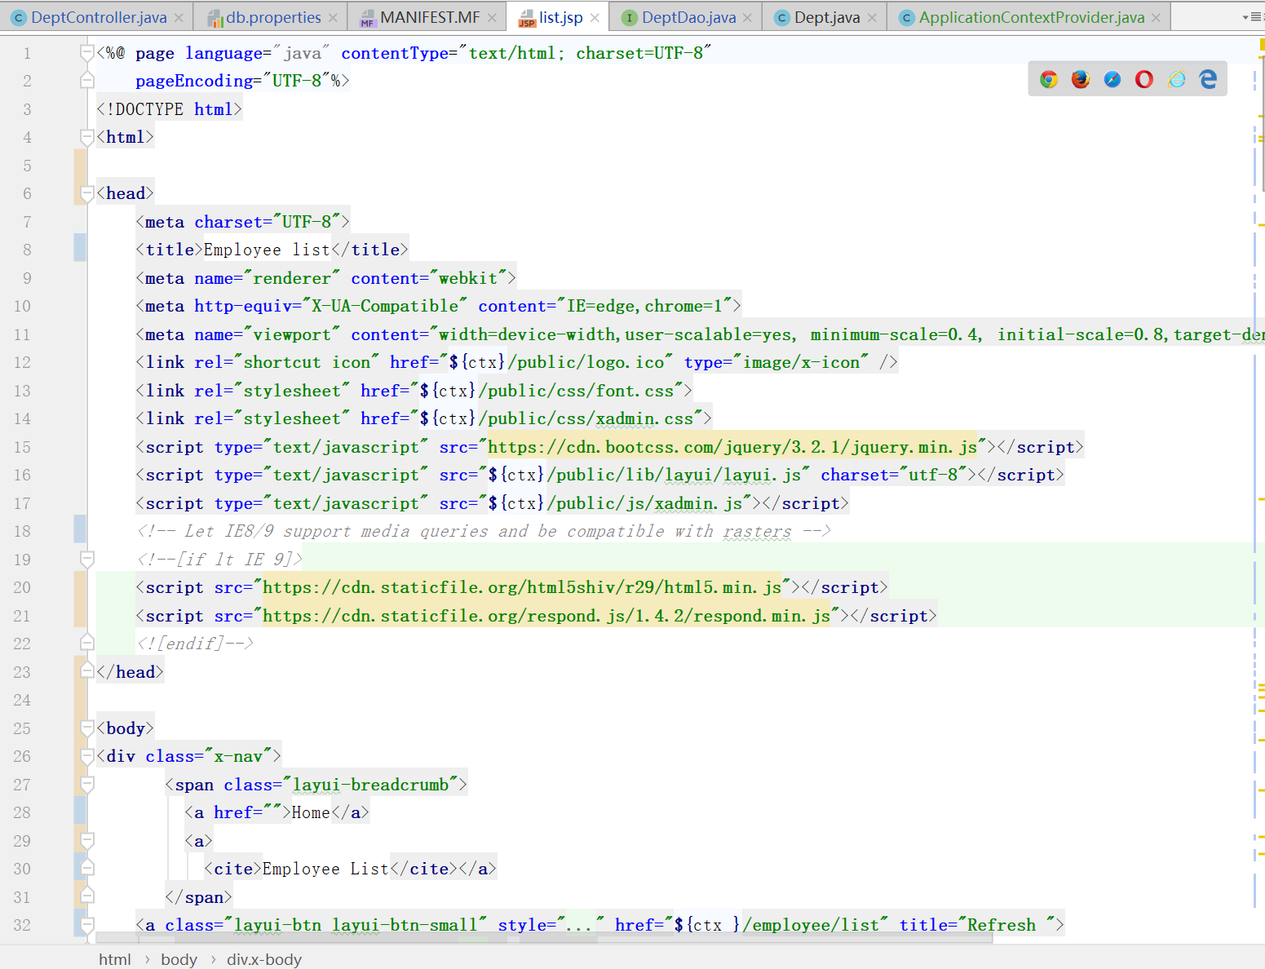
View: is the user interface part of the application. In JSP-based web applications, Views are usually composed of JSP files, which are responsible for presenting data to users and receiving user input.

Slide 9
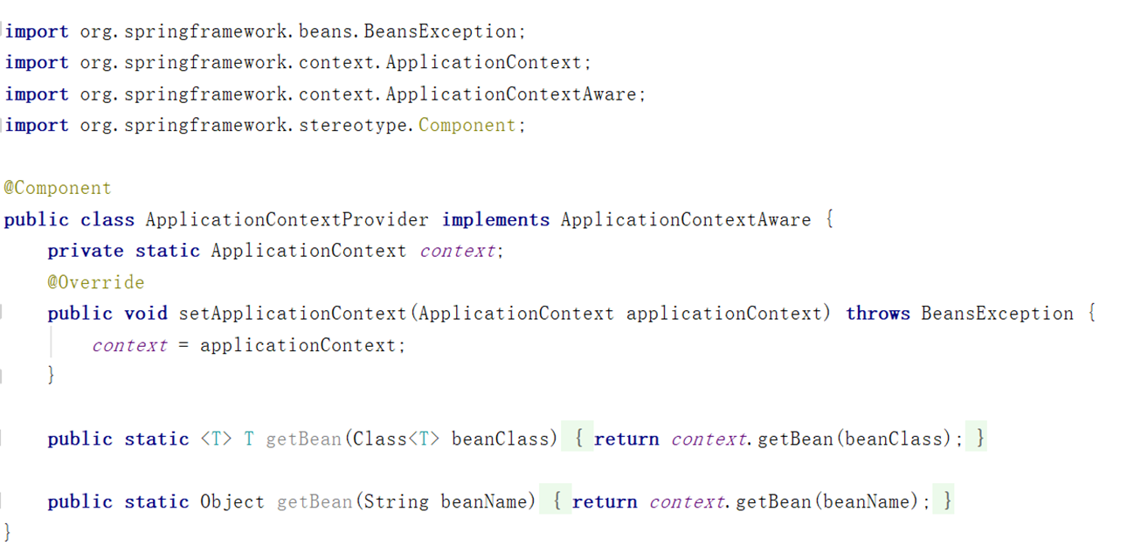
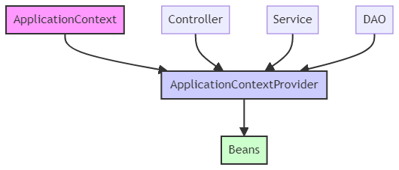
Config: The ApplicationContextProvider enables other components of the application, to access these beans. All the layers of the Spring application can use ApplicationContextProvider to access and manage beans defined in the Spring ApplicationContext.

Slide 10
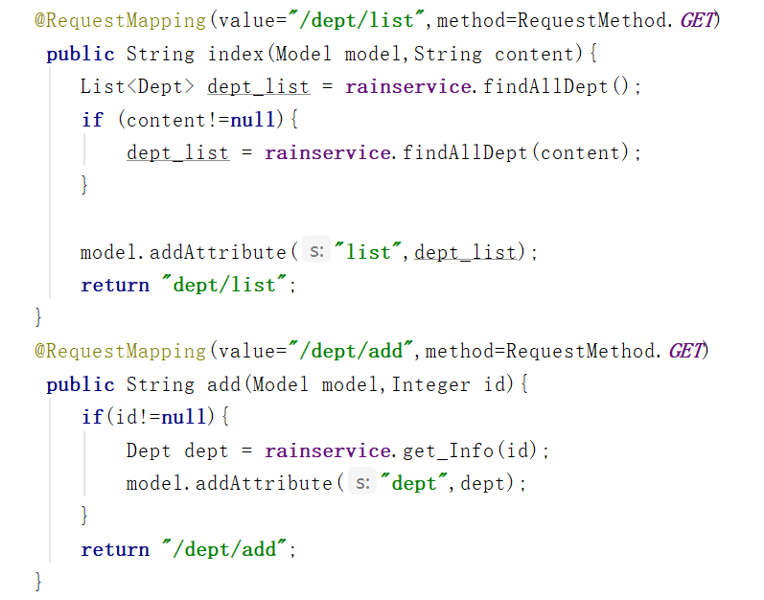
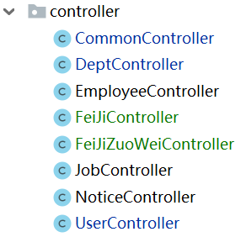
Controller: The Controller orchestrates the application logic, directing requests to appropriate handlers. It decide whether to update the model or select a view.

Slide 11
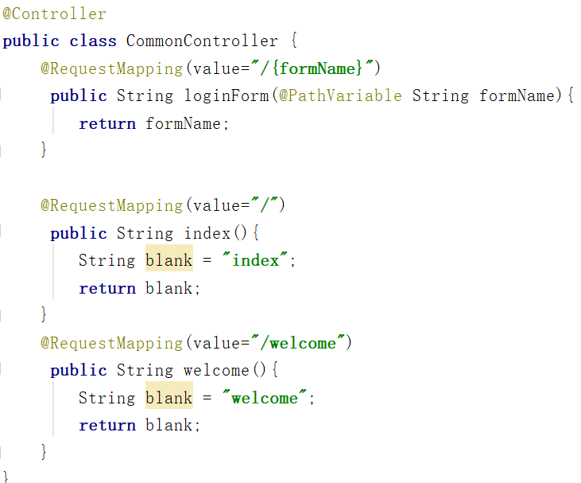
`CommonController` class. It handles generic requests. The `loginForm` method matches any invalid input and redirects to a 404 page, a way to handle erroneous paths.

Slide 12
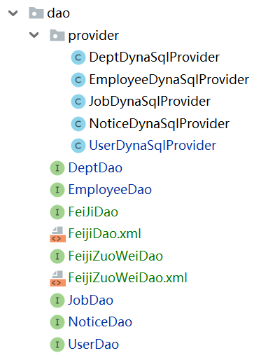
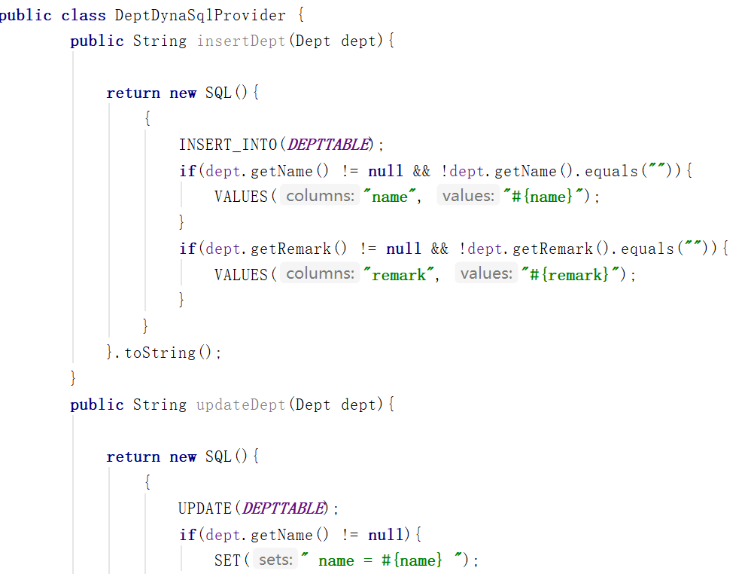
Dao
Dynamic SQL Provider

Slide 13
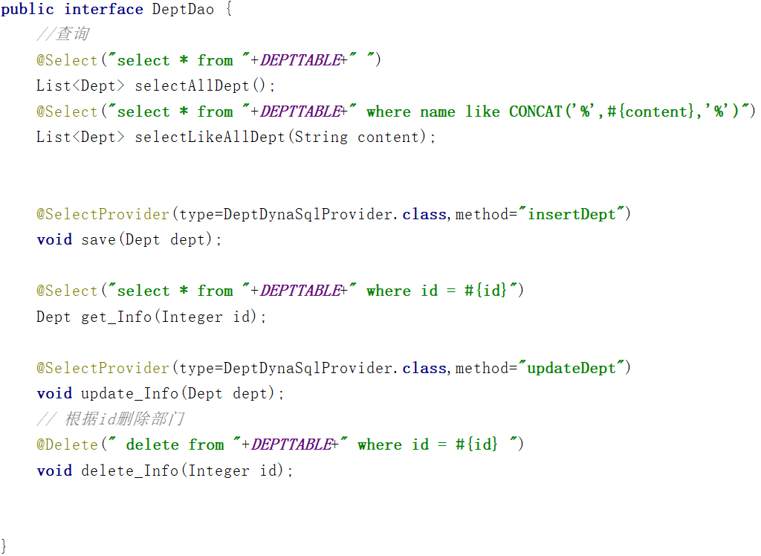
Dao
Annotation on the `selectAllDept` method maps this method to an SQL query that selects all records from the `dept_inf` table.
When this method is called, MyBatis executes the associated SQL query and returns the results as a list of `Dept` objects.

Slide 14
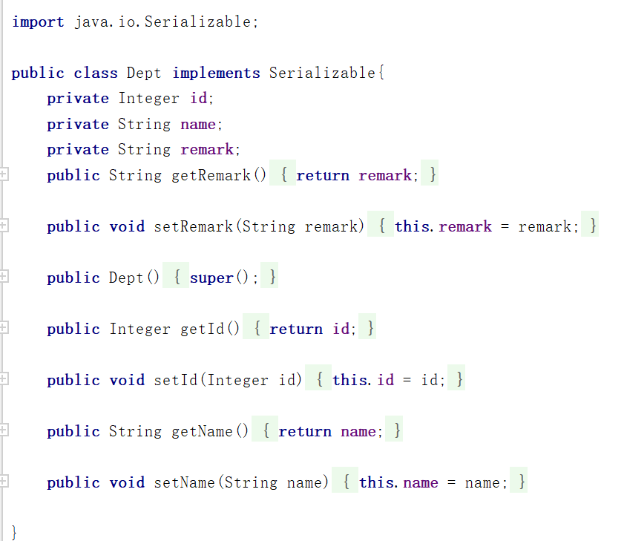
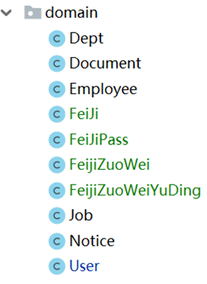
Domain： Model represents the application's data domain. This involves classes with getters and setters, allowing for data manipulation. Indicates that objects of this class can be serialized. Objects of this class can be transmitted over a network or saved to a file.

Slide 15
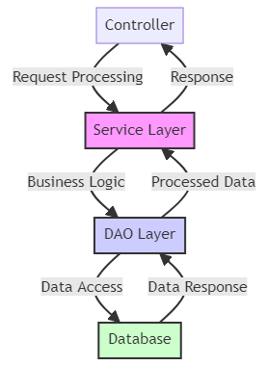
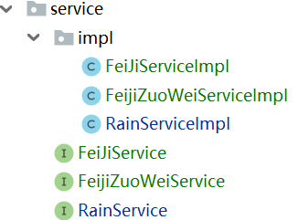
Service： The introduction of service classes facilitates the abstraction of business logic, making it easier for other layers such as controllers to invoke corresponding service methods without directly manipulating the database.

Slide 16
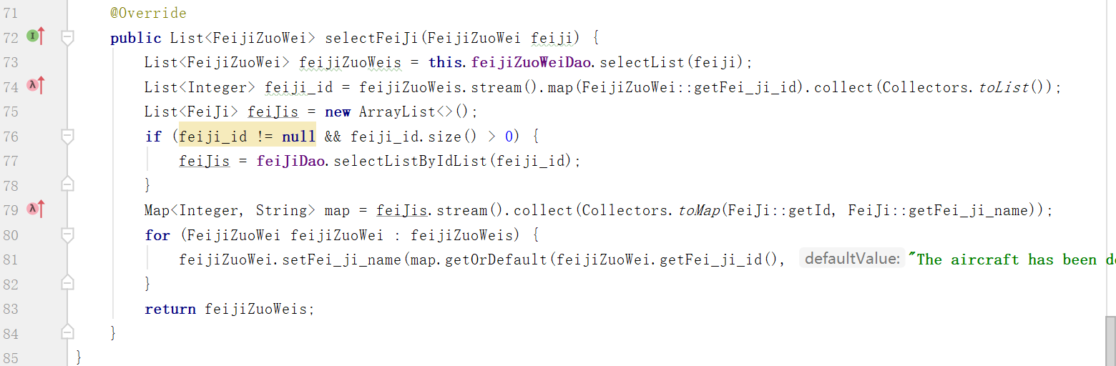
Retrieves a list of FeijiZuoWei objects. Uses a stream to transform this list into another list of flight IDs (feiji_id). Fetches FeiJi objects based on the extracted ID list and construct a mapping from ID to aircraft name. Sets the flight name for each FeijiZuoWei object, using the map. Returns the list of updated FeijiZuoWei objects.

Slide 17

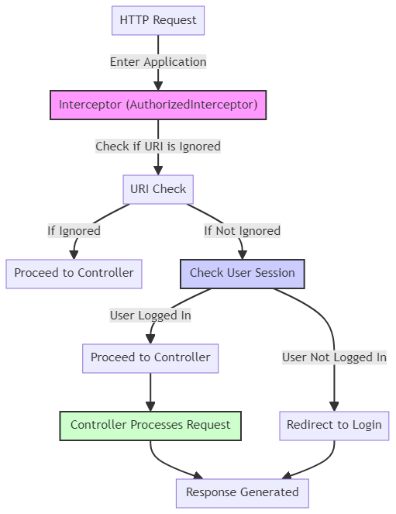
1. HTTP Request Entry: When an HTTP request enters the application, it first encounters the `AuthorizedInterceptor`. 2. URI Check: The interceptor checks if the request's URI is one of the ignored URIs. This is done in the `preHandle` method. 3. Decision Based on URI: - If the URI is ignored, the request is allowed to proceed directly to the appropriate Controller. - If the URI is not ignored, the interceptor checks the user's session.

Slide 18
4. User Session Check: - The interceptor checks if there is a user object in the session (indicating the user is logged in). - If the user is logged in, the request proceeds to the Controller. - If the user is not logged in, the interceptor redirects the request to the login page. 5. Controller Processing: - Once the request reaches the Controller, it is processed as per the business logic. 6. Response Generation: - Finally, a response is generated and sent back, either from the Controller or as a result of the redirection to the login page.

Slide 19

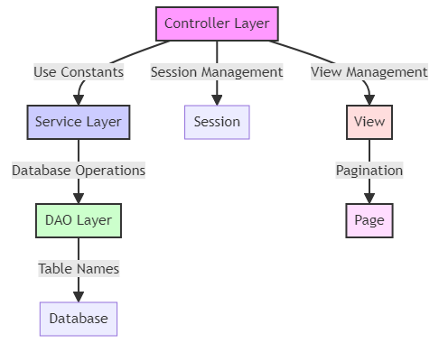
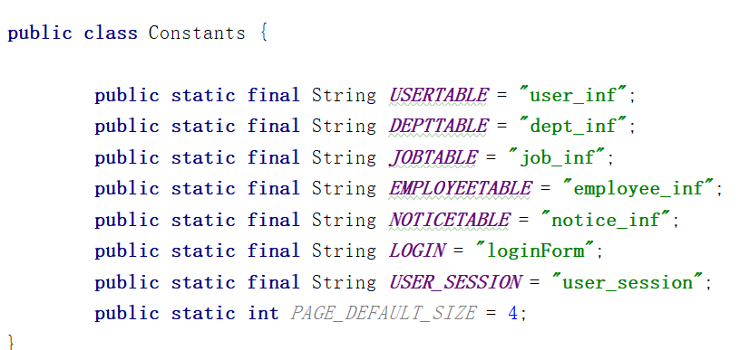
Constants class serves as a centralized repository for managing constant values, which are used across different layers of the application for database operations, session management, and view handling.

Slide 20
Reports and Analysis
This project describes a simple and effective Java based Air ticket purchase. It uses JSP Files Overview MVC Architecture, Dynamic SQL Providers, and other methods

Slide 21
Good Characteristics
Efficiency: Using the classic Model View Controller (MVC) architecture, the project has a clear organizational structure that is easy to understand and maintain.
Modularity: The project is composed of multiple classes, each representing a distinct entity or function .This design improves the code's maintainability.
2. Weaknesses
Error Handling: The system lacks robust error handling at the moment. It does not account for situations in which the user may enter incorrect information, which could result in unintended behaviour.
Functionality: Although the system is fully functional. But if there is an input error, there is no way to return to the previous interface, and you can only exit and perform seat selection again

Slide 22
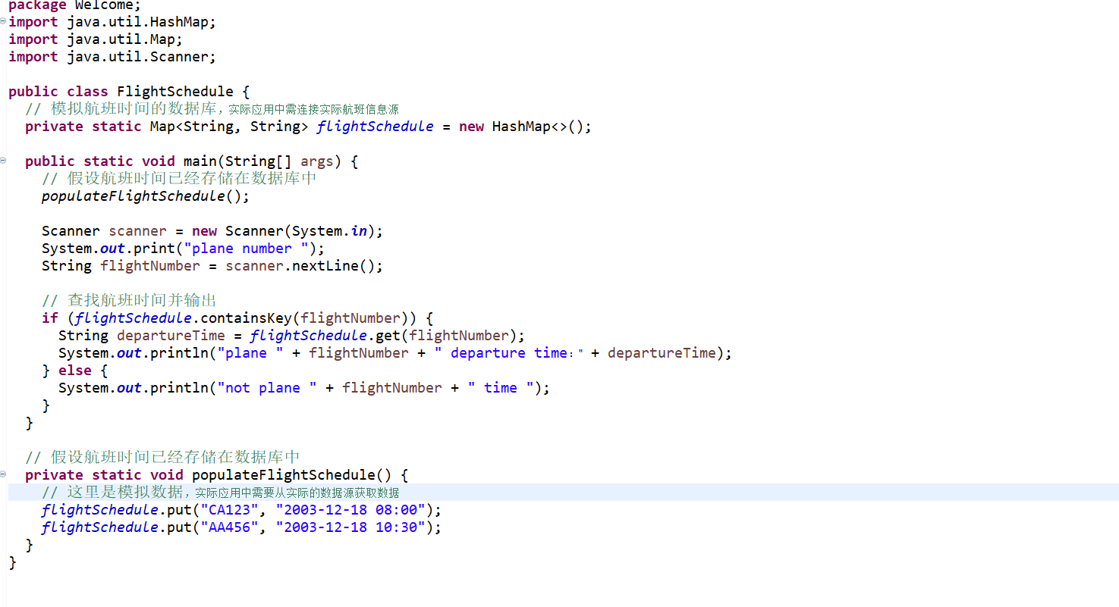
Improvements
Functionality Expansion:
Ticketing history can be added to the system, allowing people to use the program smoothly and making it more comprehensive

Slide 23
Conclusion

Slide 24
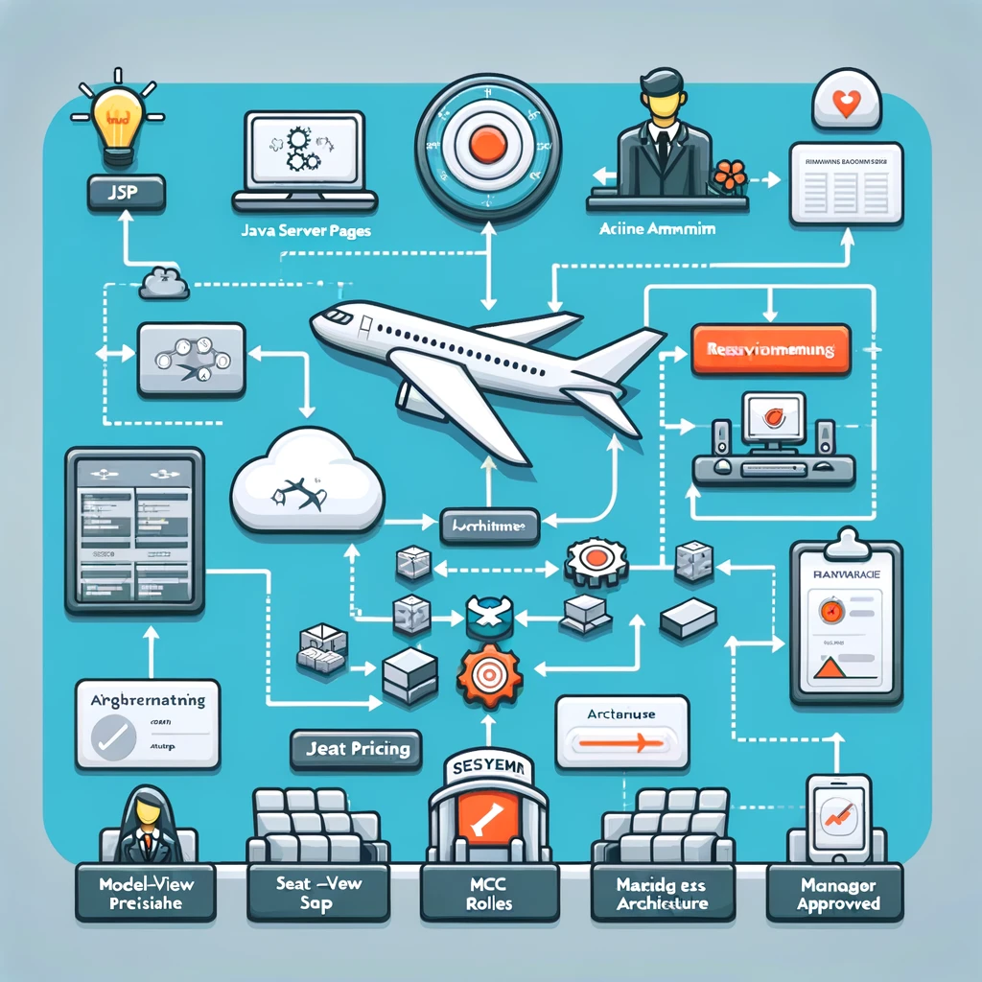
System Core Functionalities
- MVC Architecture
- Seat pricing by Airline Admin for First Class, Business, Economy
- Airline Manager role: Review and approve seat list
- Seat availability contingent on Manager's approval

Slide 25

User Interaction & Future Enhancements
- User-friendly customer interface for flight selection and payment
- Automated email itinerary post-purchase
- Suggested Improvements
- Additional confirmation steps in ticket purchase
- Features like ticket purchase history, multilingual support

Slide 26
reference
Akshay, V., Kumar S., A., Alagappan, R. M., & Gnanavel, S. (2019). BOOKAZOR - an Online Appointment Booking System. 2019 International Conference on Vision Towards Emerging Trends in Communication and Networking (ViTECoN), 1–6. https://doi.org/10.1109/ViTECoN.2019.8899460
Elizabeth Rani, G., Narasimha Murthy, G., Abhiram, M., Mohan, H., Singh Naik, T., & Sakthimohan, M. (2021). An Automated Airlines Reservation Prediction System Using BlockChain Technology. 2021 Sixth International Conference on Image Information Processing (ICIIP), 6, 224–228. https://doi.org/10.1109/ICIIP53038.2021.9702587
Lakshmipathi, J., & Lekha T., C. (2007). VIHARI: An Ontology Sevice Driven Multi-Agent System for Air Ticket Booking. 15th International Conference on Advanced Computing and Communications (ADCOM 2007), 675–680. https://doi.org/10.1109/ADCOM.2007.118
Lu, W. (2007). An Analysis of Airline E-commerce Strategies in Ticket Distribution. 2007 International Conference on Service Systems and Service Management, 1–5. https://doi.org/10.1109/ICSSSM.2007.4280082
McTavish, C., & Sankaranarayanan, S. (2010). Intelligent agent based hotel search & booking system. 2010 IEEE International Conference on Electro/Information Technology, 1–6. https://doi.org/10.1109/EIT.2010.5612121
Sakthimohan, M., Pasupulti, M. K., Gopa, V., Gosi, N., & Elizabeth, R. G. (2021). IOT Established Agile Parking System. 2021 3rd International Conference on Signal Processing and Communication (ICPSC), 637–641. https://doi.org/10.1109/ICSPC51351.2021.9451732
Sankarananrayanan, S., & Wani, S. M. A. (2014). NFC enabled intelligent hospital appointment and medication scheduling. 2014 2nd International Conference on Information and Communication Technology (ICoICT), 24–29. https://doi.org/10.1109/ICoICT.2014.6914034
Singh, H., & Shah, R. R. (2020). BOOKiiIT - Designing a Venue Booking System (Technical Demo). 2020 IEEE Sixth International Conference on Multimedia Big Data (BigMM), 287–291. https://doi.org/10.1109/BigMM50055.2020.00050
Uran, S., Hercog, D., & Jezernik, K. (2007). Remote Control Laboratory with Moodle Booking System. 2007 IEEE International Symposium on Industrial Electronics, 2978–2983. https://doi.org/10.1109/ISIE.2007.4375089
Wei, Z., Dong, R., Luo, X., & Liu, F. (2009). Model Checking Airline Tickets Reservation System Based on BPEL. 2009 Third International Conference on Genetic and Evolutionary Computing, 248–251. https://doi.org/10.1109/WGEC.2009.86

