Slide 1
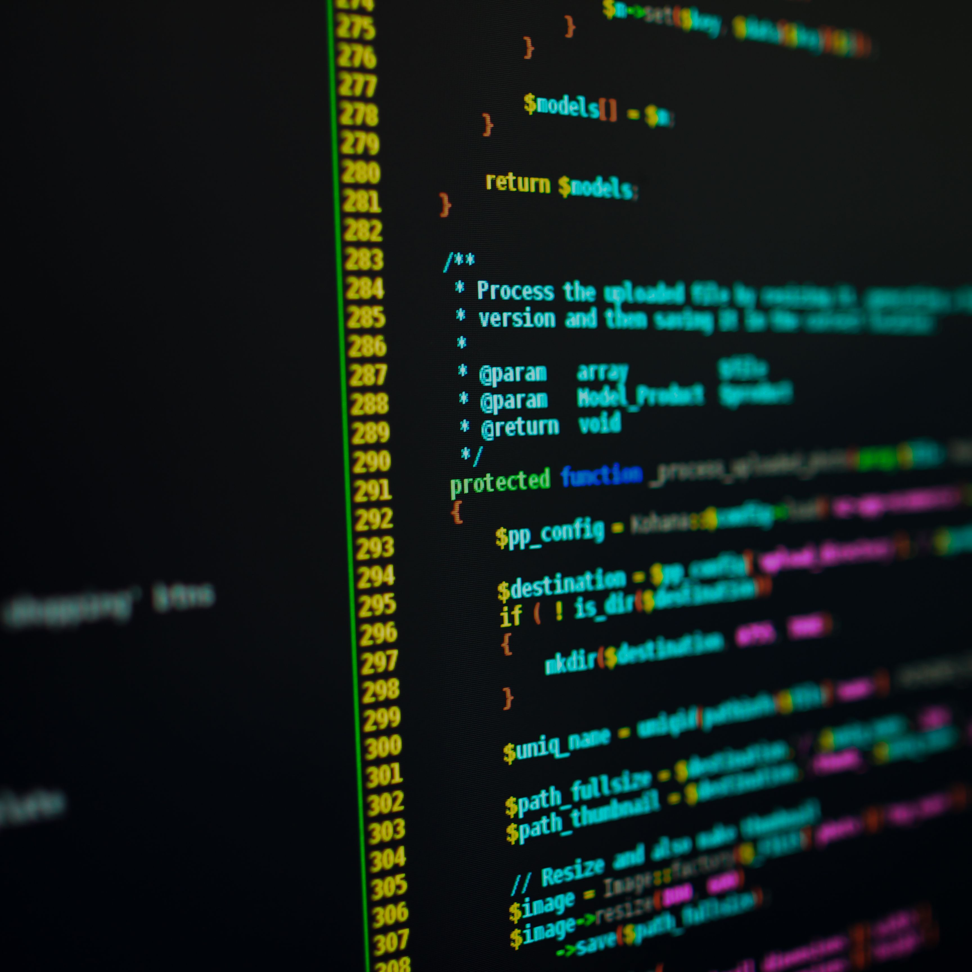

PHP Functions
Module for Web Development in PHP

Slide 2
Module Outline
Pre-requisite
What is Function
How to use it
When and Why to use it
Aha moments

Slide 3
Pre-requisite
Knowledge to Acquire
Programming Syntax
Variables, Values and Data Types
Conditional Statement

Slide 4
What is Function
Function is a piece of code which takes one more input in the form of parameter and does some processing and returns a value.
There are two type of Functions: Built In and User-Define Function
Built In function are Prepackage the ready made to be reuse in the code. Common examples are echo() and str_replace(),
User-Define Function are customized made by the Developer
What is Function
How to use it
When and Why to use it
Aha Moments

Slide 5
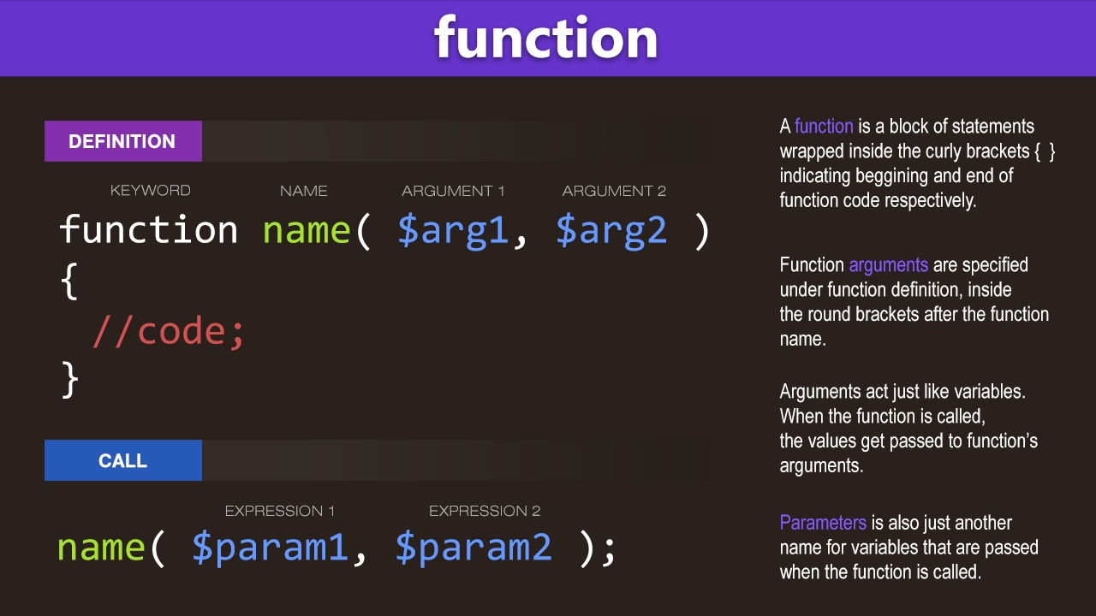



How to Use
How to use it
What is Function
When and Why to use it
Aha Moments

Slide 6
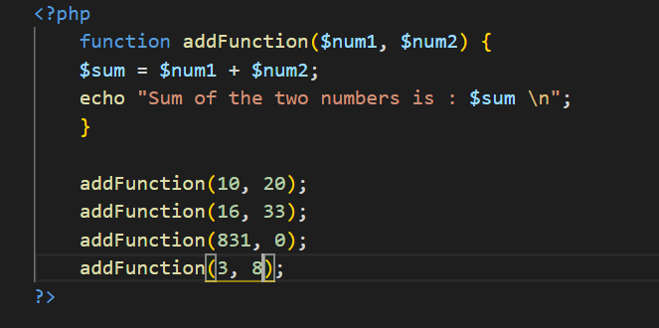
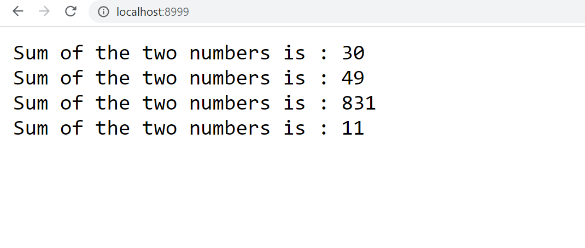
When and Why to use it
When the process is started to be repeated
Simplify and has clean codd structure that can be easily extended and modification
When and Why to use it
What is Function
How to use it
Aha Moments

Slide 7
Function Module Summary
The Aha moments are as follows:
PHP Function: Reusable library foundation that can create impact on clean code and easier maintainability
Online Materials: Github link - https://github.com/cocoytech/KredoPhpFunction
Aha Moments
What is Function
How to Use
Why and When to Use

