Slide 1
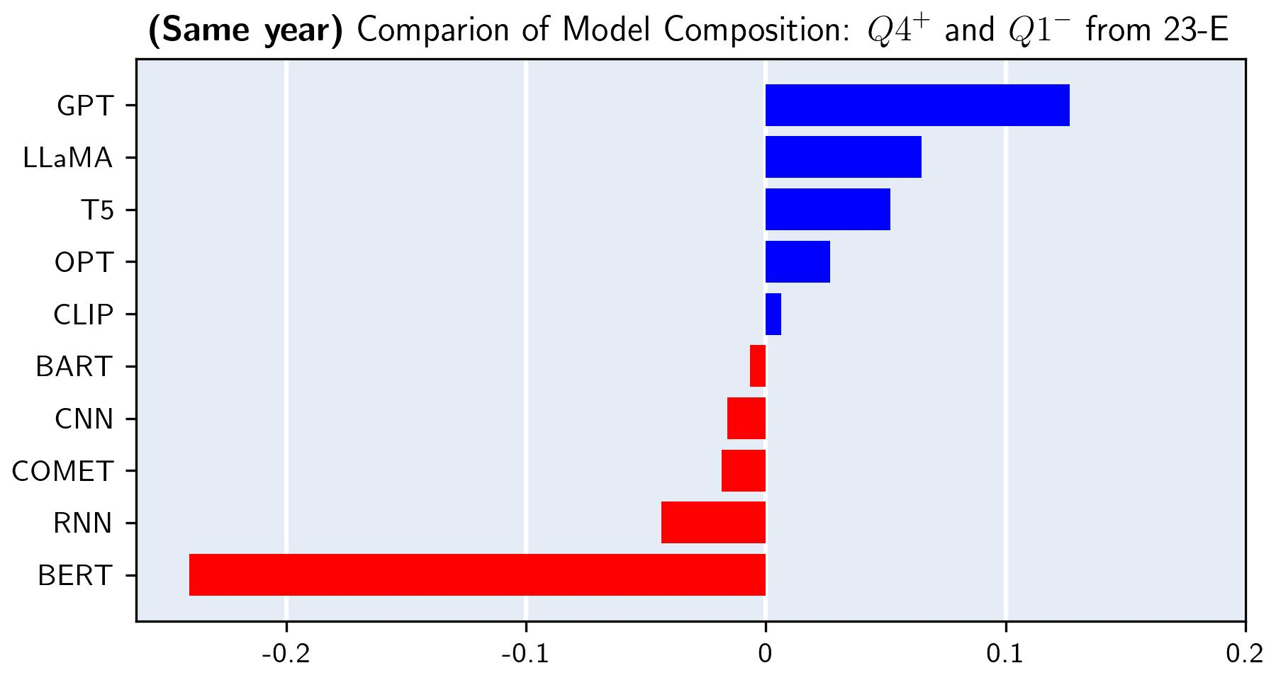
Difference of Proportion(%) Q4⁺ - Q1⁻
< 0
> 0

