Slide 1
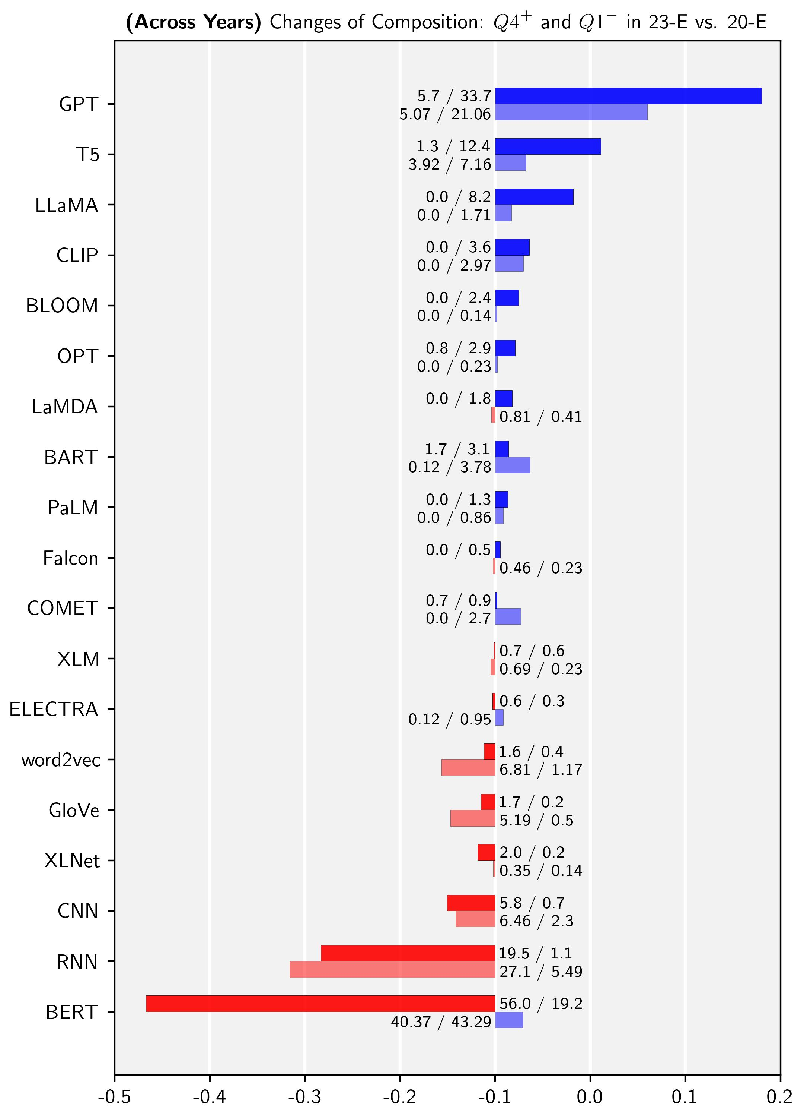

Q4⁺
Q1⁻
-
+
dec.
inc.
3.2 / 18.3
20-E
23-E
Proportion(%) in $N$

