Slide 1
SFDC Order Overview

Slide 2
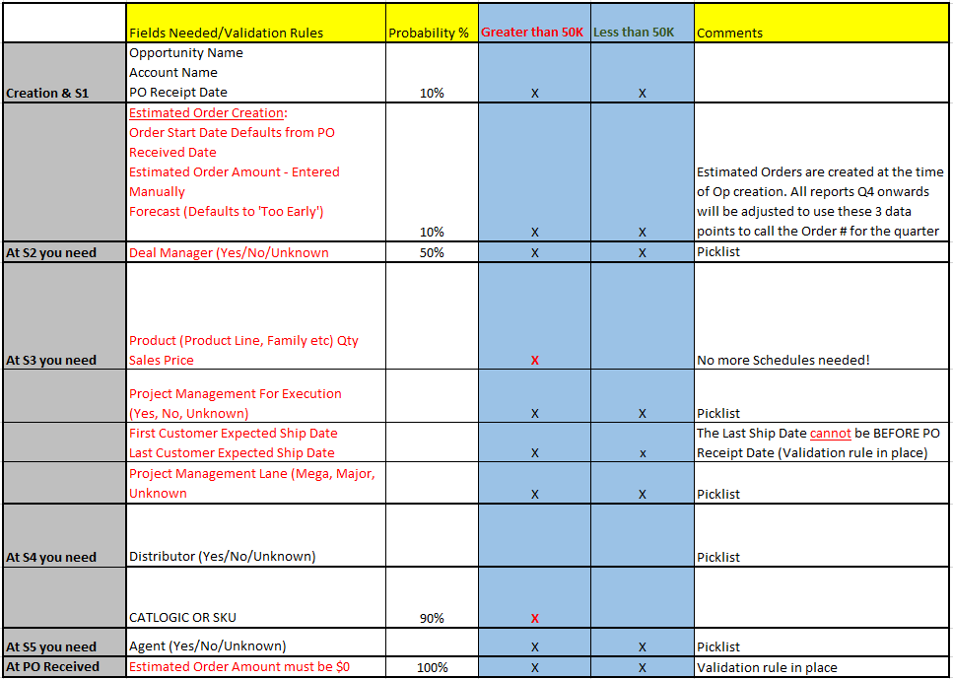
Overview of Stage validation rules
Everything in red are the NEW changes

Slide 3
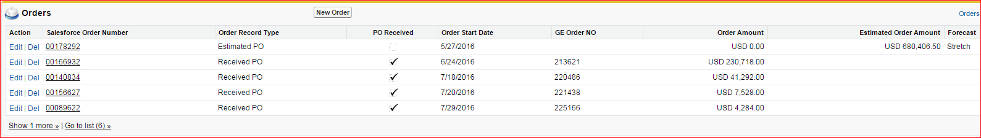

Understanding Your Orders View
A
B
Estimated PO record types are created manually and Received PO record types are those from SAP
With Received PO SAP orders, this gets checked automatically when the Order is related to the Opportunity OR you can manually check the box on Estimated Order record types
Actual Order amount from SAP. Only populates if Order has been related to the Op. this feeds into total Order Amount & Order Received fields in detail section
This is the expected order amount that you have entered – This feeds into Total Orders & Estimated Orders to Go fields in detail section
This is a SF ID #. Ignore this #.
If the order is RECEIVED, then this is the actual order date. If the order is still ESTIMATED, then it’s the date you put in. The Estimated Order Start Dates must be kept up-to date, as well (This date field also controls PO Receipt Date)
This is what you enter as the Forecast Category
Commit – select if you are including this amount in your quarter call
Stretch – select this if this is a gap closer
Too Early to indicate
All Forecasts going forward will be pulled based on the selection above. These MUST be kept up-date
SAP Order #
Last Date from Order Start Date Column above
A + B
Sum of A
Sum of B

Slide 4
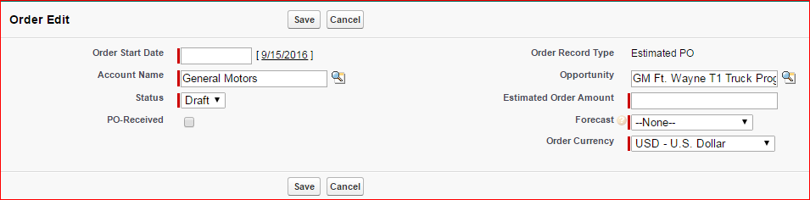
How to enter an Order?
You can ENTER/CREATE Multiple Estimated Orders in a SINGLE Opportunity.
No need to close out the opportunity for what you have already received in PO’s and open a new Opportunity for the balance amount! Benefit for you – fewer Opportunities to manage!
Order Start Date: This is the date you expect the order
Estimated Order Amount: This is the $ amount of the order you are expecting
Forecast: You have to select Commit, Stretch, Too Early to Indicate
Commit: Select this if you have HIGH confidence/low risk factors in getting the order in the quarter.
Stretch: Orders that have the best upside or gap closers. These orders are close to being a Commit but there is still some risk in getting the order in the quarter. Your confidence level on these orders is a MEDIUM. Stretch should be a shorter list of Opportunities
Too Early to Indicate: These orders are early in selling cycle and/or risk factors preclude them from being a Stretch or Commit. As selling cycle progresses, these orders could become additional upside or be a backfill for Current quarter
Quarter Call = Commit

Slide 5
What we need from you…
Validate/Change/Update the Estimated Order Amount(s), Order Start Date(s), Forecast Category(ies). Focus on Q4
We loaded the Schedule Amount & Schedule Date from the Product Section into the Order section for you. We marked everything as STRETCH
We added a chart to Enterprise and Account Manager dashboards to show what’s reflecting today for Orders in Q4
Clean up your Opportunities – mark them CLOSED LOST if needed.
Order Forecasts/QMI’s will be pulled based on data in SFDC so the onus is on you to keep your Opportunities updated. Please!!

