Slide 2
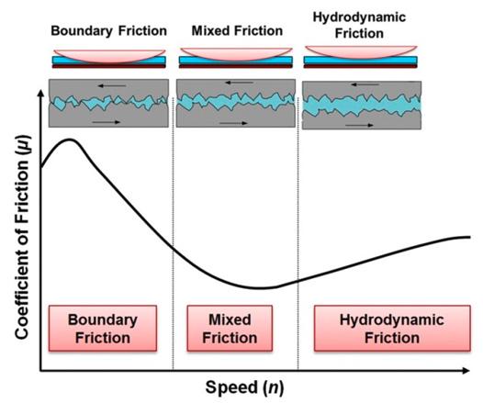
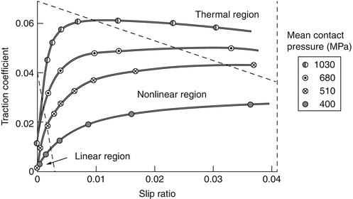

Slide 3
Hertzian
Coulomb

Slide 4
Strong
Weak

Slide 5
Hertzian
Coulomb

Slide 7
Hertzian
Coulomb

Slide 8
Strong
Weak

