Slide 1
x (2)
ω (3)
v (1)
Centripetal Force
and
Initial Angular Momentum

Slide 2
wear
The running direction of the balls is guided by the bottom groove
guide

Slide 3
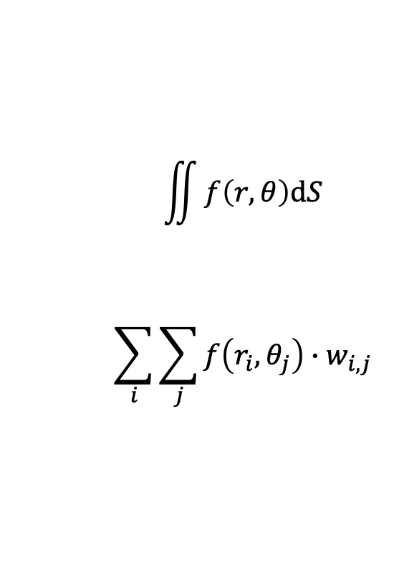
I use a classical numerical integration where an integral is replaced by a weighted sum
$$\iint{f\left(r,θ\right)dS}$$
$$\sum_{i}{\sum_{j}{f\left(r_{i},θ_{j}\right)∙w_{i,j}}}$$

Slide 5
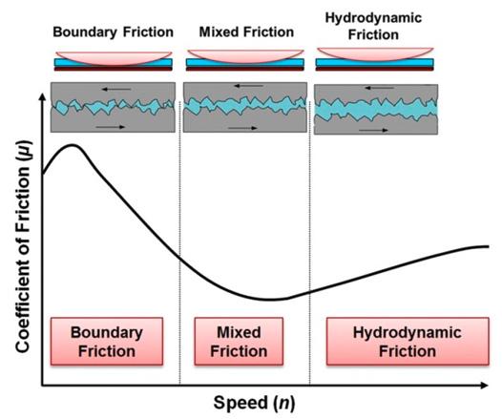
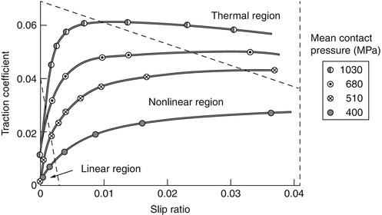

Slide 6
Hertzian
Coulomb

Slide 7
Strong
Weak

Slide 8
Hertzian
Coulomb

Slide 10
Hertzian
Coulomb

Slide 11
Strong
Weak

