Slide 1
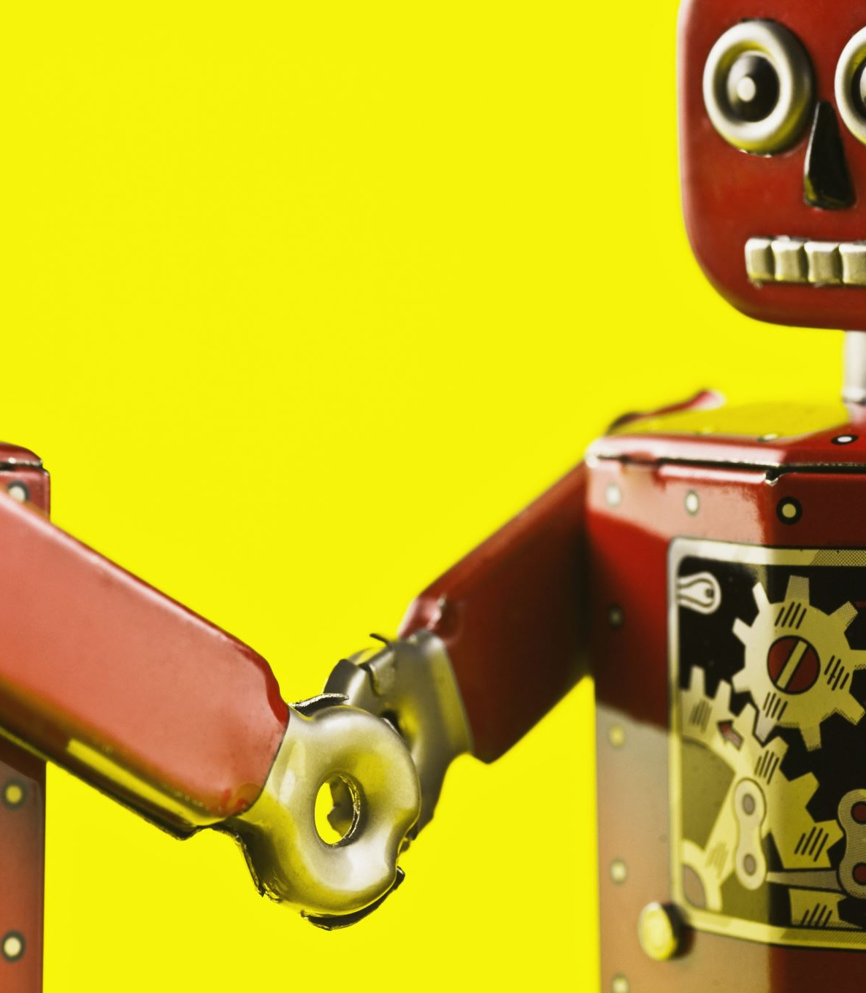
Fruit Sorting Robot
Laura Vallinaho, Marko Tiitto, Jorrit van Triest, Thomas Schenk, Sara van Eersel, Simon Schreurs & Chiara Babiak

Slide 2
Problem with manual labor
Only 8~ hours a day
Long term expenses
Staff shortage

Slide 3
Solution when using sorting robot
Flexible and easily scalable
Low investment costs
Increased productivity
24/7 up and running

Slide 4
Our Team
Two groups
Camera :
Sara van Eersel, Simon Schreurs & Chiara Babiak
Robot
Laura Vallinaho, Marko Tiitto, Jorrit van Triest & Thomas Schenk

Slide 5
The Ideas
Strawberry picking robot
Garbage sorting robot
Bug spraying robot
Watering system

Slide 6


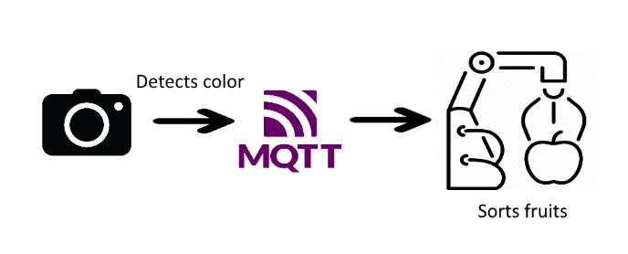
The basic plan

Slide 7
DEMO

Slide 8
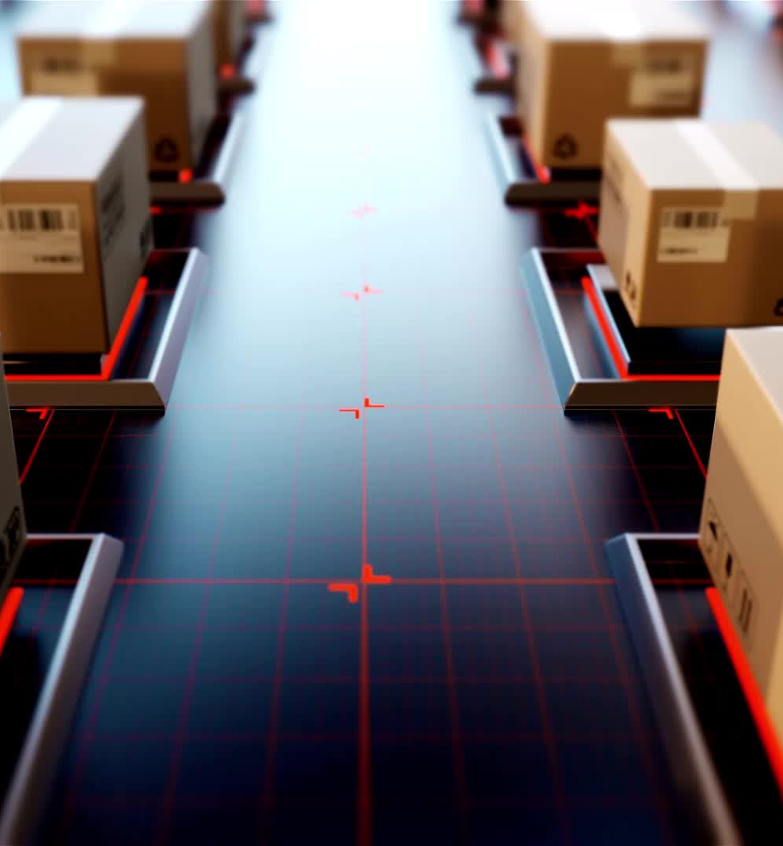
Future plans
Conveyor belt
Automatic error handling
Expand dashboard
Make connections more secure / stable

Slide 9

Questions?

