Slide 1
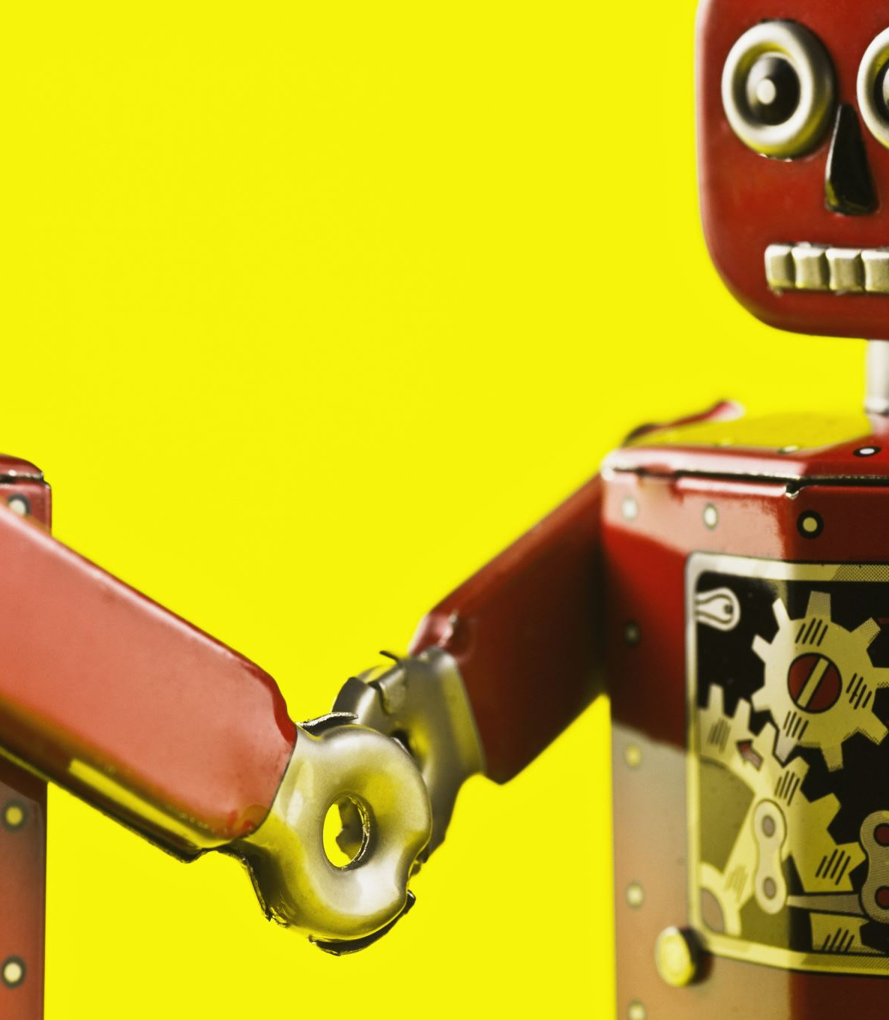
Fruit Sorting Robot
Laura Vallinaho, Marko Tiitto, Jorrit van Triest, Thomas Schenk, Sara van Eersel, Simon Schreurs & Chiara Babiak

Slide 2
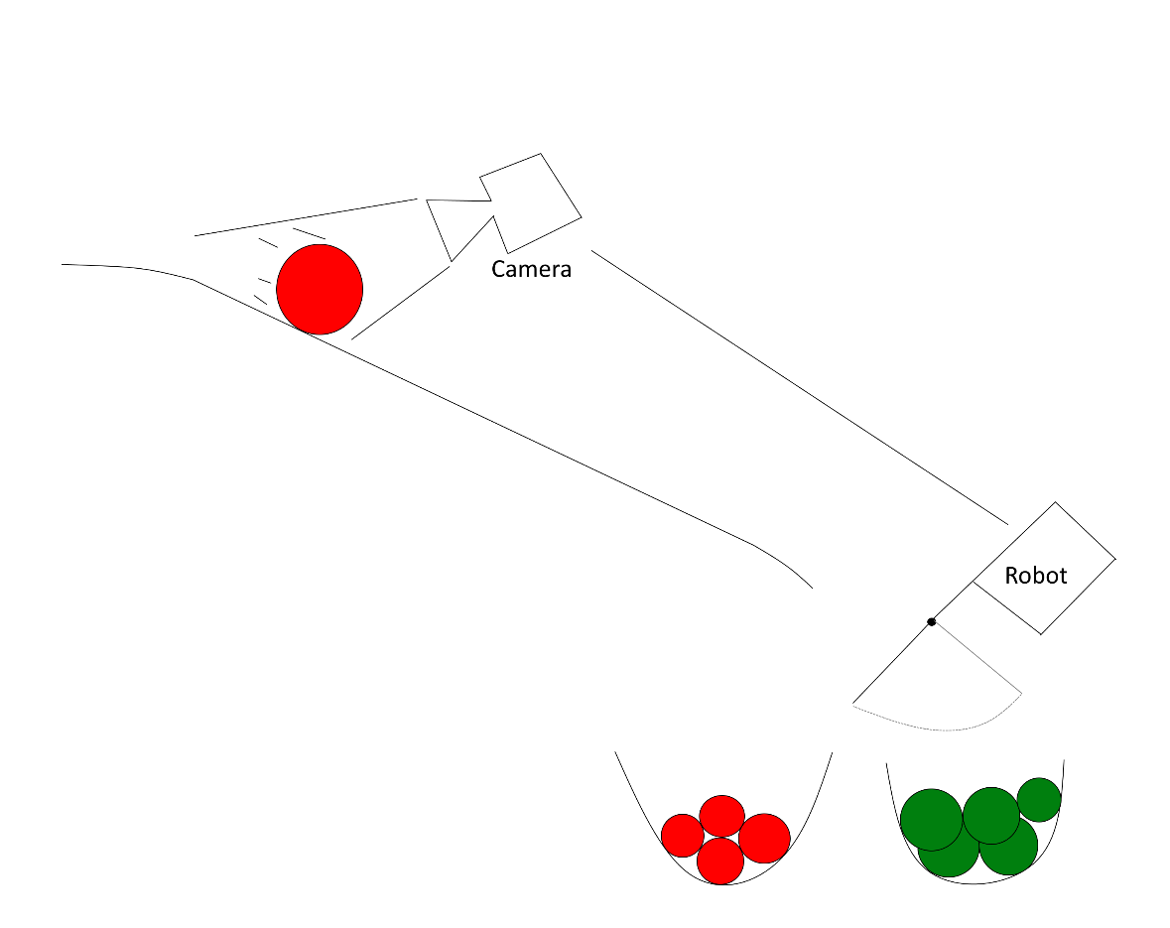
The basic plan

Slide 3
DEMO

Slide 4

Questions?

