Slide 1
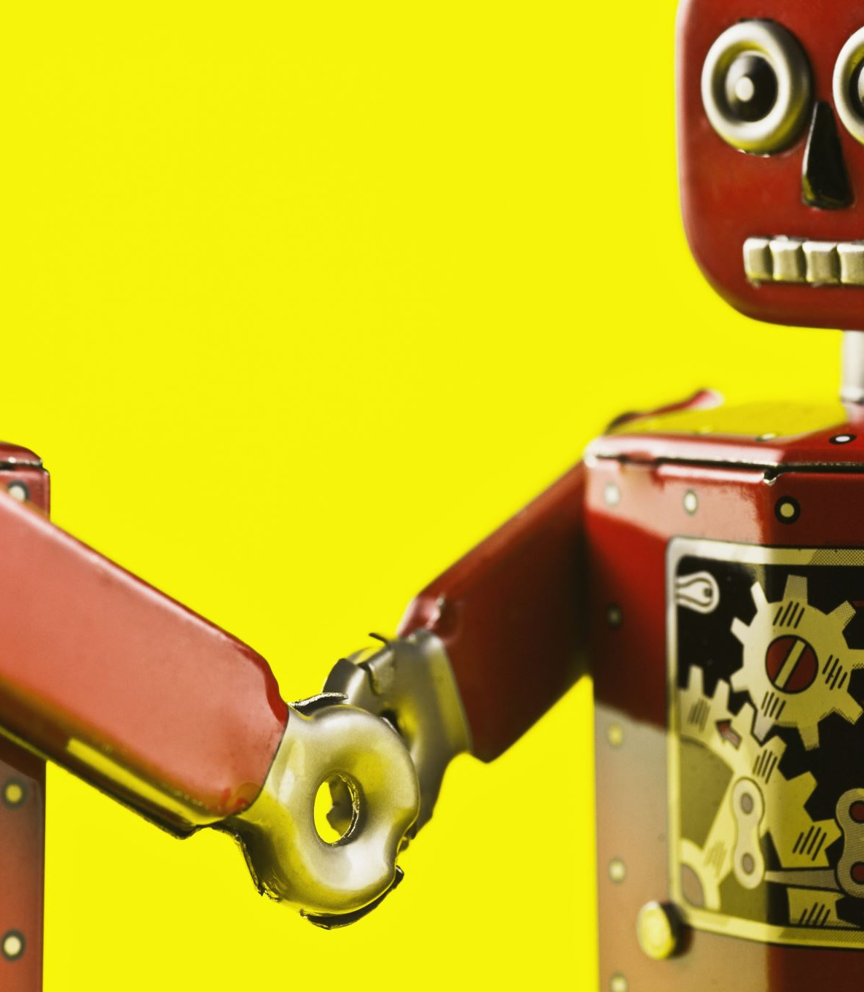
Fruit Sorting Robot
Laura Vallinaho, Marko Tiitto, Jorrit van Triest, Thomas Schenk, Sara van Eersel, Simon Schreurs & Chiara Babiak

Slide 2
Our Team
Two groups
Camera :
Sara van Eersel, Simon Schreurs & Chiara Babiak
Robot
Laura Vallinaho, Marko Tiitto, Jorrit van Triest & Thomas Schenk

Slide 3
The Ideas
Strawberry picking robot
Garbage sorting robot
Bug spraying robot
Watering system

Slide 4
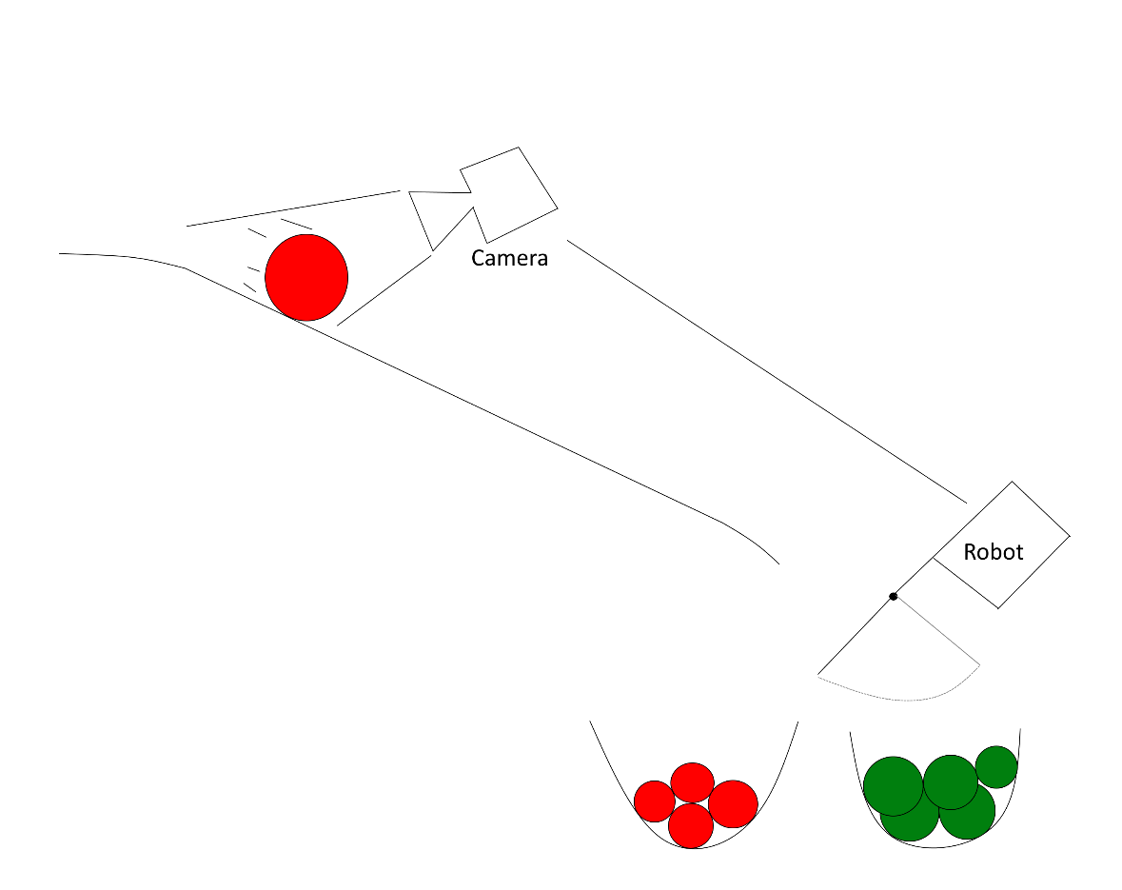
The basic plan

Slide 5
DEMO

Slide 6

Questions?

