Slide 1
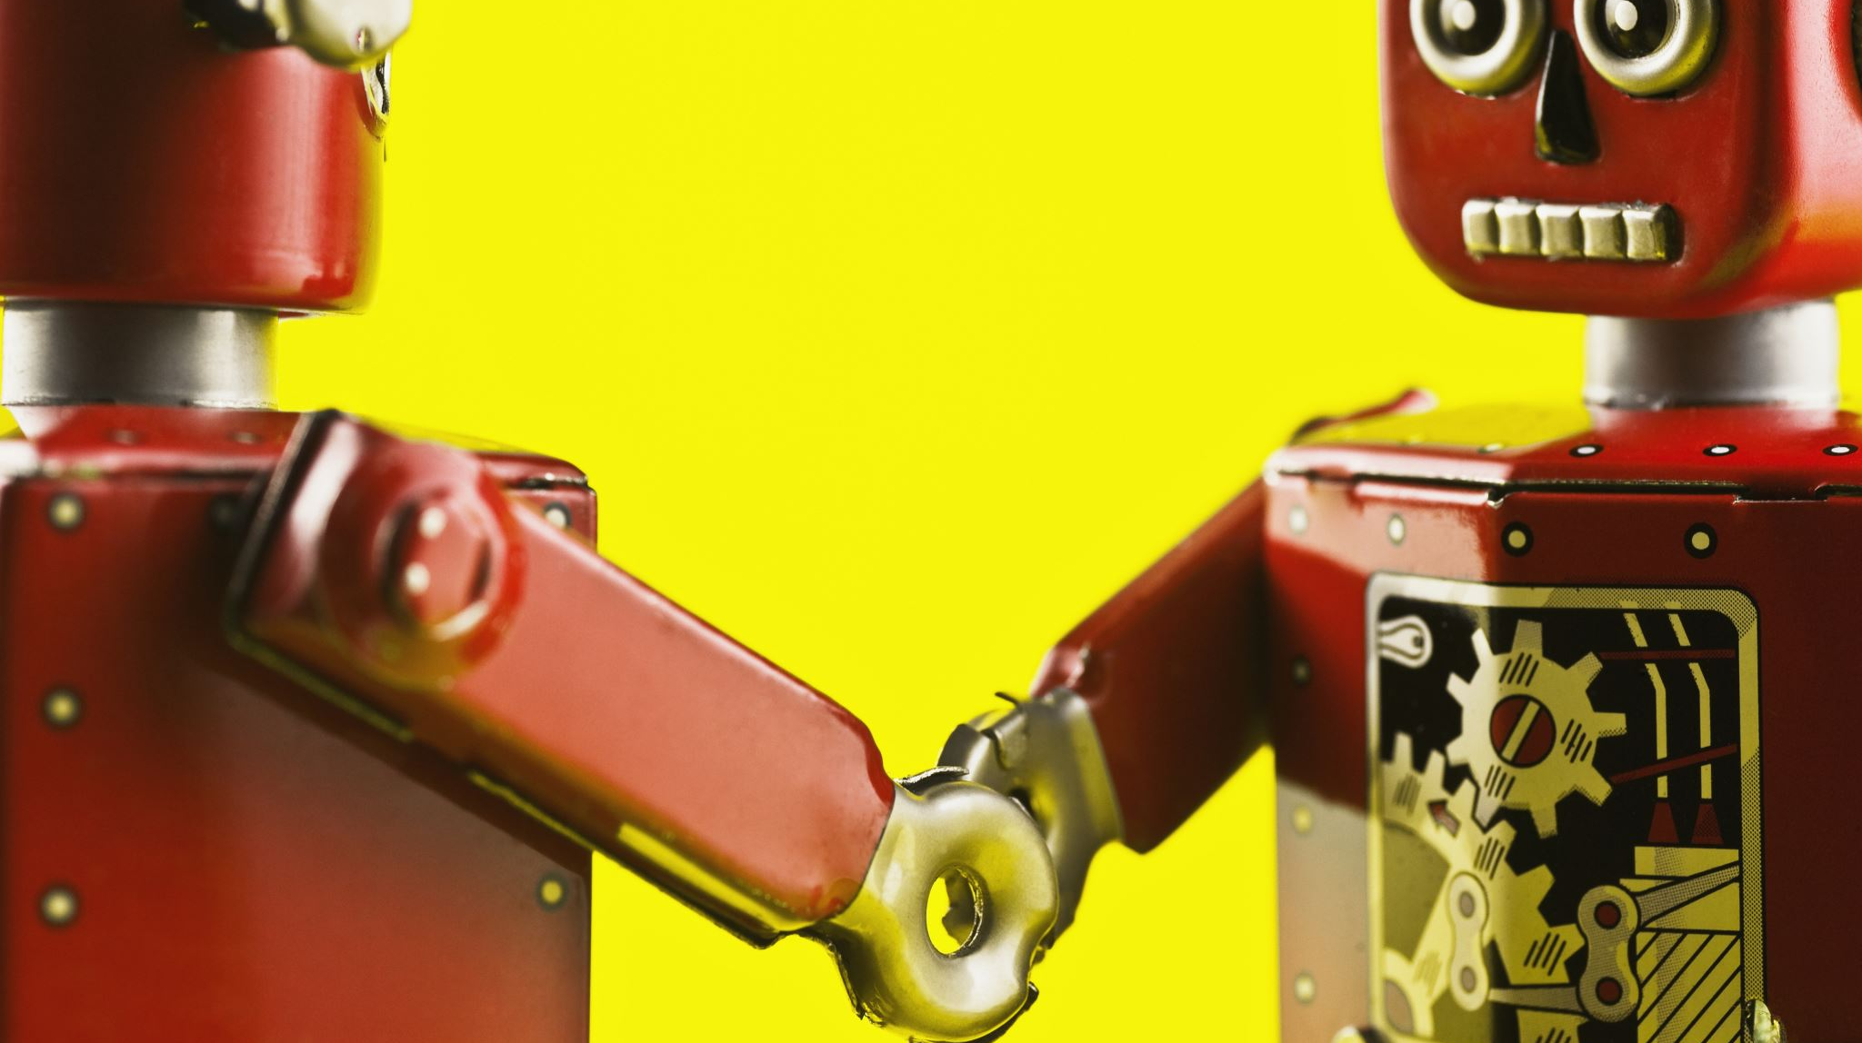
Fruit Sorting Robot

Slide 2
Our Team
Two groups
Camera
Sara van Eersel, Simon Schreurs & Chiara Babiak
Robot
Laura Vallinaho, Marko Tiitto, Jorrit van Triest & Thomas Schenk

Slide 3
Problem
Human errors in detecting:
-ripeness
-diseases

Slide 4
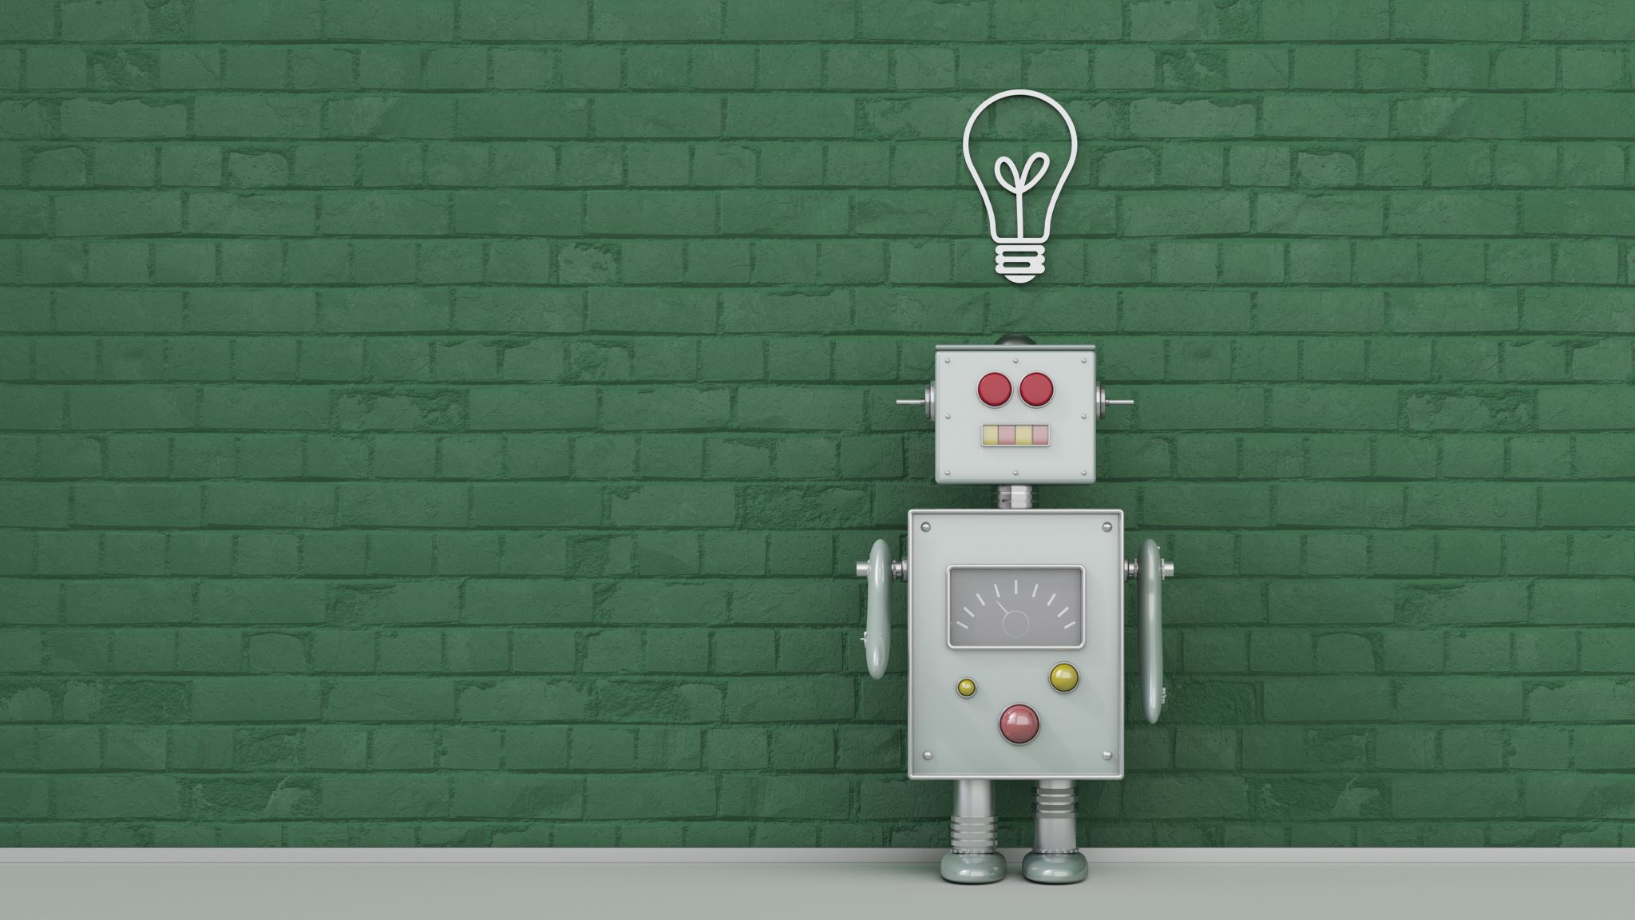
Idea
Strawberry sorting robot

Slide 5
Solutions
More precise
Flexible and easily scalable
Affordable
Efficient
Up and running 24/7

Slide 6


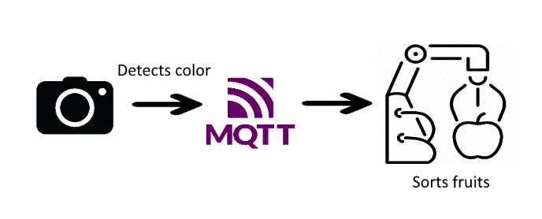
The basic plan

Slide 7
Robot
Morobot
ESP32

Slide 8

Camera
OpenCV
Color detection
HSV spectrum

Slide 9
MQTT
Quick
Wireless system

Slide 10
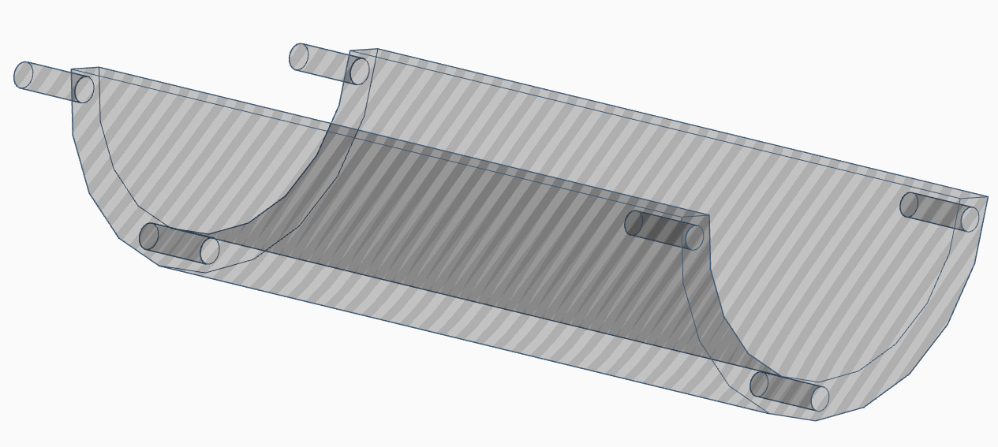
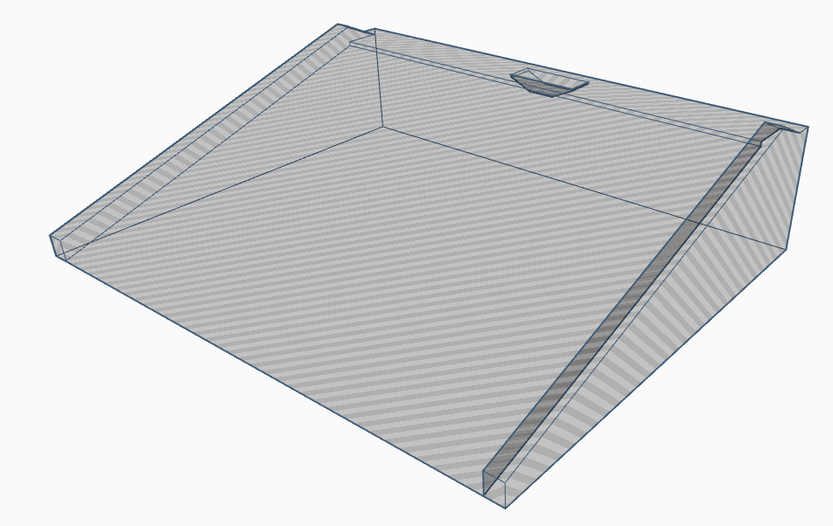
Track
3d printed
Custom design

Slide 11
Dashboard
Node-red

Slide 12
DEMO

Slide 13
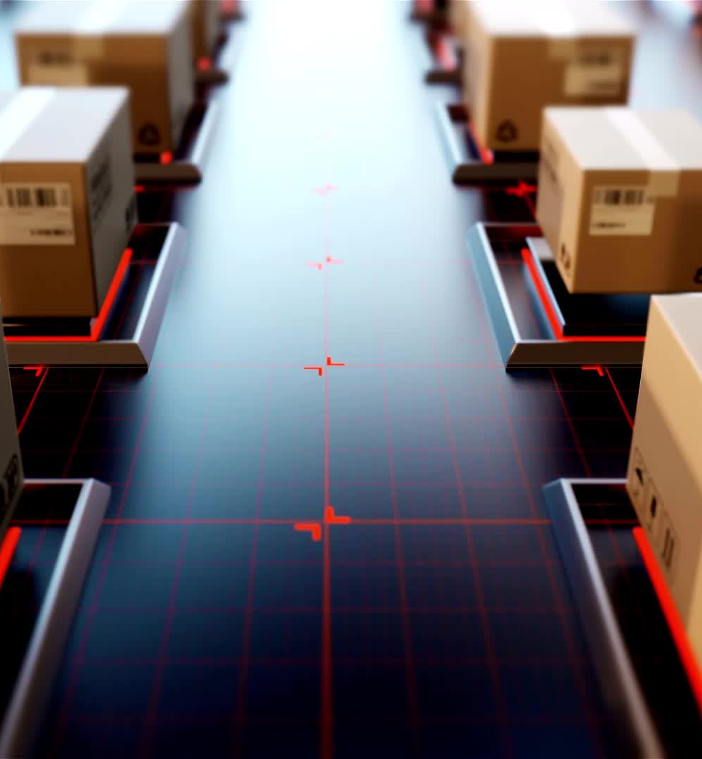
Future plans
Conveyor belt
Automatic error handling
Expand dashboard
Make connections more secure / stable

Slide 14

Questions?

