Slide 1
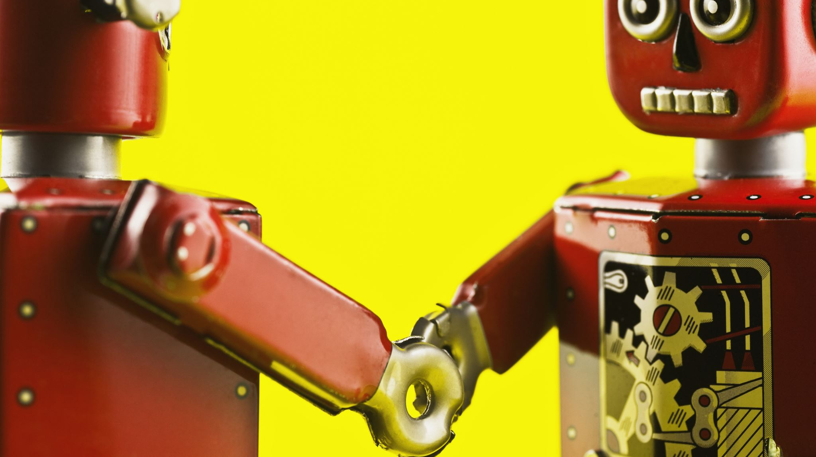
Fruit Sorting Robot
Notes:
Sara

Slide 2
Our Team
Two groups
Camera
Sara van Eersel, Simon Schreurs & Chiara Babiak
Robot
Laura Vallinaho, Marko Tiitto, Jorrit van Triest & Thomas Schenk
Notes:
Sara

Slide 3
Problem
Human errors in detecting:
-ripeness
-diseases
Notes:
Laura

Slide 4
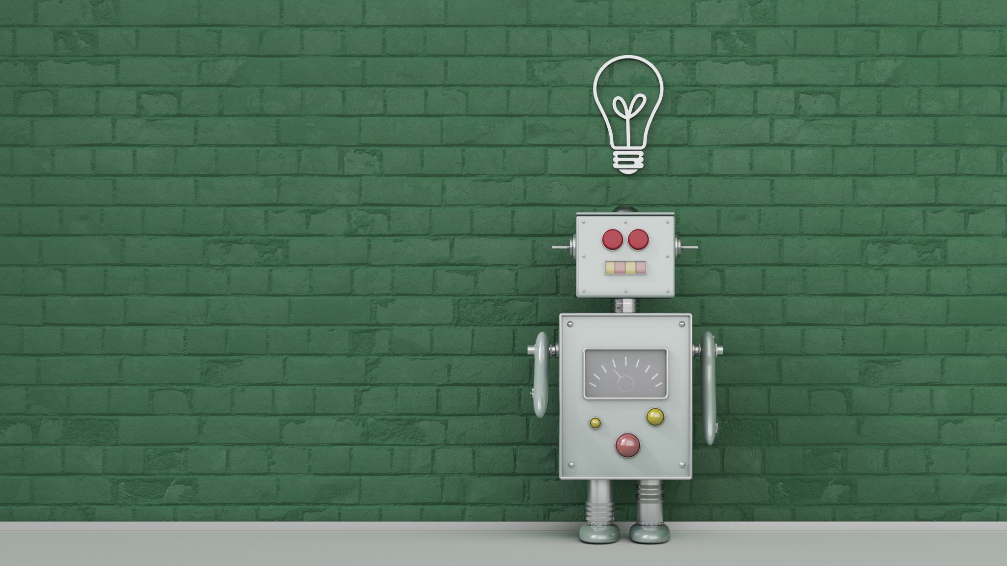
Idea
Strawberry sorting robot
Notes:
Sara

Slide 5
Solutions
More precise
Flexible and easily scalable
Affordable
Efficient
Up and running 24/7
Notes:
Laura

Slide 6


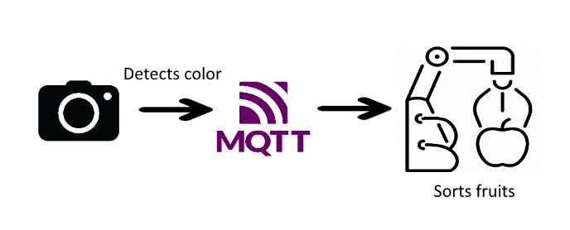
The basic plan
Notes:
Marko

Slide 7
Robot
Morobot
ESP32
Notes:
Marko

Slide 8

Camera
OpenCV
Color detection
HSV spectrum
Notes:
Chiara

Slide 9
MQTT
Quick
Wireless system
Notes:
Simon

Slide 10
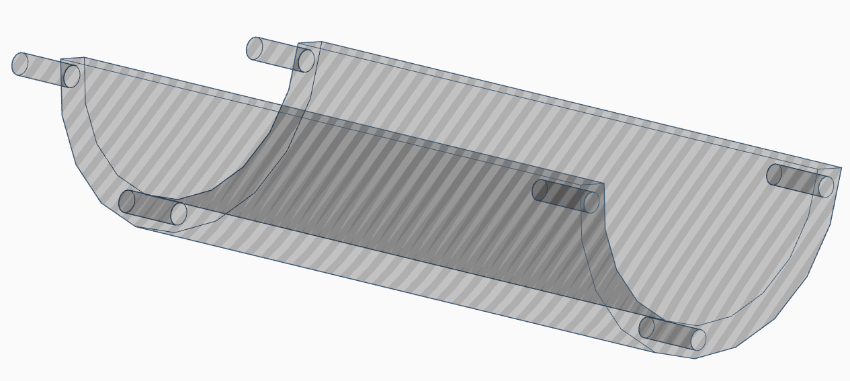
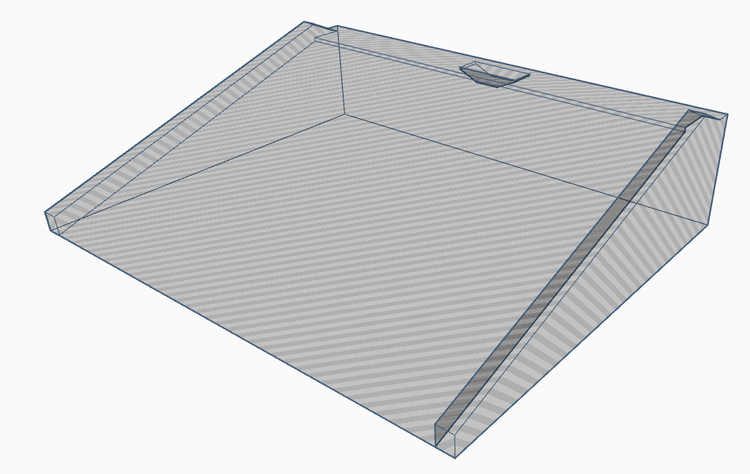
Track
3d printed
Custom design
Notes:
Jorrit

Slide 11
Dashboard
Node-red
Notes:
Jorrit

Slide 12
DEMO
Notes:
Thomas

Slide 13
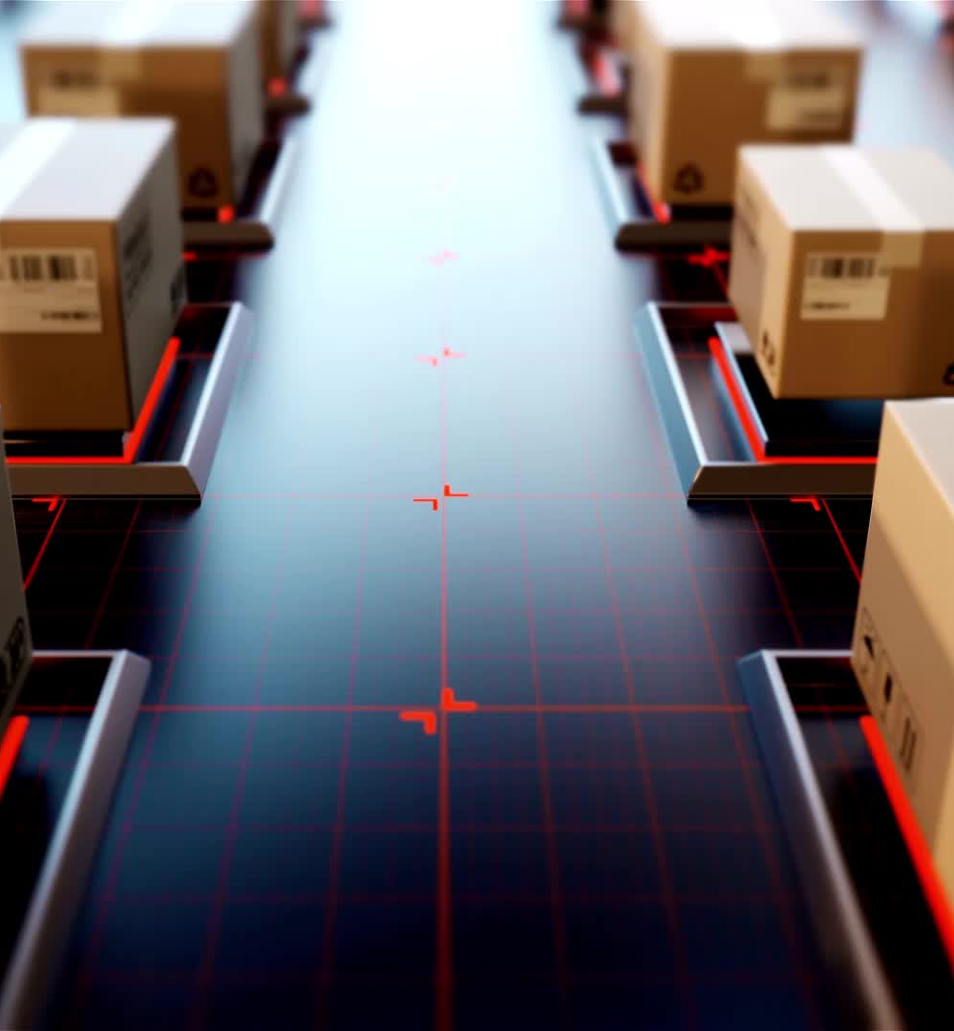
Future plans
Conveyor belt
Automatic error handling
Expand dashboard
Make connections more secure / stable
Notes:
Thomas

Slide 14

Questions?
Notes:
Simon

