Slide 1
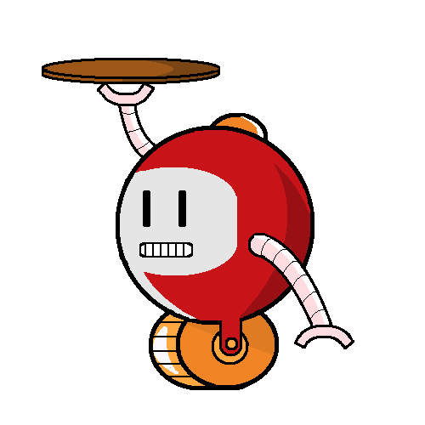
LazyBots
Sfwr eng 4G06A & Tron 4TB6a

Slide 2
Meet the Team
Karim Guirguik
David Hemms
Marko Laban
Curtis Milo
Keyur Patel
Alexandra Rahman
Alfred
Photo of the Team in alphabetical order

Slide 3
Meet Alfred
A new take on a dumb waiter
A self driving robot
A drink dispenser
Picture of Alfred

Slide 4
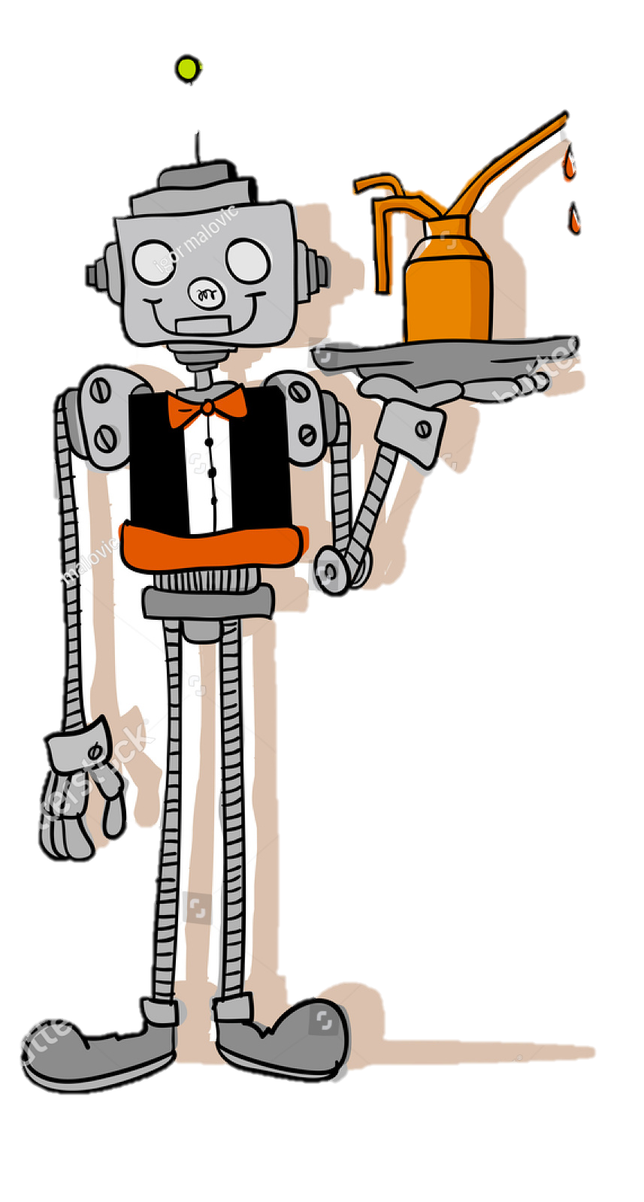
How Alfred Interacts in Social Settings
Restaurant Client
A user orders a drink via Android App
Alfred will navigate to the customers table
The correct drink will be dispensed
Alfred will return to Home Base

Slide 5
How Alfred Interacts with Staff
Restaurant Staff
Staff will refill the drink containers
Staff will change out the power supply
Restaurant Management
Management will be able to create and modify restaurant layout
Management will be able to assign available drinks
Management will be able to view error reports
Management will be able to call Alfred to Home Base

Slide 6
Layout of Restaurant
Layout of the restsurant

Slide 7
Alfred in Action
Demo of Alfred

Slide 8
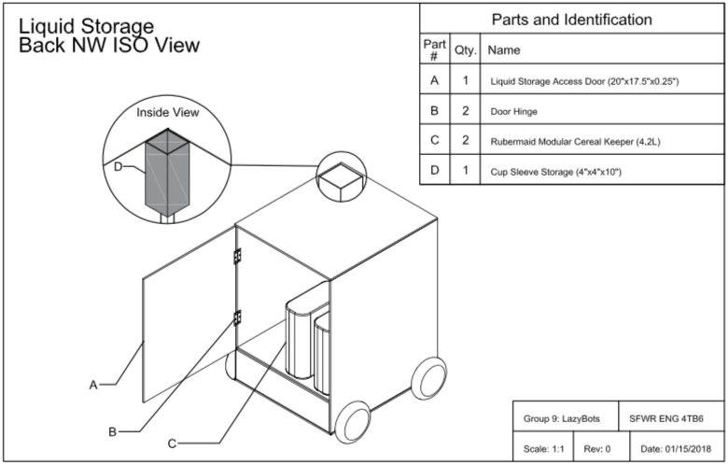
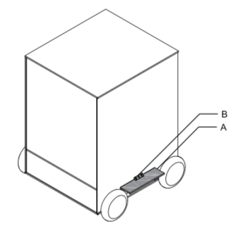
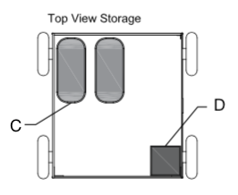
The Magic Behind Alfred
The Mechanical Design

Slide 9
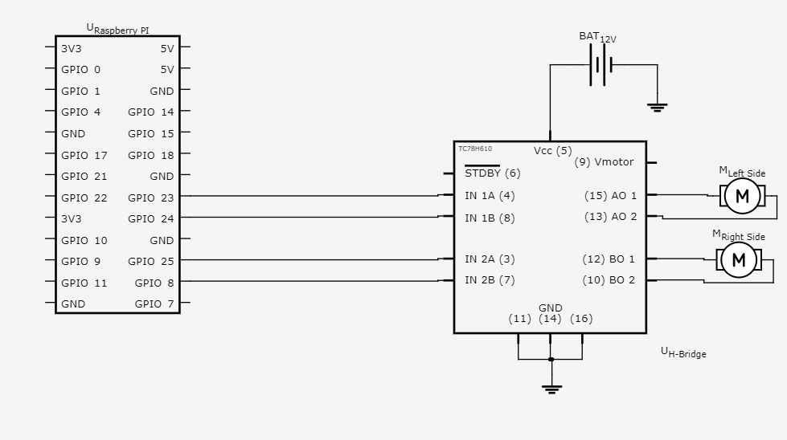
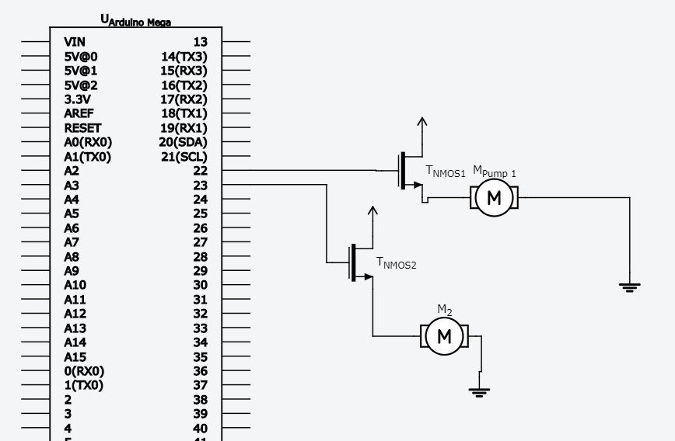
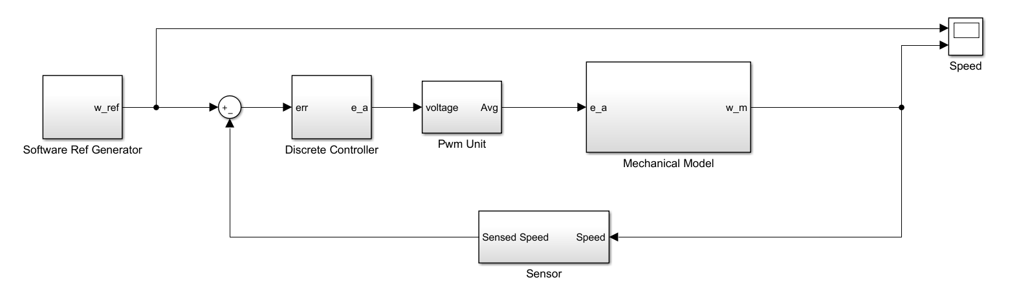
The Magic Behind Alfred
Electrical Design

Slide 10
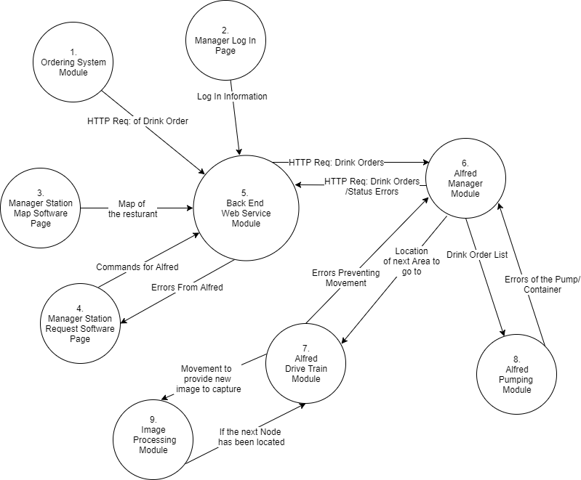
The Magic Behind Alfred
Software Design

Slide 11

Future Enhancements
Integrate Alfred’s system to existing Point of Sale Systems
Upgrading the Dispensing System

