Slide 1

Introduction to Python
Powering your machine learning

Slide 2
Copyright Notice
The material within this presentation, excluding externally sourced images and animations, is fully owned by the Curtin Machine Learning Club. No redistributing, modification, nor commercialisation is allowed without written consent from the copyright holder.
Copyright © 2021 Curtin Machine Learning Club

Slide 3
Acknowledgement of Country
Curtin University would like to pay our respect to the Aboriginal and Torres Strait Islander members of our community by acknowledging the traditional owners of the land on which the Bentley Campus is located, the Whadjuk people of the Nyungar Nation; and on our Kalgoorlie Campus, the Wongutha people of the North-Eastern Goldfields, past, present, and emerging.

Slide 4


Hardware Required

Slide 5
Python
Easy to learn
Flexible and powerful
Lots of prepackaged modules suited towards scientific application
Lots of support with machine learning modules
Easily shared through notebooks
Free and cross platform

Slide 6
About Python
Was first released in 1991 as a hobby project named after Monty Python.
Free and open-source with continued development
Is an interpreted language, meaning the code is not compiled but instead compiled as it is run.

Slide 7
Jupyter Notebook
Jupyer notebook is just one of many ways to run python.
We can also use the terminal
Now open up google colab to open the notebook.

Slide 8
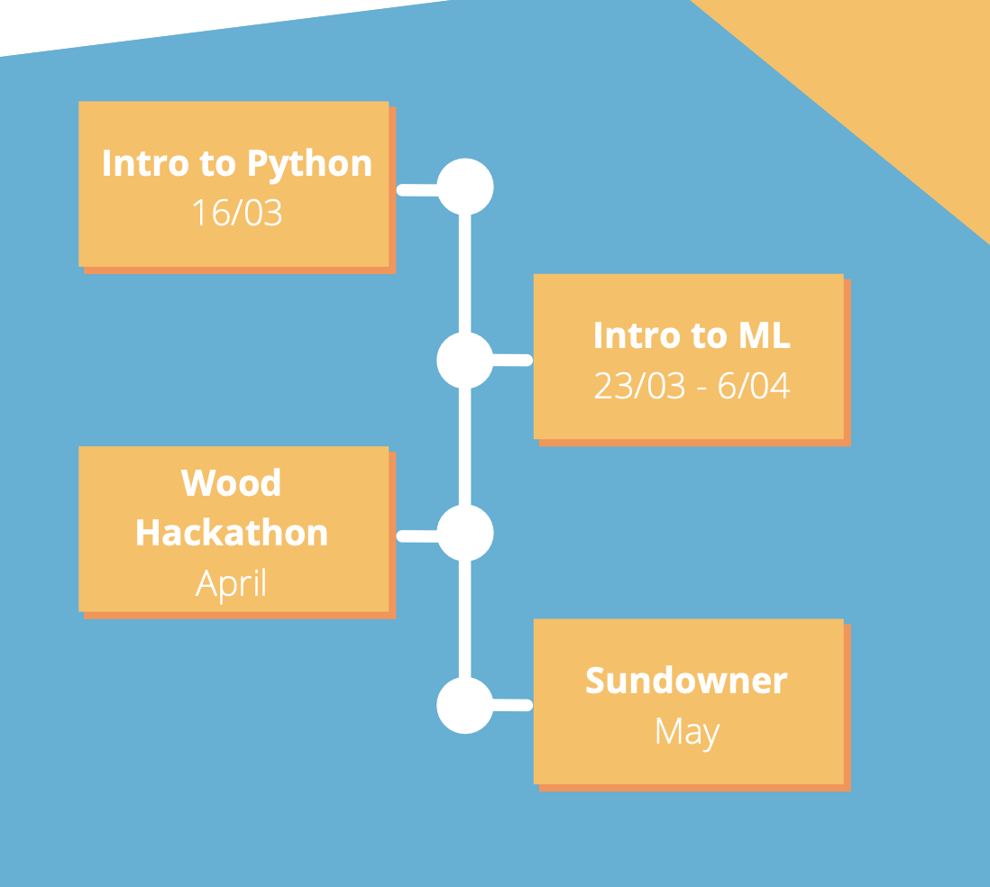
What’s next?

Slide 9
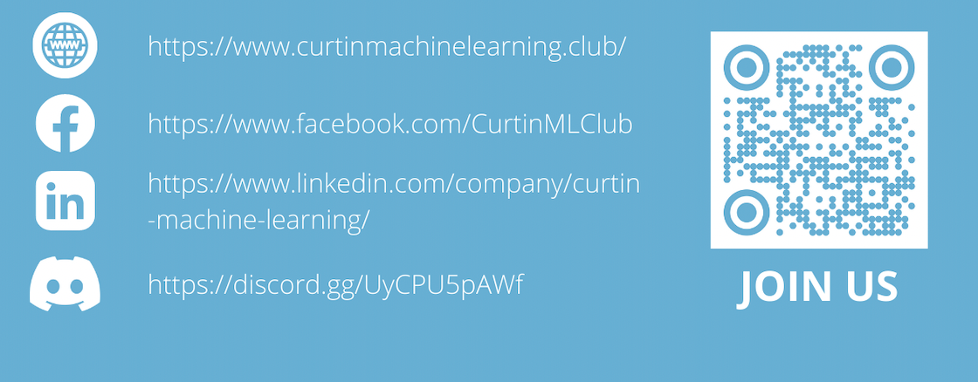
Make sure to signup!
If you haven’t yet signed up you can below.

