Slide 1
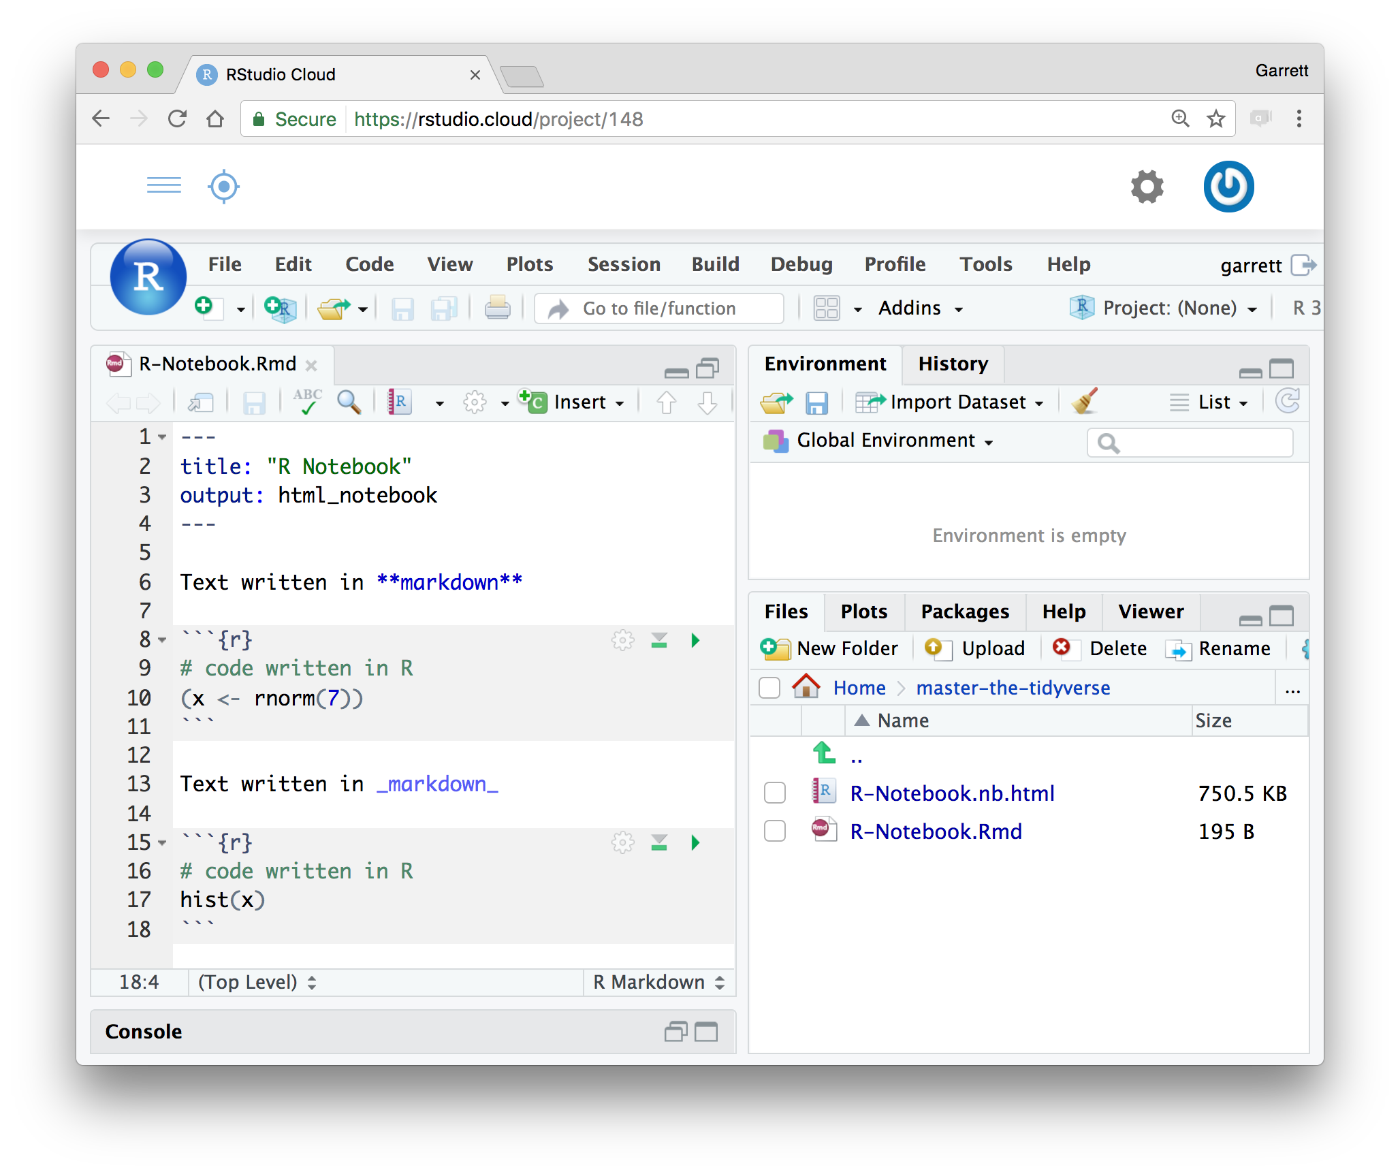
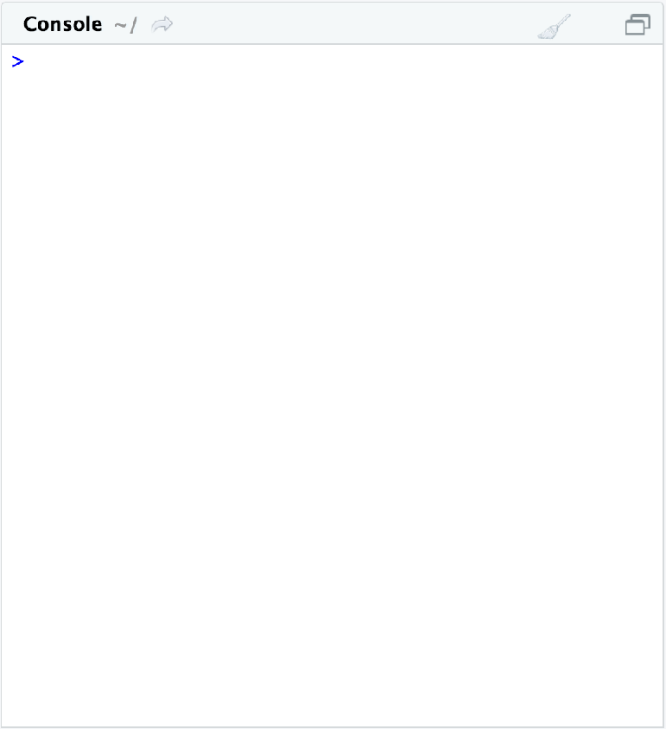
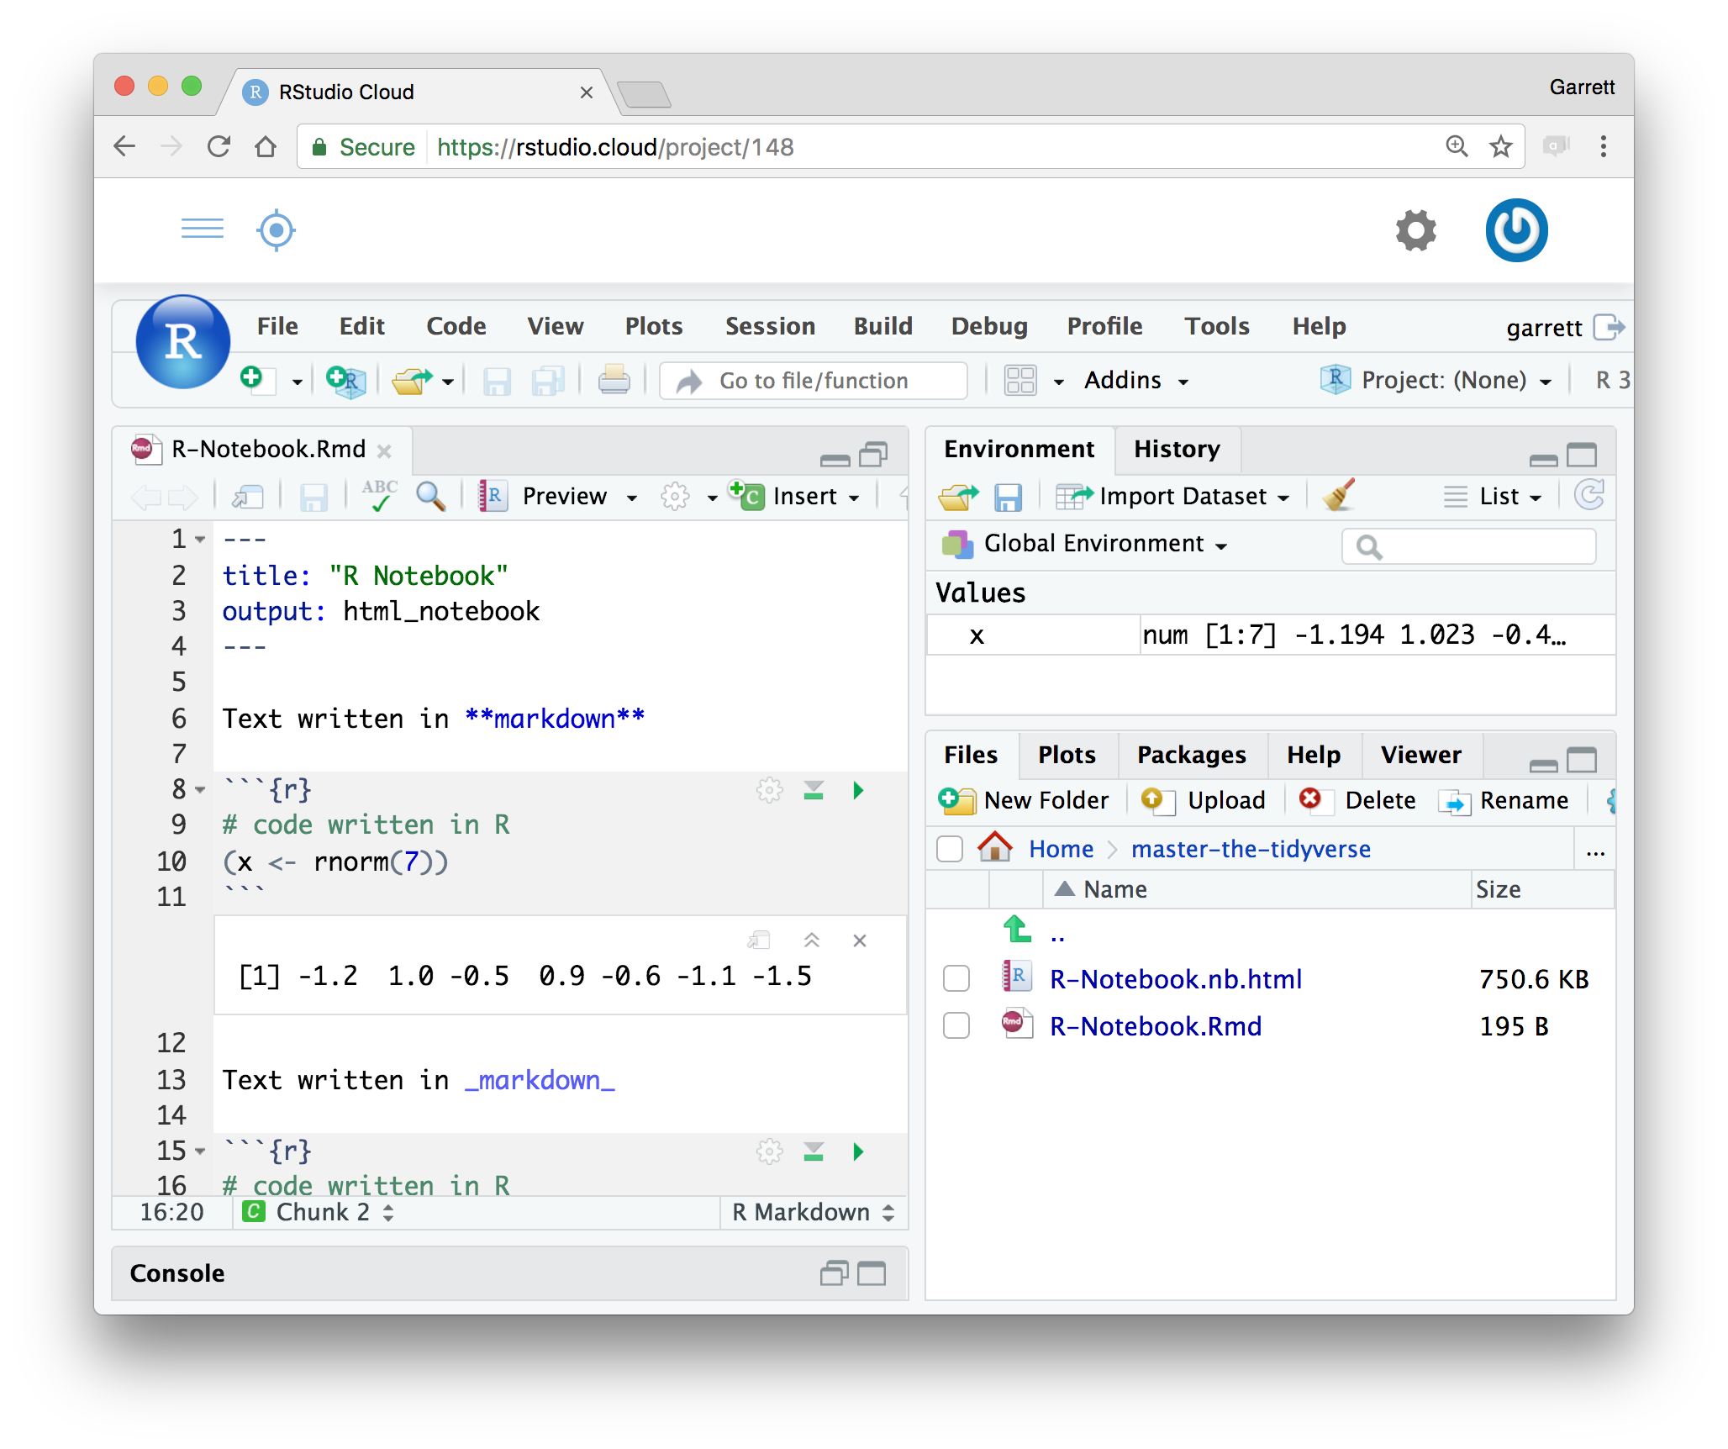
Welcome to Master the Tidyverse
Downloads at github.com/rstudio-education/master-the-tidyverse
Wireless Network: Password:

Slide 2
Welcome to Master the Tidyverse
Downloads at github.com/rstudio-education/master-the-tidyverse
Click on .Rmd file to open notebook
Wireless Network: Password:

Slide 3
Welcome to Master the Tidyverse
Downloads at github.com/rstudio-education/master-the-tidyverse
Click on .Rmd file to open notebook
Wireless Network: Password:

Slide 4
Welcome to Master the Tidyverse
Downloads at github.com/rstudio-education/master-the-tidyverse
Editable notebook
Click on .Rmd file to open notebook
Wireless Network: Password:

Slide 5
Welcome to Master the Tidyverse
Downloads at github.com/rstudio-education/master-the-tidyverse
Editable notebook
Click on .Rmd file to open notebook
Wireless Network: Password:

Slide 6
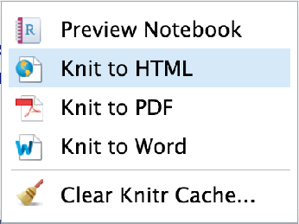
Welcome to Master the Tidyverse
Downloads at github.com/rstudio-education/master-the-tidyverse
Export as
a report
Editable notebook
Click on .Rmd file to open notebook
Wireless Network: Password:

Slide 7
Welcome to Master the Tidyverse
Downloads at github.com/rstudio-education/master-the-tidyverse
Export as
a report
Editable notebook
Click on .Rmd file to open notebook
Wireless Network: Password:

Slide 8
Welcome to Master the Tidyverse
Downloads at github.com/rstudio-education/master-the-tidyverse
Export as
a report
Editable notebook
Click on .Rmd file to open notebook
Wireless Network: Password:

Slide 9
Welcome to Master the Tidyverse
Downloads at github.com/rstudio-education/master-the-tidyverse
Wireless Network: Password:

Slide 10
Welcome to Master the Tidyverse
Downloads at github.com/rstudio-education/master-the-tidyverse
Click to run code in chunk
Wireless Network: Password:

Slide 11
Welcome to Master the Tidyverse
Downloads at github.com/rstudio-education/master-the-tidyverse
Click to run code in chunk
Wireless Network: Password:

Slide 12
Welcome to Master the Tidyverse
Downloads at github.com/rstudio-education/master-the-tidyverse
Click to run all code chunks above
Click to run code in chunk
Wireless Network: Password:

Slide 13
Welcome to Master the Tidyverse
Downloads at github.com/rstudio-education/master-the-tidyverse
Click to run all code chunks above
Click to run code in chunk
Wireless Network: Password:

Slide 14
Welcome to Master the Tidyverse
Collect a login card. Then login to the class server.
Click to run all code chunks above
Click to run code in chunk
Code result
Click on .Rmd file to open notebook
Wireless Network: Password:

Slide 15
Welcome to Master the Tidyverse
Downloads at github.com/rstudio-education/master-the-tidyverse
Click to run all code chunks above
Click to run code in chunk
Code result
Click on .Rmd file to open notebook
Wireless Network: Password:

