Slide 1
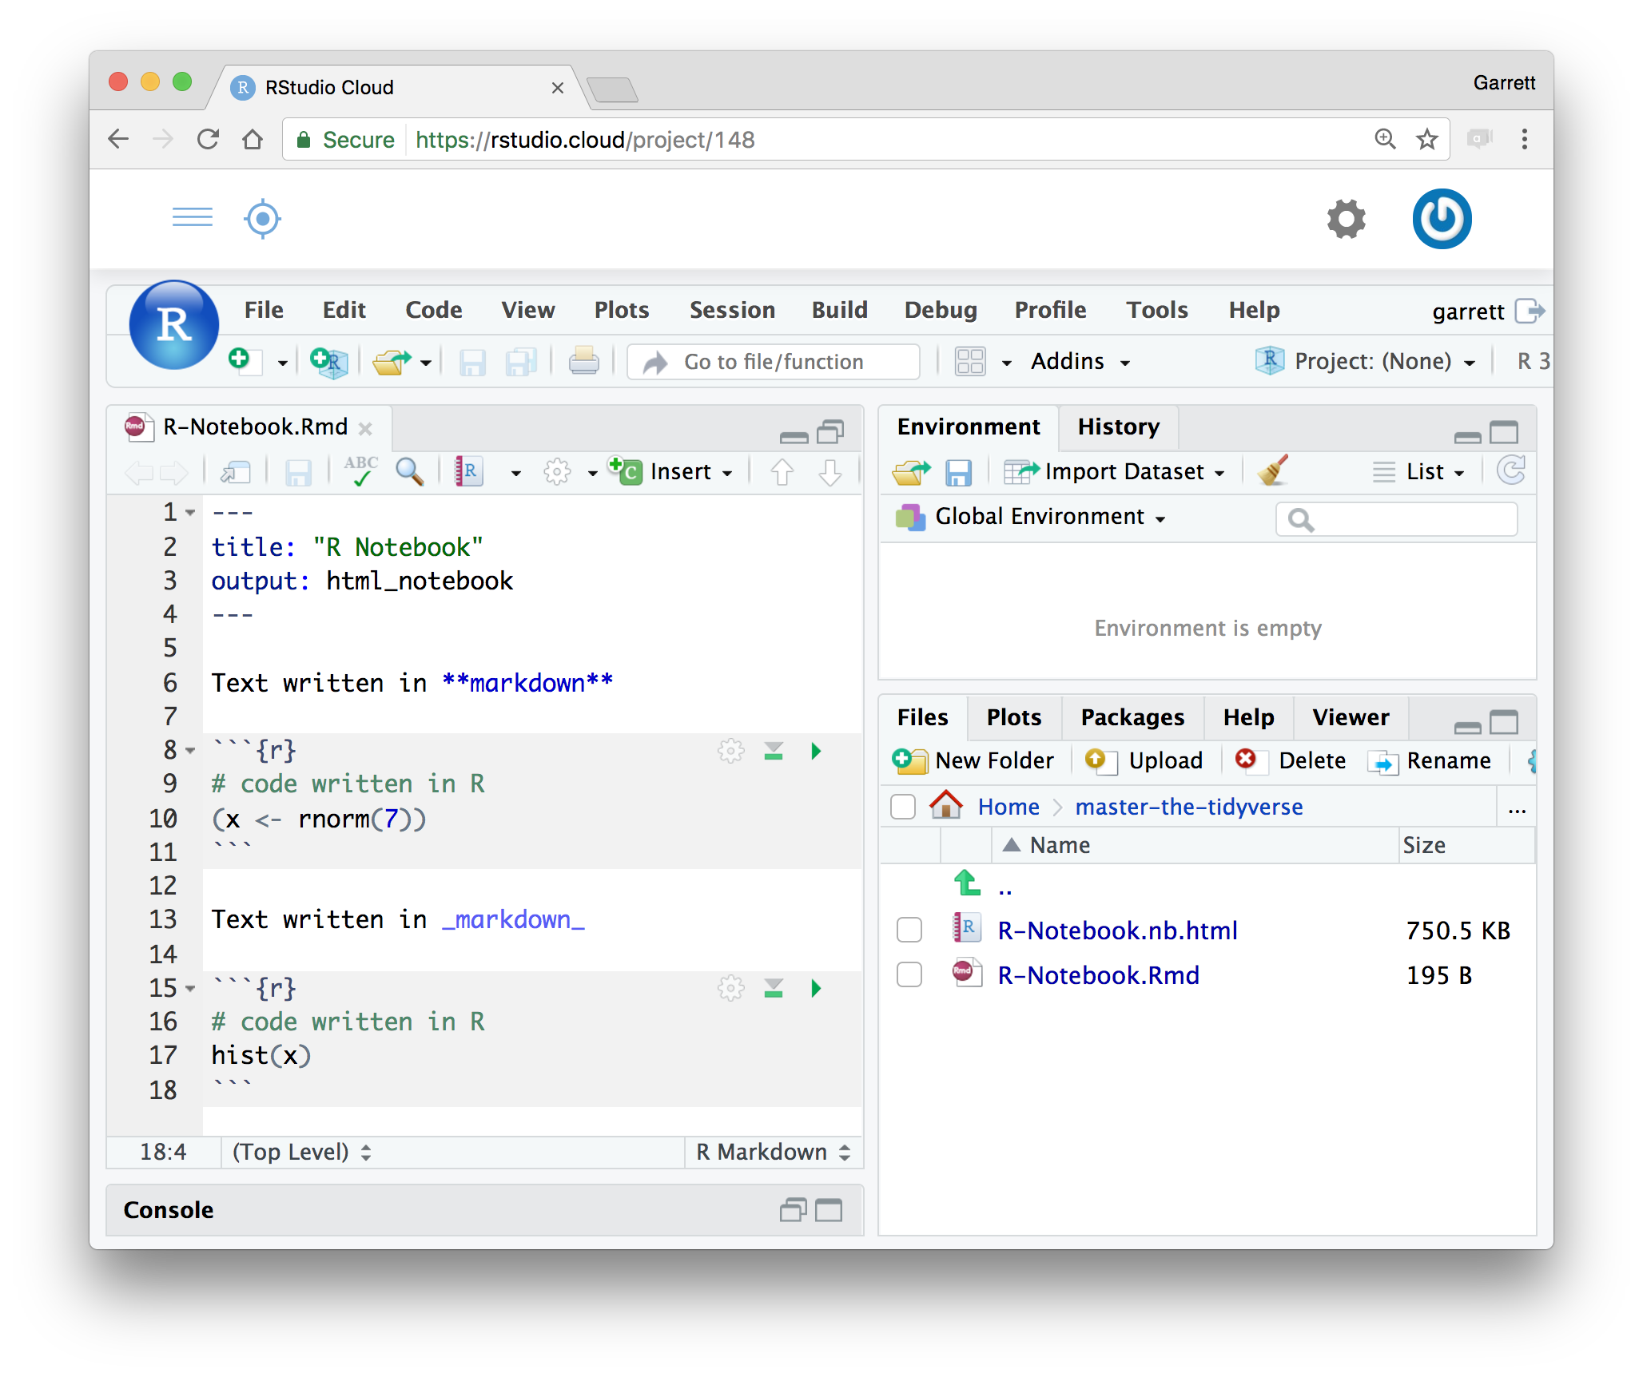
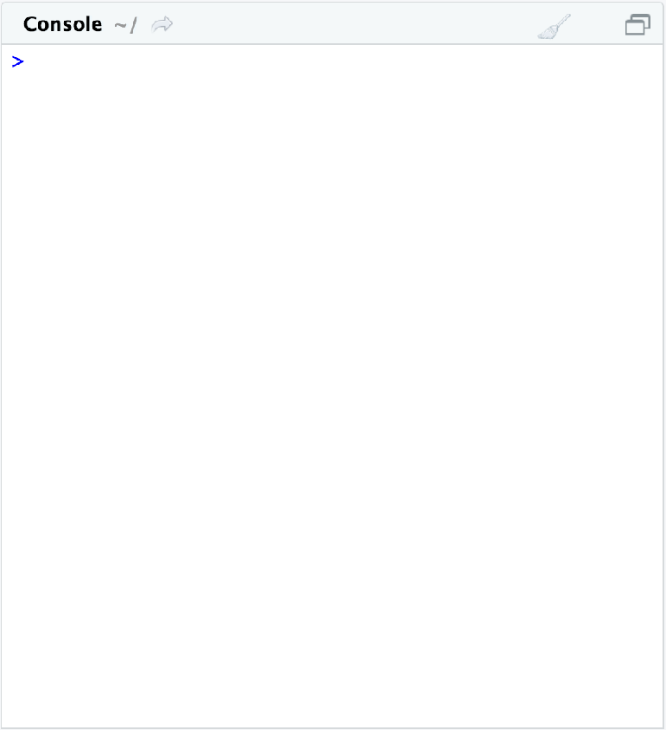
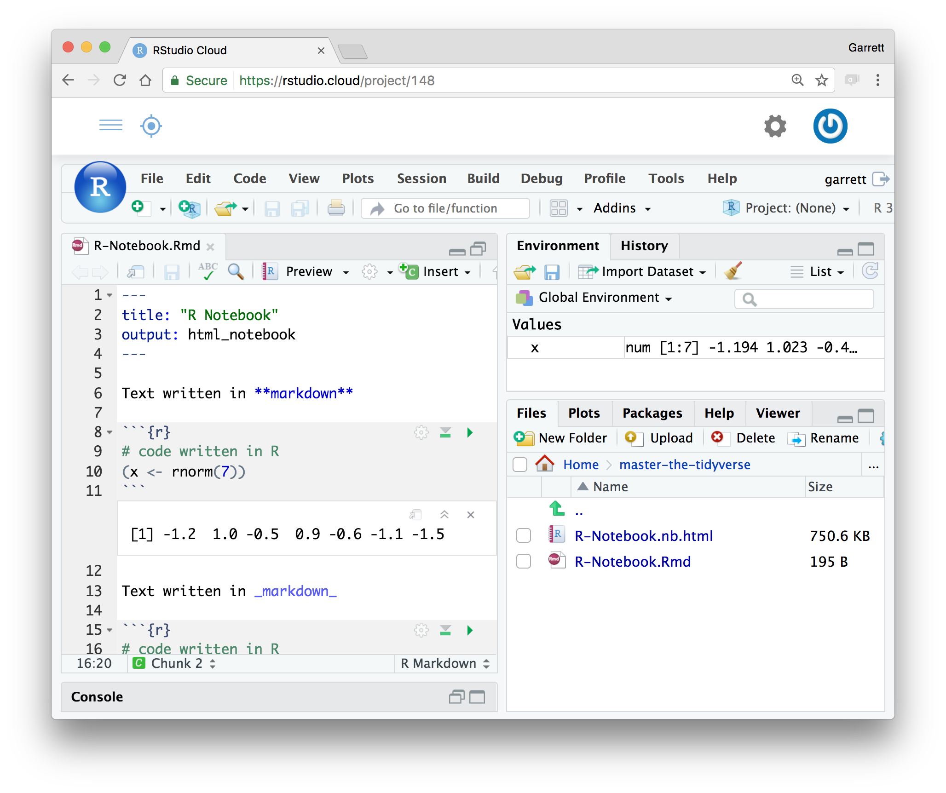
Welcome to Master the Tidyverse
Downloads at github.com/rstudio-education/master-the-tidyverse
Wireless Network: Password:

Slide 2
Welcome to Master the Tidyverse
Downloads at github.com/rstudio-education/master-the-tidyverse
Click on .Rmd file to open notebook
Wireless Network: Password:

Slide 3
Welcome to Master the Tidyverse
Downloads at github.com/rstudio-education/master-the-tidyverse
Editable notebook
Click on .Rmd file to open notebook
Wireless Network: Password:

Slide 4
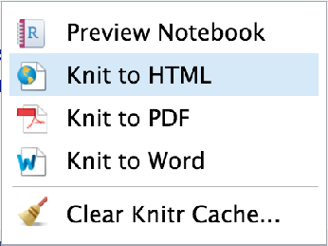
Welcome to Master the Tidyverse
Downloads at github.com/rstudio-education/master-the-tidyverse
Export as
a report
Editable notebook
Click on .Rmd file to open notebook
Wireless Network: Password:

Slide 5
Welcome to Master the Tidyverse
Downloads at github.com/rstudio-education/master-the-tidyverse
Wireless Network: Password:

Slide 6
Welcome to Master the Tidyverse
Downloads at github.com/rstudio-education/master-the-tidyverse
Click to run code in chunk
Wireless Network: Password:

Slide 7
Welcome to Master the Tidyverse
Downloads at github.com/rstudio-education/master-the-tidyverse
Click to run all code chunks above
Click to run code in chunk
Wireless Network: Password:

Slide 8
Welcome to Master the Tidyverse
Collect a login card. Then login to the class server.
Click to run all code chunks above
Click to run code in chunk
Code result
Wireless Network: Password:

