Slide 1
Poster template
IMPORTANT:
This slide has been configured for the screens that will be used to display your poster.
Original template dimensions are 28.584cm x 50.809cm
Do not change these dimensions, otherwise your poster may not display correctly.
Posters must be submitted by Monday 1 July 2019. Send to resbazbris@gmail.com.
Recommended Font Sizes: Title: 60px (min) – 80px (max) Title 60px ,Title 80px Body Text : 22px (min) – 32max (for best effect)
: 18 absolute min – 40 absolute max Text 22px , Text 32px
Please Note:
Solid background colours are recommended, however white should not be used as the brightness of the panel can make it difficult to read when standing in front of it.
To save your poster as an image (PNG or JPG) for display on the Cube:
Click File > Save As
Select JPG or PNG from the dropdown Save as type box
Click Save and select either All Slides or Just This One when prompted
PNG’s are generally better for text and high-detail diagrams
Please keep a copy of your original PowerPoint template as this will allow you to go back and edit your poster again if required

Slide 2

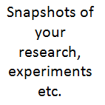
My digital toolbox
My research:
A couple of sentences about your research. This is your ‘elevator pitch’ about your research. Make it interesting! You might like to illustrate it with pictures, visualisations, drawings, etc.
Something about me:
A quirky fact about yourself that may not be widely known.
My favourite tool or resource:
Short explanation of how you use it and why you love it.
I wish I had known:
Share a tip that you would like to share with other researchers that you wish you had known when you started out.
Ask me about:
If you’re happy to share your expertise, or talk about your research, include it here.
Your name
Your current role/status
Your email
Your Twitter handle
Your website, if any

Slide 3

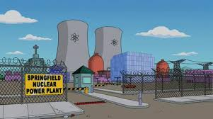
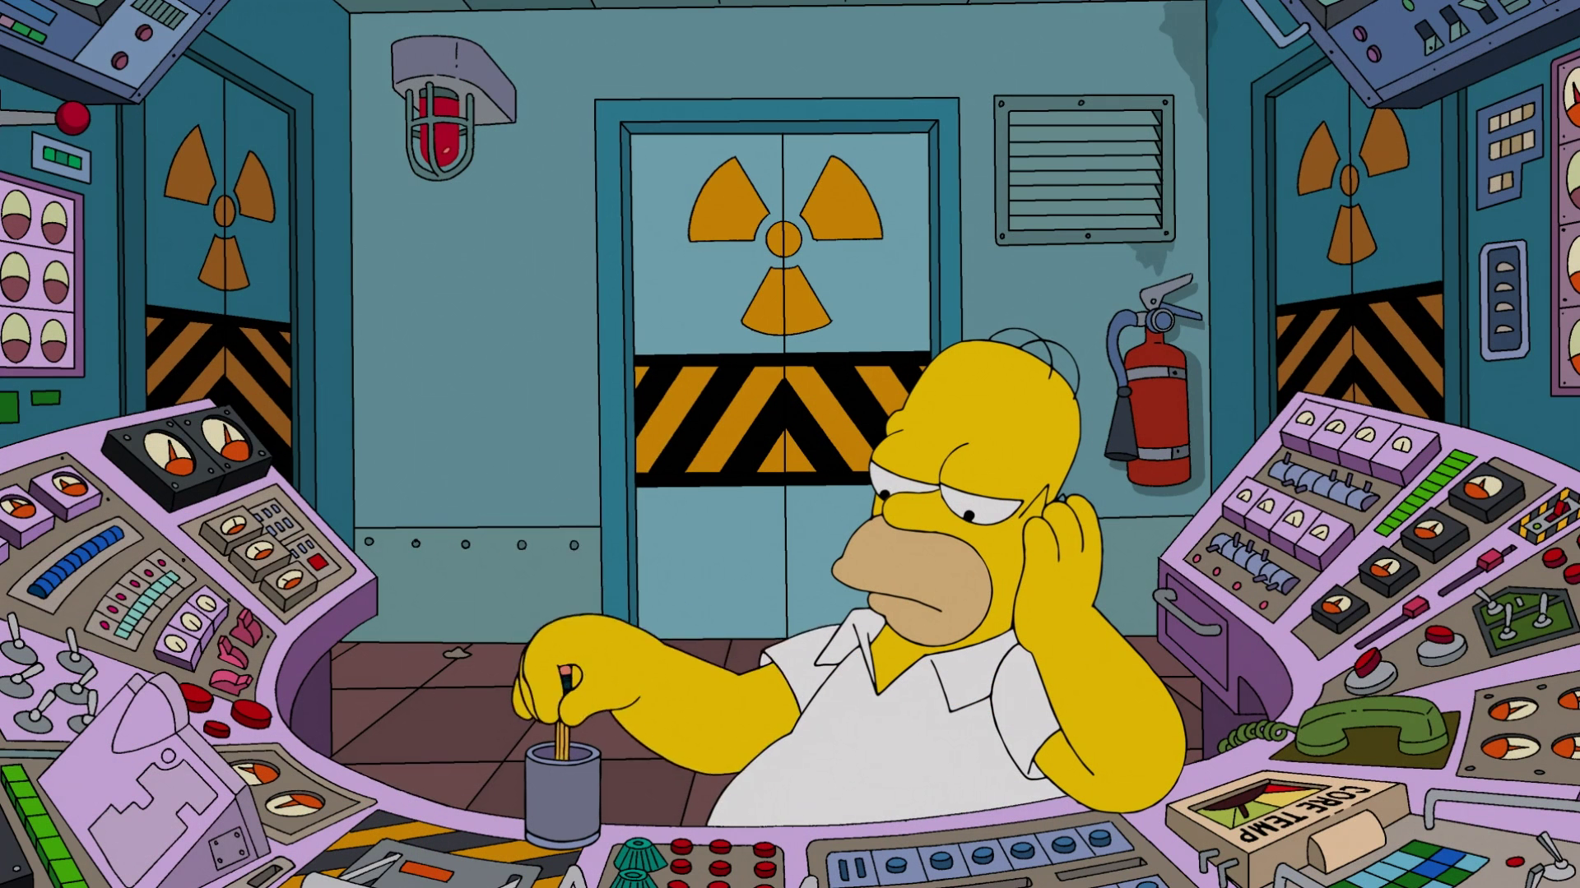

My digital toolbox
Montgomery Burns
CEO, Springfield Nuclear Power Plant
monty@springfieldnuclearpp.org
@montyburns
www.springfieldnuclearpp.org
My research:
I am investigating how I can maximise efficiencies at the Springfield Nuclear Power Plant to increase my personal wealth and power. This involves the development of alternative sustainable energy technologies.
Something about me:
I was ranked by Rolling Stone as the #8 greatest TV villains of all time.
My favourite tool or resource:
I love GitHub. I can share my code with other developers and build upon other researchers’ work. I can also share CC-licensed images of my pet chinchillas with the world.
I wish I had known:
I wish I had known the impact highly refined sugar would have on the productivity of my workforce. Had I known I would have implemented a healthy eating program at the Springfield Nuclear Power Plant.
Ask me about:
I am happy to have a chat about nuclear power, human resources management, or my pet chinchilla collection.

