Slide 1
AI Travel Itinerary Generator
Generative AI + Personalization
CAP 4630 – Intro to Artificial Intelligence
Team: Curtis Williams , Kylie Capes and Mackenzie VanMeter
Notes:
Open with the motivation: simplifying trip planning through personalized AI itineraries.

Slide 2
Objectives
- Create a system that generates personalized travel itineraries
- Incorporate budget awareness and dietary personalization
- Provide structured JSON output for easy integration
Notes:
Briefly describe the problem: travelers want AI help that is truly personalized.

Slide 3
System Overview
- Frontend: Flask web app
- Backend: LangChain + OpenAI LLM
- Core features:
• Destination & interest input
• 3-5 day itinerary generation
• Budget estimator
Notes:
Explain the full-stack design. Flask handles UI, LangChain handles LLM prompts.

Slide 4
Architecture & Methodology
- Data Flow:
1. User Form → Flask
2. Prompt template → LLM
3. JSON Output → Parsed Itinerary
4. Budget module adds cost analysis
- Metrics: response latency, output validity
Notes:
Show the pipeline logic step-by-step. Emphasize prompt structure importance.

Slide 5
Prompt Engineering
System prompt enforces structure, tone, and budget awareness.
User prompt slots include destination, dates, interests, budget, diet, and hotel area.
JSON output reduces parsing overhead and errors.
Notes:
Discuss your prompt design philosophy and improvements from trial runs.

Slide 6
Demo Preview
Input form: destination, budget, party size, dietary preferences.
Output: 3-day itinerary with morning/afternoon/evening structure.
Also includes budget breakdown (lodging, food, activities, transit).
Notes:
Describe your live demo or screenshots of app results.

Slide 7
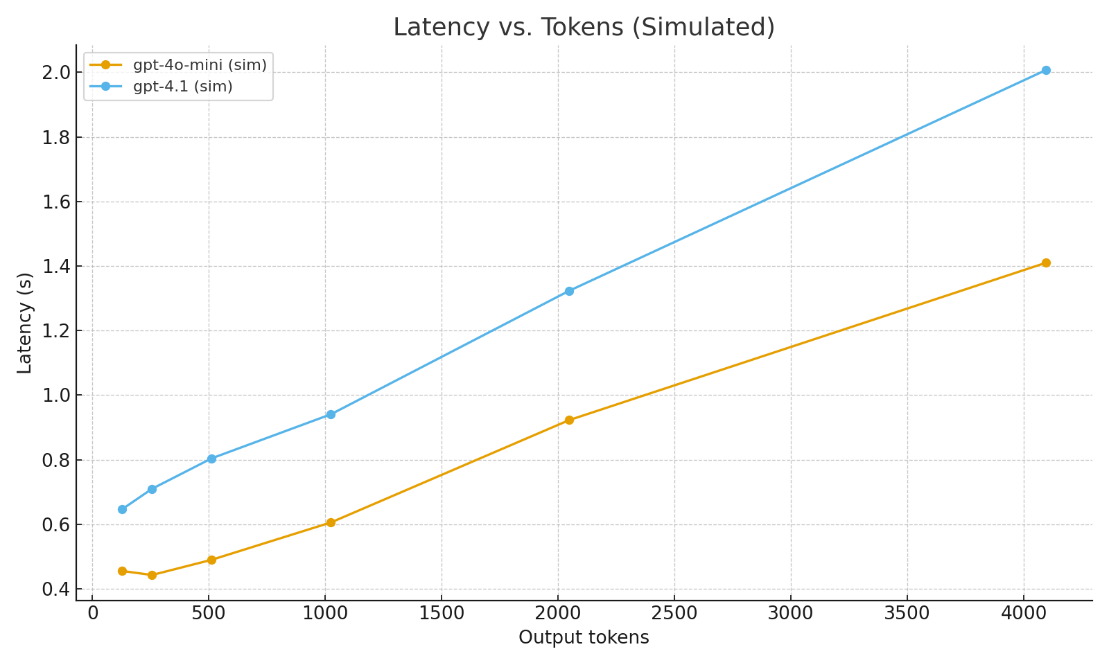
Results – Latency vs Tokens
Notes:
Explain that gpt‑4o‑mini is faster at low token counts, while gpt‑4.1 scales slower but richer responses.

Slide 8
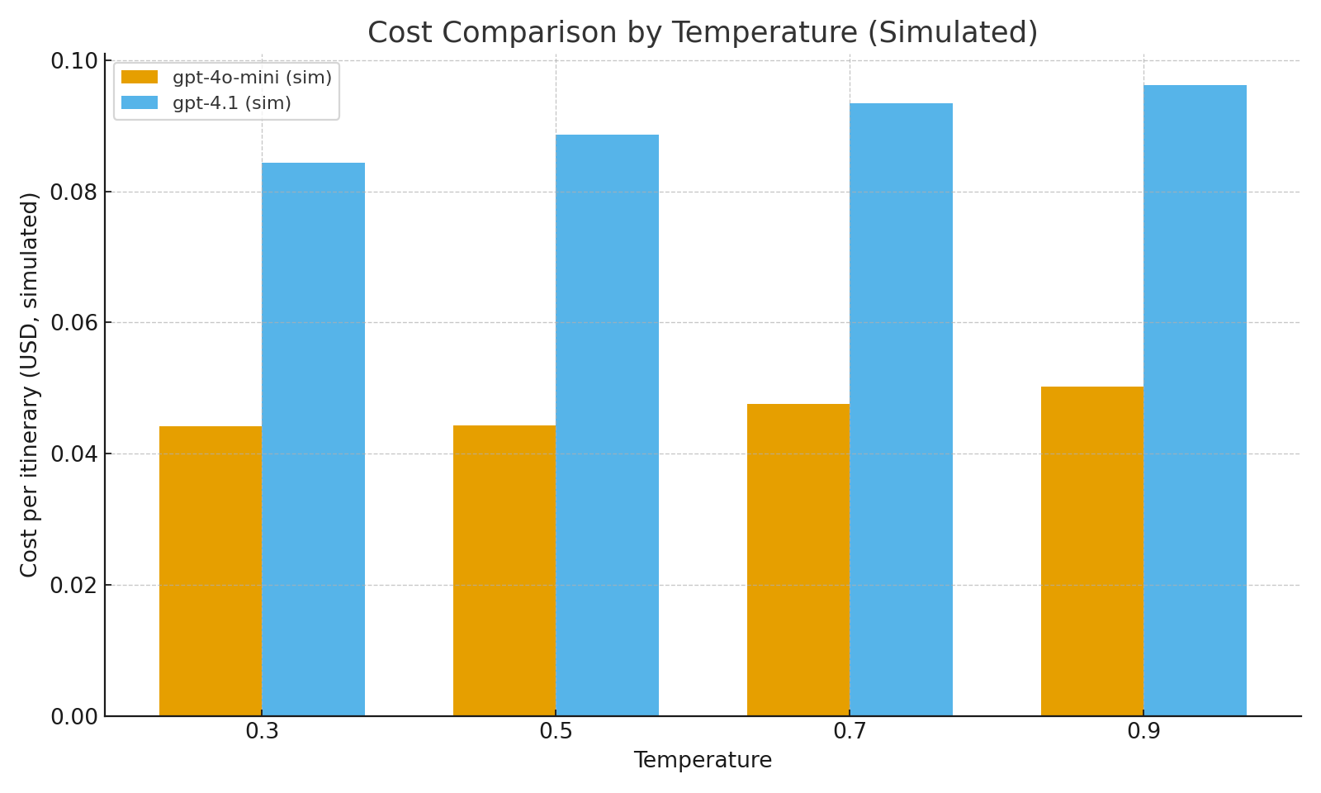
Results – Cost Comparison
Notes:
Compare simulated costs; explain optimal temperature for balance between creativity and cost.

Slide 9
Key Findings
- Structured prompting yields predictable JSON outputs
- Personalization knobs (budget/diet) visibly change itineraries
- LLM‑only system sufficient for MVP (no heavy retrieval)
Notes:
Summarize what worked best and why.

Slide 10
Limitations
- No real‑time data (e.g., closed attractions)
- Occasional hallucinated locations
- Budget is approximate, not sourced
Notes:
Be transparent about constraints; propose retrieval‑augmented enhancement.

Slide 11
Next Steps
- Add POI retrieval and ranking
- Integrate live maps & pricing APIs
- Deploy as mobile‑friendly PWA
Notes:
Future roadmap—align with applied AI best practices.

Slide 12
Conclusion
The AI Travel Itinerary Generator demonstrates how
LLMs + thoughtful prompt engineering can deliver
practical personalization for everyday tasks.
Notes:
End confidently—highlight innovation, scalability, and relevance to AI in daily life.

