Slide 1
Tutorial 3
COMP90014 Algorithm for Bioinformatics
Semester 2, 2025

Slide 2
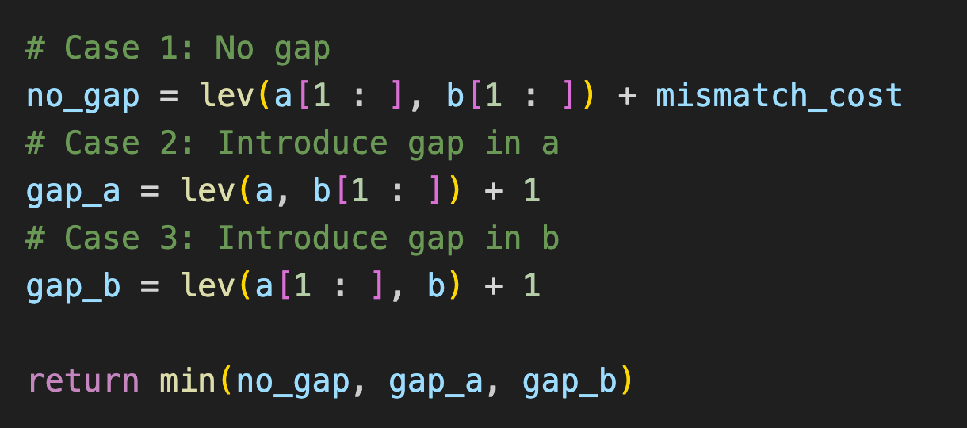
Levenshtein Distance - Recursive
Exponential time complexity

Slide 3
Dynamic Programming
Reuse middle results
O(n²)

