Slide 1
Tutorial 1
COMP90014 Algorithm for Bioinformatics
Semester 2, 2025

Slide 2
About your tutor
Name: Liwen Li
Email: liwen.li.1@unimelb.edu.au
Master of Science (Bioinformatics)

Slide 3
Structure
Setup your computer
Selection Sort
Complexity evaluation
Merge Sort (Extension)

Slide 4

Setting up Environments
Visual Studio Code
Python Virtual Environment
Python Notebook

Slide 5
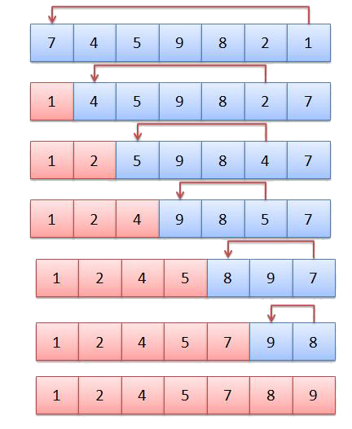
Selection Sort
https://studyalgorithms.com/array/selection-sort/

Slide 6
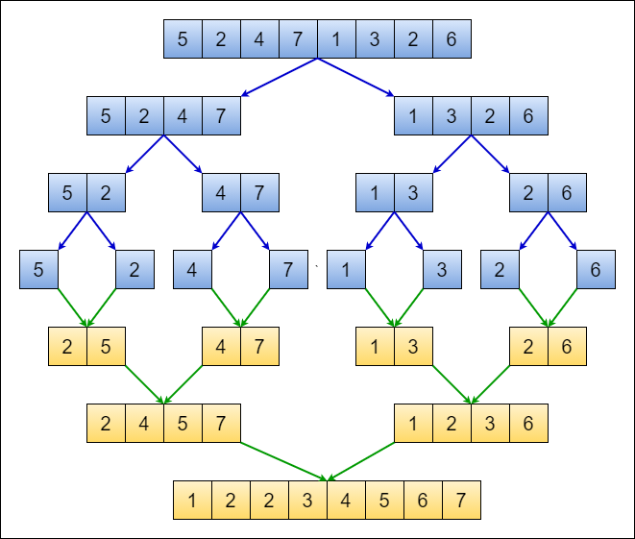
Merge Sort
https://medium.com/javarevisited/visualizing-designing-and-analyzing-the-merge-sort-algorithm-904ceb78a592

Slide 7
Merge
2 | 4 | 5 | 7
1 | 2 | 3 | 6
i
j
1
2
2
3
4
5
6
7
i + j

