Slide 1
Student Attendance Report
Computer Science Capstone
CISP 2980 Spring 2014

Slide 2
Team Three
Bradford Laws
Joshua Fair
Samuel Wells
Steven Smith
Ariel Rowland

Slide 3
Project Specifications
Customer: Dr. Kurt Kominek
Build an application that connects to the network and has both server and client components that record daily attendance

Slide 4
Client
Icon on the desktop
Computer name
Username
Student Name
Computer IP Address
Datestamp
Timestamp
Course Number
Dialog box indicating success or failure
Database | Attendance
Table | student
Column Name | Data Type | Null | Primary/Foreign
DayOfWeek | int(1) | Not null
UserName | varchar(50) | Not null
StuName | int(9) | Not null
PCName | Varchar(50) | Not null
Date | date | Not null
Time | time | Not null
CourseNumber | varchar(50) | Not null

Slide 5
Server
Database that stores attendance
Teacher application
Course Name
Course Number
Room Number
Section
Start Time
End Time
Instructor
Day of the Week
Database | Attendance
Table | courses
Column Name | Data Type | Null | Primary/Foreign
CourseName | int(50) | Not null
CourseNumber | varchar(50) | Not null
RoomNumber | varchar(6) | Not null
Section | varchar(10) | Not null
StartTime | time | Not null
EndTime | time | Not null
Instructor | varchar(50) | Not null
Sunday | tinyint(1)
Monday | tinyint(1)
Tuesday | tinyint(1)
Wednesday | tinyint(1)
Thursday | tinyint(1)
Friday | tinyint(1)
Saturday | tinyint(1)

Slide 6
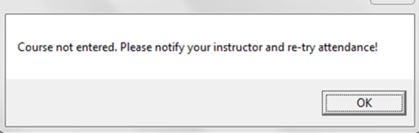
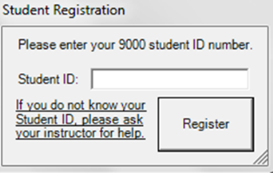
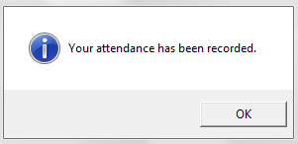
Student User

Slide 7
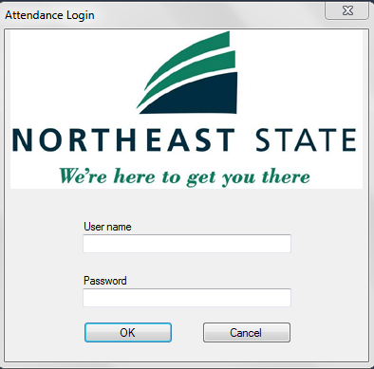
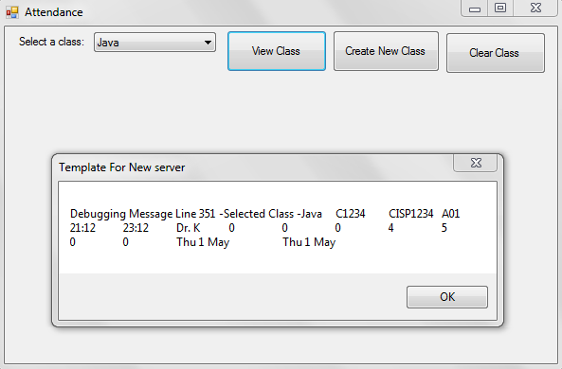
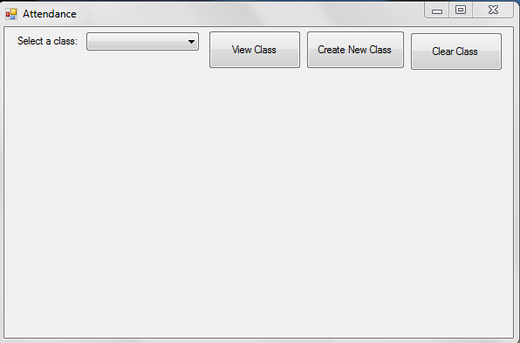
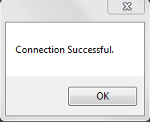
Instructor User

Slide 8
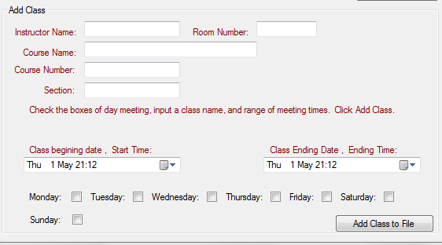
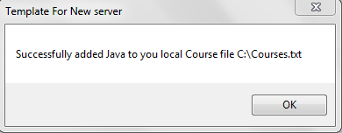
Instructor User Cont.

