Slide 1
Flight Route Planning using Weighted Directed Graph
Curtis Lemke
University of Missouri-Kansas City
4/19/24

Slide 2
Project Introduction
Create a data of airports with distances of flights between them
Using this data, create a graph of directed and weighted edges (Weights are distances in miles)
Account for one-way flights
Implement Dijkstra's algorithm to find shortest flight paths

Slide 3
Problem to solve
Is there an available flight from one airport to another?
Useful to see if you can fly direct without stopping
What’s the shortest flight from one airport to the other?
Used to find the quickest flight from on airport to another
Which airports are hubs?
A HUB is defined as airports with the most outgoing/incoming flights

Slide 4
Methodology
Wrote out what I envisioned the program to do
Inputs and outputs
Options available to the user
Language:
Python
Libraries Used:
Pandas (Used for parsing A CSV file of flight data)
Networkx (Used to create the graph from the pandas dataframe)
matplotlib.pyplot (Visual representation of the graph)
Excel, Visual Studio Code

Slide 5
Data Collection
Originally researched old flight data to gather the airports and distances
Deemed to be too inaccurate and time consuming for this project
Found an open-source dataset on Kaggle
3.5 million flights from 1990 to 2009.
Sampled 200 flights from the data for this project
Initially tried to parse the entire 3.5 million flights, while using Python, ran into long runtimes

Slide 6
Implementation
Step 1: Create an Excel sheet with the 200 flights
Step 2: Convert to a CSV and strip any duplicate
Step 3: Parse the data into a pandas data frame using pandas
Step 4: Convert the data frame into a graph using Networkx
Step 5: Create the dijkstra function to find the shortest flight path
Step 6: Create a function to extract the path returned from the Dijkstra function
Step 7: Create a function to find the airport hubs
Step 8: Create a function to find unreachable airports from a given airport
Step 9: Create user input options for the above functions and print relevant data

Slide 7
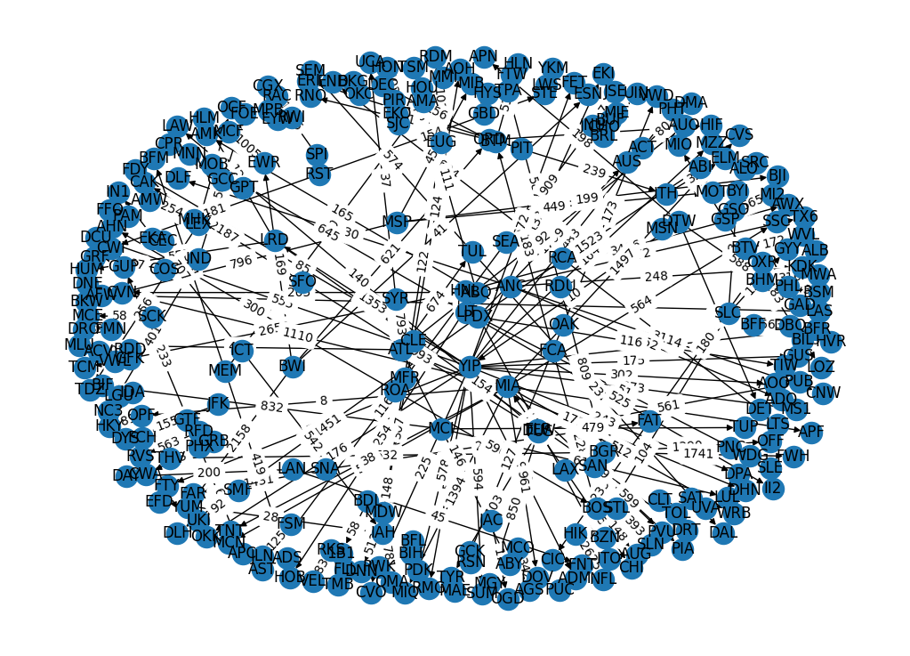
Graph Visualized-All Nodes/Edges

Slide 8
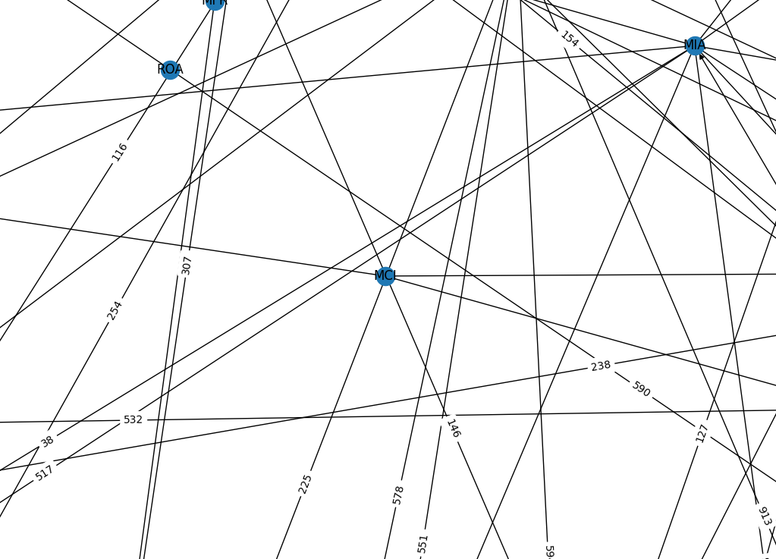
Graph Visualized-MCI Only

Slide 9
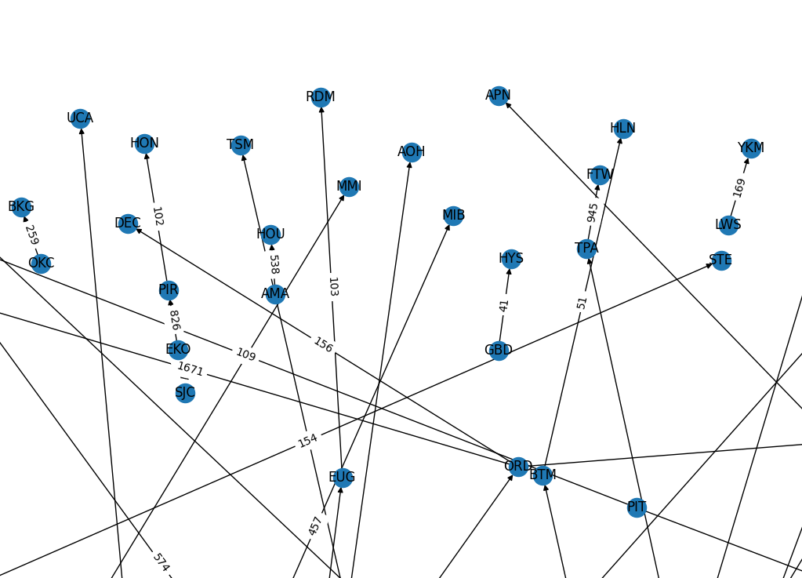
Graph Visualized-Incoming (example)

Slide 10
Discussion
Graph creation is working per objective
The shortest path is returned accurately
Verifying if a path exists to a specific airport returns valid data
Returning the top 5 airport hubs, determined to be a more useful metric
The main limitation is the data set size (200 flights)
Most airports return no flights available due to only having incoming or only having outgoing flights

Slide 11
Conclusion
Overall, the project was successful
The graph and data make parsing the flight much easier than using Excel or manually searching

Slide 12
Future Work
Increase data set size to around 100,000
This will require optimizing how the data is parsed into the data frame
Implement a GUI to make interacting with the program easier
Export the graph as an interactive graph instead of a PNG file
More robust error handling

Slide 13
Questions & Comments?

Slide 14
References
Data Set
https://www.kaggle.com/datasets/flashgordon/usa-airport-dataset?resource=download
MatPlotLIB (Graph Visualization)
https://matplotlib.org/

Slide 15
Thank You!

