Slide 1

CurveScope
Meteora DBC pool intelligence
Inspect live curve state without connecting a wallet.
Crypto World’s Fair 2026 / Meteora Dynamic Bonding Curve
Notes:
Product: https://curvescope-orbit-2026.navy-coin-0045.chatgpt.site/
Source: https://github.com/CurveScope/curvescope
Artwork generated for CurveScope.

Slide 2
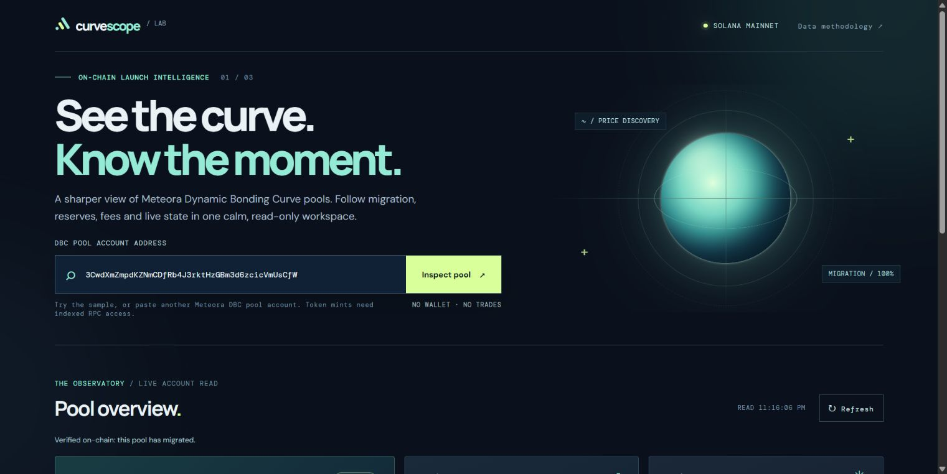
One pool, one clear view
Live prototype using a real Solana DBC pool account
Migration progress
Reserves and fees
Historical curve price
Export observed state as JSON
The screenshot shows the shipped interface, not a design mockup.
Notes:
Live prototype: https://curvescope-orbit-2026.navy-coin-0045.chatgpt.site/
Source and run instructions: https://github.com/CurveScope/curvescope
The sample pool is migrated, so its displayed DBC curve price is historical rather than current market price.

Slide 3
What works today
Public pool account read
Read-only by design
Meteora’s official DBC SDK decodes live on-chain state through a public Solana RPC.
No wallet connection, transaction signing, custody, or trading. Invalid addresses return a clear error.
Next work
Indexed token discovery and historical pool snapshots, followed by alerts for meaningful pool changes.
Demo: curvescope-orbit-2026.navy-coin-0045.chatgpt.site Code: github.com/CurveScope/curvescope
Notes:
Implementation evidence and limitations: https://github.com/CurveScope/curvescope
Meteora DBC developer documentation: https://docs.meteora.ag/developer-guides/dbc
PublicNode RPC: https://solana-rpc.publicnode.com/
Roadmap items on this slide are proposals, not completed features.

