Slide 1
Substrate 区块链应用开发
孙凯超
kaichao@parity.io
获取帮助: https://substrate.io
Runtime 宏介绍

Slide 2
内容
Rust 宏
Runtime 常用的宏
cargo expand
其它宏

Slide 3
Rust 宏
宏（Macro）是一种元编程的方式，常见的还有Java里的反射，Rust提供了两种宏：
声明宏
过程宏
https://doc.rust-lang.org/book/ch19-06-macros.html
Notes:
HW:
Substrate provides you with everything you need
to run a blockchain out of the box.
A database layer, networking layer, consensus engine, transaction queue, and libraries of runtime modules
But if you need to, you can choose to customize
Each of these components for your specific needs

Slide 4
Substrate 为什么使用宏
为了简化 Runtime 的开发，Substrate 使用宏建立了一套 DSL (Domain Specific Language)，设计合理的DSL可以：
很好的被用户理解
代码更加简洁，提升效率
解放应用开发者，只需实现业务组件
数据库
点对点网络
密码学
WASM 执行环境
……
Notes:
HW:
Substrate provides you with everything you need
to run a blockchain out of the box.
A database layer, networking layer, consensus engine, transaction queue, and libraries of runtime modules
But if you need to, you can choose to customize
Each of these components for your specific needs

Slide 5
Substrate Runtime 定义
交易
&
Runtime
逻辑
State A
State B

Slide 6
Substrate Runtime 定义
Substrate Module
assets | babe | balances | collective
contract | democracy | elections | grandpa
indices | grandpa | identity | membership
offences | session | staking | sudo
system | timestamp | treasury | and more...
内置的模块也称为
pallet (调色板)

Slide 7
Runtime 模块的组成
使用Substratet进行 Runtime 模块开发的过程中，常用到的宏有：
frame_support::pallet 定义功能模块
pallet::config 定义配置接口
pallet::storage 存储单元
pallet::event 事件
pallet::error 错误信息
pallet::call 包含可调用函数
pallet::hooks 区块不同时期的执行逻辑
construct_runtime 添加模块到 Runtime

Slide 8
storage 宏
不管是 web2.0 传统的互联网应用，还是采用区块链技术的 web3.0 应用，关键数据都需要存起来。
storage 宏，就是用来定义 runtime 模块的存储单元。
Notes:
HW:
Substrate provides you with everything you need
to run a blockchain out of the box.
A database layer, networking layer, consensus engine, transaction queue, and libraries of runtime modules
But if you need to, you can choose to customize
Each of these components for your specific needs

Slide 9
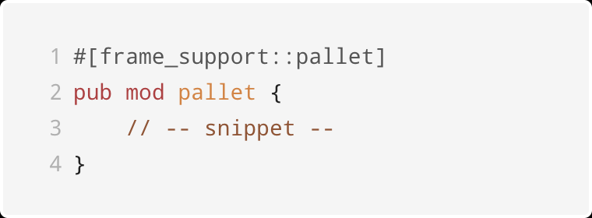
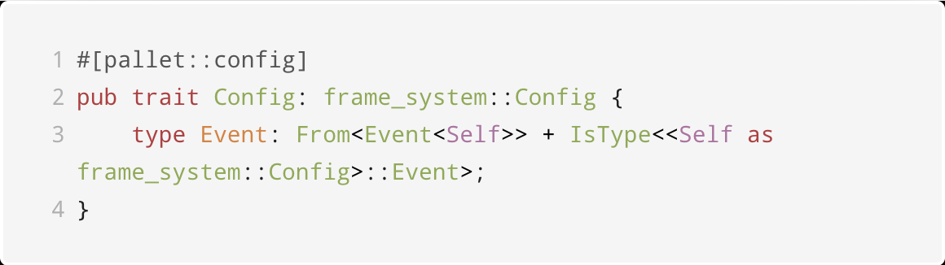
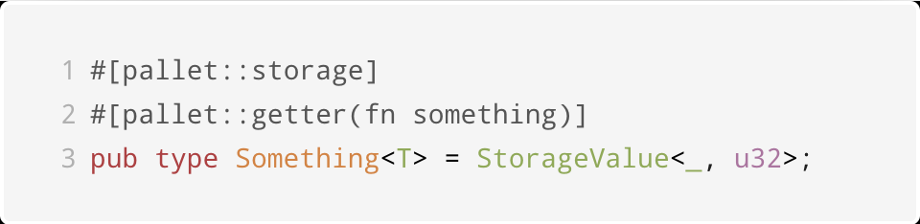
storage 宏举例
Notes:
HW:
Substrate provides you with everything you need
to run a blockchain out of the box.
A database layer, networking layer, consensus engine, transaction queue, and libraries of runtime modules
But if you need to, you can choose to customize
Each of these components for your specific needs

Slide 10
storage 宏举例
数据类型：
单值 StorageValue
映射 StorageMap
双键映射 StorageDoubleMap
多键映射 StorageNMap
https://docs.substrate.io/v3/runtime/storage/
Notes:
HW:
Substrate provides you with everything you need
to run a blockchain out of the box.
A database layer, networking layer, consensus engine, transaction queue, and libraries of runtime modules
But if you need to, you can choose to customize
Each of these components for your specific needs

Slide 11
call 宏
区块链的链上状态变化由交易触发，Substrate 不仅支持自定义的存储数据结构，还支持自定义的交易，例如转账、注册身份、投票等等，也叫做 extrinsic 外部交易。
call 用来定义模块里可调用函数，每一个外部交易都会触发一个可调用函数，并根据交易体信息也就是函数参数，更新链上状态。
Notes:
HW:
Substrate provides you with everything you need
to run a blockchain out of the box.
A database layer, networking layer, consensus engine, transaction queue, and libraries of runtime modules
But if you need to, you can choose to customize
Each of these components for your specific needs

Slide 12
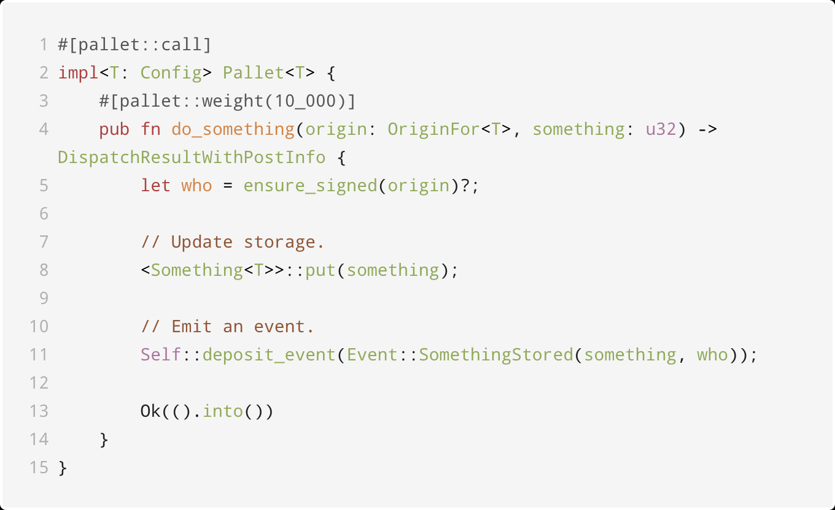
call 宏举例
Notes:
HW:
Substrate provides you with everything you need
to run a blockchain out of the box.
A database layer, networking layer, consensus engine, transaction queue, and libraries of runtime modules
But if you need to, you can choose to customize
Each of these components for your specific needs

Slide 13
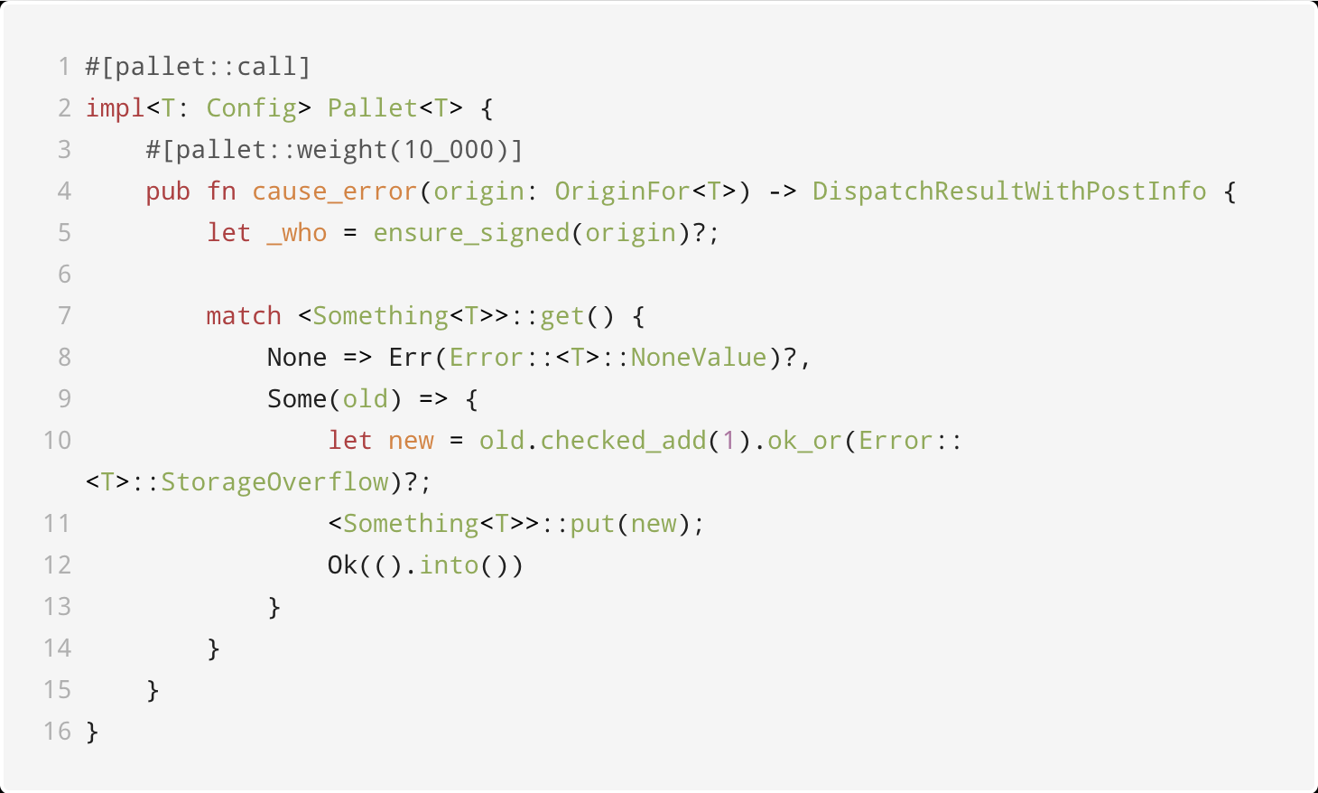
call 宏举例
Notes:
HW:
Substrate provides you with everything you need
to run a blockchain out of the box.
A database layer, networking layer, consensus engine, transaction queue, and libraries of runtime modules
But if you need to, you can choose to customize
Each of these components for your specific needs

Slide 14
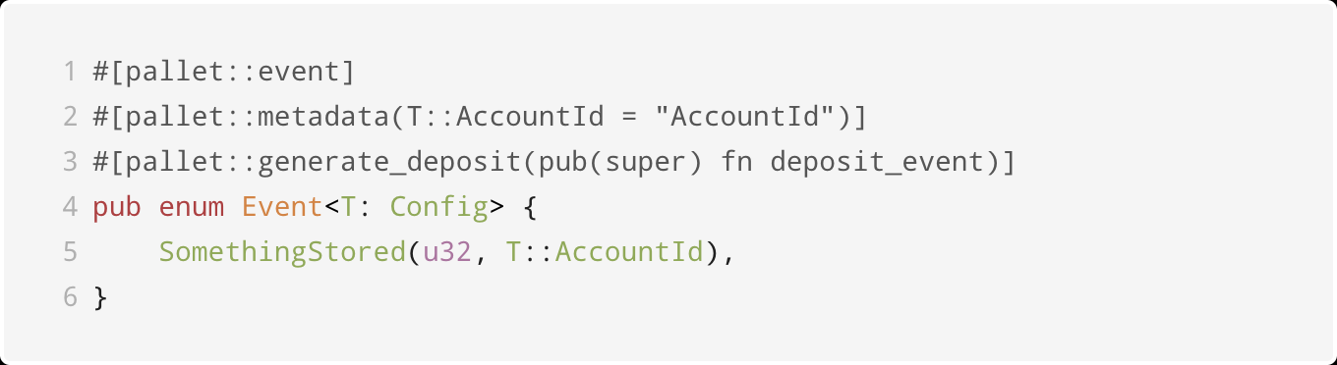
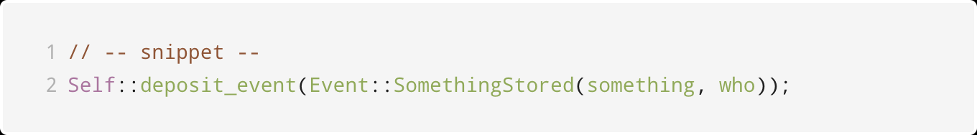
event 宏
区块链是一个异步系统，runtime 通过触发事件通知交易执行结果。
Notes:
HW:
Substrate provides you with everything you need
to run a blockchain out of the box.
A database layer, networking layer, consensus engine, transaction queue, and libraries of runtime modules
But if you need to, you can choose to customize
Each of these components for your specific needs

Slide 15
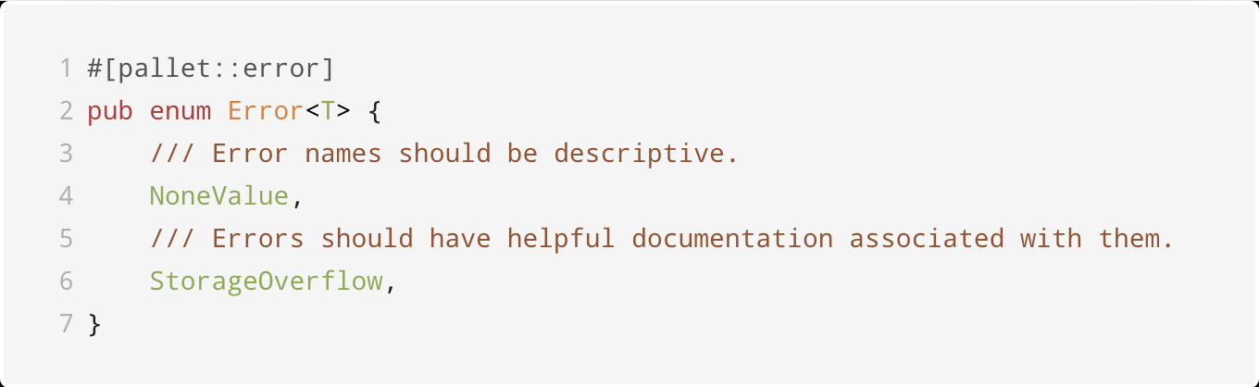
error 宏
当可调用函数执行过程发生错误时，通过error信息通知客户端。
Notes:
HW:
Substrate provides you with everything you need
to run a blockchain out of the box.
A database layer, networking layer, consensus engine, transaction queue, and libraries of runtime modules
But if you need to, you can choose to customize
Each of these components for your specific needs

Slide 16
error 宏
可调用函数里的错误类型，
不能给它们添加数据；
通过 metadata 暴露给客户端；
错误发生时触发system.ExtrinsicFailed 事件，包含了对应错误的索引信息。
Notes:
HW:
Substrate provides you with everything you need
to run a blockchain out of the box.
A database layer, networking layer, consensus engine, transaction queue, and libraries of runtime modules
But if you need to, you can choose to customize
Each of these components for your specific needs

Slide 17
hooks 宏
Runtime 模块里存在保留函数，用于执行特定的逻辑：
on_initialize，在每个区块的开头执行；
on_finalize，在每个区块结束时执行；
offchain_worker：开头且是链外执行，不占用链上的资源；
on_runtime_upgrade：当有 runtime 升级时才会执行，用来迁移数据。

Slide 18
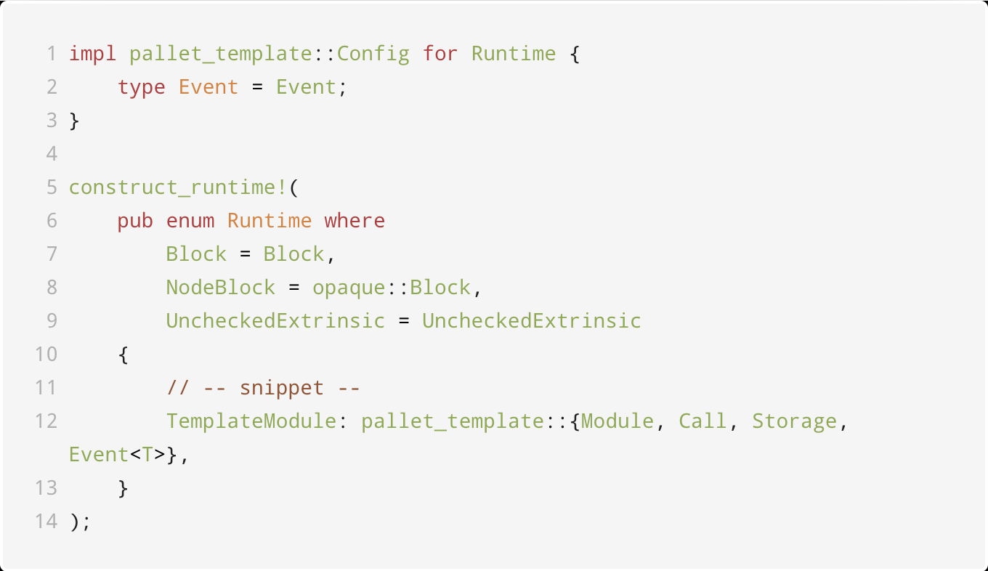
construct_runtime 加载模块
Notes:
HW:
Substrate provides you with everything you need
to run a blockchain out of the box.
A database layer, networking layer, consensus engine, transaction queue, and libraries of runtime modules
But if you need to, you can choose to customize
Each of these components for your specific needs

Slide 19
资料
cargo expand 将宏里的代码展开，得到 Rust 的标准语法，
https://github.com/dtolnay/cargo-expand
https://github.com/kaichaosun/play-substrate/blob/master/pallets/template/expanded.rs
pallet 属性宏参考文档，
https://crates.parity.io/frame_support/attr.pallet.html
Notes:
HW:
Substrate provides you with everything you need
to run a blockchain out of the box.
A database layer, networking layer, consensus engine, transaction queue, and libraries of runtime modules
But if you need to, you can choose to customize
Each of these components for your specific needs

Slide 20
其它宏
decl_runtime_apis & impl_runtime_apis，定义runtime api：
https://substrate.dev/recipes/runtime-api.html
https://crates.parity.io/sp_api/macro.decl_runtime_apis.html
https://crates.parity.io/sp_api/macro.impl_runtime_apis.html
runtime_interface，定义在 runtime 里可以调用的 Host 提供的函数：
https://crates.parity.io/sp_runtime_interface/attr.runtime_interface.html
Notes:
HW:
Substrate provides you with everything you need
to run a blockchain out of the box.
A database layer, networking layer, consensus engine, transaction queue, and libraries of runtime modules
But if you need to, you can choose to customize
Each of these components for your specific needs

Slide 21
多实例模块
Substrate 的模块在 runtime 里可以有多个实例，例如，可以添加多个内置的 collective 模块实例，分别用来表示理事会和技术委员会，来实现复杂的治理模型。
Notes:
HW:
Substrate provides you with everything you need
to run a blockchain out of the box.
A database layer, networking layer, consensus engine, transaction queue, and libraries of runtime modules
But if you need to, you can choose to customize
Each of these components for your specific needs

Slide 22
多实例模块 - 例子
pub trait Trait<I: Instance = DefaultInstance>: frame_system::Trait {
type Event: From<Event<Self, I>> + Into<<Self as frame_system::Trait>::Event>;
}
decl_storage! {
trait Store for Module<T: Trait<I>, I: Instance=DefaultInstance> as Collective {
// -- snip --
}
}
Notes:
HW:
Substrate provides you with everything you need
to run a blockchain out of the box.
A database layer, networking layer, consensus engine, transaction queue, and libraries of runtime modules
But if you need to, you can choose to customize
Each of these components for your specific needs

Slide 23
多实例模块 - 例子
decl_module! {
pub struct Module<T: Trait<I>, I: Instance = DefaultInstance> for enum Call where origin: T::Origin {
// -- snip --
}
Notes:
HW:
Substrate provides you with everything you need
to run a blockchain out of the box.
A database layer, networking layer, consensus engine, transaction queue, and libraries of runtime modules
But if you need to, you can choose to customize
Each of these components for your specific needs

Slide 24
多实例模块 - 例子
decl_event!(
pub enum Event<T, I: Instance = DefaultInstance> where
<T as frame_system::Trait>::AccountId,
{
// -- snip --
}
);
decl_error! {
pub enum Error for Module<T: Trait<I>, I: Instance> {
// -- snip --
}
}
Notes:
HW:
Substrate provides you with everything you need
to run a blockchain out of the box.
A database layer, networking layer, consensus engine, transaction queue, and libraries of runtime modules
But if you need to, you can choose to customize
Each of these components for your specific needs

Slide 25
多实例模块 - 例子
type CouncilCollective = pallet_collective::Instance1;
impl pallet_collective::Trait<CouncilCollective> for Runtime {
// -- snip --
}
construct_runtime!(
pub enum Runtime where
Block = Block,
NodeBlock = node_primitives::Block,
UncheckedExtrinsic = UncheckedExtrinsic
{
Council: pallet_collective::<Instance1>::{Module, Call, Storage, Origin<T>, Event<T>, Config<T>},
}
);
Notes:
HW:
Substrate provides you with everything you need
to run a blockchain out of the box.
A database layer, networking layer, consensus engine, transaction queue, and libraries of runtime modules
But if you need to, you can choose to customize
Each of these components for your specific needs

Slide 26
Questions?
官网文档：substrate.io 知乎专栏：parity.link/zhihu
kaichao@parity.io
https://parity.link/asia-support

Slide 27
Substrate 区块链应用开发
孙凯超
kaichao@parity.io
获取帮助: https://substrate.io
Runtime 数据存储的设计

Slide 28
内容
区块链存储的不同点和约束
Substrate 存储单元的类型
存储的初始化
最佳实践

Slide 29
区块链存储的不同点
区块链应用通常几个特点，
开源可审查，对等节点，引入延迟和随机来达到共识
链式、增量地存储数据
区块链应用的节点软件依赖高效的键值对数据库：
LevelDB
RocksDB
Notes:
HW:
Substrate provides you with everything you need
to run a blockchain out of the box.
A database layer, networking layer, consensus engine, transaction queue, and libraries of runtime modules
But if you need to, you can choose to customize
Each of these components for your specific needs

Slide 30
区块链存储的约束
区块链作为业务的载体，存储相关的限制有：
大文件直接存储在链上的成本很高；
链式的区块存储结构不利于对历史数据的索引；
另外一个约束是，在进行数值运算时不能使用浮点数。
Notes:
HW:
Substrate provides you with everything you need
to run a blockchain out of the box.
A database layer, networking layer, consensus engine, transaction queue, and libraries of runtime modules
But if you need to, you can choose to customize
Each of these components for your specific needs

Slide 31
Substrate 存储单元的类型
开发链上存储单元的特点：
Rust原生数据类型的子集，定义在核心库和alloc库中
原生类型构成的映射类型
满足一定的编解码条件
单值
简单映射
双键映射
Notes:
HW:
Substrate provides you with everything you need
to run a blockchain out of the box.
A database layer, networking layer, consensus engine, transaction queue, and libraries of runtime modules
But if you need to, you can choose to customize
Each of these components for your specific needs

Slide 32
回顾 storage 宏
Notes:
HW:
Substrate provides you with everything you need
to run a blockchain out of the box.
A database layer, networking layer, consensus engine, transaction queue, and libraries of runtime modules
But if you need to, you can choose to customize
Each of these components for your specific needs

Slide 33
单值类型
存储某种单一类型的值，如布尔，数值，枚举，结构体等：
数值：u8,i8,u32,i32,u64,i64,u128,i128
大整数：U128,U256,U512
布尔：bool
集合：Vec<T>, BTreeMap, BTreeSet
定点小数：Percent,Permill,Perbill,FixedU128
定长哈希：H128,H256,H512
其它复杂类型：Option<T>,tuple,enum,struct
内置自定义类型：Moment,AccountId
Notes:
HW:
Substrate provides you with everything you need
to run a blockchain out of the box.
A database layer, networking layer, consensus engine, transaction queue, and libraries of runtime modules
But if you need to, you can choose to customize
Each of these components for your specific needs

Slide 34
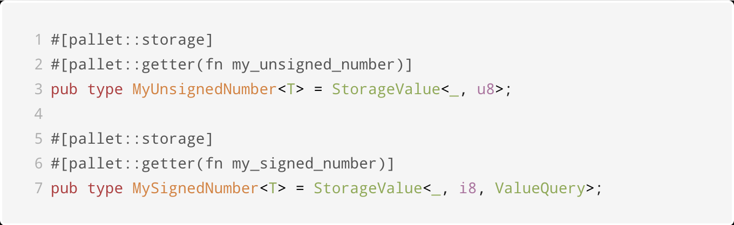
单值类型
数值类型 u8 的定义：
Notes:
HW:
Substrate provides you with everything you need
to run a blockchain out of the box.
A database layer, networking layer, consensus engine, transaction queue, and libraries of runtime modules
But if you need to, you can choose to customize
Each of these components for your specific needs

Slide 35
单值类型
数值类型 u8,i8,u32,i32,u64,i64,u128,i128 的使用：
增：MyUnsignedNumber::<T>::put(number);
查：MyUnsignedNumber::<T>::get();
改：MyUnsignedNumber::<T>::mutate(|v| v + 1);
删：MyUnsignedNumber::<T>::kill();
更多API，请参考文档 https://crates.parity.io/frame_support/pallet_prelude/struct.StorageValue.html
Notes:
HW:
Substrate provides you with everything you need
to run a blockchain out of the box.
A database layer, networking layer, consensus engine, transaction queue, and libraries of runtime modules
But if you need to, you can choose to customize
Each of these components for your specific needs

Slide 36
单值类型
数值类型 u8,i8,u32,i32,u64,i64,u128,i128 的安全操作：
返回Result类型：checked_add, checked_sub, checked_mul, checked_div
// fail the transaction if error
my_unsigned_num.checked_add(10)?;
溢出返回饱和值：saturating_add,saturating_sub,saturating_mul
// result is 255 for u8
my_unsigned_num.saturating_add(10000);
Notes:
HW:
Substrate provides you with everything you need
to run a blockchain out of the box.
A database layer, networking layer, consensus engine, transaction queue, and libraries of runtime modules
But if you need to, you can choose to customize
Each of these components for your specific needs

Slide 37
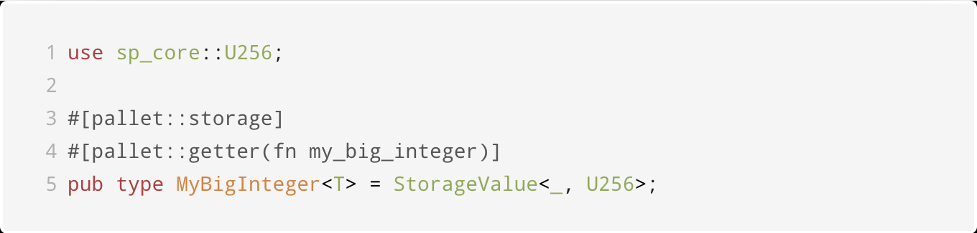
单值类型
大整数 U256,U512 类型定义：
Notes:
HW:
Substrate provides you with everything you need
to run a blockchain out of the box.
A database layer, networking layer, consensus engine, transaction queue, and libraries of runtime modules
But if you need to, you can choose to customize
Each of these components for your specific needs

Slide 38
单值类型
大整数 U256,U512 类型定义：
操作：checked_add,overflowing_mul...
更多API，参考文档
https://crates.parity.io/sp_core/struct.U256.html
Notes:
HW:
Substrate provides you with everything you need
to run a blockchain out of the box.
A database layer, networking layer, consensus engine, transaction queue, and libraries of runtime modules
But if you need to, you can choose to customize
Each of these components for your specific needs

Slide 39
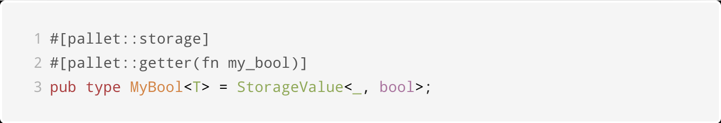
单值类型
bool 类型定义：
If else 逻辑判断
对于 ValueQuery, 默认值为false
Notes:
HW:
Substrate provides you with everything you need
to run a blockchain out of the box.
A database layer, networking layer, consensus engine, transaction queue, and libraries of runtime modules
But if you need to, you can choose to customize
Each of these components for your specific needs

Slide 40
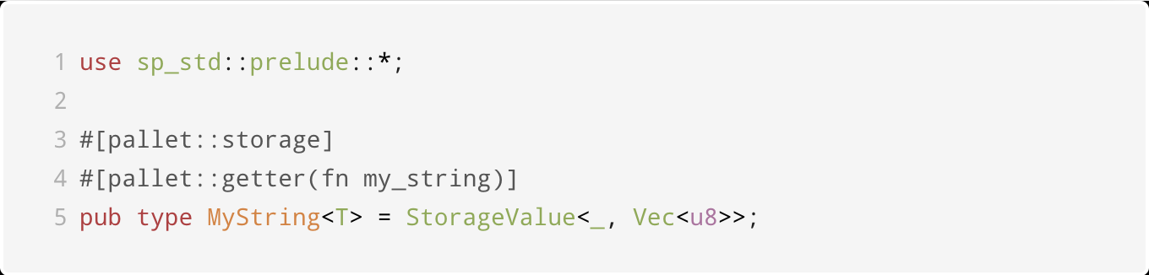
单值类型
Vec<T> 类型定义：
Notes:
HW:
Substrate provides you with everything you need
to run a blockchain out of the box.
A database layer, networking layer, consensus engine, transaction queue, and libraries of runtime modules
But if you need to, you can choose to customize
Each of these components for your specific needs

Slide 41
单值类型
Vec<T> 类型定义：
操作：push,pop,iter… https://doc.rust-lang.org/alloc/vec/struct.Vec.html
对于 ValueQuery, 默认值为 0x00
Notes:
HW:
Substrate provides you with everything you need
to run a blockchain out of the box.
A database layer, networking layer, consensus engine, transaction queue, and libraries of runtime modules
But if you need to, you can choose to customize
Each of these components for your specific needs

Slide 42
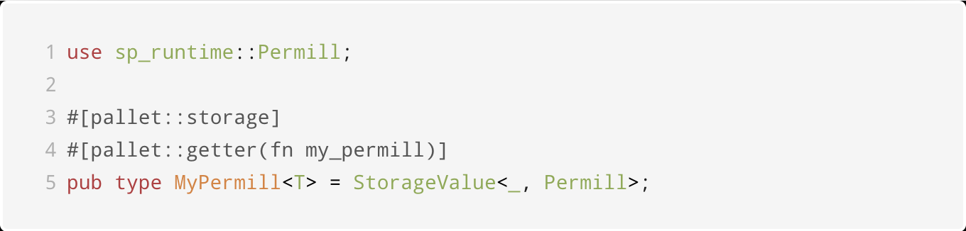
单值类型
Percent,Permill,Perbill 类型定义：
Notes:
HW:
Substrate provides you with everything you need
to run a blockchain out of the box.
A database layer, networking layer, consensus engine, transaction queue, and libraries of runtime modules
But if you need to, you can choose to customize
Each of these components for your specific needs

Slide 43
单值类型
Percent,Permill,Perbill 类型操作：
构造
Permill::from_percent(value);
Permill::from_parts(value);
Permill::from_rational(p,q);
计算
permill_one.saturating_mul(permill_two);
my_permill * 20000 as u32
API文档 https://crates.parity.io/sp_runtime/struct.Permill.html
Notes:
HW:
Substrate provides you with everything you need
to run a blockchain out of the box.
A database layer, networking layer, consensus engine, transaction queue, and libraries of runtime modules
But if you need to, you can choose to customize
Each of these components for your specific needs

Slide 44
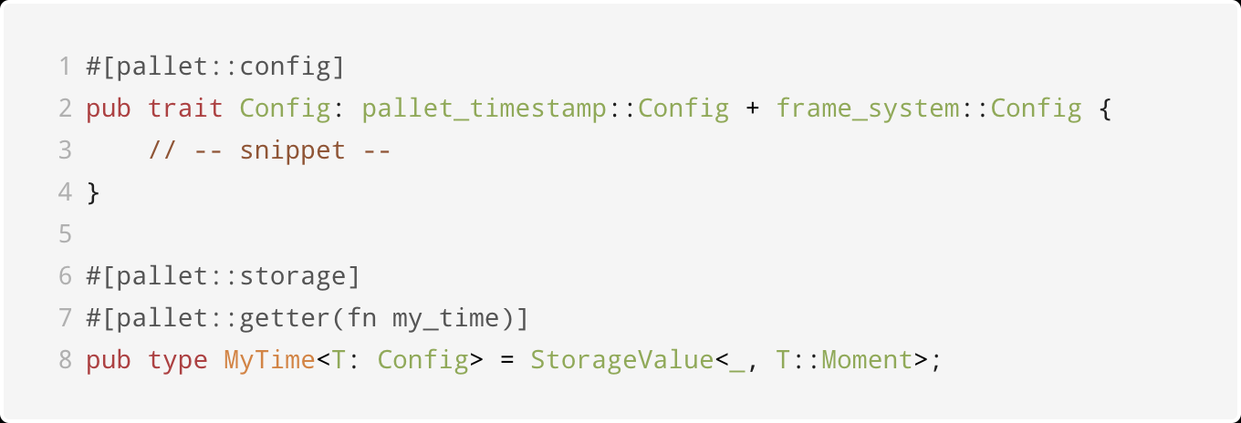
单值类型
Moment 时间类型定义：
Moment 是 u64 的类型别名
获取链上时间：pallet_timestamp::Pallet::<T>::get()
Notes:
HW:
Substrate provides you with everything you need
to run a blockchain out of the box.
A database layer, networking layer, consensus engine, transaction queue, and libraries of runtime modules
But if you need to, you can choose to customize
Each of these components for your specific needs

Slide 45
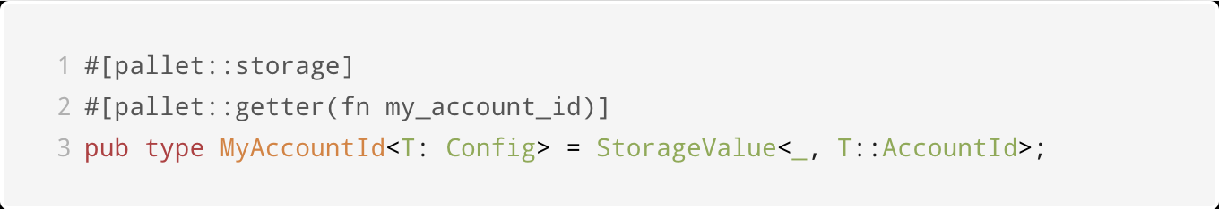
单值类型
AccountId 账户类型定义：
- 定义在 frame_system 中，通常是 Public key
- 获取AccountId: let sender = ensure_signed(origin)?
Notes:
HW:
Substrate provides you with everything you need
to run a blockchain out of the box.
A database layer, networking layer, consensus engine, transaction queue, and libraries of runtime modules
But if you need to, you can choose to customize
Each of these components for your specific needs

Slide 46
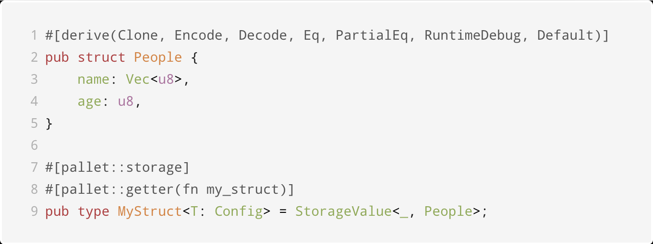
单值类型
struct 类型定义：
Notes:
HW:
Substrate provides you with everything you need
to run a blockchain out of the box.
A database layer, networking layer, consensus engine, transaction queue, and libraries of runtime modules
But if you need to, you can choose to customize
Each of these components for your specific needs

Slide 47
单值类型
enum 类似，还需要实现Default接口
https://github.com/kaichaosun/play-substrate/blob/master/pallets/data-type/src/lib.rs#L97
Notes:
HW:
Substrate provides you with everything you need
to run a blockchain out of the box.
A database layer, networking layer, consensus engine, transaction queue, and libraries of runtime modules
But if you need to, you can choose to customize
Each of these components for your specific needs

Slide 48
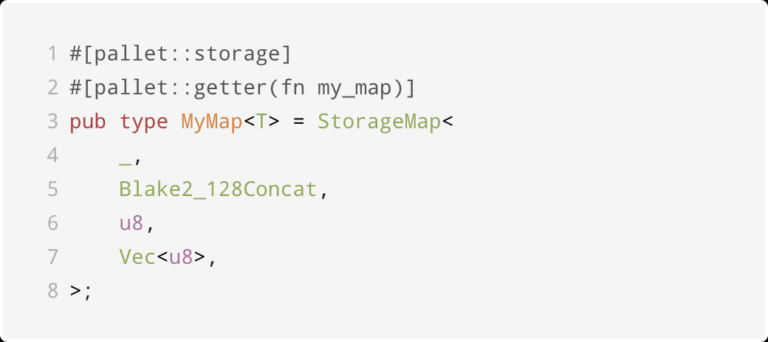
简单映射类型
StorageMap 类型，用来保存键值对，单值类型都可以用作key或者value。
Notes:
HW:
Substrate provides you with everything you need
to run a blockchain out of the box.
A database layer, networking layer, consensus engine, transaction queue, and libraries of runtime modules
But if you need to, you can choose to customize
Each of these components for your specific needs

Slide 49
简单映射类型
StorageMap 类型，用来保存键值对，单值类型都可以用作key或者value。
key的哈希算法：Blake2_128Concat, Twox64Concat, Identity
Notes:
HW:
Substrate provides you with everything you need
to run a blockchain out of the box.
A database layer, networking layer, consensus engine, transaction queue, and libraries of runtime modules
But if you need to, you can choose to customize
Each of these components for your specific needs

Slide 50
简单映射类型
StorageMap 类型，用来保存键值对，单值类型都可以用作key或者value。
插入一个元素：MyMap::<T>::insert(key, value);
通过key获取value：MyMap::<T>::get(key);
删除某个key对应的元素：MyMap::<T>::remove(key);
覆盖或者修改某个key对应的元素
MyMap::<T>::insert(key, new_value);
MyMap::<T>::mutate(key, |old_value| old_value+1);
API 文档：https://crates.parity.io/frame_support/pallet_prelude/struct.StorageMap.html
https://crates.parity.io/frame_support/storage/trait.IterableStorageMap.html
Notes:
HW:
Substrate provides you with everything you need
to run a blockchain out of the box.
A database layer, networking layer, consensus engine, transaction queue, and libraries of runtime modules
But if you need to, you can choose to customize
Each of these components for your specific needs

Slide 51
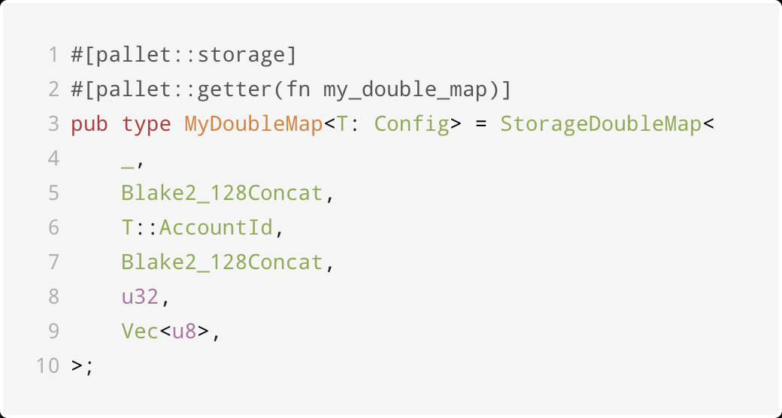
双键映射类型
StorageDoubleMap 类型，使用两个key来索引value，用于快速删除key1对应的任意记录，也可以遍历key1对应的所有记录，定义：
Notes:
HW:
Substrate provides you with everything you need
to run a blockchain out of the box.
A database layer, networking layer, consensus engine, transaction queue, and libraries of runtime modules
But if you need to, you can choose to customize
Each of these components for your specific needs

Slide 52
双键映射类型
StorageDoubleMap 类型，使用两个key来索引value，用于快速删除key1对应的任意记录，也可以遍历key1对应的所有记录，定义：
插入一个元素：MyDoubleMap::<T>::insert(key1, key2, value);
获取某一元素：MyDoubleMap::<T>::get(key1, key2);
删除某一元素：MyDoubleMap::<T>::remove(key1, key2);
删除 key1 对应的所有元素：MyDoubleMap::<T>::remove_prefix(key1, None);
API文档 https://crates.parity.io/frame_support/pallet_prelude/struct.StorageDoubleMap.html
https://crates.parity.io/frame_support/storage/trait.IterableStorageDoubleMap.html
Notes:
HW:
Substrate provides you with everything you need
to run a blockchain out of the box.
A database layer, networking layer, consensus engine, transaction queue, and libraries of runtime modules
But if you need to, you can choose to customize
Each of these components for your specific needs

Slide 53
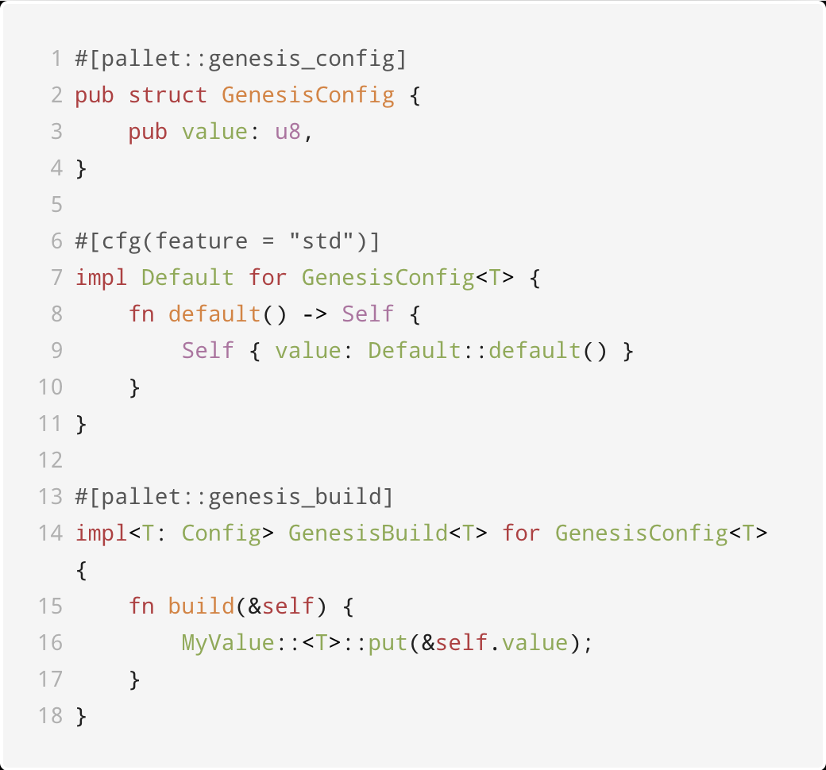
存储的初始化
创世区块的数据初始化：
Notes:
HW:
Substrate provides you with everything you need
to run a blockchain out of the box.
A database layer, networking layer, consensus engine, transaction queue, and libraries of runtime modules
But if you need to, you can choose to customize
Each of these components for your specific needs

Slide 54
存储的初始化
演示:
https://github.com/paritytech/substrate/blob/master/frame/sudo/src/lib.rs
Notes:
HW:
Substrate provides you with everything you need
to run a blockchain out of the box.
A database layer, networking layer, consensus engine, transaction queue, and libraries of runtime modules
But if you need to, you can choose to customize
Each of these components for your specific needs

Slide 55
最佳实践
最小化链上存储
哈希值
设置列表容量
Verify First, Write Last
事务管理：Transactional macro
Notes:
HW:
Substrate provides you with everything you need
to run a blockchain out of the box.
A database layer, networking layer, consensus engine, transaction queue, and libraries of runtime modules
But if you need to, you can choose to customize
Each of these components for your specific needs

Slide 56
其它Tips
可以通过pub关键字设置存储单元的可见范围
ValueQuery 设置默认值，如:
https://github.com/kaichaosun/play-substrate/blob/master/pallets/data-type/src/lib.rs#L42
在frame目录下查找对应的最新用法
pallet::storage 宏的说明文档
Notes:
HW:
Substrate provides you with everything you need
to run a blockchain out of the box.
A database layer, networking layer, consensus engine, transaction queue, and libraries of runtime modules
But if you need to, you can choose to customize
Each of these components for your specific needs

Slide 57
Questions?
官网文档：substrate.io 知乎专栏：parity.link/zhihu
kaichao@parity.io
https://parity.link/asia-support

Slide 58
Substrate 区块链应用开发
孙凯超
kaichao@parity.io
获取帮助: https://substrate.dev
存证模块的功能开发

Slide 59
内容
存证的介绍
写代码
作业

Slide 60
链上存证的介绍
存证是一种在线服务，可用于在某一时间点验证计算机文件的存在性，最早是通过比特币网络带有时间戳的交易实现的。存证的应用场景有：
数字版权
司法存证
供应链溯源
电子发票
……
Notes:
HW:
Substrate provides you with everything you need
to run a blockchain out of the box.
A database layer, networking layer, consensus engine, transaction queue, and libraries of runtime modules
But if you need to, you can choose to customize
Each of these components for your specific needs

Slide 61
链上存证的功能实现
一起敲代码！
资料：https://docs.substrate.io/tutorials/v3/proof-of-existence/
Notes:
HW:
Substrate provides you with everything you need
to run a blockchain out of the box.
A database layer, networking layer, consensus engine, transaction queue, and libraries of runtime modules
But if you need to, you can choose to customize
Each of these components for your specific needs

Slide 62
作业
第一题：列出3个常用的宏、3个常用的存储数据结构；
第二题：实现存证模块的功能，包括：
创建存证；
撤销存证。
第三题：为存证模块添加新的功能，
转移存证，接收两个参数，一个是内容的哈希值，另一个是存证的接收账户地址。

Slide 63
Questions?
官网文档：substrate.io 知乎专栏：parity.link/zhihu
kaichao@parity.io
https://parity.link/asia-support

