Slide 1

BUILDING
Rally Apps
(
)
Extending the Platform
with javascript
API & SDK
Docs

Slide 2
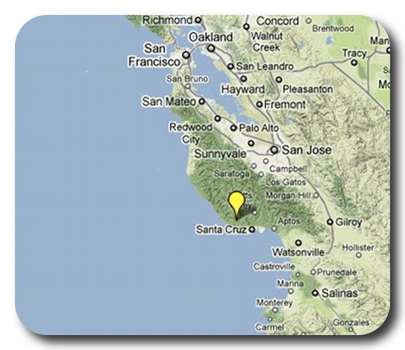

David P Thomas
dthomas@rallydev.com
ME
ABOUT
Notes:
Things that are nice to include in your introduction or things you might think about:
Where are you from?
Where do you work?
A funny Story.
Use some images that show who you are.

Slide 3
Purpose
As a Rally Customer, I want to be comfortable
extending the Rally platform to provide our
business with unique insights into our own data.
Acceptance Criteria:
Know where to find existing apps
Know where to find help & resources
Start a new app in < 3 minutes
Comfortable trying, failing, debugging, and learning.
Feel overwhelmed with possibilities… not stress.

Slide 4
Rally API & SDK
Web Service API (WSAPI) Allows for programatic access to create/read/update/delete artifacts in your subscription. The 2.0 version of the Rally API is REST based and uses the JSON format.
Rally App SDK - Allows you to write apps that extend and customize your Rally subscription. Apps are written in JavaScript and deployed to your Rally subscription within a custom page. The SDK relies on the WSAPI for data exchange.
Sencha Ext JS SDK - The App SDK is based on Sencha’s Ext JS and is used by Rally Engineering to build Rally itself.

Slide 5
Developer Portal
http://developer.rallydev.com
How to get to:
App SDK – Developer Portal > 2.0 SDK
Web Service API – Developer Portal > 2.0 SDK > Web Service API Docs
Sencha Docs – docs.sencha.com

Slide 6
But wait… There’s More!
Analytics Lookback API (LBAPI) - Database (mongo) that retains every single change event in your subscription. With this API, you will be able to roll back the clock and see what any work item or collection of work items looked like at any moment in time. Data is usually only 15-60sec behind Rally.

Slide 7
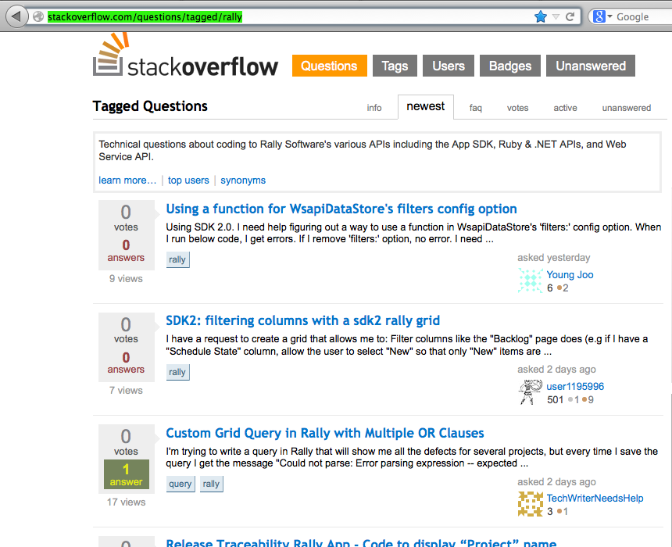
Stackoverflow
When in doubt, phone a friend. Or a few thousand of them on stackoverflow.
http://stackoverflow.com/questions/tagged/rally

Slide 8
This slide intentionally left blank
(except for this text)

