Slide 1

BUILDING
Rally Apps
(
)
Extending the Platform
with javascript
Getting Started
Dev Environment & Custom Grid

Slide 2
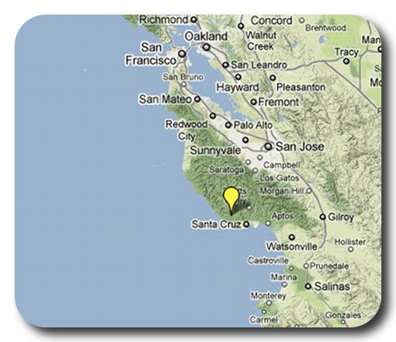

David P Thomas
dthomas@rallydev.com
ME
ABOUT
Notes:
Things that are nice to include in your introduction or things you might think about:
Where are you from?
Where do you work?
A funny Story.
Use some images that show who you are.

Slide 3
Purpose
As a Rally Customer, I want to be comfortable
extending the Rally platform to provide our
business with unique insights into our own data.
Acceptance Criteria:
Know where to find existing apps
Know where to find help & resources
Start a new app in < 3 minutes
Comfortable trying, failing, debugging, and learning.
Feel overwhelmed with possibilities… not stress.

Slide 4


Development Environment
Chrome Browser – Ideal debugging tools
(https://chrome.google.com)
Chrome Terminal Extension – ‘Devtools Terminal’
(https://chrome.google.com/webstore -> search ‘devtools terminal’)
Rally App Builder – Create, build, and deploy apps
(https://github.com/RallyApps/rally-app-builder)
Github.com – Store and share your app.
Before you begin…
First, install chrome and the terminal extension.
Then, install Rally App Builder.
Lastly, create an account on github.com.

Slide 5
Let’s Do this…

Slide 6
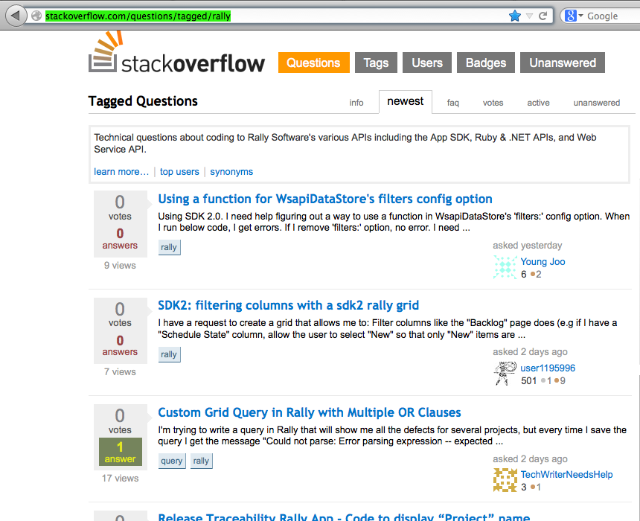
Stackoverflow
When in doubt, phone a friend. Or a few thousand of them on stackoverflow.
http://stackoverflow.com/questions/tagged/rally

Slide 7
Development Environment
Chrome Browser – Ideal debugging tools
(https://chrome.google.com)
Chrome Terminal Extension – ‘Devtools Terminal’
(https://chrome.google.com/webstore -> search ‘devtools terminal’)
Rally App Builder – Create, build, and deploy apps
(https://github.com/RallyApps/rally-app-builder)
Github.com – Store and share your app.
Before you begin…
First, install chrome and the terminal extension.
Then, install Rally App Builder.
Lastly, create an account on github.com.

Slide 8
This slide intentionally left blank
(except for this text)

