Slide 1

BUILDING
Rally Apps
(
)
Extending the Platform
with javascript
Tips, Tricks,
and
Patterns

Slide 2
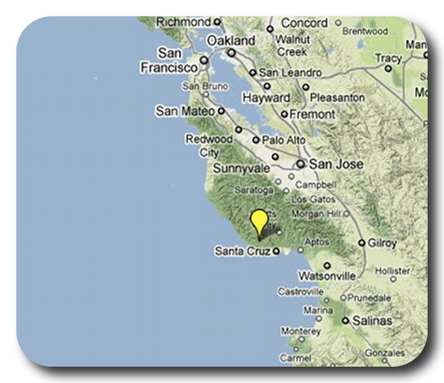

David P Thomas
dthomas@rallydev.com
ME
ABOUT
Notes:
Things that are nice to include in your introduction or things you might think about:
Where are you from?
Where do you work?
A funny Story.
Use some images that show who you are.

Slide 3
10 Tips, Tricks & Patterns
#1: App design: favor reusable methods over deep nesting
#2: Favor long hand approach to creating components
#3: Do the smallest thing you can do and test. Automate build/test/deploy as much as possible.
#4: debugging with the console()
#5: Keeping track of ‘this’
#6: store components as app ‘attributes’
#7: store your app in github
#8: debug sdk
#9: Bookmark your API/Guide references
#10. When in doubt, phone a friend. Or a few thousand.

Slide 4
#1 – App Design: Favor reusable methods over deep nesting
Deep Nesting launch: function() { Ext.create(<combobox>, { listeners: { select: function(combobox) { Ext.create(<wsapiDataStore>, { listeners: { load: function(store) { Ext.create(<grid>, { listeners: { cellclick: function() { alert(‘hello world!’); } } )}; } } } } } })}; | Reusable Methods launch: function() { Ext.create(<combobox>, { listeners: { select: function(combobox) { this.loadData(<ref>); } }, scope: this } }, loadData: function(ref) { Ext.create(<wsapiDataStore>, { listeners: { load: function(store) { this.buildGrid(store); } }, scope: this }, buildGrid: function(store) { Ext.create(<grid>, { listeners: { cellclick: function() { alert(‘hello world!’); } } )}; }

Slide 5
#2 – Favor long hand approach to creating components
As you get started, favor creating components with the long-hand notation. You’ll find your code is readable and likely more maintainable as you start to get comfortable opening files weeks later.
// long hand
var myFooObject = Ext.create(‘Rally.ui.chart.Chart’, {
width: 500,
height: 400,
chartConfig: {…}
});
this.add(myFoObject);
// short hand
this.add({
xtype: ‘rallychart’,
width: 500,
height: 400,
chartConfig: {…}
});

Slide 6
launch: function() {
doLayout();
},
doLayout: function() {
var app = Ext.create(<someContainer>, { layout: <vertical> });
var pulldown = Ext.create(<somePulldown>, {…});
var grid = Ext.create(<someGrid>, {…});
var buttonList = Ext.create(<someContainer>, {…});
var okButton= Ext.create(<someButton>, { layout: <horizontal> });
var cancelButton= Ext.create(<someButton>, {…});
buttonList.add(okButton);
buttonList.add(cancelButton);
app.add(pulldown);
app.add(grid);
app.add(buttonList);
this.add(app);
}

Slide 7
#3 - Do the smallest thing you can do and test. ^{(John Martin)}
Automate build/test/deploy as much as possible.
If your testing includes manual steps (like copy & paste) you’ll find yourself cramming in batches of changes all at once making it harder to debug when several things could be simultaneously broken.
Automated build/deploy makes it trivial to test even a single line change.
TIP! Consider registering the ‘rake’ commands in hotkeys!
(I did mine for vim ☺ )

Slide 8
#4 – debugging with the console()
Enable the javascript console or developer console in your browser
Write to the console with these methods
console.log(…)
console.debug(...)
console.error(…)
Console can help pretty-print objects even very complex, nested ones
You can add several objects in a single log call
console.log(‘See this?’, myPulldown, myRecord, myVariable);
console.log(‘Found %i records’, records.length);
NOTE: the console API can be browser dependent so do not release production code with console logs enabled. Just comment them out ☺
Example API:
https://developers.google.com/chrome-developer-tools/docs/console

Slide 9
#5 – Keeping track of ‘this’
Navigating a sea of ‘this’ variables can be daunting. One pattern you’ll see is to create a variable called ‘me’ or ‘that’ (or whatever you want) that points to the current scope. Then using ‘me’ makes your code a bit more readable IMO. Great threads on stackoverflow on this topic.
launch: function() {
var me = this; // var app = this; var that = this;
var comboBox = Ext.create(<someComboBox>, {
listeners: {
ready: function(box) {
this.loadGrid(box.getValue());
}
}, scope: me
});
},
loadGrid: function(value) {
…
}

Slide 10
#6 – store components as app ‘attributes’
Deep in your code, you realize you need access to your display grid.
Option #1
Call this.myGrid because you created that attribute on grid creation. Recall, your app, while extending Rally.app.App, is just a regular o’le javascript object – you can add new name/value pairs to it at runtime!
Option #2
Set an Ext id/itemId on the grid and use some (longwinded) lookup code to find it.

Slide 11
Option 1: this.myGrid
This suggestion is based on pure simplicity – KISS. The types of apps you’ll likely build for Rally won’t be full on desktop quality applications with 50 custom classes and wickedly complex nesting, etc. So just take advantage of the fact that you can augment any javascript object and call it a day – get it working and go surfing! ☺
doLayout: function() {
this.myGrid = Ext.create(‘Ext.grid.Panel’, {…});
this.add(this.myGrid);
},
someOtherFunction: function() {
Ext.create(<someCombobox>, {
listeners: {
select: {
this.myGrid.reconfigure(…);
}
}, scope: this
});
}

Slide 12
Option 2: Ext id/itemId
ExtJS provides a mechanism for identifying components with a (unique) id (think serial #) or reusable name itemId (think model #). ExtJS also provides global ‘managers’ to lookup components later on using these identifiers.
doLayout: function() {
var listGrid = Ext.create(‘Ext.grid.Panel’, itemId: ‘displayPanel’});
var columnGrid = Ext.create(‘Ext.grid.Panel’, { itemId: ‘displayPanel’});
this.add(myGrid);
this.add(columnGrid);
},
someOtherFunction: function() {
Ext.create(<someCombobox>, {
listeners: {
select: {
// find ALL components with itemId ‘displayPanel’
var displayPanels = Ext.componentQuery.query(‘#displayPanel’);
var columnGrid = displayPanels[1];
columnGrid.reconfigure();
}
}, scope: this
});
}

Slide 13

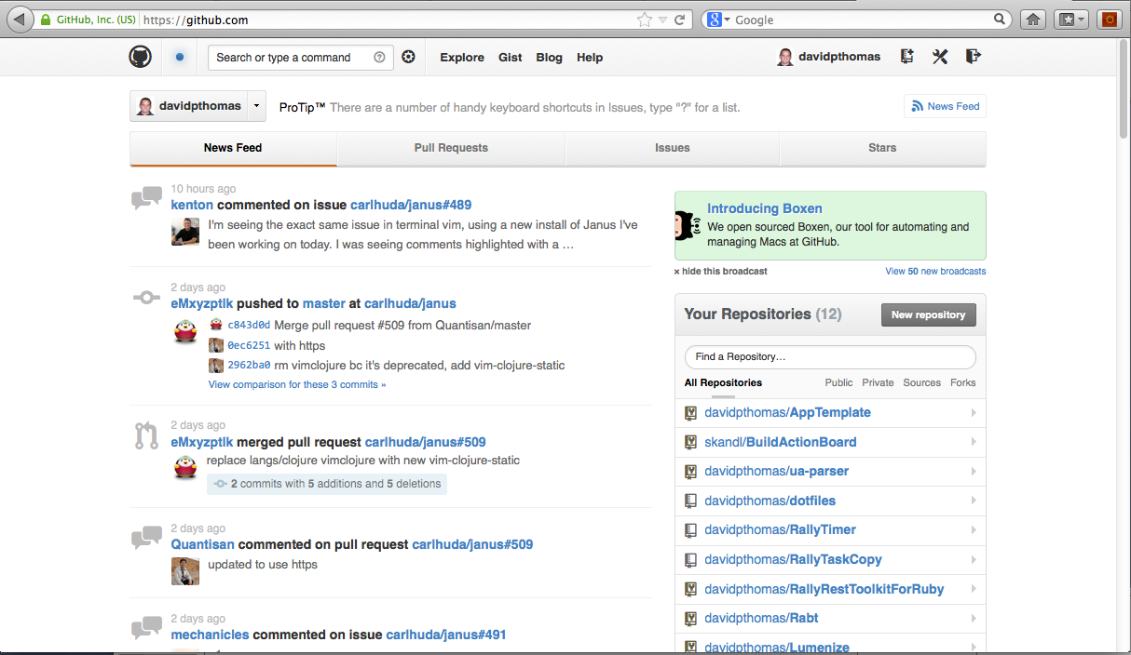
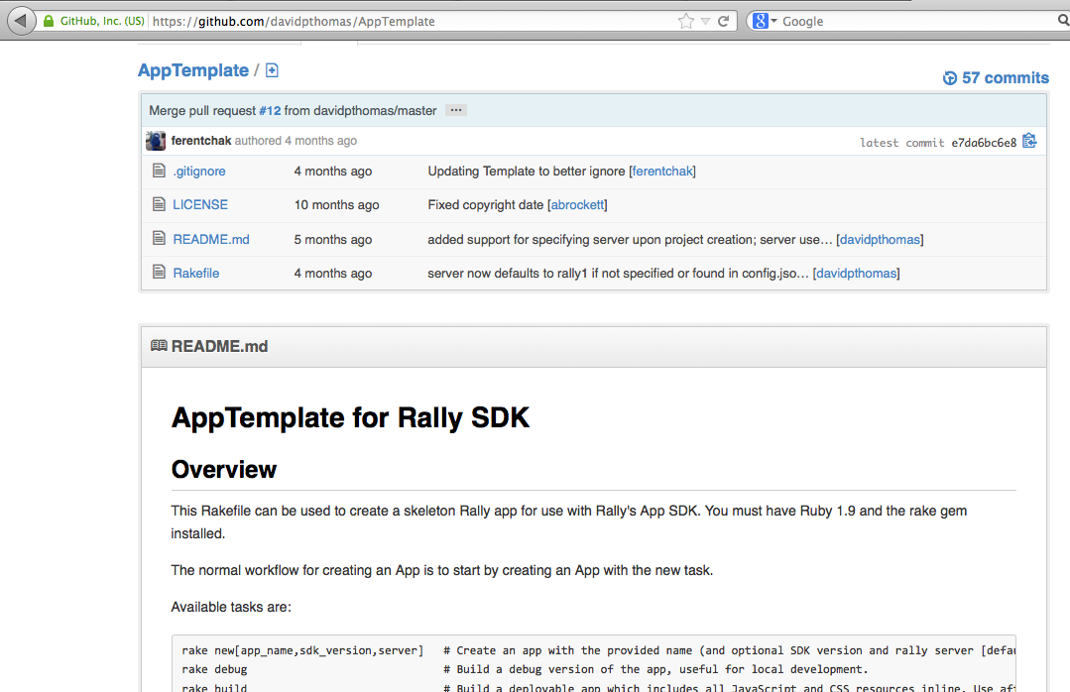
#7 – Store your app in GitHub
Start early. Using github is easier than you think. The sooner you get in the habit of committing code, you’ll take on more risk experimenting and sleep well knowing all of your changes are tucked away safely.

Slide 14
#8 – debug sdk
The Rally AppTemplate used in the videos has a ‘rake debug’ option. This will create a local file that you can use to load in your browser and test your changes outside of Rally. One additional trick is that it pulls in a ‘debug’ version of the SDK which makes it tremendously easier to navigate stack traces in the developer console (code is not minified).
NON-DEBUG
<script type="text/javascript"
src="https://demo01.rallydev.com/apps/2.0p5/sdk.js"></script>
DEBUG
<script type="text/javascript"
src="https://demo01.rallydev.com/apps/2.0p5/sdk-debug.js"></script>

Slide 15
#9 – Bookmark API/Guide References
Rally SDK/API | ExtJS API | Rally Guides (developer.rallydev.com)
Rally portal
Rally specific components built on Ext framework
Tutorials on using Rally components
Full API for Ext (no guides/tutorials though)
ExtJS SDK/API | Ext Guides (docs.sencha.com)
Sencha portal
Fantastic tutorials, guides, videos on vanilla ExtJS
Rally Web Services API (developer.rallydev.com – link on left side)
Object model definitions
Requires logging in with your Rally credentials
Access to all fields on all objects
e.g. ‘Defect’ object has fields Priority, Severity, Name, etc.

Slide 16
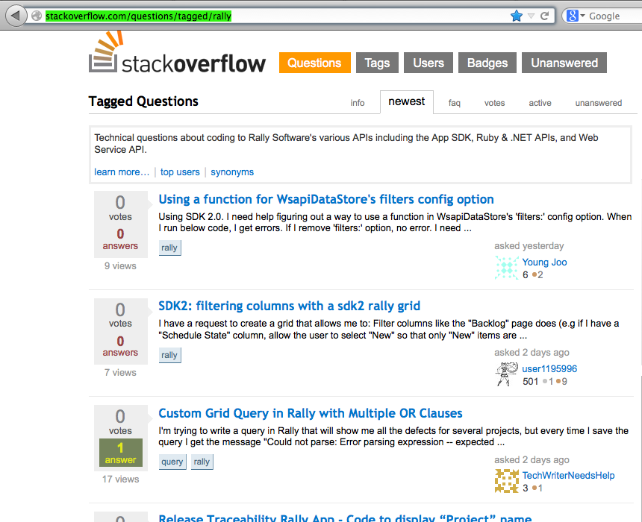
#10 – When in doubt, phone a friend. Or a few thousand of them on stackoverflow.
http://stackoverflow.com/questions/tagged/rally

Slide 17
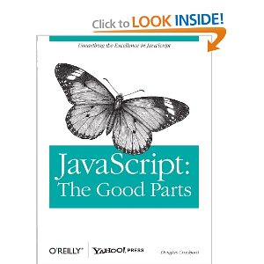

Resources
http://developer.rallydev.com
Rally & Ext APIs in one place (Rally only guides though)
http://docs.sencha.com
KILLER examples and guides
Book: Javascript the Good Parts, Douglas Crockford
(http://www.amazon.com/JavaScript-Good-Parts-Douglas-Crockford/dp/0596517742)
Book: Learning Highcharts, Joe Kuan
http://www.amazon.com/Learning-Highcharts-Joe-Kuan/dp/1849519080
Highcharts/Sencha Extension (by Joe Kuan)
https://github.com/JoeKuan/Highcharts_Sencha/
http://joekuan.org/demos/Highcharts_Sencha/docs/#!/api/Chart.ux.Highcharts
Stackoverflow forums
http://stackoverflow.com/questions/tagged/rally

