Slide 1

BUILDING
Rally Apps
(
)
Extending the Platform
with javascript
DT’s
Dev Environment
Mac + Chrome + Tmux

Slide 2
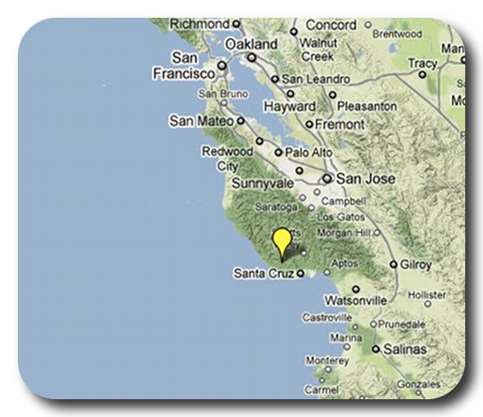
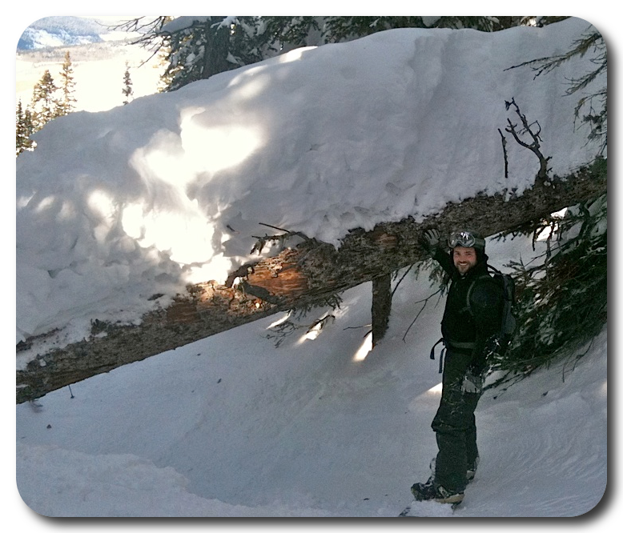
David P Thomas
dthomas@rallydev.com
ME
ABOUT
Notes:
Things that are nice to include in your introduction or things you might think about:
Where are you from?
Where do you work?
A funny Story.
Use some images that show who you are.

Slide 3
Installation Notes
Chrome Browser:
https://chrome.google.com
Chrome Terminal: http://blog.dfilimonov.com/2013/09/12/devtools-terminal.html
Git for Mac: http://git-scm.com/download/mac
Homebrew for Mac (for tmux): http://brew.sh/
tmux for Mac: $ brew install tmux

Slide 4
Tmux Usage Notes
tmux docs: http://tmux.sourceforge.net/
tmux: create session: $ tmux new-session -s <name>
tmux: list sessions: $ tmux list-sessions
tmux: attach session: $ tmux attach-session -t <name>
tmux: detach session: Ctrl-B D // last user will kill session; tmux config file can redefine Ctrl-B leader key
tmux: kill session: last active user to close terminal
Create-new-terminal: Ctrl-B c
Goto-next-terminal: Ctrl-B n
Goto-previous-terminal: Ctrl-B p
Note: You can re-map Ctrl-B
to another leader key.
Personally, I prefer Ctrl-F.
See tmux docs.

Slide 5
This slide intentionally left blank
(except for this text)

