Slide 1
ONCOLOGY WORKFLOW

Slide 2
ONCOLOGY REQUIREMENTS
Dashboard (? Scaleable) (exportable to excel)
Patient selection – MRN – DOB – create Oncology patient list (with active appointments – all oncology patients – create from ward list
Notes (patient related)
Notes (visit related)
Colour code consultants – build consultants
Postpone (as in move complete schedule out one week or just one appointment)
Build schedules
Schedules will prepopulate (warnings if default number exceeded)
Shell out to Ward Enquiry from dash board – will outstanding lists etc
Shell out to OCM (a later requirement)
This should be added to OCM user profiles
Investigate the possibility of texting patient
Set alerts against a patient if results not back by ? 2 days prior to appointment flag
Set drug ordering reminders
View IPC alerts

Slide 3
SCHEDULE
Schedule name
Frequency (in days)
Number of cycles
Length of stay (hrs)
Drug alert
Section (Oncology – Infusion)
Ability to schedule an appointment outside of the normal schedule

Slide 4
ONCOLOGY PATIENT DETAILS
Chart Number
IHI Number
Surname
Forename
DOB
Address
Mobile number
Patient Note
Active (Y/ N)

Slide 5
WARD DETAILS
Ward name
Number of spaces
Max extra spaces
Ward diary ability to alter for 1 day the number of spaces

Slide 6
DASHBOARD
Looks like Excel spread sheet
Click on any patient to get menu
Patient details
Reschedule
Notes
Ward Enquiry
Auto display patients who have arrived
Display alerts
Display auto updates every 5 minutes

Slide 7
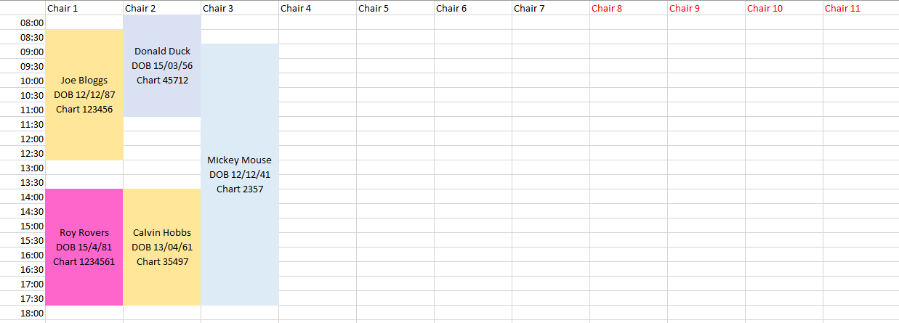
DASHBOARD

Slide 8
PATIENT SCREEN
N
Chart Number
Surname
Forename
DOB
Patient Notes
Current Schedule
Schedule Notes
Add Schedule
Modify schedule
Patient History
Lab Results
`Notes

