Slide 1
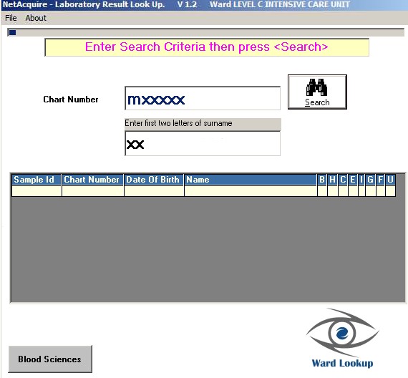
Opening Screen
M
xxxxx
This field could have M pre populated
Search Criteria
Must include:
Chart Number
First Two Letters of Surname

Slide 2
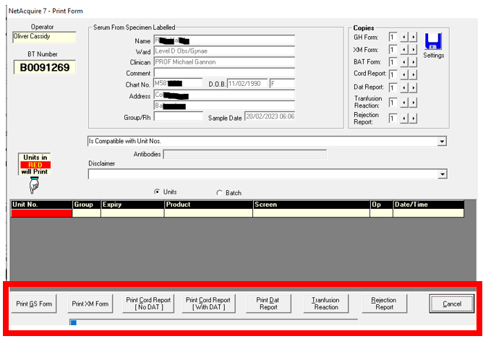
Transfusion Report Options:
There are 7 Transfusion Report Options available. When the Transfusion Department select a report (it should always be the last report printed) this then should be the report visible on Ward Enquiry with the following exception When the Print GS Form or the Print XM Form is selected by the Transfusion Department the only report that should be viewable in Ward Enquiry is the Print GS Form Report.

Slide 3
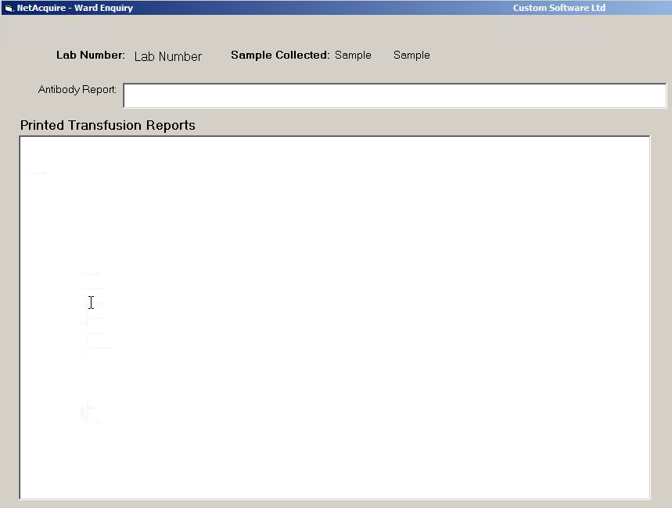
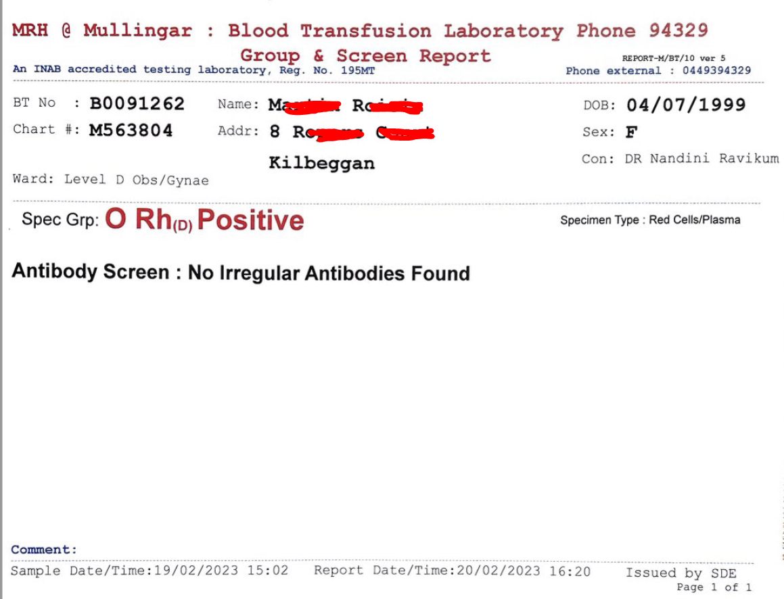
Current Sample Expiry date for cross matching
Add 72 Hours from / If past 72 hours - Expired
Processing Sample
PatDetails / BooNo. Valid Field
Suitable for EI
EI Screen Field
Field Result in Highlighted Box
Confirmatory Sample Required
If Ticked – No / If X – Yes / If x in this box then need to check Processing sample Field to see if sample is processing
Possible Transfusion Delays – Contact Laboratory
Yes / No (If text in this box says No irregular antibodies found the result should be NO
Print Button
Full audit trail on this print option to see who printed the report to be recorded in the Database

Slide 4
