Slide 1
sc-Pipeline
Jan.28
Discussed pipeline steps
Jan.30
Updated pipelines
Finished running 297 skin data
Finished most visualization
Adding visualization code to pipeline…
PBMC meta (199) pending…
Feb.3
Discussed QC, Normalization details, updating
Streamlined code, added readme file, uploaded to GitHub
Feb.3.2025

Slide 2
sc-Pipeline steps overview
raw h5 →
filtered h5 → SoupX in R → matrix.mtx, barcodes.tsv, genes.tsv
filtered h5 → Norm, PCA, Neighboring, Clustering →
(these steps can be skipped if cluster info given)
PCA ← Norm ← QC ← merged h5ad ← merging all samples ← calculate doublet score ←
→ Harmony → Neighboring, UMAP before/after harmony for visualization
Performance:
Sample-wise steps (SoupX, Doublet, Merging) is paralleled, takes <4h for 297 samples
Harmony converged after 5 iterations, ~3h
Rest steps are ~minutes

Slide 3
297 Skin Samples: SoupX Step
Following steps run in R, with default parameters, for getting cluster info
Normalize
FindVariableFeatures
ScaleData
RunPCA
FindNeighbors
FindClusters
Then SoupX run in default parameters
Visualization: How much ambient RNA is removed TODO
Boxplot for each cell on sample level (this will be 297 figures, thus require bathcing)
Box plot for each sample’s stat metrics(mean, std, etc.), doable

Slide 4
297 Skin Samples: Doublet Removal Step
Following steps run in Python, with default parameters
scanpy.pp.scrublet
Visualization for this step will be presented together with the QC step

Slide 5
297 Skin Samples: Merging
Before merging
sample_i matrix: n_cells_i X n_genes_i (i = 1, 2, …, 297)
After merging
merged matrix: n_cells X n_genes
n_cells = sum(n_cells_i) = 2,383,734
n_genes = intersection(n_genes_i) = 23,412
Merged h5ad file is ~56G for 2.4m cells
Note that n_cells is before any removal- doublet step is calculated but not actually removal at this moment

Slide 6
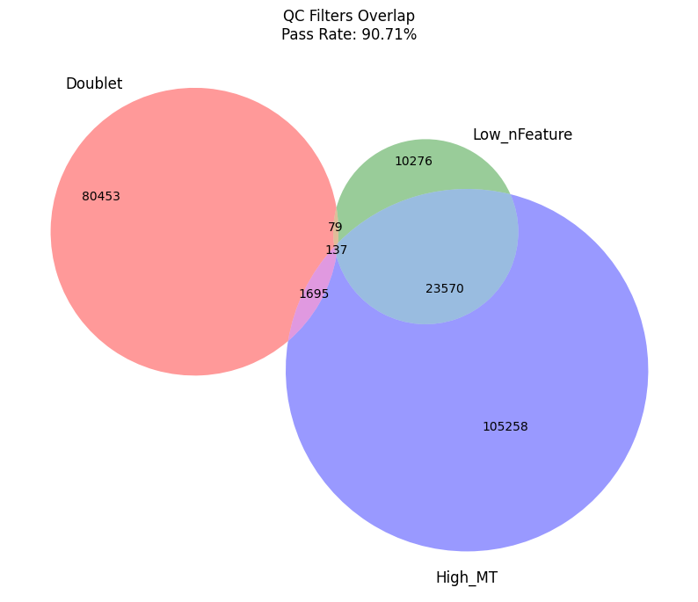
Merged Sample: QC step
Cells marked as failure
Doublet: doublet score > 0.15
High_MT: mitochondria percentage > 0.10
Low_nFeature: active gene numbers per cell < 200
Visualization
Merged-level: on the right
Cells that passed QC: 2,162,266 out of 2,383,734 (90.71%)
Venn Graph 3 types for failed cells
Sample-level: table 297 * 8: next slide
Each row is a sample
Each column is a state, 8 states: pass & 7 areas in the Venn graph

Slide 7
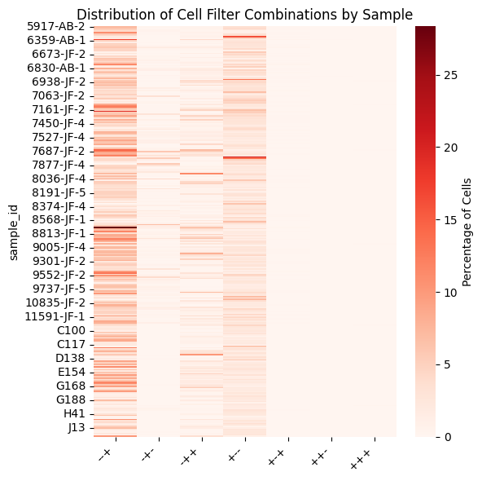
Merged Sample: QC step
Three signs in column means: isDoublet, isLowFeature, isHighMT
E.G. the first column is the percentage of cells isHighMT but neither isLowFeature nor isDoublet

Slide 8
Merged Sample: Normalization Step
Following steps run in Python,
sc.pp.normalize_total: sum set to 1e6 thus CPM
sc.pp.log1p
SCT?

Slide 9
Merged Sample: PCA Step
Following steps run in Python, with default parameters
sc.pp.highly_variable_genes, n_top_genes=2,000
sc.tl.pca, n_comps=50
Visualization:
Variance Ratio Plot: on the right
Based on the graph, PC numbers cut to 20 for the sake of speeding up Harmony step

Slide 10
Merged Sample: Harmony Step
Following steps run in Python, with default parameters
sc.external.pp.harmony_integrate
Visualization: Will be presented after the clustering step.

Slide 11
Merged Sample: Clustering
Following steps run in Python, with default parameters
sc.pp.neighbors: run twice using PCA before/after harmony
sc.tl.umap : run twice using neighbors before/after harmony
Visualization for Harmony:
~150 batches in meta, too much for visualization
Solution:
2 Sequencing Sites: Michigan, Physioseq
13 Pseudo Batches based on core name prefixes
Michigan: JF7(63), JF8(50), JF9(38), JF6(27), JF1(21), AB(18)
Physioseq: E(18), C(17), J(13), G(12), H(11), D(8), r(1)

Slide 12
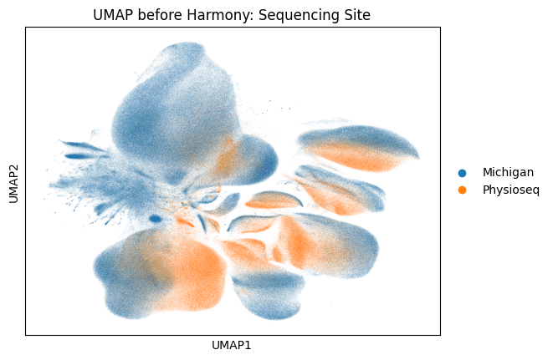
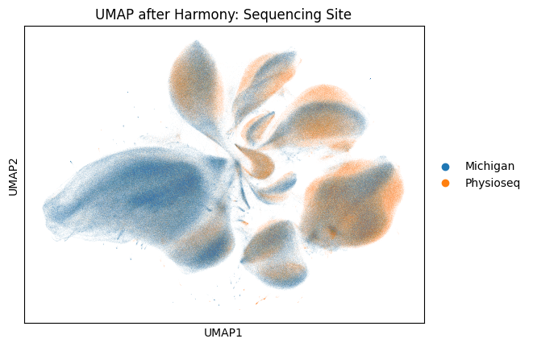
Merged Sample: Clustering, Harmony Visualization

Slide 13
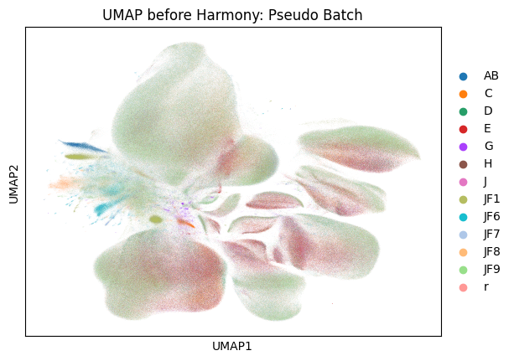
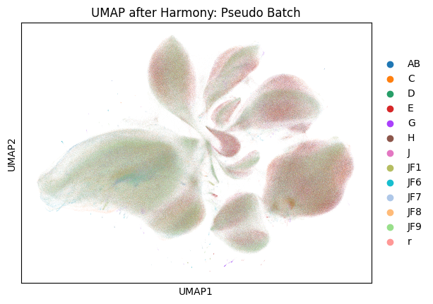
Merged Sample: Clustering, Harmony Visualization

