Slide 1
Applied Reinforcement Learning – Obstacle Avoidance
Alperen Gündogan
Rachid Ellouze
Uzair Akbar
Dr. Hao Shen
Hao.shen@tum.de

Slide 2
Table of Contents
Project Objective
Completed Works
State & Action spaces
Approaches
Results
Conclusion & Further Improvements

Slide 3
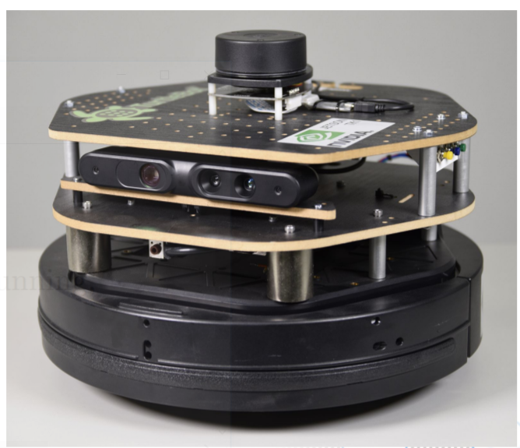
Project Objectives
The turtlebot covers maximum distance within an episode.
The turtlebot avoids collisions.

Slide 4
State Space Methods
Discretize
Grid discretizer
VAE discretizer
Features
Grid
Tile coding
Auto-Encoder
Random

Slide 5
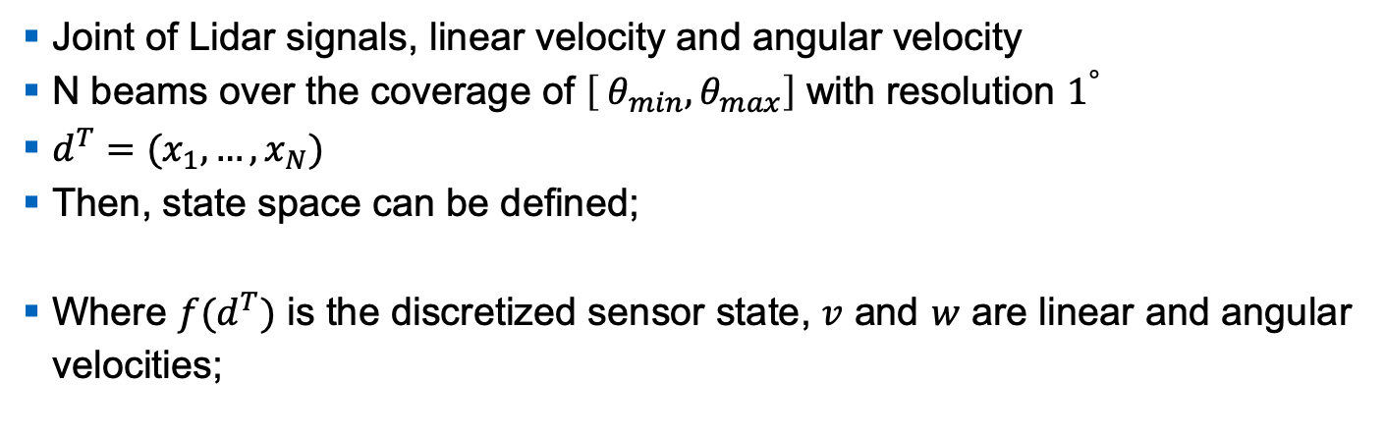


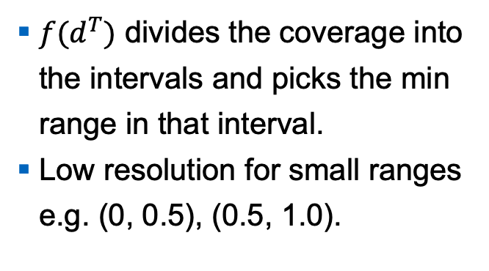
Discretized Grid State Space
Joint of Lidar signals, linear velocity and angular velocity
N beams over the coverage of $\left[ θ_{min},θ_{max}\right]$ with resolution $1^{°}$
$d^{T}={(x}_{1}, …,x_{N})$
Then, state space can be defined;
Where $f(d^{T})$ is the discretized sensor state, $v$ and $w$ are linear and angular velocities;
$f(d^{T})$ divides the coverage into the intervals and picks the min range in that interval.
Low resolution for small ranges e.g. (0, 0.5), (0.5, 1.0).
$$θ_{min}$$
$$θ_{max}$$
2.0m
0.5m
0.3m
Discretization of LIDAR
Notes:
This is the one that we exploited for the real turtlebot.
Picking the min range in an interval makes the robot more robust to noisy lidar measurements and enhance an obstacle awareness.

Slide 6
Feature based state space
TODO: Uzair

Slide 7




Autoencoder
Input
$$loss= \left|x−\hat{x}\right|$$
Output
$$x$$
$$\hat{x}$$
Code
$$z$$
Encoder
Decoder

Slide 8
Autoencoder

Slide 9
Autoencoder
Input
Output
$$x$$
$$\hat{x}$$
Code
$$z$$
$$q_{φ}\left(z | x\right)$$
$$\sim$$
$$p_{θ}\left(x | z\right)$$

Slide 10






Autoencoder
Forward Pass
$$p\left(x | z_{q}\right)$$
Encoder
Embeddings Code Book
Decoder
$$z_{e}(x)$$
$$z_{q}(x)$$
$$x$$
$$\hat{x}$$
$$q\left(z_{q} | x\right)$$

Slide 11
Tile Coding
TODO: Uzair

Slide 12




Action Space
Joint of linear and angular velocities
Linear velocity: { 0.2; 0.4 m/s}
Angular velocity: { -π/6; - π/12; 0; π/12; π/6 rad/s}
Two types;
0.4m/s
0.2m/s
$$−π/12$$
$$π/12$$
$$−π/6$$
$$π/6$$
Action Space
Linear velocity
Angular velocity
Notes:
2 approaches for taking an action.
Combination of linear and angular velocity: 10 actions
Either change linear velocity or angular velocity: 7 actions
We used the first approach to run real turtlebot.

Slide 13
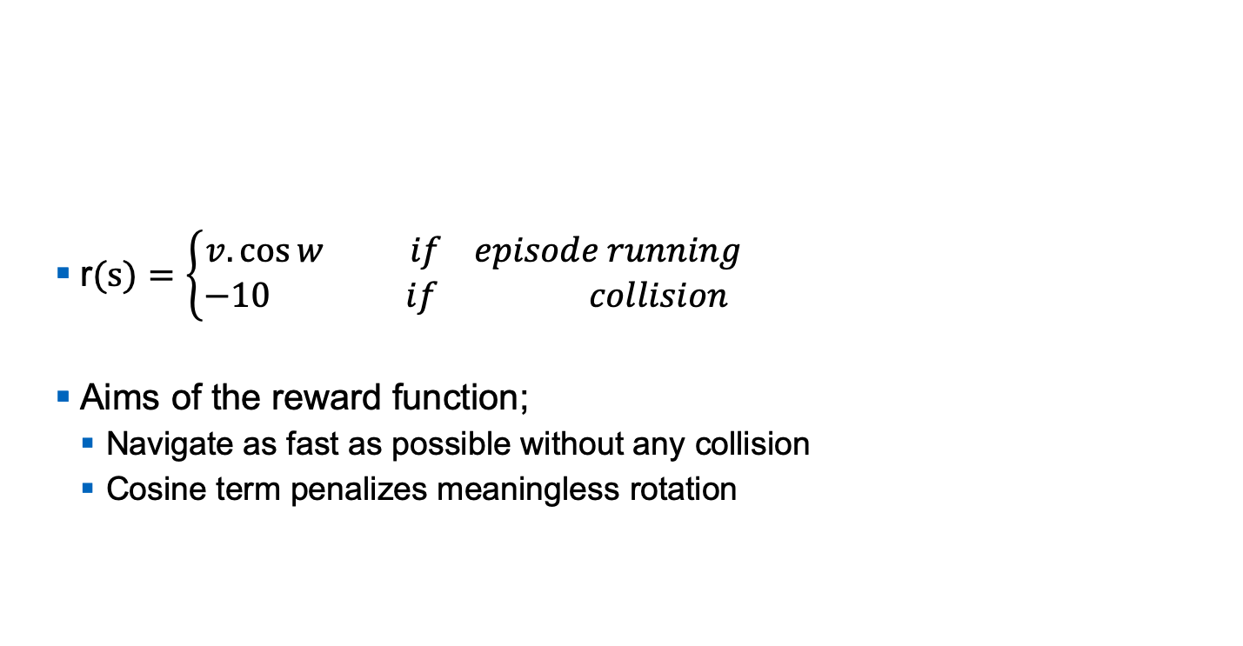
Reward function
r$(s)=\left\{\begin{aligned}v. \cos{w} if episode running \\ −10 if collision \end{aligned}\right.$
Aims of the reward function;
Navigate as fast as possible without any collision
Cosine term penalizes meaningless rotation

Slide 14
Reinforcement Learning approaches
Algorithms;
Q-Learning with eligibility traces
Q-table
LVFA
SARSA with eligibility traces
Q-table
LVFA
Policies;
Greedy
Eps-greedy
Softmax

Slide 15
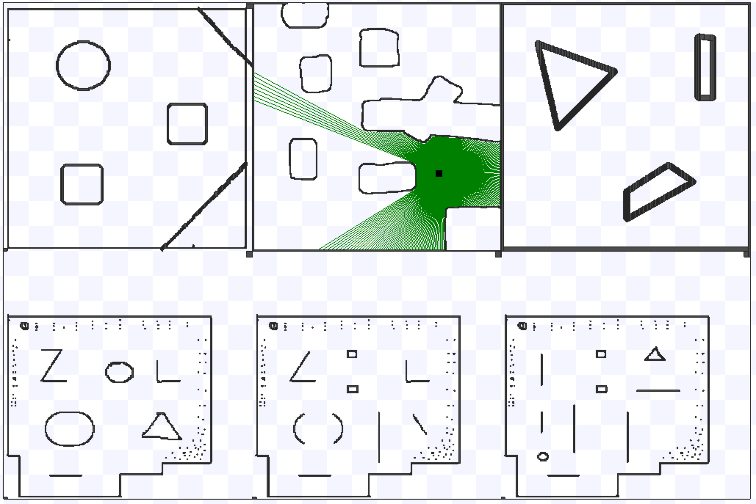
Training the agent
Simple 2D simulator “Stage” is exploited to reduce unnecessary computational overhead.
Apply domain randomization technique to generalize the policy during training;
Notes:
We created 6 (a variety of )simulated environments with randomized properties and train a model that works across all of them.
Close the gap between simulation and reality.
Domain randomization techniques is applied to generalize the policy during traning. We created 6 different simulation environments with randomized properties and train a model that Works across all of them.

Slide 16
Improvements to run real turtlebot
Lidar Filter
A simple filter which observes last N consecutive lidar measurements to replace unreliable laser hits of the last measurement with the reliable ones from the previous measurements.
Sensor Model (TODO: Uzair)
5
2
1
4
3
6
Measurements from the room -1981 to train the sensor model
Notes:
To deal with the noise in the real turtlebot measurements we need to use a filter

Slide 17
Improvements to run real turtlebot
Sensor Model results
Notes:
To deal with the noise in the real turtlebot measurements we need to use a filter

Slide 18
Improvements to run real turtlebot
Notes:
To deal with the noise in the real turtlebot measurements we need to use a filter

Slide 19
Improvements to run real turtlebot
Notes:
To deal with the noise in the real turtlebot measurements we need to use a filter

Slide 20
Improvements to run real turtlebot
Notes:
To deal with the noise in the real turtlebot measurements we need to use a filter

Slide 21
Results

Slide 22
Demonstrations
Simulation
Real world
Attempt 1
Attempt 2
Attempt 2 different perspective
https://youtu.be/tGrZRYJZ-YE
https://youtu.be/kJCo0gmgGCw
https://youtu.be/XOWhKis15BE
https://youtu.be/Yj-vVpthBO0

Slide 23

Questions?

Slide 24
BONUS
Object
1.5m
1.5m
0.5m
0.5m
Example;
State= 1, 0, 0, 0, 1, 2
Discretization of LIDAR

