Slide 1
Wind Generator Charge Controller Hardware
Zinah Alsaad
Iliana Tafoya
Anna Janicek

Slide 2
INA219
(Read battery current and voltage)
High-Level
Overview
ESP32
(Transmit data via Wi-Fi)
Battery (B)
CL Input
Generator (G)
Rectifier
(Convert AC to DC)
Buck Converter (BC)
(Keep voltage constant at 13.6 V)
Voltage Divider (VD)
(Supply CL with 3.3 V)
Current Limiter (CL)
Feedback (Output of CL connected to pin 5 of BC)
Notes:
The INA 219 did not work.

Slide 3
Voltage Follower (VF 2)
(Convert 13.6 V to 3.3 V)
High-Level
Overview B
ESP32
(Transmit data via Wi-Fi)
Battery (B)
Voltage reading 2 on ESP32 ADC Pins
CL Input
Generator (G)
Buck Converter (BC)
(Keep voltage constant at 13.6 V)
Voltage Divider (VD)
(Supply CL with 3.3 V)
Current Limiter (CL)
Resistor (Read regulated current)
Current reading (Calculate from
voltage reading and shunt resistivity)
Feedback (Output of CL connected to pin 5 of BC)
Voltage Follower (VF 1)
(Convert G voltage to 3.3 V)
Voltage reading 1 on ESP32 ADC Pins

Slide 4
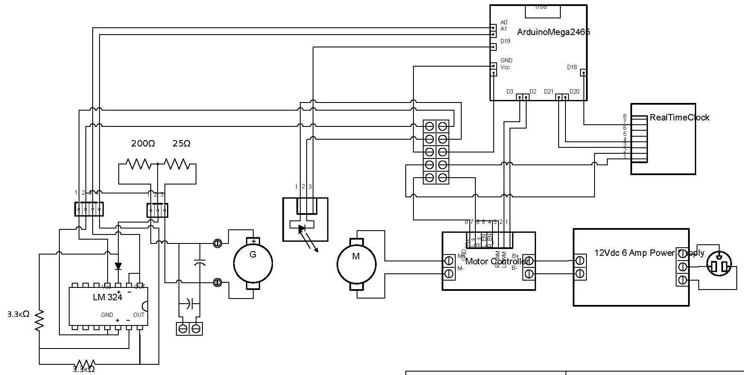
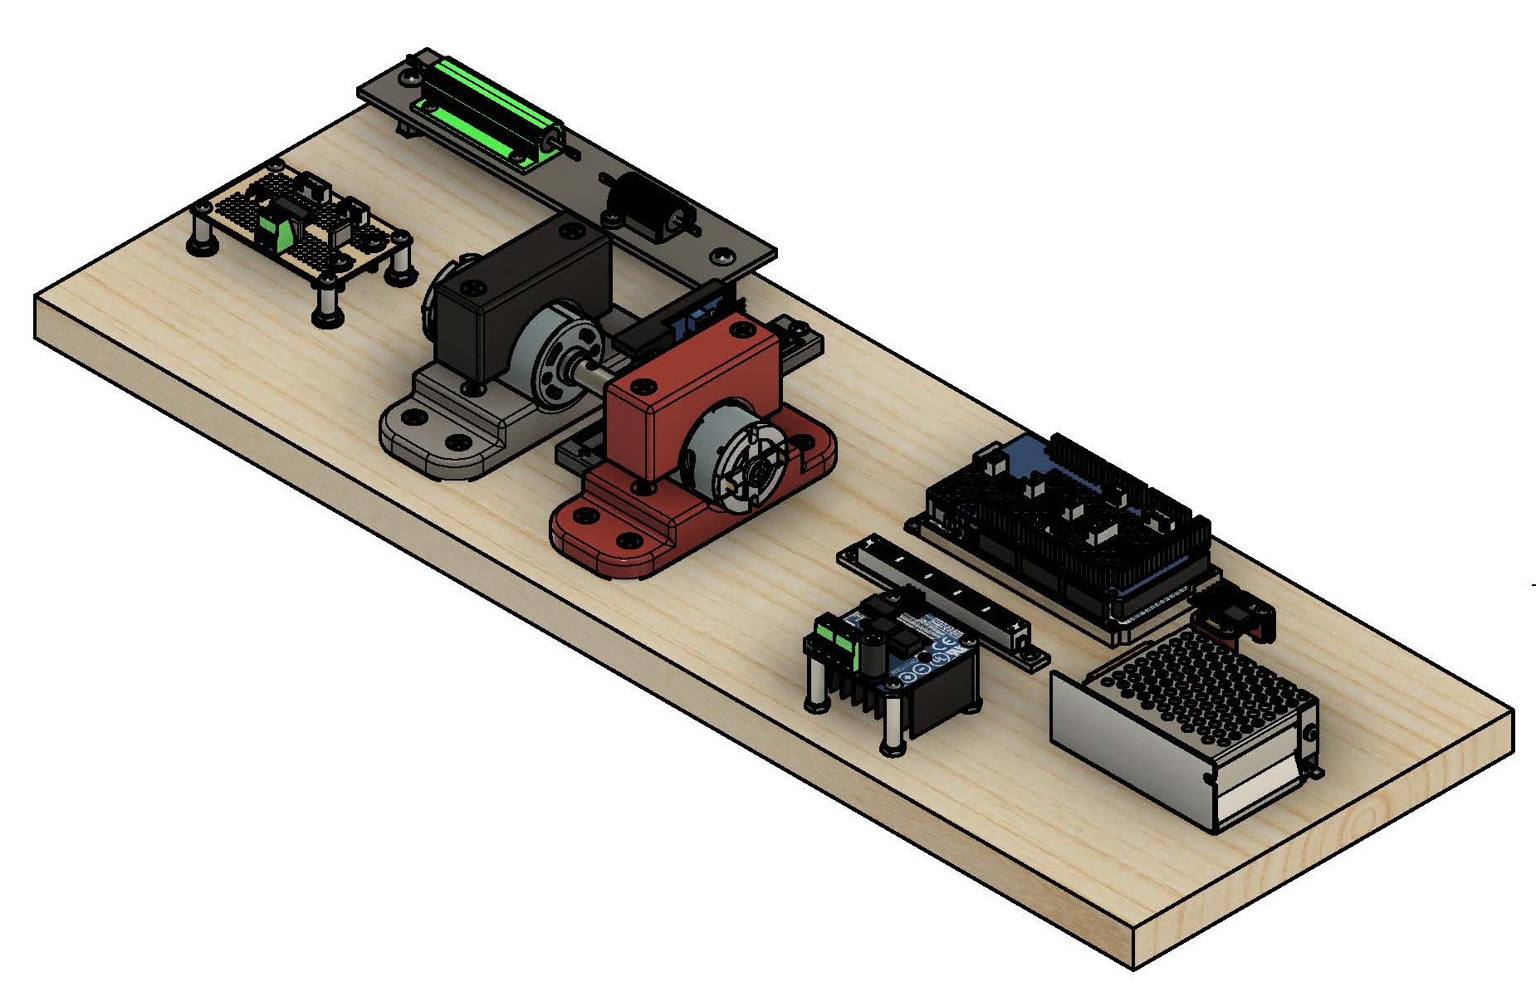
Generator Work Bench

Slide 5
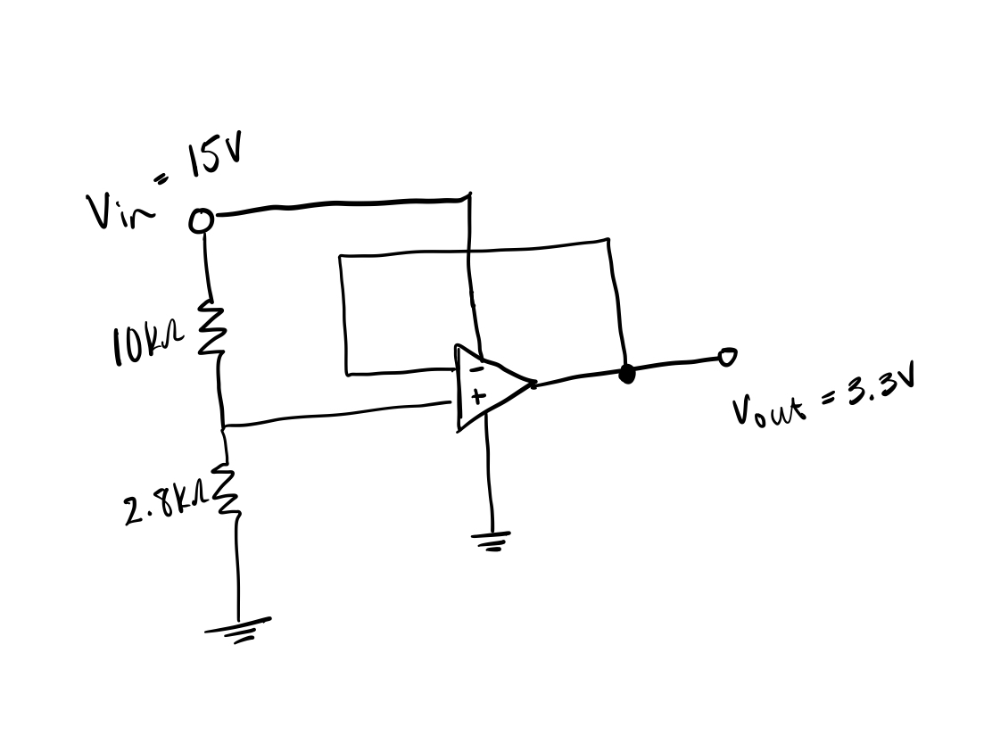
Voltage Follower 1

Slide 6
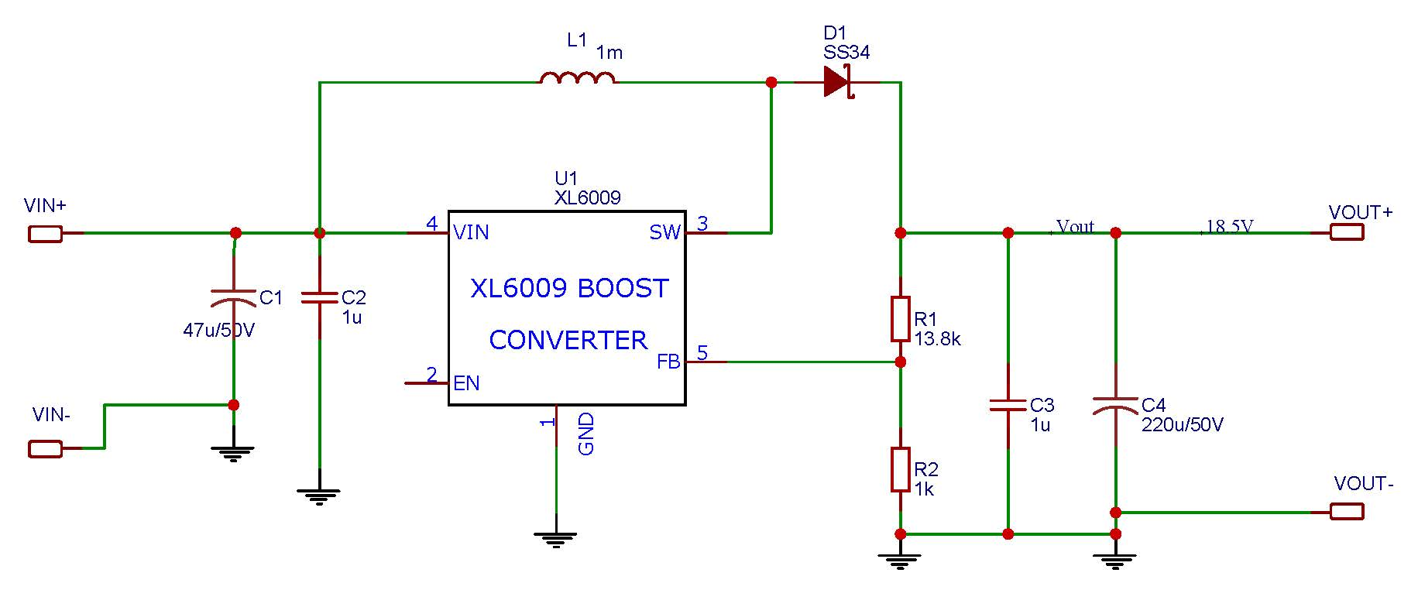
Buck Converter IC

Slide 7
Voltage Divider

Slide 8
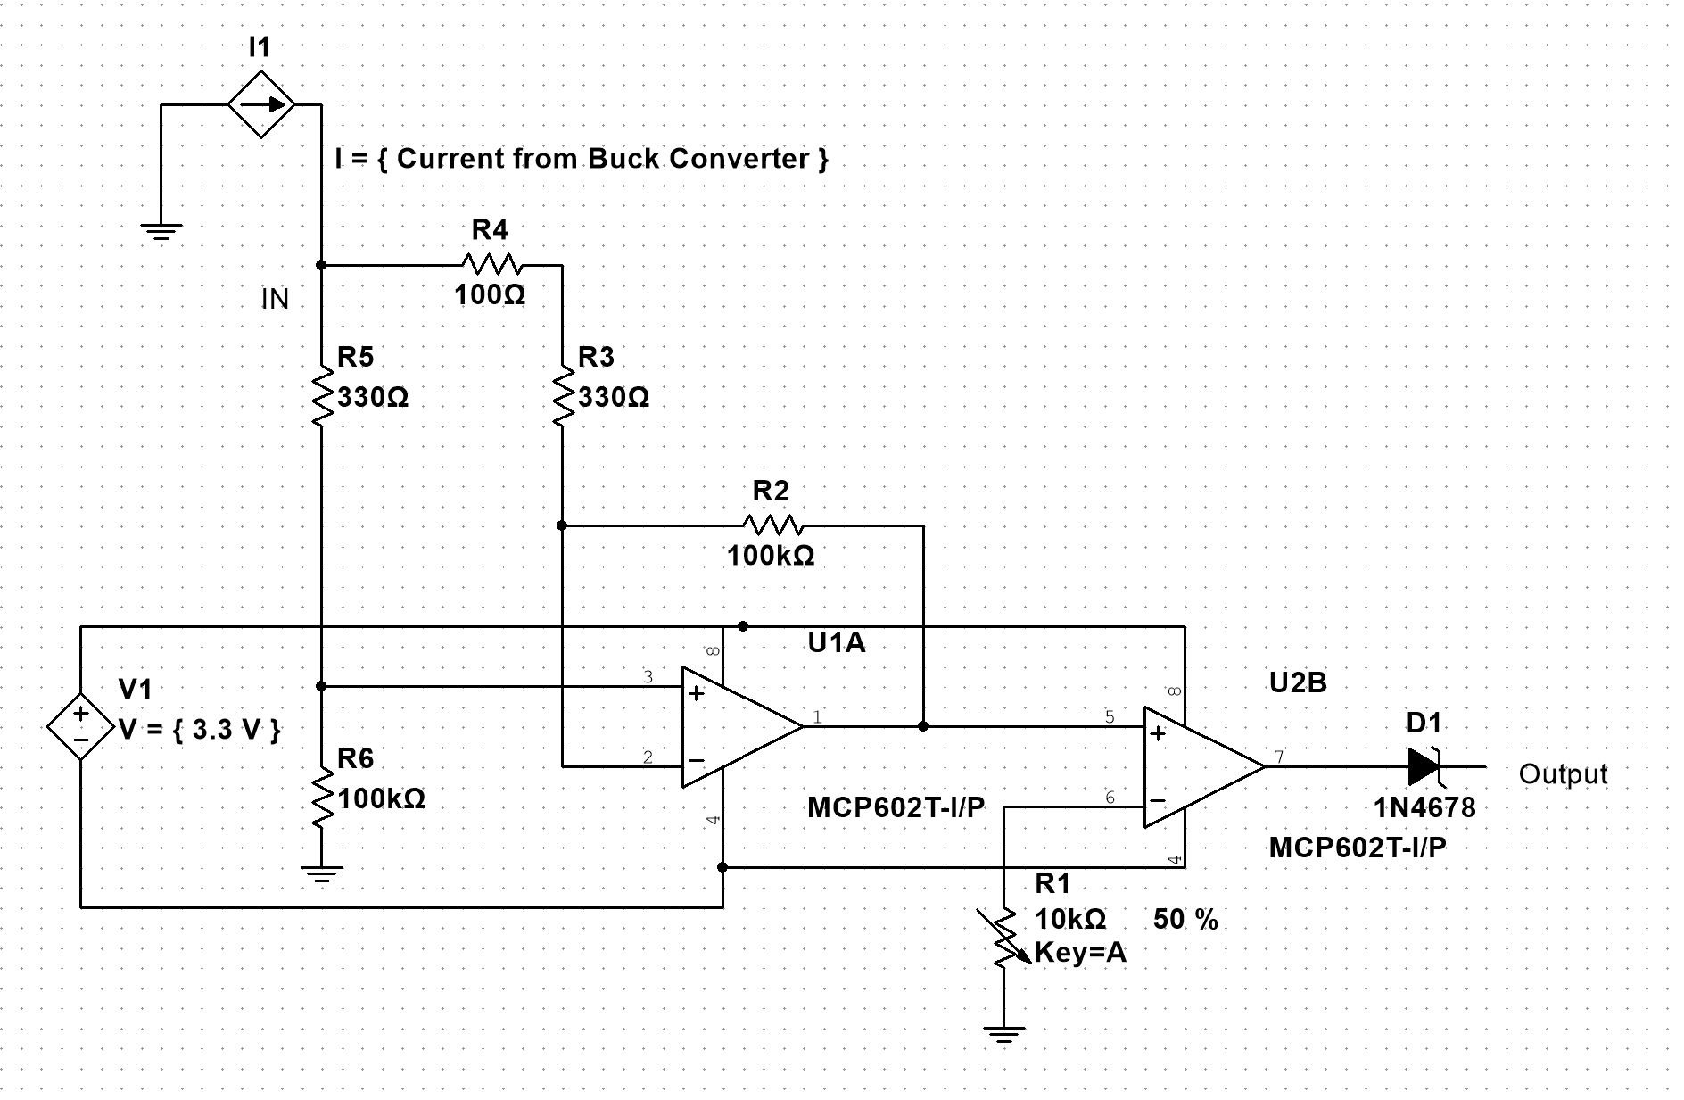
Current Limiter

Slide 9
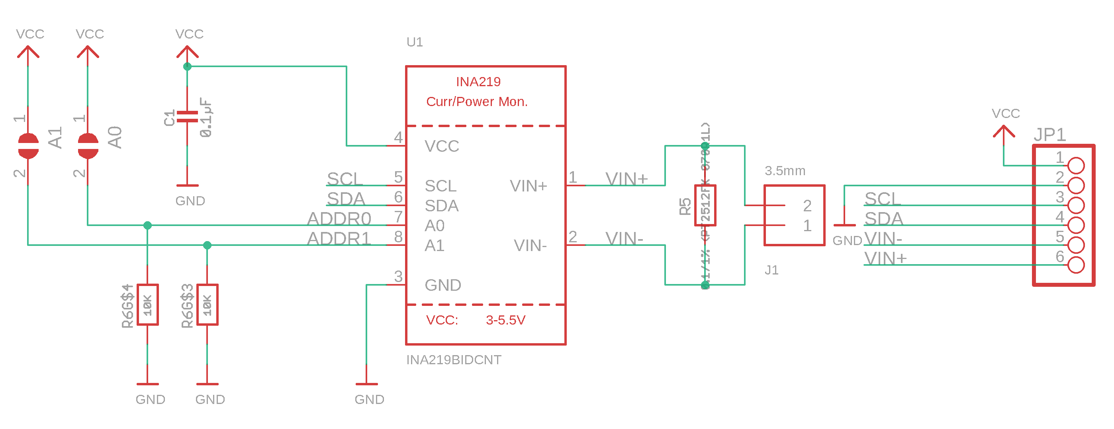
INA219

Slide 10
Voltage Follower 3

Slide 11
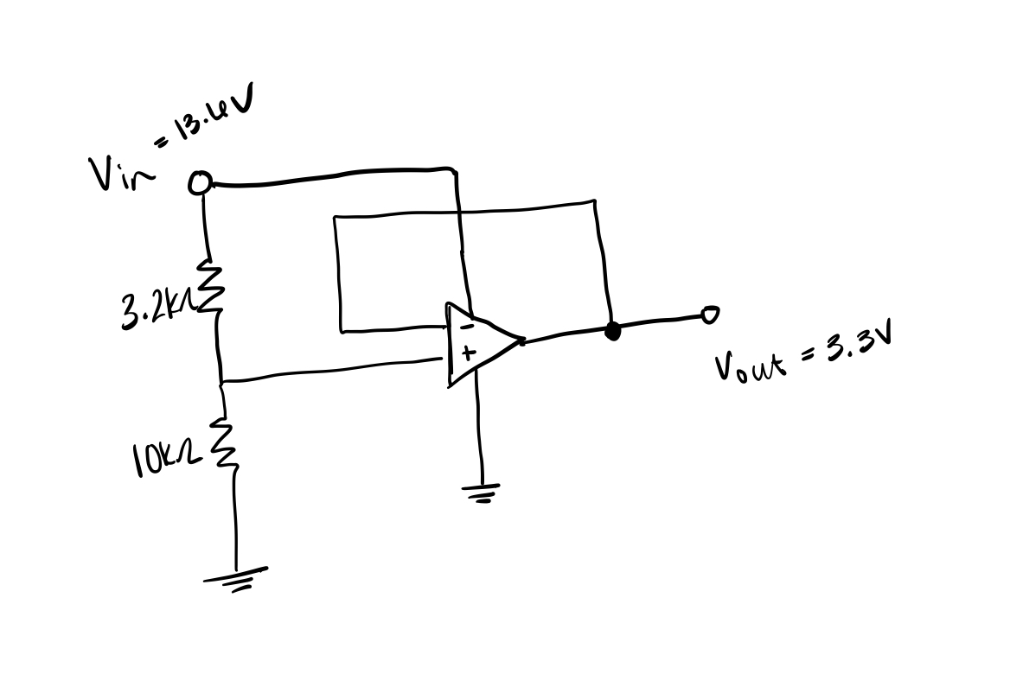
Voltage Follower 2

