Slide 1
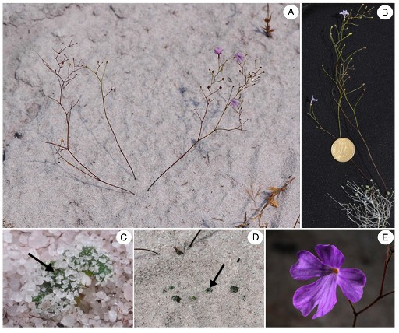
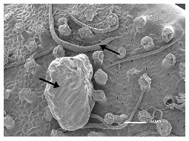
The Plant of the Day
Philcoxia
Brazil
Well lit and low-nutrient habitat
Sticky underground leaves
Eats worms!
Pereira et al. 2012

Slide 2
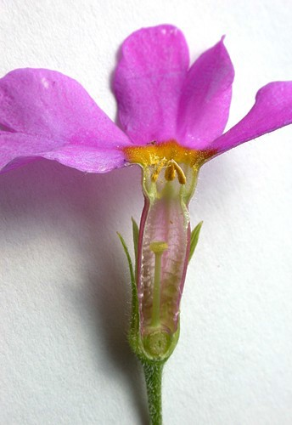
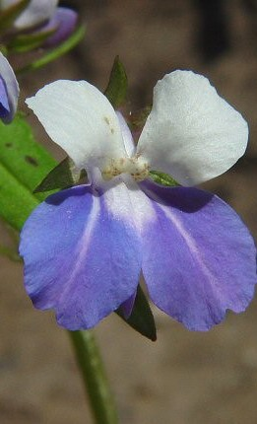
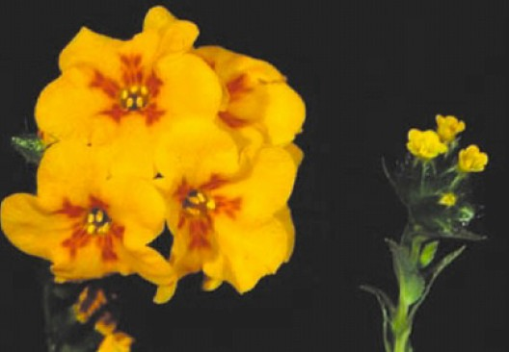
The evolution and maintenance of plant sexual diversity

Slide 3
Mating Systems
What are plant mating systems?
What are the major costs and benefits of selfing?
What are the consequences of selfing on genetic variation and why?

Slide 4
Mating Systems
Mating system: the mode of transmission of genes from one generation to the next through sexual reproduction (e.g. maternal selfing rate)
Selfing rate (s): the proportion of seeds that are self fertilized
Outcrossing rate (t=1-s): the proportion of seeds that are outcrossed
The outcrossing rate of a population can be estimated from genotyping seed families

Slide 5
Sexual Systems
Sexual system: the particular deployment of sexual structures within and among plants and the physiological mechanisms governing mating

Slide 6
Why do we care about the evolution of reproductive traits?
They influence their own transmission and the transmission of all other genes
Shift in mating system can strongly influence genetic variation, speciation and evolutionary diversification
It is just really cool

Slide 7
The evolution of self-fertilization
20% of angiosperm species have evolved a predominantly selfing strategy
What is a major cost of self fertilization?
-inbreeding depression
What is inbreeding depression?
-inbreeding depression: the reduction in viability and fertility of inbred offspring compared with outbred offspring.
δ=1-w_{s}/w_{o}
What causes inbreeding depression?
-homozygosity of recessive deleterious alleles
-overdominance (heterozygote advantage)

Slide 8
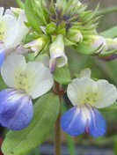
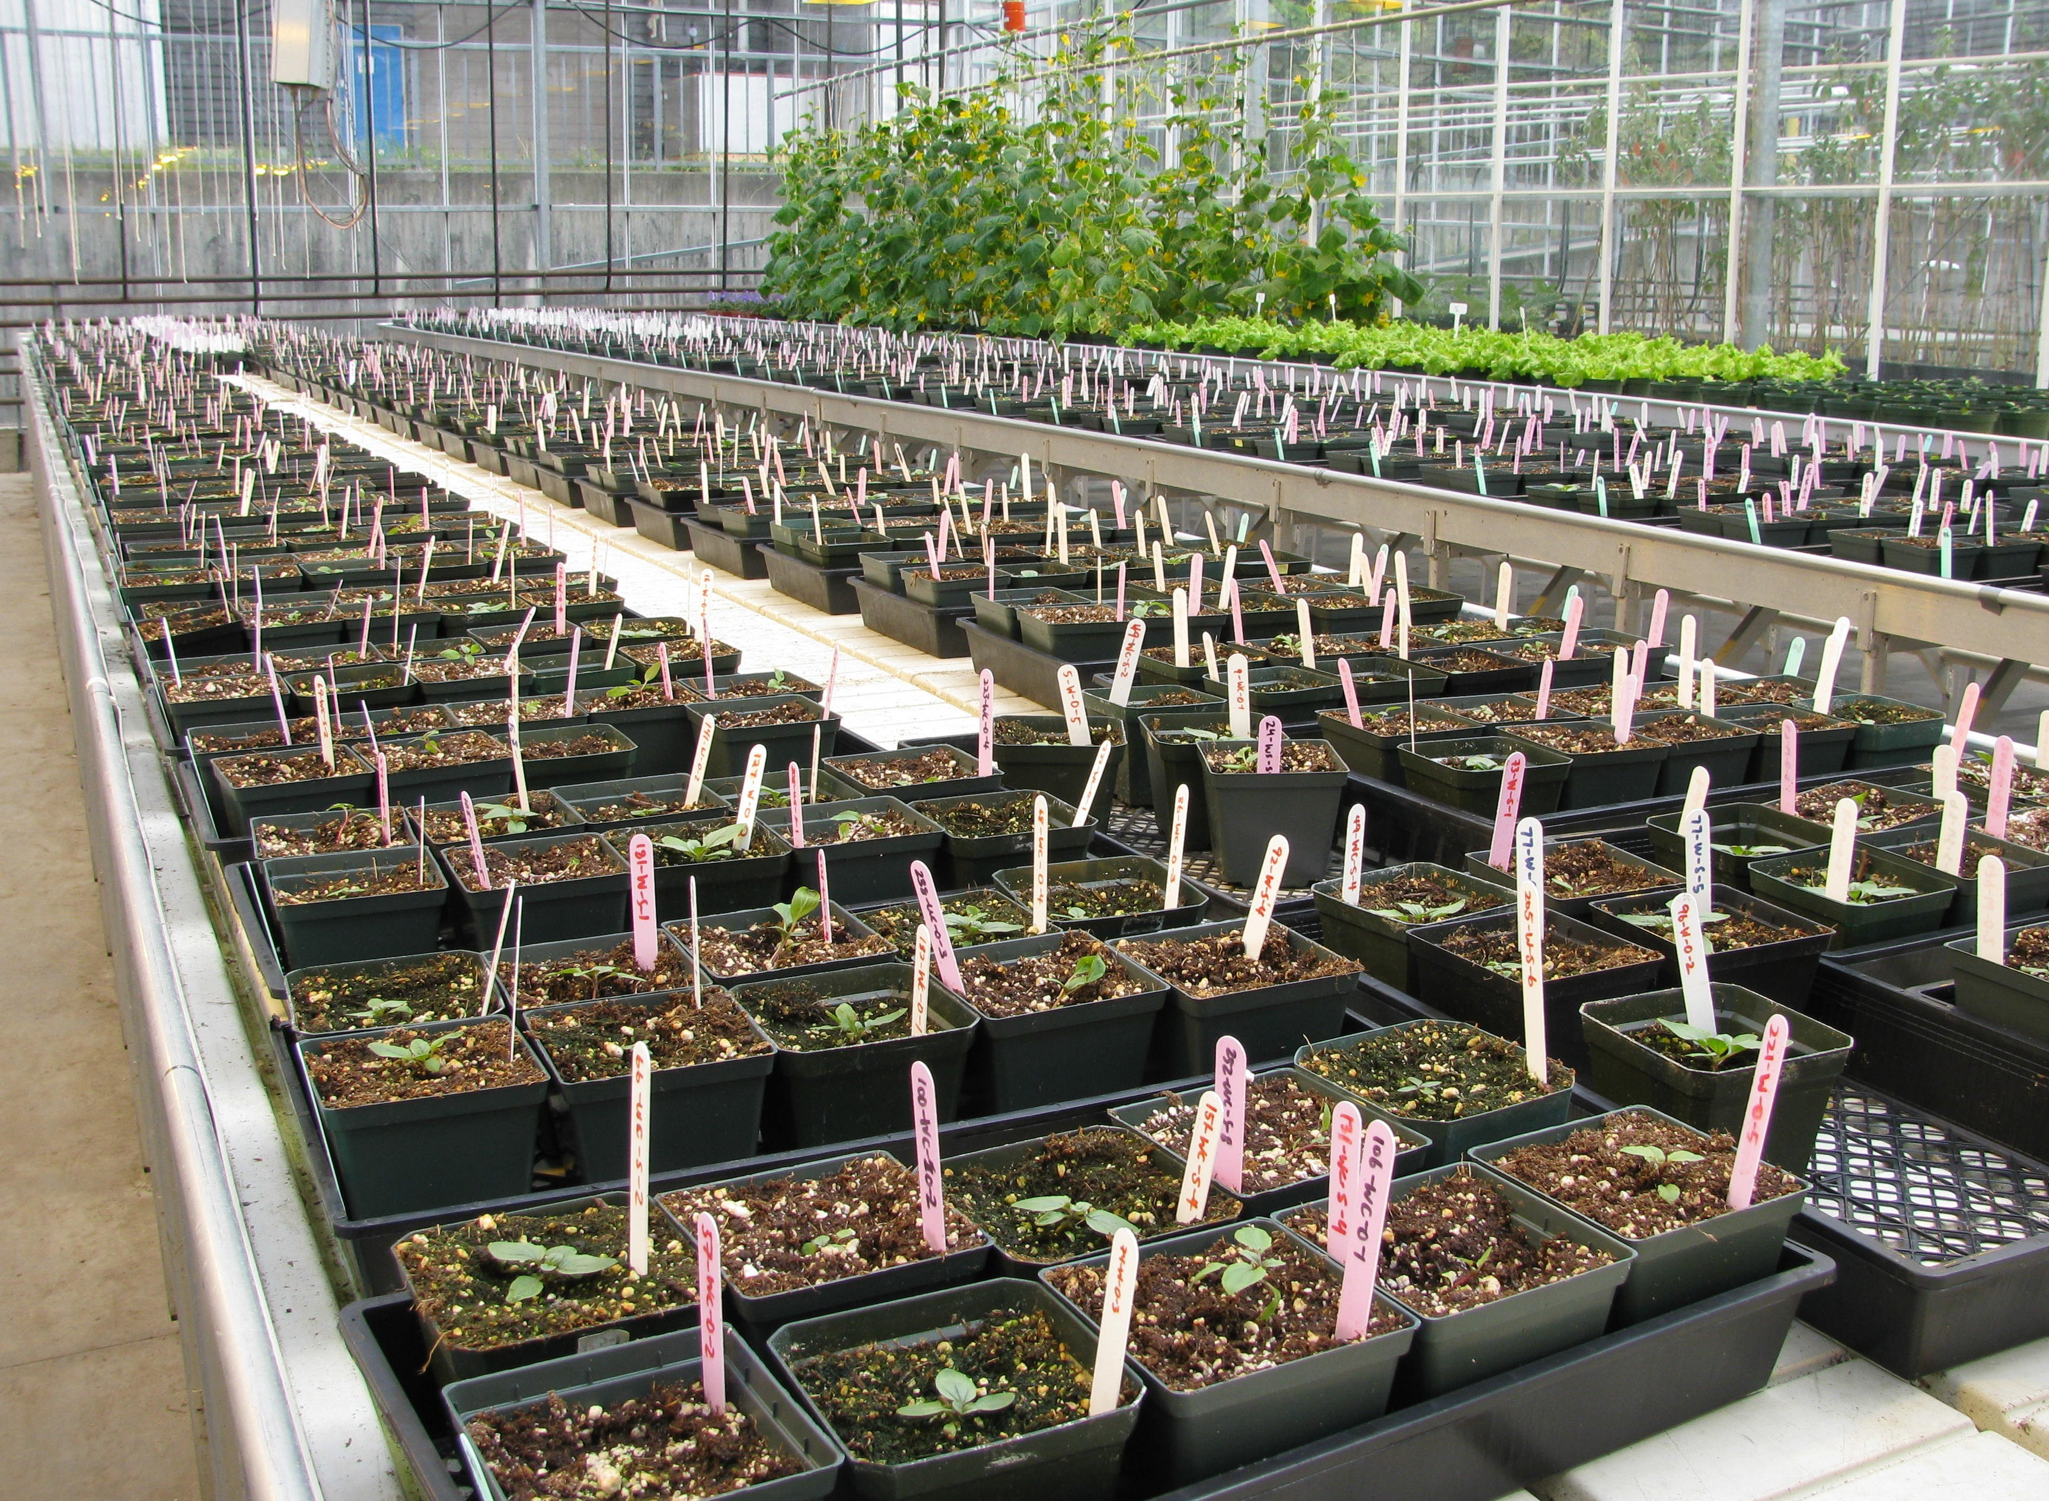
How would you assess inbreeding depression?
Greenhouse/field experiment
-Self and outcross plants
-Measure progeny fitness
-Calculate inbreeding depression
δ=1-w_{s}/w_{o}

Slide 9
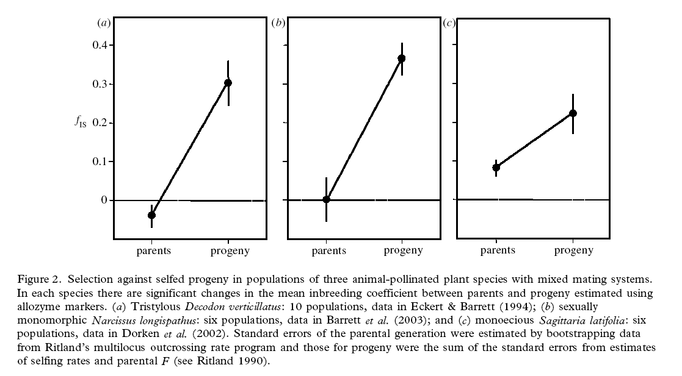
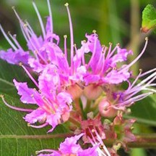
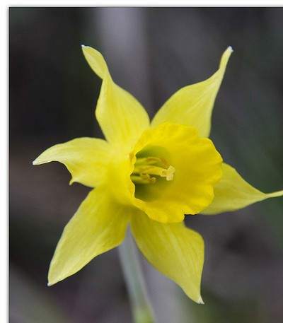
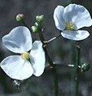
How would you assess inbreeding depression?
Using genetic markers compare inbreeding coefficient of parents and progeny Ritland 1990)

Slide 10
Self fertilization
Why do so many species self despite the cost of inbreeding depression?

Slide 11
Self fertilization
What is a major benefit of selfing?
Transmission advantage (Fisher)
pollen parent seed parent total
outcrossing 1 1 2
selfing (1 out+1self=2) 1 3
The transmission advantage lost if δ>0. 5
Early models on the evolution of selfing predicted that only fully outcrossing or selfing would be evolutionary stable strategies

Slide 12
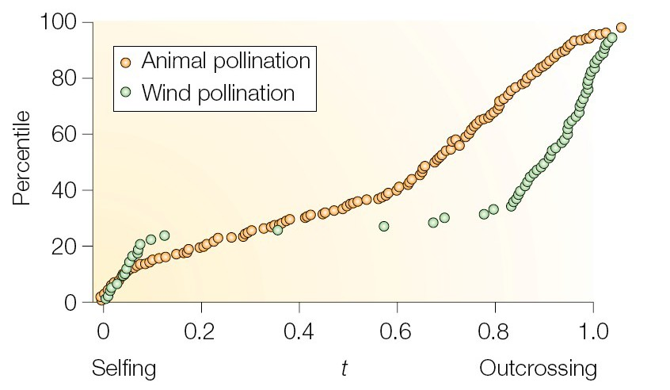
The evolution of self-fertilization
THINK – PAIR - SHARE
Why do so many species have a mixed mating strategy?

Slide 13
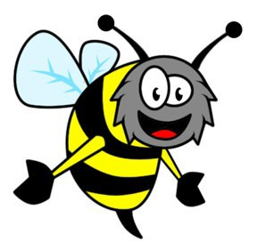

Self fertilization:
pollen discounting
Additional costs of selfing?
i. pollen discounting: the loss in outcrossed siring success as a result of self-pollination
Geitonogamy: between flower self-pollination

Slide 14
Self fertilization:
pollen discounting
Additional costs of selfing?
i. pollen discounting: the loss in outcrossed siring success as a result of self-pollination
Geitonogamy: between flower self-pollination

Slide 15
Self fertilization:
pollen discounting
Additional costs of selfing?
ii. pollen discounting: the loss in outcrossed siring success as a result of self-pollination
Pollen discounting
(reduces transmission advantage)
Geitonogamy: between flower self-pollination

Slide 16
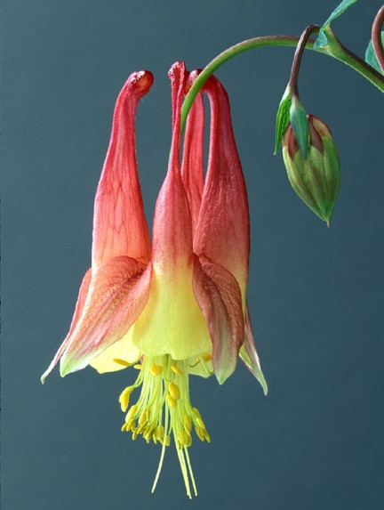

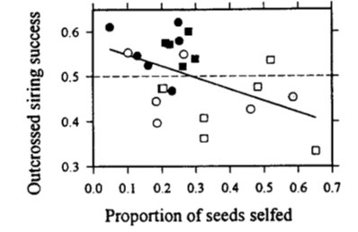
Pollen discounting in Eichhornia
paniculata
3 flowers
12 flowers
Spencer Barrett
Harder and Barrett 1995 Nature
Negative association between outcrossed siring success and selfing rate provides evidence for pollen discounting
The more flowers/inflorescence the more pollen discounting

Slide 17
Self fertilization:
seed discounting
Additional costs of selfing?
iii. seed discounting: the formation of self-fertilized seeds from ovules that, if they had not been self-fertilized, would have been cross-fertilized
If selfing had not happened there would have been 7 more outcrossed seeds
Outcrossed Seed number=18
Outcrossed Seed number =11

Slide 18
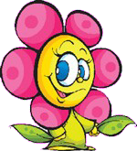
Self fertilization
Additional benefits of selfing?
ii. Reproductive assurance: assured reproduction through selfing when conditions for outcrossing are not favourable (absence of mates or pollinators)
Who can I mate with?
I guess I will mate with myself…
iii. Reduce gene flow and facilitate local adaptation (i.e., reduce outbreeding depression)

Slide 19
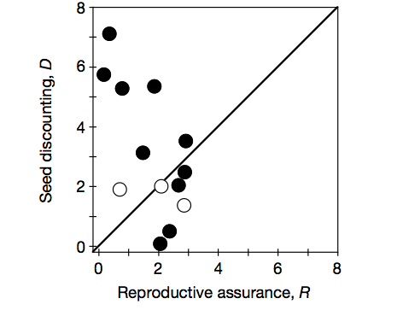
Seed discounting in Aquilegia
canadensis
Test of reproductive assurance hypothesis: Selfing boosts seed set by 14%
Selfing rates very high (circa 75%)
High inbreeding depression, seed discounting = costly
Why does this species self at such high rates?
Herlihy and Eckert 2002 Nature

Slide 20
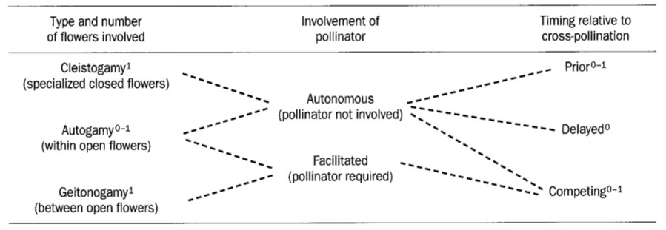
Modes of self pollination
From Harder and Barrett 1996 TREE
Which type of selfing should be favored when there are no mates?
Which type of selfing should be favored when there are few pollinators?

Slide 21
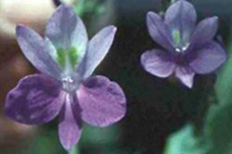
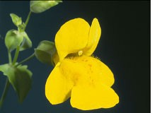
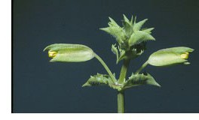
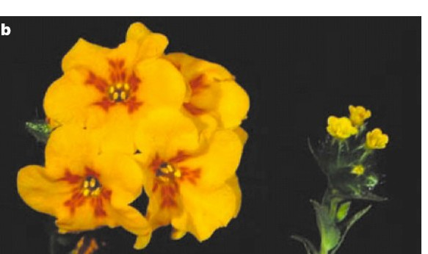


Mating system is correlated with morphological and life history traits
What changes in floral morphology are correlated with selfing?
Eichhornia paniculata
Mimulus guttatus M. nasutus
Amsinckia furcata A. vernicosa
Selfing
-Smaller flowers
-Less attractive
-Fewer rewards
-Lower pollen production
-Smaller stigma-anther distance

Slide 22
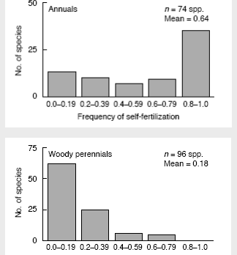
Mating system is correlated with morphological and life history traits
What life history traits are associated with the evolution of selfing?
Annuals tend to be selfers
Why?
Repoductive assurance
Perennials tend to be outcrossers Why?
-costs to future survival and reproduction of reproductive assurance
Barrett et al 1996

Slide 23
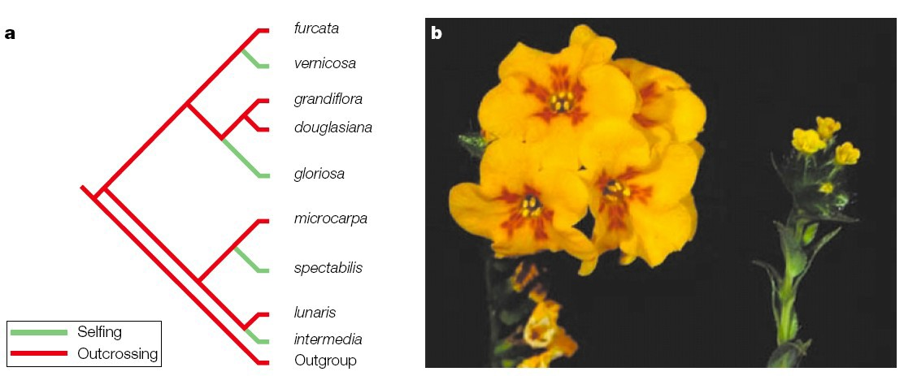
Evolutionary transitions from outcrossing to selfing
Amsinckia
outcrosser Multiple origins of self-fertilization
selfer
The evolution of selfing is thought to be a unidirectional shift Why?

Slide 24
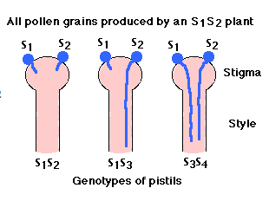
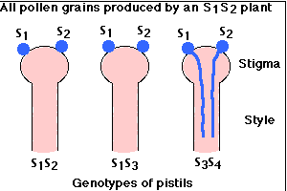
Homomorphic self incompatibility
Two main types of homomorphic incompatibility (up to 50% of angiosperms)
-gametophytic: incompatibility phenotype is determined by its haploid genotype
e.g. S1 or S2 can not fertilize S1S2 plants but S3 pollen can
-sporophytic: incompatibility governed by the genotype of the pollen producing parent
e.g. any pollen from an S1S2 plant can not fertilize an SI_ or S2_ plant

Slide 25
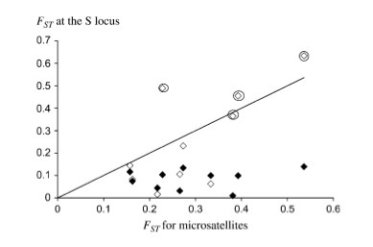
Homomorphic self incompatibility
Maintained by negative frequency dependent selection
(balancing selection):
Rare SI types have a fitness advantage as they can mate with all other plants in the population
Brassica
Many S alleles
Low Fst compared to neutral loci
(higher effective migration due to balancing selection)
Glemin et al. 2005

Slide 26
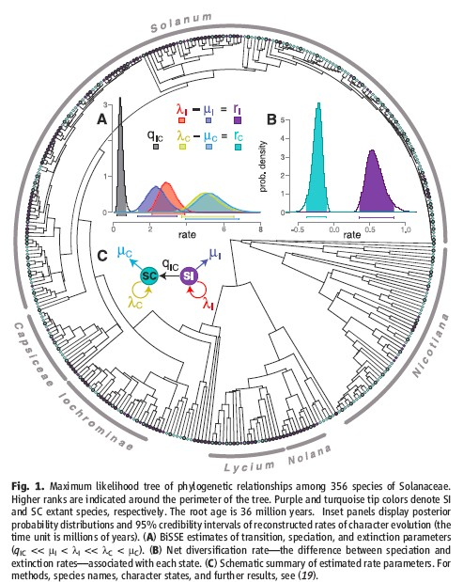
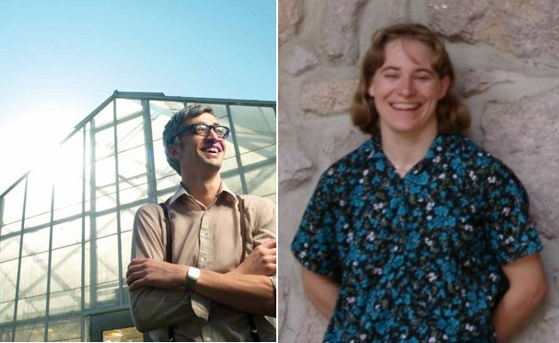
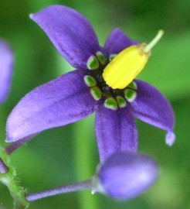
Is selfing a dead end? Long term costs and species selection
Goldberg et al. Science 2010
Boris Igic Emma Goldberg
Solanum dulcamara
SC species have high speciation rates but even higher extinction rates
SI species have lower speciation rates but even lower extinction rates
Long term costs to selfing?

Slide 27
What are the consequences of selfing for genetic variation?
Selection and drift reduce genetic variation in inbreeding vs. outbreeding populations
Selfing and drift
-Completely selfing populations are expected to have a two-fold reduction in effective population size (Ne)
-Therefore drift is stronger in selfing vs outcrossing populations
-Reduces ability of selection to purge deleterious alleles or fix advantageous ones
Selfing demography and drift
-The capacity for uniparental reproduction gives selfers high colonizing ability
-Bottlenecks and lower census population size can further reduce Ne (thereby increasing drift)

Slide 28
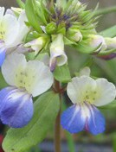
What are the consequences of selfing for genetic variation?
definitions
Selective sweep: an advantageous variant rises to fixation eliminating polymorphism at this locus
Genetic hitchhiking: when an allele increases in frequency because it is linked to a locus under positive selection
Background selection: negative selection reduces variation at linked neutral loci

Slide 29
What are the consequences of selfing for genetic variation?
Selection
-Reduced effective recombination in selfers (due to increased homozygosity)

Slide 30
What are the consequences of selfing for genetic variation?
Reduced effective recombination
Outcrossing
Selfing
Wright et et. 2008

Slide 31
What are the consequences of selfing for genetic variation?
Reduced effective recombination
Outcrossing
Selfing
Wright et et. 2008

Slide 32
What are the consequences of selfing for genetic variation?
Reduced effective recombination
Outcrossing
Selfing
Wright et et. 2008

Slide 33
What are the consequences of selfing for genetic variation?
Reduced effective recombination
Outcrossing
Selfing
Wright et et. 2008

Slide 34
What are the consequences of selfing for genetic variation?
Selection
-Reduced effective recombination in selfers (due to increased homozygosity)
-Positive selection (selective sweep) or selection against deleterious mutations (background selection) reduces variation at linked loci

Slide 35
What are the consequences of selfing for genetic variation?
Selective sweeps and hitchhiking
Outcrossing
Selfing
Wright et et. 2008

Slide 36
What are the consequences of selfing for genetic variation?
Selective sweeps and hitchhiking
Outcrossing
Selfing
reduced neutral diversity
Wright et et. 2008

Slide 37
What are the consequences of selfing for genetic variation?
Does genetic variation in outcrossing and selfing taxa follow these predictions?
Genetic diversity
(selfers vs outcrossers)
Species
Eichhornia paniculata | 2x
Solanum SI/ SC | 4 to 40x
Mimulus guttatus/nasutus | 7x
Arabidopsis lyrata/thaliana | 4x

Slide 38
Mating system summary
Ecological and genetic factors influence the evolution of self fertilization from outcrossing
Selfing is associated with a number of morphological and life history traits
Mating systems and associated demographic traits have strong consequences for genetic variation, as well as speciation and extinction rates
Selfing can have many short term advantages, but appears to be an evolutionary dead end (high speciation rate and extinction rate)

Slide 39
Unanswered questions
What genetic changes are commonly associated with the transition to selfing?
How have transitions away from selfing occurred?
How will selfing rates affect adaptation to a changing climate?
How does the purging of inbreeding depression occur?

