Slide 1
Introduction to Android Programming
Curzel Federico

Slide 2
Android
Introduction to Android
Dalvik Virtual Machine

Slide 3
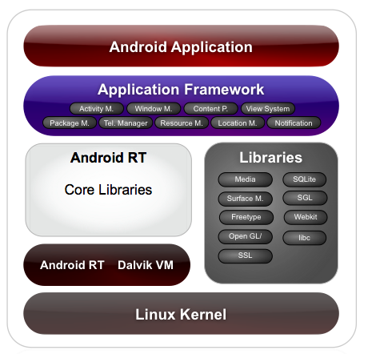
Introduction to Android
Android is a Linux-Based OS which target-platform are mobile devices.
Nowaday, over the 60% of smartphones in the world are running Android.
It is Open Source, it has a good SDK, and it is Linux, this made developers quickly start to love Android.

Slide 4
Life, Death and Miracles
When | What
2003 | Android development starts.
2005 | Google buy Android.
oct 2008 | HTC Dream is the first Android phone to be commerced
apr 2009 | Android 1.5 "Cupcake" released, based on Kernel Linux 2.6.
oct 2011 | Android 4.0 "Ice Cream Sandwich" released, based on Kernel Linux 3.0.
q1 2012 | More than 800.000 Apps on the Play Store.
q3 2012 | 1.5 Million new device activation per day.
q1 2013 | Over 600 Million total activation.

Slide 5
Dalvik Virtual Machine
Executes Dalvik Bytecode.
As there is no exceptions handling in Dalvik Bytecode, DVM handle them at runtime.
Manages multiple instance of itself ( Like the JVM does. )
Provides a "sandbox" where applications can run *without* interact each other.
Abstracts the problem of memory menagement to the OS.

Slide 6
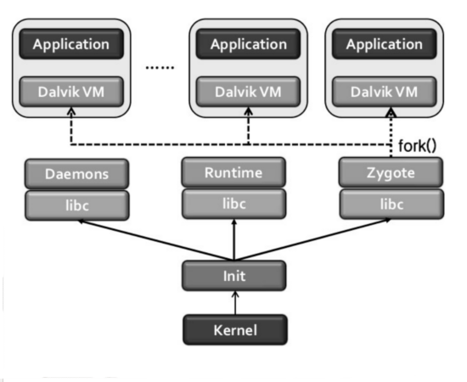
Make it Efficient
Boot-loader load kernel and start init process.
Starts Zygote process.
Initializes a Dalvik VM which preloads and pre-initializes core library classes.
Keep in an idle state by system and wait for socket requests.
Once an application execution request occur, Zygote forks itself and create new process with pre-loaded Dalvik VM.

Slide 7
Android Programming
General lines about Android Programming
Activity
Sample Application
The Role of Java

Slide 8
General lines about Android Programming
Install Google Android SDK and NDK
Install Eclipse (or the ADT Bundle)
Write the application in Java
Test your app on the Android emulator
Test your app on a physical device using ADB

Slide 9
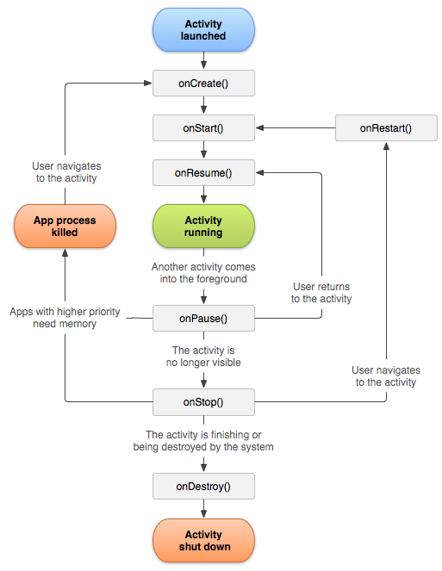
Activity
An activity is a single, focused thing that the user can do.
Almost all activities interact with the user, so the Activity class takes care of managing graphics resources.
Every application is build around a single instance of the Activity class.
All the activity classes must have a corresponding tag in their package's manifest file.

Slide 10
Sample Application
package com.curzel.sample.helloword;
import android.app.Activity;
import android.os.Bundle;
import android.widget.TextView;
public class MainActivity extends Activity {
@Override
protected void onCreate( Bundle savedInstanceState ) {
super.onCreate( savedInstanceState );
TextView text = new TextView(this);
text.setText( "Hello World of Android!" );
setContentView( text );
}
}

Slide 11
The Role of Java
The portability of Java, and all the benefits gained from using J2ME, had led Java soon to become a de-facto development standart for mobile devices
The main problem of mobile architecture is the limited computational power.
A solution that has been found was to make CPU natively execute Java Bytecode (Jazelle).
More recent tecnologies improved the use of JIT compilers ( ThumbEE ).
Every use of the ThumbEE instruction set have been deprecated at the and of 2011, as AArch64 has enstabilished.

Slide 12
Python as an alternative to Java
Python in Pills
Python on Android
Conclusion

Slide 13
Python in Pills
Python is a multi-paradigm programming language, initially developed by Guido Van Rossum, in 1989.
In analogy with Java, is both compiled and interpreted, note that compilation could also come at runtime
Python source files ( *.py ) are compiled in bytecode, which is executed by an interpreter.
Using third-party tools it can also be packaged into standalone executables.

Slide 14
Python on Android
SL4A, Scripting Layer for Android, emulates various kind of interpreters on Android, for a large variety of languages, such as Python or Ruby.
Python-For-Android project allows the developer to create its own python distriution, including all the modules he wants.
Kivy is a cross-platform Python framework for rapid development of application.
Using python-for-android technology to create a python distribution that includes kivy allows you to run the same application code on any Android device.

Slide 15
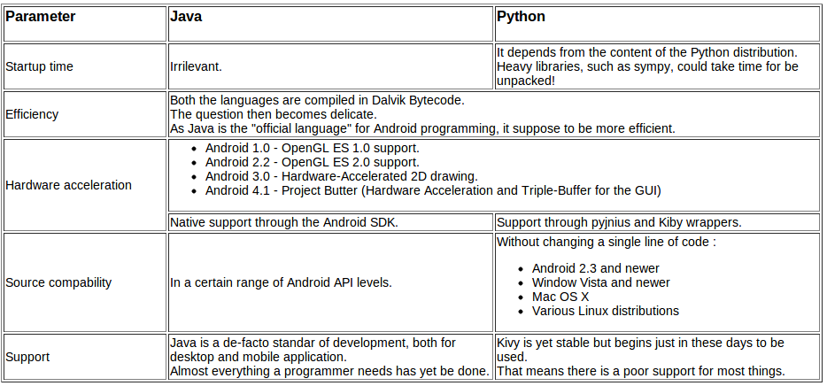
Conclusion

