Slide 1
Running Spar/Java on the DAS
Kees van Reeuwijk, Frits Kuijlman, Henk Sips
TU Delft

Slide 2
Timber project goals
A compiler for high-performance computation on
  Traditional parallel computers
  Clusters like the DAS
  High-performance embedded systems
Convenient parallel programming
Good support for numerical computing, especially arrays

Slide 3
Description
Spar is a set of language constructs for parallel programming and array manipulation
Built on top of Java
Implemented as a batch native compiler that generates C code (plus exceptions).
Supports most of Java 1.0.
Supports many Java 1.2 extensions. No inner classes/interfaces yet.

Slide 4
Spar: sequential constructs
New primitive type complex
Multi-dimensional arrays
Subscript vectors as first-class citizens
A ‘toolkit’ for specialized array representations.
complex a[*,*] = new complex[10,10];
for( v<~[0,0]:a.getSize() ) a@v = 1i;
tuple int^2 ix = [5,5];
a@ix = 1+2i;

Slide 5
Spar: foreach
each { s1; s2; }: statements are executed sequentially, but in arbitrary order.
foreach( i<~0:N ) a[i]=0; executes each iteration sequentially, but in arbitrary order.
Minimal non-determinism.
Allows reduction operations to be expressed

Slide 6
Spar: annotations
Most language constructs can be annotated with pragmas.
Currently used for
  distribution declaration from user
  analysis information
However: general notation
int n <$ on=p[12] $> = 0;
for( v<~[0,0]:a.getSize())
<$ iterations=100 $> a@v = 1i;

Slide 7
Implementation
Batch compiler on entire programs.
No JVM out (or in).
Engines are implemented on Vnus, an intermediate language
Spar/Java
Vnus
Vnus
C/C++
engines
frontend
backend

Slide 8
Current Status
Sequential compiler to gcc (ix86/Linux)
  Java (95%)
  rougly 50% of the Spar extensions
Sequential compiler to Trimedia compiler
Preliminary version of an engine for the data-parallel subset

Slide 9
DAS configuration
MPI over Panda
No bounds checking
No null pointer checks (but ix86 could provide zero overhead on this)
We do support static class initialization
Delft DAS cluster

Slide 10
Saxpy: code
static final double a = 3.41;
static final int N = 50000;
static double Z[*] =
<$on=(lambda (I) p[(block I)])$>
new double[N];
// ... array init done here ...
for( iter<~:8000 )
foreach( i<~ 0:N )
Z[i] = a*X[i]+Y[i];

Slide 11
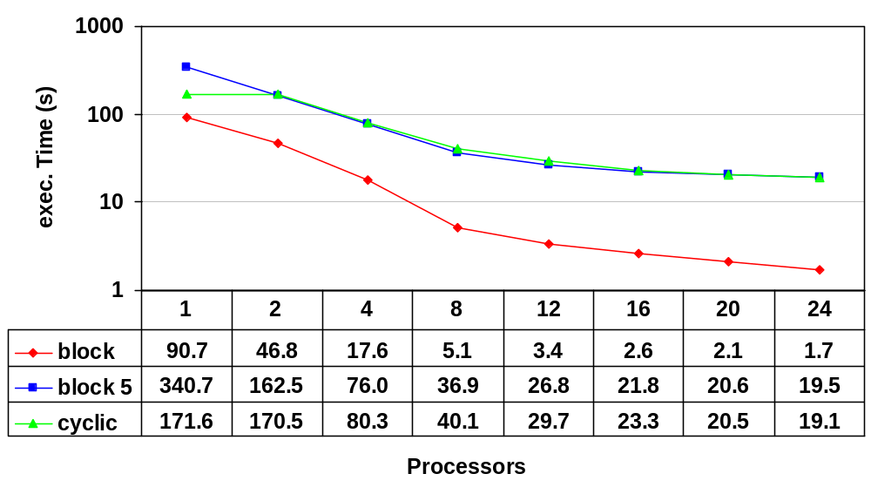
saxpy: graphs

Slide 12
Reduction: code
int a[] = new int a[1000000];
for( iters=0:100 )
int sum = 0;
foreach( i<~0:N )
sum += a[i];

Slide 13
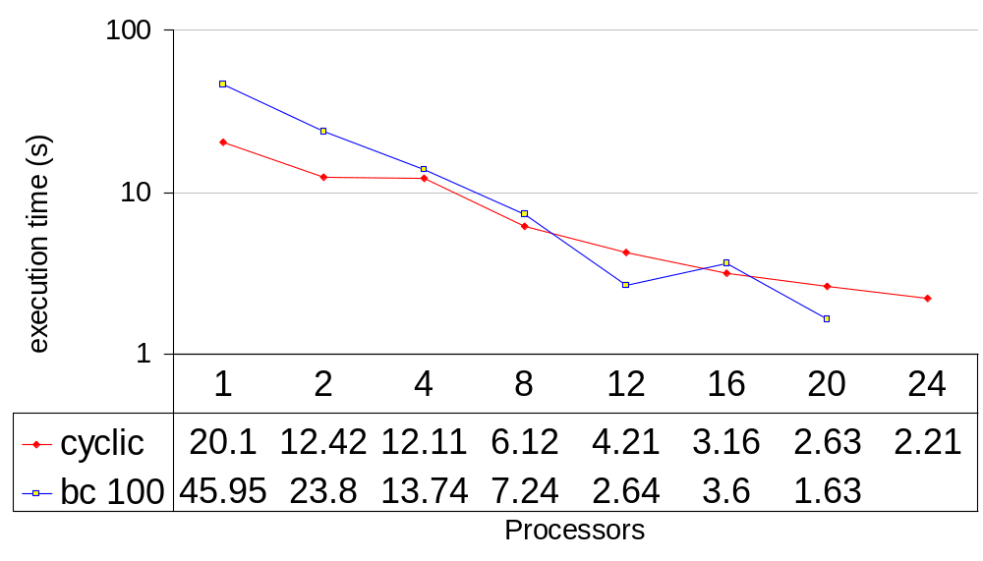
Reduction: graphs

Slide 14
Matrix-matrix multiply
static final int DSZ=16000, SSZ=250, ITER=50;
for( k<~:ITER ){
foreach( i<~:DSZ ) A[i,k] = 0;
foreach( j<~:SSZ ) tmp[j] = C[j,k];
foreach( j<~:SSZ, i<~:DSZ )
A[i,k] += b[i,j]*tmp[j];
}

Slide 15
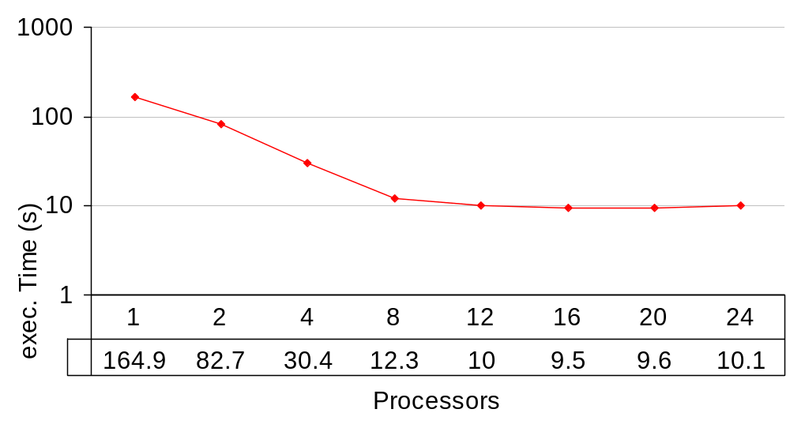
Matrix-matrix multiply: graphs

Slide 16
Future
Official support for data-parallel mode
Beyond the data-parallel mode
Downloadable releases
Completion of the language extensions
Some sequential optimization (virtual call elim., constant prop., Exception check elimination, class init elim.)

Slide 17
Further information
The Timber website: <http://www.pds.twi.tudelft.nl/timber/index.html>
Announcements mailing list: send email to spar-request@pds.twi.tudelft.nl with the subject ‘subscribe’.
The compiler is currently available from a CVS repository.
We will make the compiler available under the GNU public license.

