Slide 1
EMOPortraits
Artifact Bleed & Identity Leakage — What We Know
Internal Review • April 2026

Slide 2
What Is EMOPortraits?
Origin
0.70–0.74
Extends MegaPortraits (Samsung, 2022). Published at CVPR 2024.
CSIM identity score
Task
One-shot head avatar synthesis — animate a single photo with a driving video or audio.
70.3%
Standout
User pref. for expression
Intense & asymmetric expressions, speech-driven mode, cross-identity animation.
FID 59.6
Public Model
Retrained with 17/23 FEED identities; HQ VoxCeleb2 no longer public — weaker than paper.
Generation quality

Slide 3
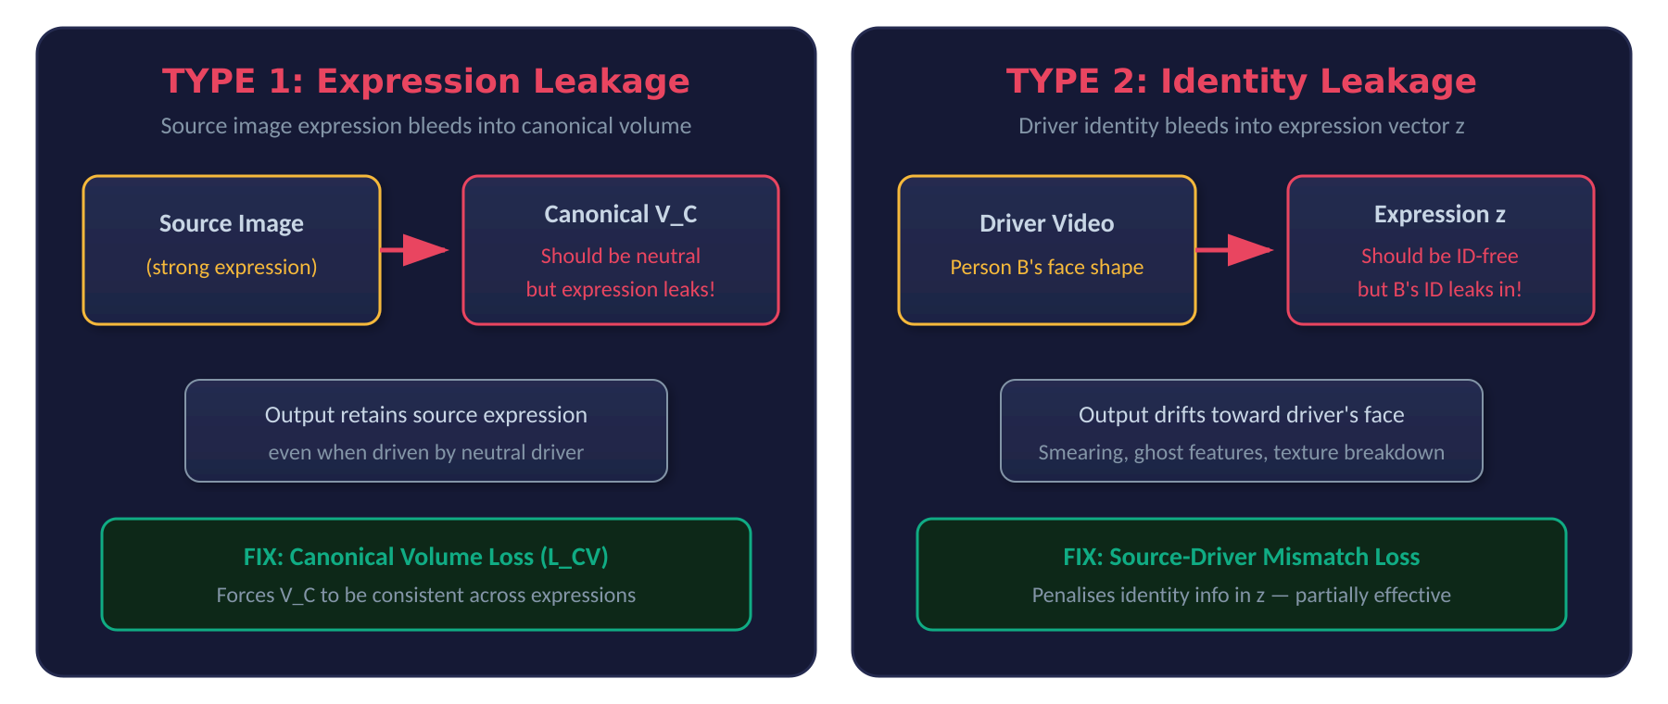
Two Types of Artifact Bleed
Both were partially fixed in EMOPortraits, but neither fully solved — subsequent papers still address residual leakage.

Slide 4
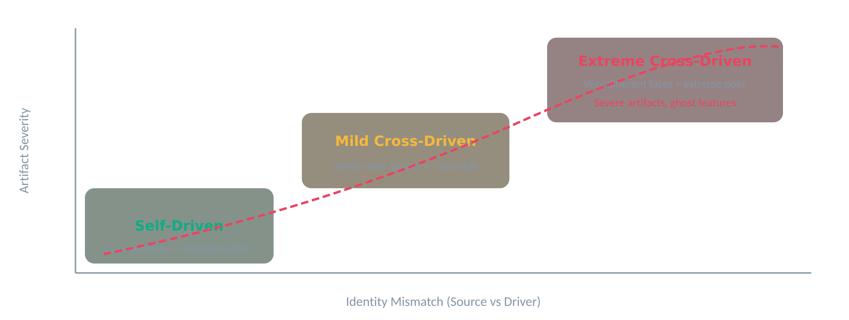
When Do Artifacts Get Worse?
Key insight from FixTalk (2025): In self-driven mode, leakage actually helps detail generation. But in cross-driven mode, the same leakage causes severe artifacts — the model was using it as a crutch.

Slide 5
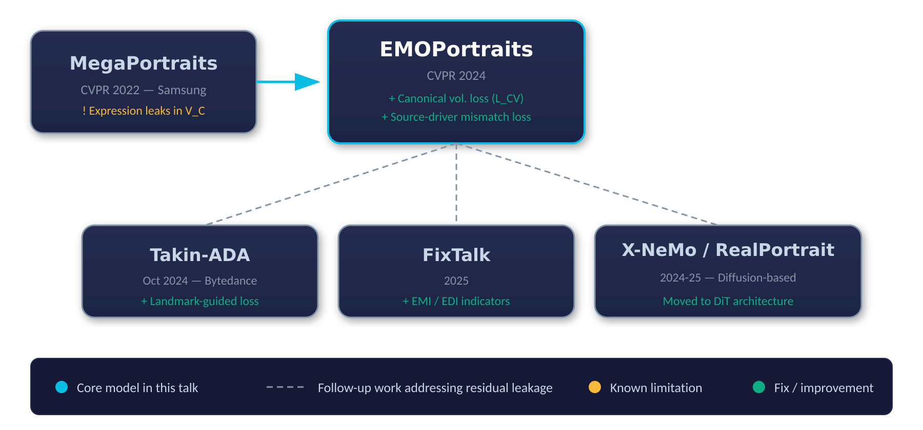
Model Lineage & Follow-Up Work

Slide 6
Practical Recommendations
01
Use neutral source images
Strong expressions in the source will persist in output regardless of driver — residual V_C leakage.
02
Minimize identity gap
Similar face geometry between source and driver produces cleaner results. Large mismatches trigger ghost features.
03
Avoid extreme poses
Extreme head rotations and asymmetric expressions hit the detail-loss cliff — FixTalk's core finding.
04
Public weights are limited
Trained on 17/23 FEED IDs; original HQ VoxCeleb2 is gone. Expect weaker results than the paper shows.
05
Consider newer alternatives
FixTalk (GAN, lightweight), RealPortrait or X-NeMo (diffusion, higher quality) specifically target residual leakage.

Slide 7
TL;DR
EMOPortraits reduced expression & identity leakage vs MegaPortraits, but didn't eliminate either.
The community treats this as an open problem — at least three follow-up papers (Takin-ADA, FixTalk, X-NeMo) specifically target residual artifacts.
For production use, pair EMOPortraits with constrained source inputs, or evaluate the newer diffusion-based alternatives.
Sources: CVPR 2024 (EMOPortraits), arXiv (Takin-ADA, FixTalk, X-NeMo, RealPortrait), ResearchGate

