Slide 1

Analysis of the rise of Cryptocurrency???
Presentation by Colin Wallace and Olga Pisetska

Slide 2
Cryptocurrency vs Fiat money
Currency fluctuation
Analysis and price predictions

Slide 3
Cryptocurrency vs Fiat money
Generated by computers
No known control
Digital medium of exchange
Unknown supply
Issued by the government
Monitored by central bank
Physical medium of exchange
Unlimited supply

Slide 4
Currency Fluctuation
Market is unknown and incredibly volatile
Supply and demand

Slide 5
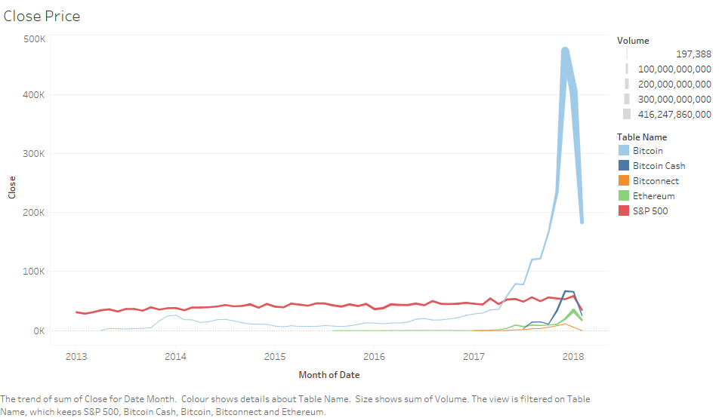

Slide 6
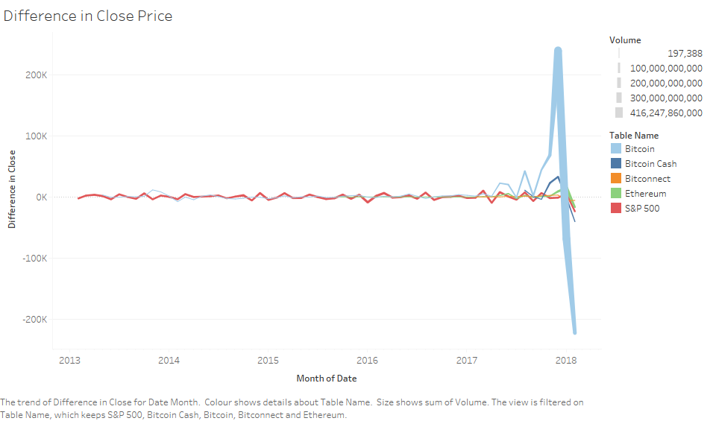

Slide 7
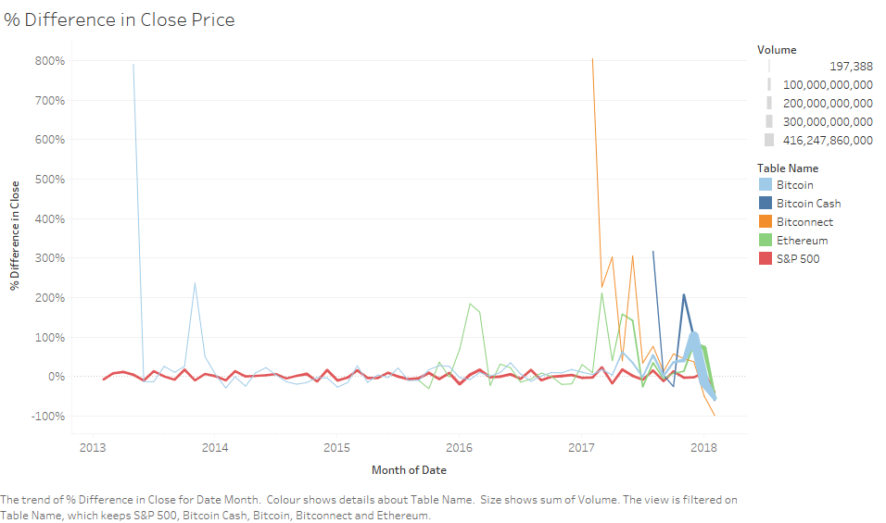

Slide 8
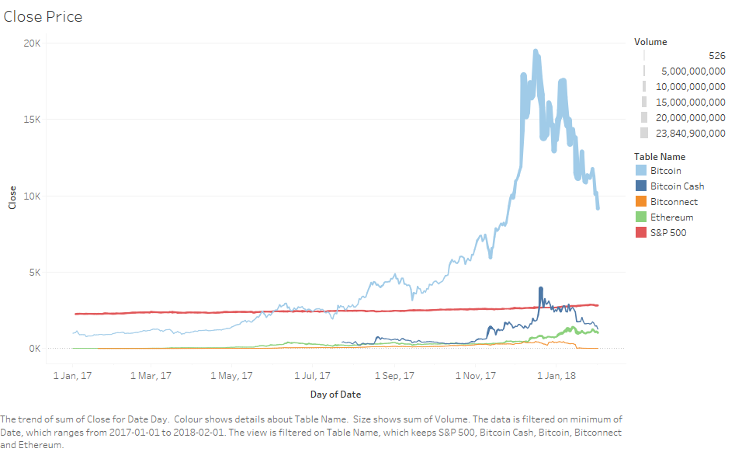

Slide 9
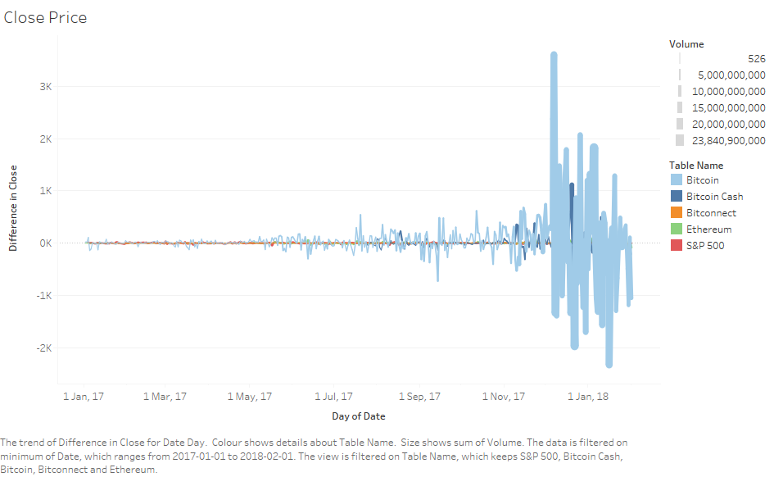

Slide 10
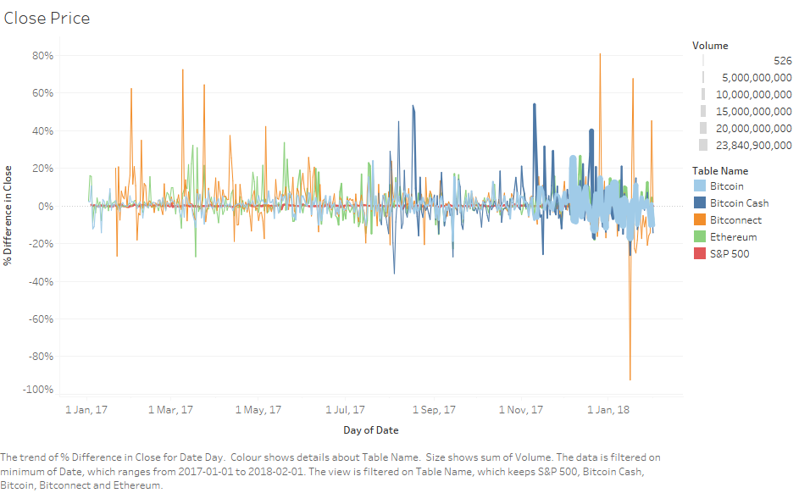

Slide 11
Price Prediction
Extreme from both sides of the scale.
Factors to consider:
Regulations
Growth in the market

