Slide 1
Puzzle-RPG Progress
By Caleb Compton
Advised By Nathan Bean

Slide 2
My Progress
Completed playable Demo
Got animations working (currently very few implemented)
Working on character skills and abilities, should be done by the end of the month

Slide 3
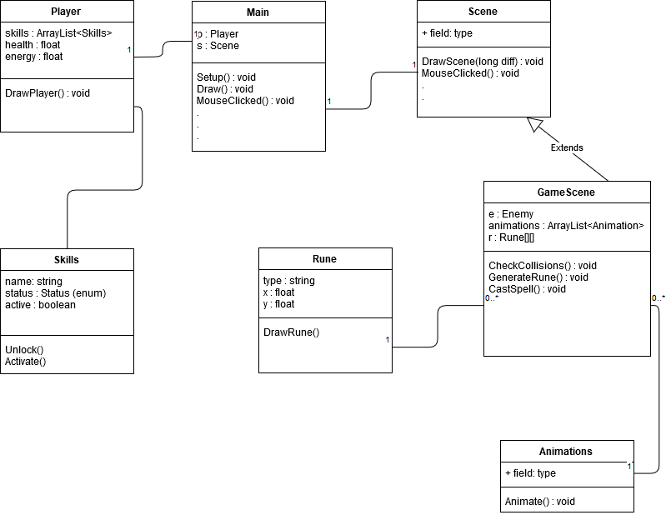
Overall Structure

Slide 4
The Main Class
Processing has 2 required functions in the main class – Setup and Draw
Setup initializes all of the global variables and sets the screen dimensions. Gets called once, before anything else happens
The Draw function is the primary game loop. Gets called repeatedly until program is closed
Everything that happens in the game gets called from the Draw function
Has a number of variables to keep track of the passage of time, framerate, screen size, etc.
All global information is kept in the Main class. Anything else in the program can reference these variables.
Most important variables are the Player and the current Scene.
Main class also has a number of input functions (such as KeyPressed or MouseClicked). These functions automatically call the corresponding function in the current scene

Slide 5
The Scene Class
The scene class does the majority of the actual drawing, as well as input and output
All input actions automatically trigger in the Main class, which call this class to actually handle the input
Various different scenes for different purposes – Map scene for moving across map, menu scenes, skill tree scene, and the actual primary gameplay scenes.
Only one scene is active at a time, when a new action takes place a new scene is loaded.
All information in a given scene is local and temporary, and gets lost when a new scene is loaded

Slide 6
The Game Scene
The majority of the actual gameplay takes place in this scene.
The top of the screen is reserved for drawing the characters and enemies. Players should be able to watch the battle happen, reflecting their actions on the bottom of the screen.
The bottom half of the screen is where gameplay takes place
Every time the draw loop is called, the “DrawScene” function is called. This draws all of the health and energy bars, the characters, as well as the runes.

Slide 7
Animations
Animating using a sprite sheet
All images of a single animation cycle are in a single file
less memory, faster load times
Load the complete sprite sheet image file, then keep track of which part you want to load for any given frame.
Every sprite animated separately, gives fine control over the scene
Animation code currently implemented, but not widely used in the program

Slide 8
Demo

Slide 9
Future Work
Project is pretty much on schedule
April 1st – Complete implementation of Characters and Skills
April 15th – Implement map + at least 1 boss
April 30th – Improve Visuals + User Interface
Stretch Goals – Add Story Features, Implement Additional Game Modes, More levels and Bosses

Slide 10
Any Questions?

