Slide 1

Puzzle-RPG Project “Rune Battle”
By Caleb Compton
Advised By Nathan Bean

Slide 2
Original Project Goal
Develop a puzzle-based rpg to run on Android devices
Allow players to customize their gaming experience through modifiable characters and skill choices
Have several different game modes, including Campaign, Free-play mode, and Competitive mode

Slide 3
Requirements
Game should be accessible to as many users as possible
Be simple to understand, yet have significant depth of strategy
Avoid predatory game design practices found in many mobile games

Slide 4
Timeline
Planned
Actual
February 28th – Have Demo Functionally Complete
March 15th – Implement Animation Class
April 1st – Implement Characters and Skills
April 15th – Implement map + at least 1 boss
April 30th – Improve Visuals + User Interface
Stretch Goals – Add Story Features, Implement Additional Game Modes, More levels and Bosses
February 28th – Have Demo Functionally Complete
March 15th – Implement Animation Class
April 15th – Implement Characters and Skills
April 30th – Implement map + at least 1 boss
Got behind in early April, was able to complete most of my planned features but did not get to improve the UI or stretch goals

Slide 5

Technologies Used
Processing – the primary language and IDE used for most of the project
Towards the end switched to Java (using the Processing library) due to issues with the processing IDE

Slide 6
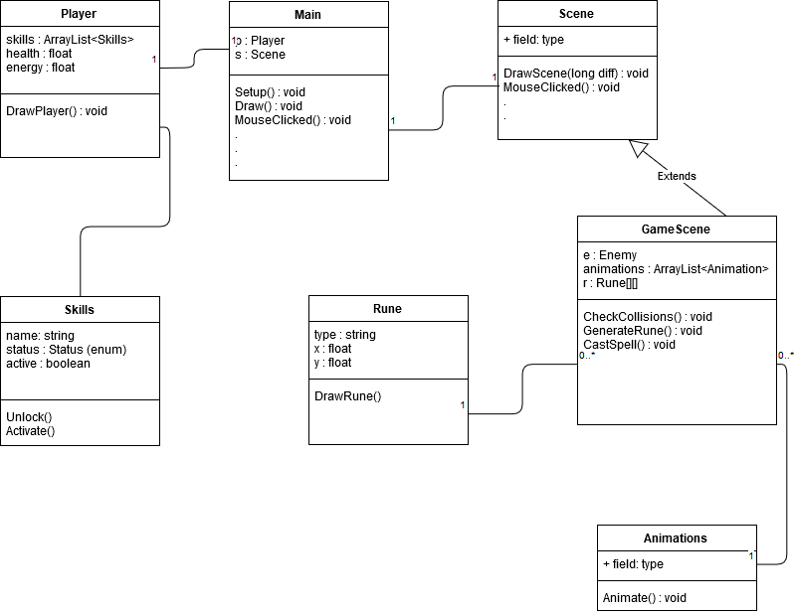
Overall Structure

Slide 7
Control Flow
Load Character
Start Menu
Map Scene
Game Level
New Character

Slide 8
The Main Class
Processing has 2 required functions in the main class – Setup and Draw
Setup initializes all of the global variables and sets the screen dimensions. Gets called once, before anything else happens
The Draw function is the primary game loop. Gets called repeatedly until program is closed
Everything that happens in the game gets called from the Draw function
Has a number of variables to keep track of the passage of time, framerate, screen size, etc.
All global information is kept in the Main class. Anything else in the program can reference these variables.
Most important variables are the Player and the current Scene.
Main class also has a number of input functions (such as KeyPressed or MouseClicked). These functions automatically call the corresponding function in the current scene

Slide 9
The Scene Class
The scene class does the majority of the actual drawing, as well as input and output
All input actions automatically trigger in the Main class, which call this class to actually handle the input
Various different scenes for different purposes – Map scene for moving across map, menu scenes, and the actual primary gameplay scenes.
Only one scene is active at a time, when a new action takes place a new scene is loaded.
All information in a given scene is local and temporary, and gets lost when a new scene is loaded

Slide 10
The Game Scene
The majority of the actual gameplay takes place in this scene.
The top of the screen is reserved for drawing the characters and enemies. Players should be able to watch the battle happen, reflecting their actions on the bottom of the screen.
The bottom half of the screen is where gameplay takes place
Every time the draw loop is called, the “DrawScene” function is called. This draws all of the health and energy bars, the characters, as well as the runes.
Eventually the game scene will have its own subclasses for different levels. Currently have 2 game scenes – one for the regular levels, and one for the Boss level.

Slide 11
Animations
Animating using a sprite sheet
All images of a single animation cycle are in a single file
less memory, faster load times
Load the complete sprite sheet image file, then keep track of which part you want to load for any given frame.
Every sprite animated separately, gives fine control over the scene
Animation code currently implemented, but not widely used in the program

Slide 12
Other Scenes
New Character Scene – allows players to name a new character, and then choose what class it should be (Wizard or Knight)
Map Scene – player moves around the map to different levels. Completing levels unlocks new ones.
Load Game Scene – lists saved characters, and loads the selected character

Slide 13
Player Class
Keeps track of stats such as health and energy, as well as what runes and levels have been unlocked
Gets saved as a JSON file, and then gets reloaded from that file when the player is selected

Slide 14
Gameplay
Various colored circles (called “Runes”) fall from the top of the screen
Player has two options:
Placing similar runes in the “spellbox” will allow the player to cast spells. This uses energy
Connecting three of the same runes in a row will refill some of their energy bar
Player must cast spells to defeat the enemy before they lose all of their health
Player can face challenging bosses that significantly alter the standard rules of the game.

Slide 15
Demo

Slide 16
Challenges
Working with the Processing environment
Tabbed structure made it difficult to work with many files
Very limited IDE made development slow
Converting from Processing to Java

Slide 17
Future Work
Improve visuals
Adjust gameplay to encourage different styles of play
Different enemy types have different weaknesses/strengths, which must be adapted to
Unlocking new runes and abilities over time encourage exploration
Adding combos will encourage players to be more strategic with their runes
Combining runes of different types will add new possibilities
Expand the scope of animations, allowing players to anticipate and react to enemy actions
Higher levels of player customization
Add additional RPG elements (more characters, more customization, items, etc).

Slide 18
Any Questions?

