Slide 1

DNS Webserver configuration
@EG

Slide 2
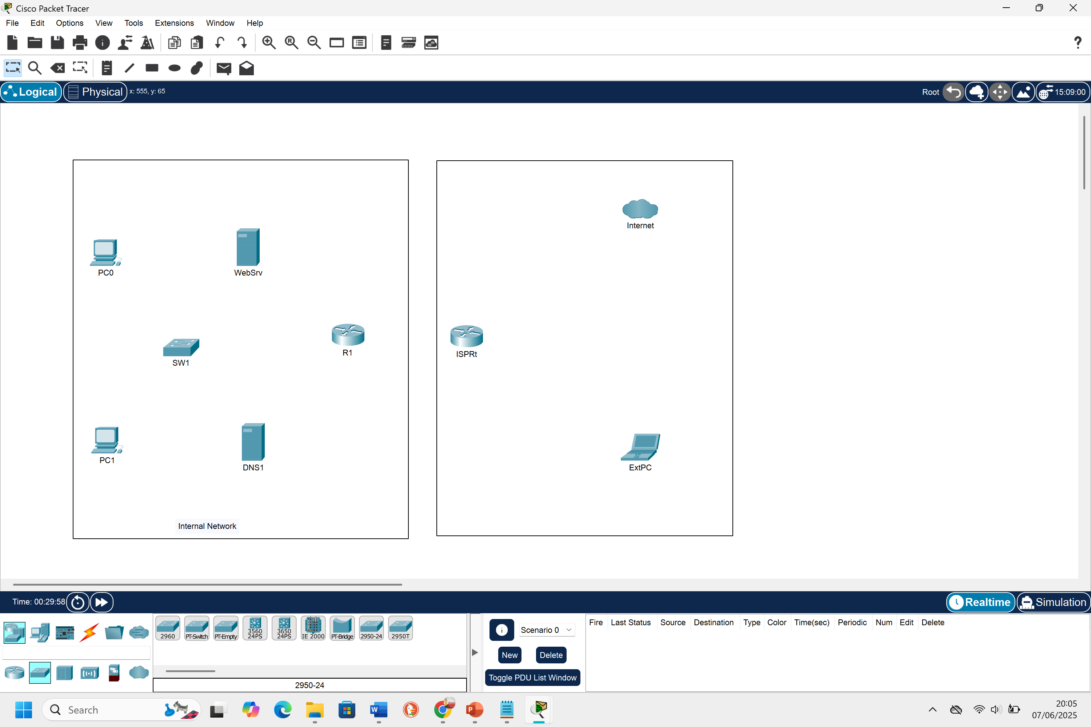
Essential networking equipment
2 Clients PCs labelled PC0, PC1
A switch: SW0
An Internal Router: R1
A Web Server: Websrv
A DNS Server: DNS1
External PC: ExtPC
ISP Router: ISPRt
A Sniffer: Sniffer2

Slide 3

Device configuration
PC0 IP Address: 192.168.1.10/24
PC1 IP Address: 192.168.1.11/24
Default Gateway for PC0 and PC1: 192.168.1.1
DNS server: 192.168.1.60
Internal Router, R1 IP Address: 192.168.1.1/24
A Web Server, Websrv IP Address: 192.168.1.50/24
A DNS Server, DNS1 IP Address: 192.168.1.60/24
External PC, ExtPC DHCP from ISPRt
ISP Router, ISPRt IP Address: 192.168.2.1/24

Slide 4
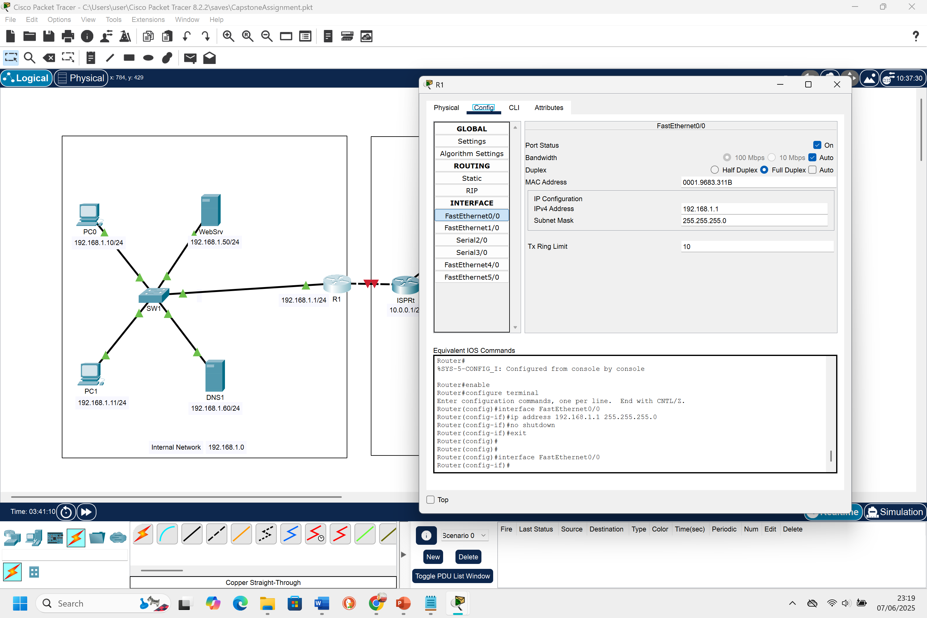
Connecting cables and router(r1) configuration
To configure the router R1, click on the router R1 to open its properties
Click on the CLI tab, then click on the inside rectangular box, then hit enter. “Router>” will appear. Now type these commands in the terminal
Enable
Configure terminal
Interface FastEthernet0/0
Ip address 192.168.1.1 255.255.255.0
No shutdown
Interface FastEthernet1/0
Ip address 10.0.0.1 255.255.255.0
No shutdown
Ip route 0.0.0.0 0.0.0.0 10.0.0.254
exit

Slide 5
CONFIGURATION AND DNS SERVER SETUP(DNS1)
To setup and configure the DNS1, click on the DNS1 icon to open its properties.
Click on the Config tab, then select Settings from the Global menu.
Click on the radio icon for the Static under the Gateway/DNS IPv4
Enter Default Gateway 192.168.1.1 and 192.168.1.60 for DNS Server.
Again, select FastEthernet0 under Interface tab, then select Static radio button, and then input the IPv4 address under IP Configuration as 192.168.1.60. It will automatically assign a subnet mask of 255.255.255.0 when you hit enter
N.B: Make sure the port status is ON, and the Bandwith is set to 100Mbs and Duplex is set to Full Duplex.

Slide 6

CONFIGURATION, web SERVER SETUP(Websrv) and website hosting
Repeat the same process as you did for the DNS1 setup by following the steps and assigning an IP address of 192.168.1.50
Now to host the company’s website, click on the Web Server device(WebSrv)
Go to the Services tab
Select HTTP on the left panel
Under Web pages, click on: index.html and edit by writing or pasting your html code. Eg n the right side.
Click on the save button

Slide 7
TESTING CONNECTIVITY BETWEEN DEVICES
After setting up your client PC0 and PC1, you can test connectivity using the “ping” command.
Verify that your IP for PC0 is 192.168.1.10 with subnet mask of 255.255.255.0 by typing the “ipconfig” command in the terminal in PC0 properties. Repeat the same for PC1.
After confirming the IP address, use the “ping” command to test connectivity.
On the desktop tab in the PC0 properties, click on the command prompt icon
Type the command: ping 194.168.1.11
When you receive four replies, it verifies there’s a connection.
N:B- You can do same on other devices by using the same command and typing the corresponding IP address.

Slide 8
CONFIGURING TWO DISTINCT SUBNETS ON R1 AND ISPRT ROUTER
This is necessary because routers are designed to router traffic between different networks. For this reason, they cannot have two interfaces in the same subnet.
That means one subnet handles internal routing to the LAN and the other handles the external user segment. Below shows what I mean
R1 runs an IPv4 of 10.0.0.1 on fastethernetFa1/0 and ISPRt runs IPv4 of 10.0.0.254 on fasethernetFa0/0 on subnet 10.0.0.0/24
ISPRt runs an IP of 10.0.1.1 on fastethernetFa0/1 and Extpc runs an IP of 10.0.0.10 on fastethernet0 on a subnet 10.0.1.0/24

Slide 9
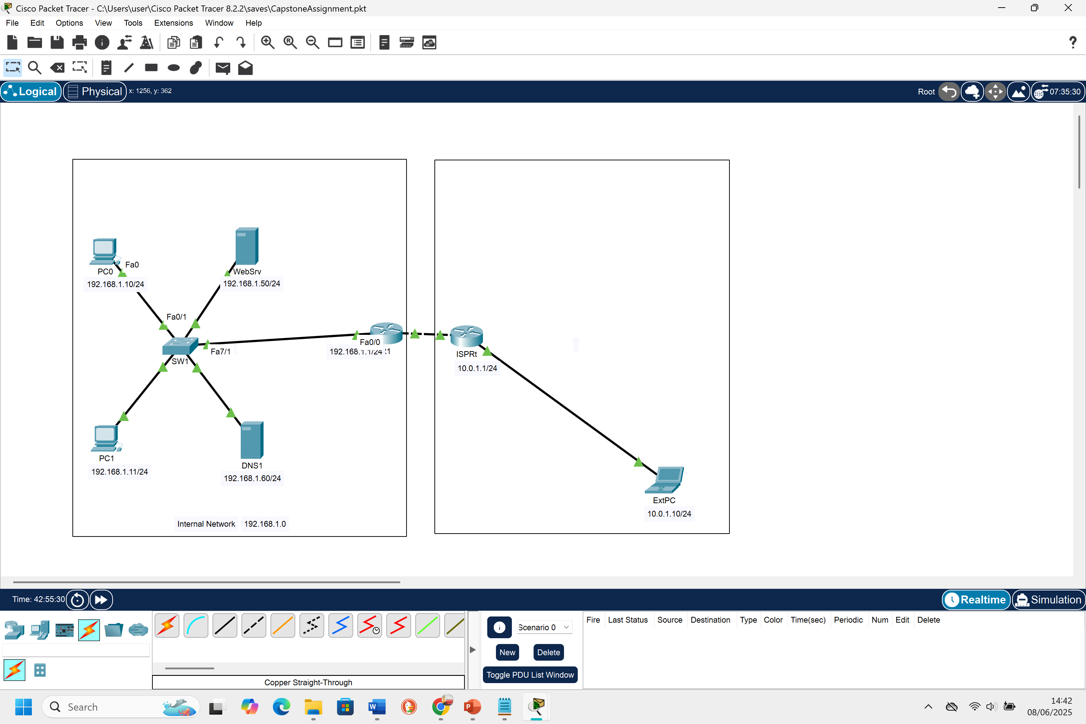
Connecting all nodes and testing connectivity
It can be seen on the diagram that all nodes are connected and there’s a flow of traffic between all hosts on the network. Use the command “ping” to test the connectivity between all devices.
It can be seen that the cloud icon is deleted from the topology since its not needed in our network as required.

Slide 10
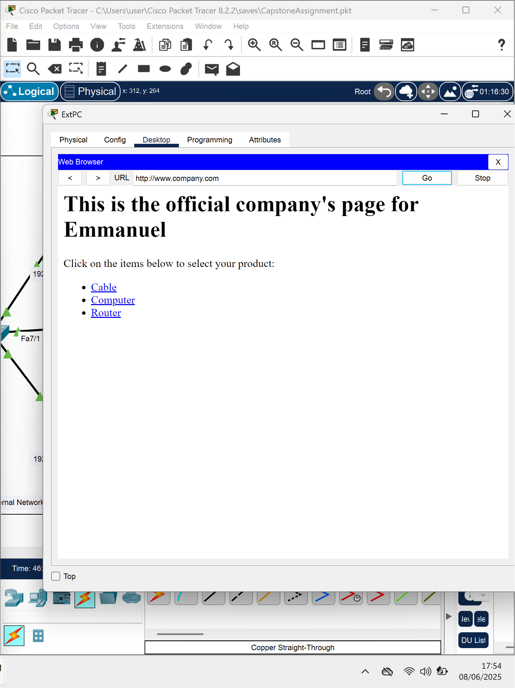
Testing connectivity on extpc browser
Click on ExtPc to open its properties. Click on desktop tab and select Web Browser from the page.
In the URL of the opened browser, enter www.company.com and hit enter.
It appears that the hosted website on the Websrv server is requested through the DNS server which opens the page “This is the official company’s page for Emmanuel…”

Slide 11
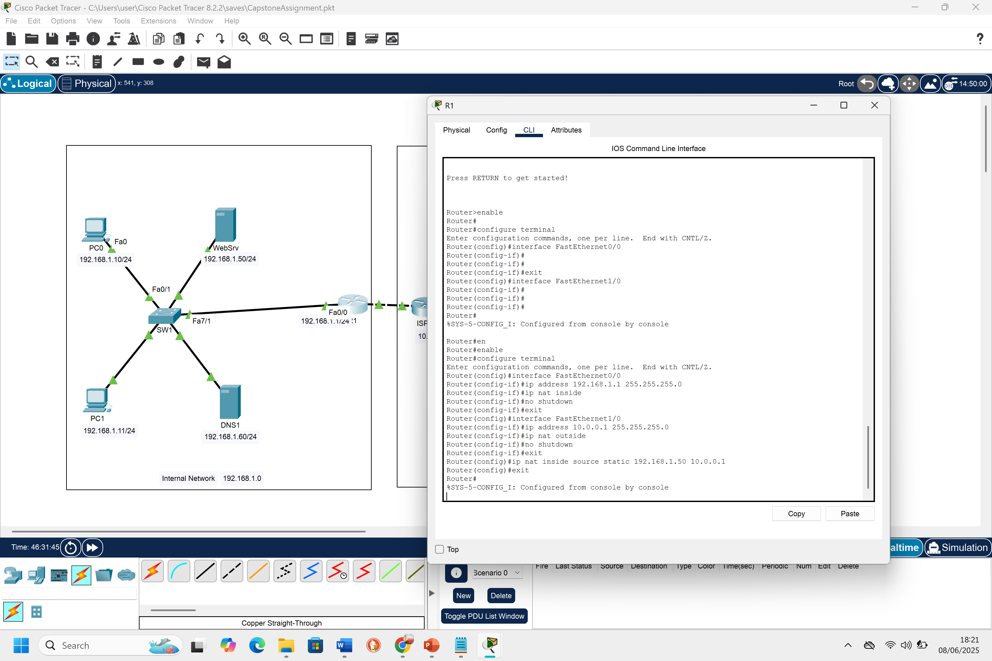
Configuring nat on r1
Click on R1 to open its properties. Click on CLI tab to input these command.
Enable
Configure terminal
IDENTIFY INSIDE AND OUTSIDE INTERFACE ON R1
# On Interface FastEthernet0/0
Ip address 192.168.1.1 255.255.255.0
Ip nat inside
No shutdown
Exit
# On interface FastEthernet1/0
Ip address 10.0.0.1 255.255.255.0
Ip nat outside
No shutdown
Exit
# Set up static NAT for web server
Ip nat inside source static 192.168.1.50 10.0.0.1

Slide 12
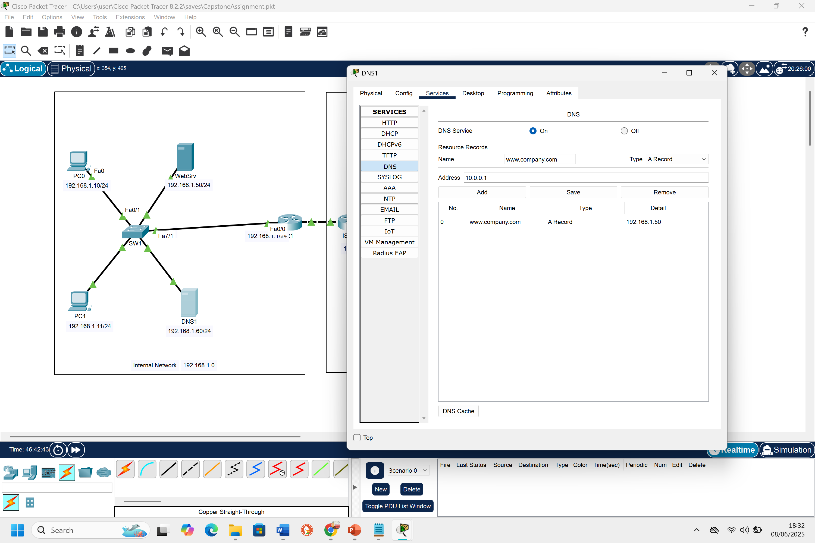
Configuring dns1 again after setting nat
When NAT is configured on a router R1, if fails to send packets to the ExtPC. This is because NAT resolve to 10.0.0.1 only to send packets to external source ExtPC. To configure, follow these steps;
Click on DNS1
Go to Services tab and click DNS
Ensure DNS is still ON
Add www.company.com to the name textbox and enter 10.0.0.1 in the address box. Choose A record for the type.
Hit the add and save button respectively.
Now close the properties and browser the domain again to confirm there’s connection.

Slide 13
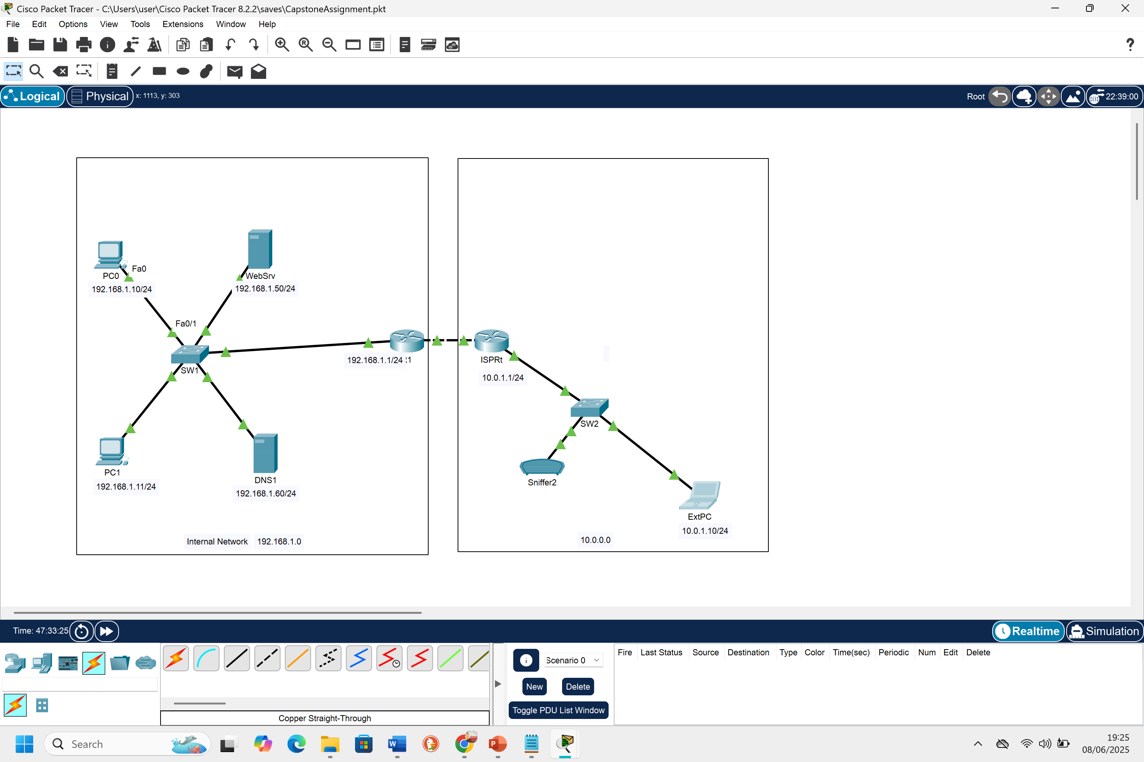
Final view of the canvas
After a successful connection with all the nodes on the network, the canvas should look like this image on the right.

