Slide 1
Collidres
Unity

Slide 2
Collider
class in UnityEngine / Inherits from:Component / Implemented in:UnityEngine.PhysicsModule

Slide 3

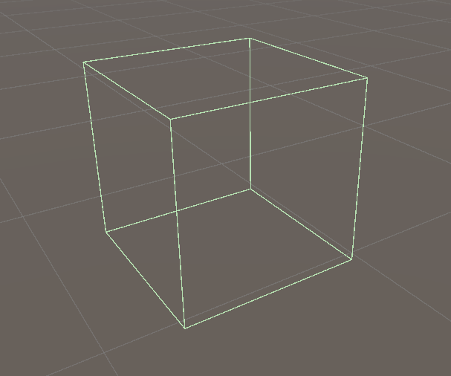
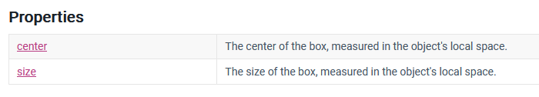
Box Collider

Slide 4

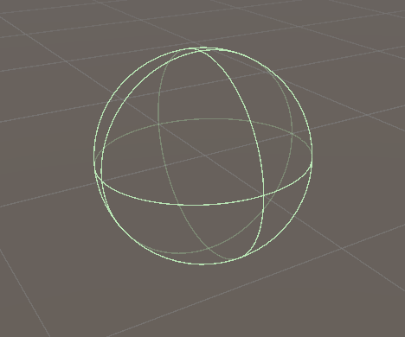
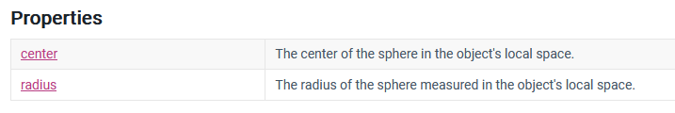
Sphere Collider

Slide 5

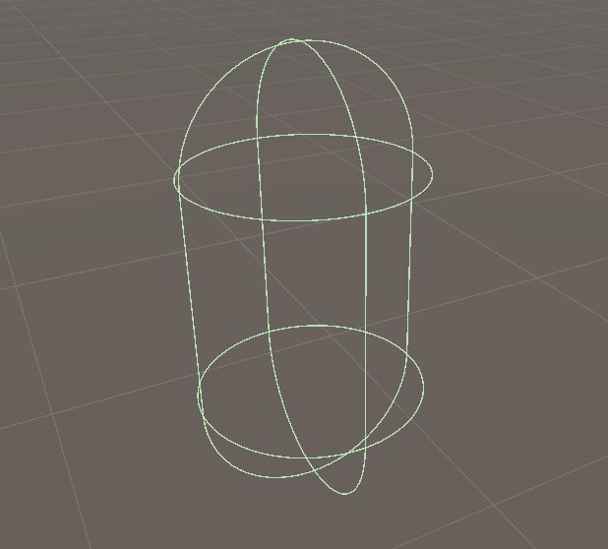
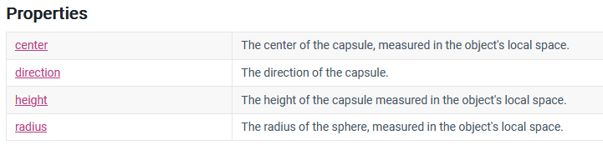
Capsule Collider

Slide 6

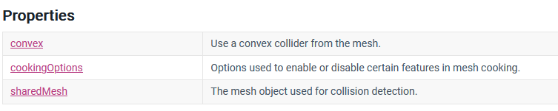
Mesh Collider

Slide 7

Mesh collider component reference
The Mesh collider takes a Mesh Asset and builds a collider that matches the geometry of that Mesh. It is more accurate for collision detection than using primitives, and is a better option for complicated Meshes.
Mesh colliders that are marked as Convex can collide with other Mesh colliders.
A mesh asset represents a mesh in your Unity project.
Usually, Unity creates mesh assets when it imports model, but you can also create mesh assets directly in Unity; for example, by creating a mesh with code and saving the results as an asset.

Slide 8
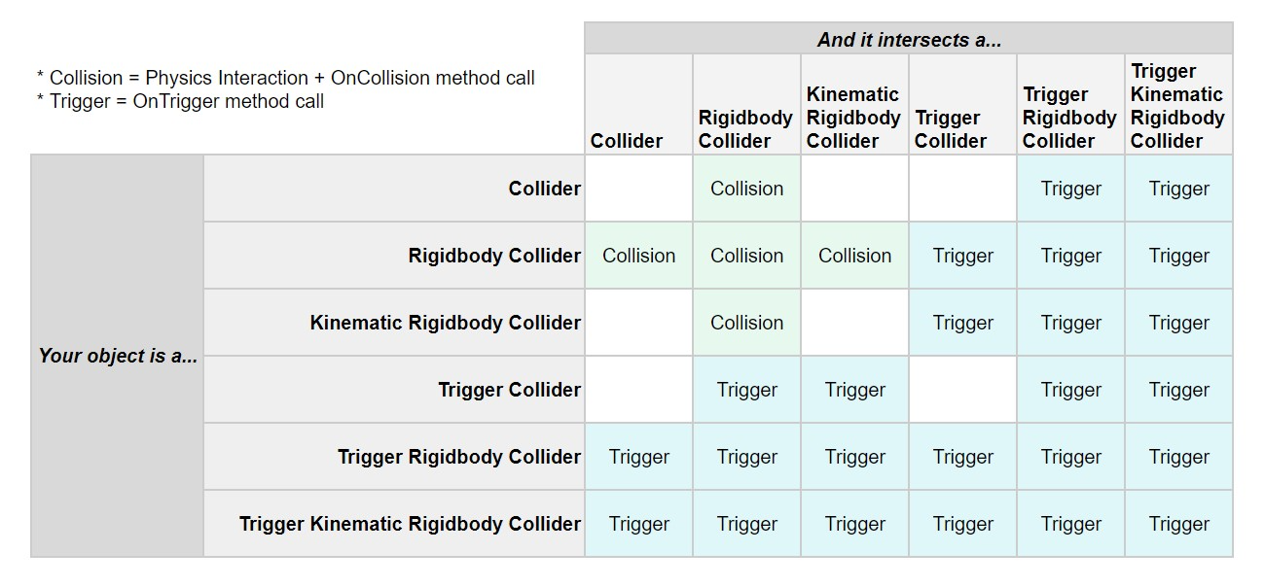

Slide 9
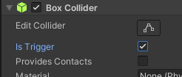
Collider
OnTrigger
OnCollision

Slide 10
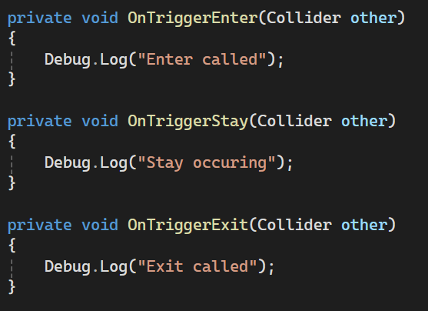
Trigger

Slide 11
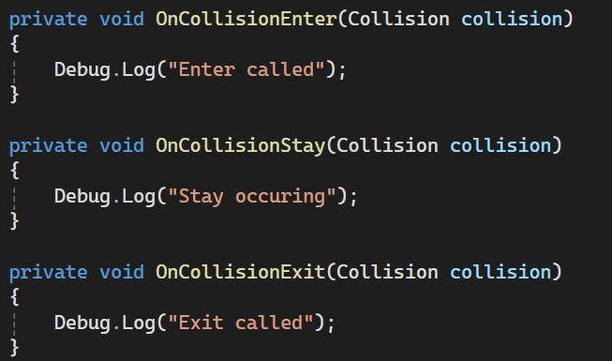
Collision

