Slide 1

Deep Transfer Learning for Person Re-id
Mengyue Geng Yaowei Wang Tao Xiang Yonghong Tian
Arxiv 2016
报告人 陈伟航

Slide 2
Transfer Learning
旧数据训练得到的分类器，在新的数据上重新训练，从而在新数据上取得比较好的表现，新数据与旧数据有相似的地方，但具有不同的分布。
Target
DataSet
Fine tune
Image
Classifier
Pretrain Model
TargetModel
Source DataSet
训练
ImageNet

Slide 3
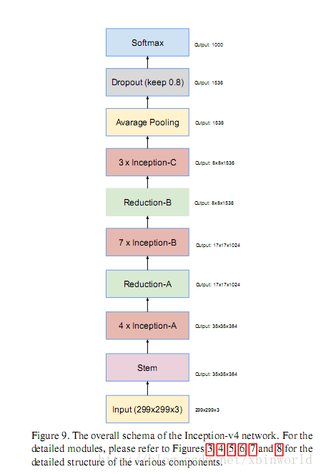
Fine tuning
移除Softmax分类层
换成与目标数据集输出维数相同的Softmax层
冻结靠近输入的卷积层
以较高的学习率训练分类层
以很低的学习率微调剩下的卷积层

Slide 4
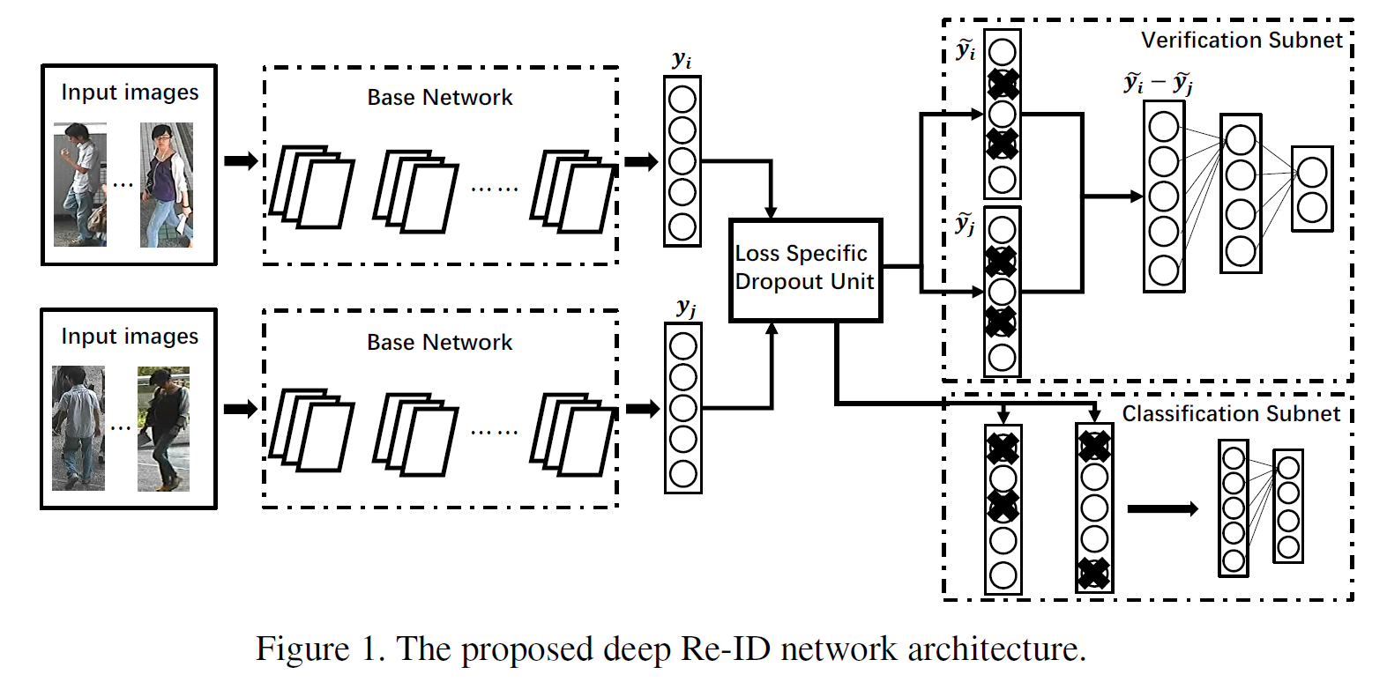
Deep Transfer Learning for Person Re-id
Multi loss
GoogleNet（InceptionV1）
Two step fine tune

Slide 5
Unsupervised Transfer Learning
Self-training
Co-training
Similarity from Deep Model
Similarity from Co-Model

Slide 6
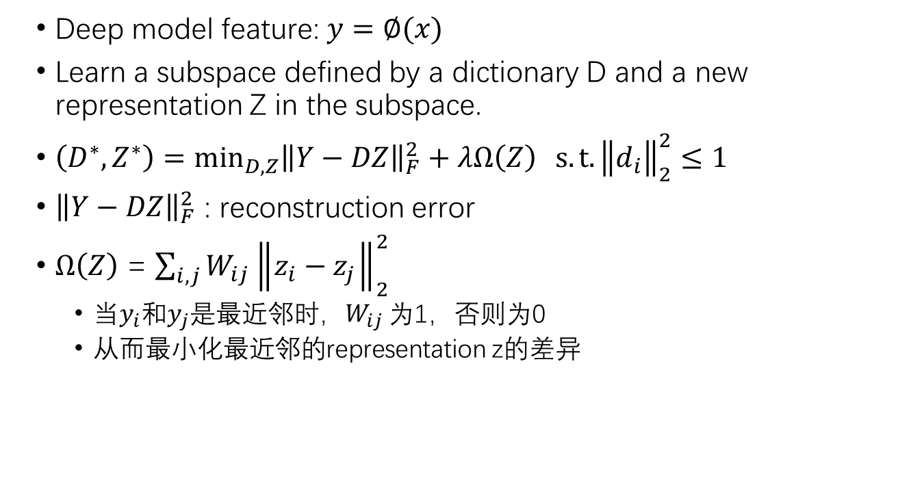
Co-training
Deep model feature: $y=∅(x)$
Learn a subspace defined by a dictionary D and a new representation Z in the subspace.
$（D^{∗},Z^{∗}）=\min_{D,Z}{{\left\|Y\right.−\left.DZ\right\|}_{F}^{2}+λΩ\left(Z\right)} s.t.{\left.\left\|d_{i}\right.\right\|}_{2}^{2}≤1$
${\left\|Y\right.−\left.DZ\right\|}_{F}^{2}$ : reconstruction error
$Ω\left(Z\right)$ = $\sum_{i,j}{W_{ij}{\left.\left\|z_{i}−z_{j}\right.\right\|}_{2}^{2}}$
当$y_{i}$和$y_{j}$是最近邻时，$W_{ij}$ 为1，否则为0
从而最小化最近邻的representation z的差异

Slide 7
Trick Result
Softmax loss VS Multi loss： 76.6% -> 83.7%（Market1501）
一致的Dropout VS 随机的Dropout： 80.8%-> 83.7% （Market1501）
Two-stepped VS one-stepped: 47.6%->56.3%(VIPeR)

Slide 8
Supervised Transfer Learning Result
Dataset | State of the art | Transfer
CUHK03 | 75.3 | 85.4
Market1501 | 82.21 | 83.7
VIPeR | 53.5 | 56.3
PRID | 40.9 | 43.6
CUHK01 | 86.6 | 93.2

Slide 9
Unsupervised Transfer Learning Result
Dataset | State of the art | Transfer
VIPeR | 33.5 | 45.1
PRID | 25.0 | 36.2
CUHK01 | 41.0 | 68.8
Compare with other unsupervised method
Method | State of the art
Self-training | 42.8
Subspace | 42.3
Transfer | 45.1
CNN + Auto Encoder | 36.4
Adversarial | 22.8

Slide 10
Thank You

