Slide 1

ShelfSense API system
ShelfSense API • XJCO3011 Web Services and Web Data
Author
[ Yantong Chen / 201690988 ]
Date
[April 2026]

Slide 2
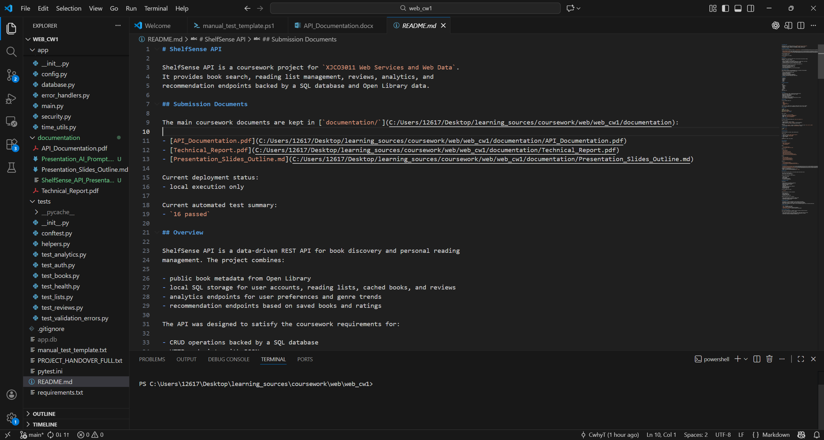
Project & Features Overview
RESTful backend service for book discovery, reading management, and lightweight recommendation.
Combines Open Library metadata with local SQL-backed user data.
Core areas: authentication, reading lists, reviews, analytics, and recommendations.
Implements structured HTTP endpoints with JSON request/response handling.
Designed as an individual coursework API project rather than a frontend application.
Project overview visual
Insert overall system screenshot or API docs overview
FastAPI
SQLite
Open Library
pytest

Slide 3
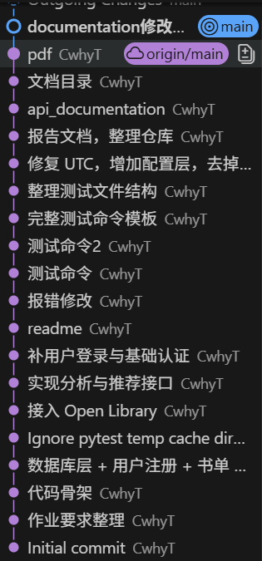
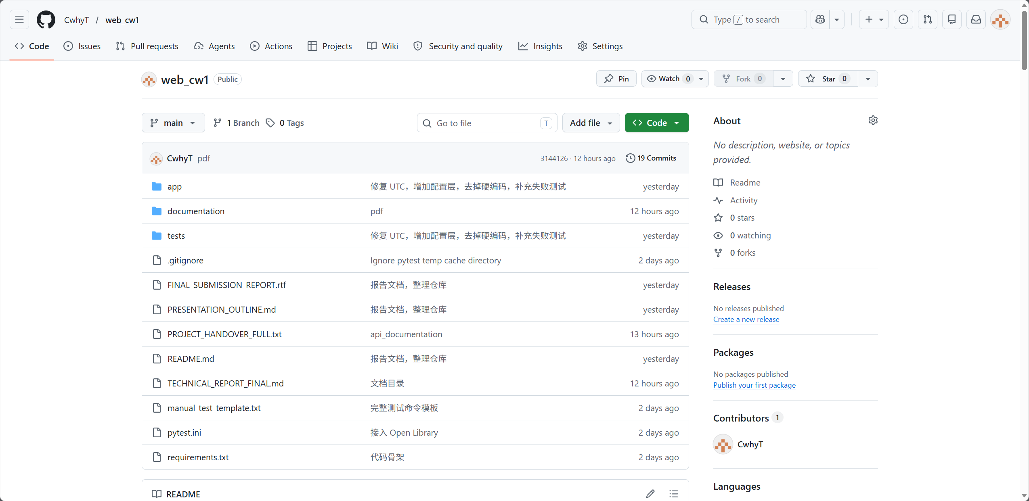
Version Control
Repository history shows staged progress from planning to documentation.
Public GitHub repository maintained throughout development.
Progress moved through planning, CRUD implementation, external integration, testing, and documentation.
Commit history provides evidence of iterative development rather than one-stage upload.
Repository link
https://github.com/CwhyT/web_cw1

Slide 4
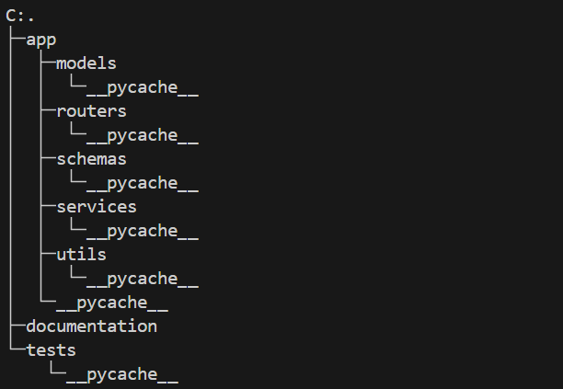
Tech Stack and Architecture
Layered API structure chosen for clarity, maintainability, and coursework scope.
Stack
Design choice
Architecture diagram
FastAPI
SQLAlchemy + SQLite
Pydantic
httpx
pytest
REST was preferred over GraphQL
because the system is resource-oriented, CRUD-heavy, and easier to validate, document, and test.
Application layers
routers
models
schemas
services
tests

Slide 5
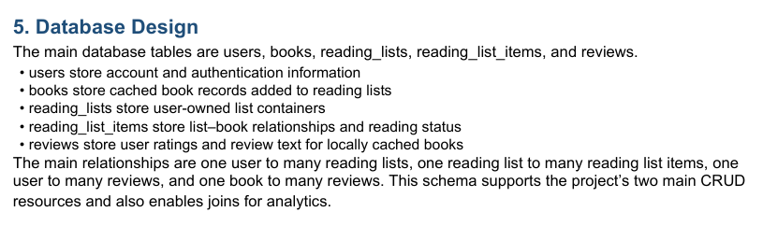
Database Design
Relational structure supports authenticated CRUD, cached books, and lightweight analytics.
Local SQL tables: users, books, reading_lists, reading_list_items, and reviews.
Books are cached locally only when users add them to a reading list.
Analytics and recommendations operate on local relational data rather than live external search results.
ER diagram / schema screenshot
Key relationships
One user → many reading lists
One list → many list items
One user → many reviews
One book → many reviews

Slide 6
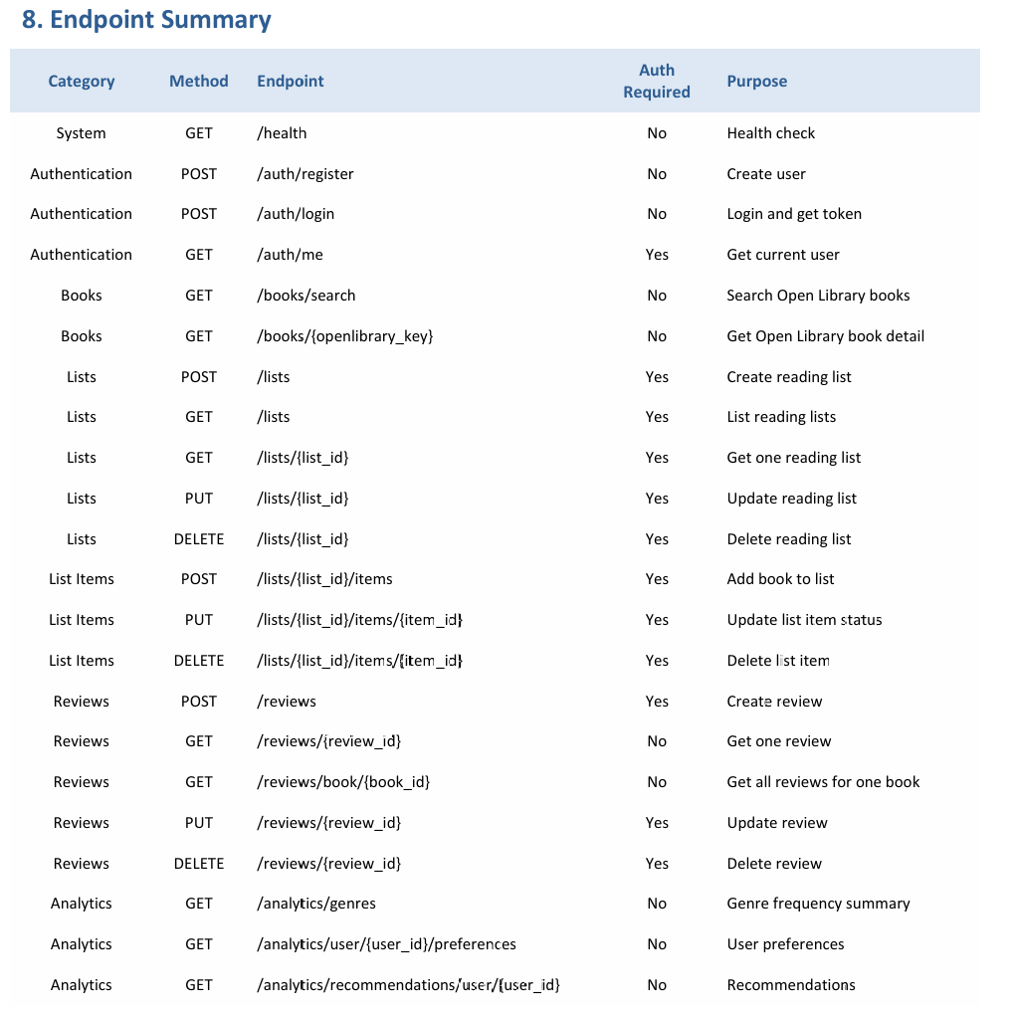
Key API Functionality
Implemented endpoint groups cover discovery, user-owned state, and analytical features.
Endpoint or Swagger screenshot
Public endpoints
Open Library provides live book search and detail retrieval.
Reading list items also trigger local book caching for later review and analytics.
Recommendations are rule-based and derived from saved books plus highly rated reviews.
/health
/api/books/search
/api/books/{openlibrary_key}
Authenticated CRUD
/api/auth/me
/api/lists/...
/api/reviews/...
Insert API docs page, endpoint examples, or Postman output
Analytical endpoints
/api/analytics/genres
/api/analytics/user/{user_id}/preferences
/api/analytics/recommendations/user/{user_id}

Slide 7
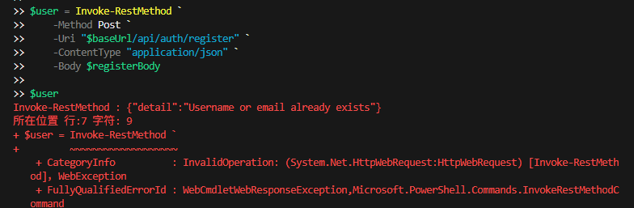
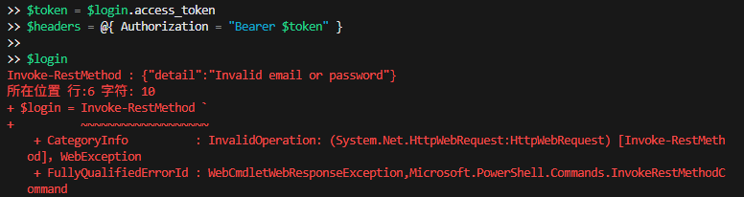

Authentication / Validation / Error Handling
Access control and input validation make the API more realistic than an open CRUD prototype.
Auth / error response screenshot
Bearer token authentication is issued through the login endpoint.
Ownership checks prevent modification of another user’s reading lists or reviews.
Concise validation messages improve readability during testing and demonstration.
Conventional status codes are used consistently across endpoints.
Validation messages
Examples
Invalid email format
Rating must be between 1 and 5
401 Unauthorized
403 Forbidden
404 Not Found
409 Conflict
422 Unprocessable Entity

Slide 8
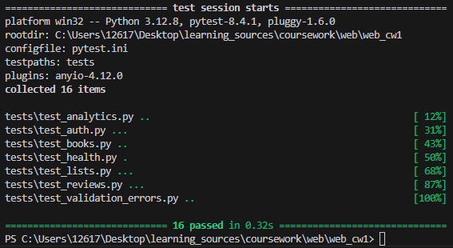
Testing Evidence
Automated tests were used to verify core behaviour and permission-sensitive paths.
16 passed
Testing screenshot
pytest and FastAPI TestClient used for automated verification.
External Open Library calls were mocked to remove network dependence.
Coverage includes authentication, permissions, reviews, analytics, validation, and /health.

Slide 9
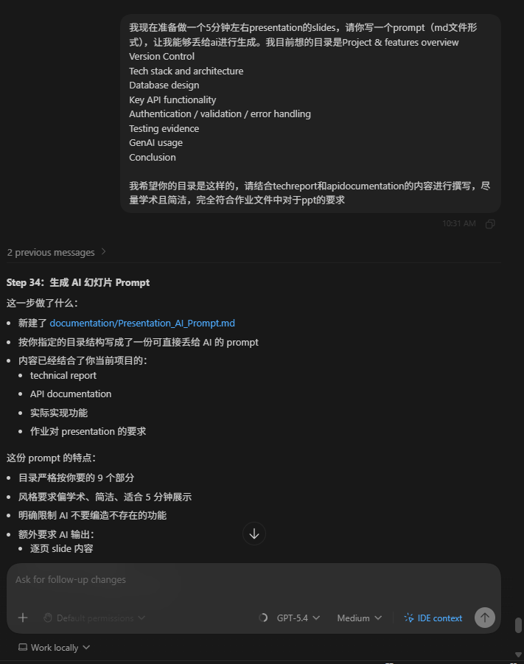

GenAI Usage
Used in a declared, supportive, and reviewed manner throughout development.
GenAI evidence placeholder
Tools used: ChatGPT and Codex.
Main roles: brief interpretation, planning, debugging support, and documentation refinement.
Outputs were checked manually against the coursework brief, repository state, and local test results.
Final implementation and validation remained the student’s responsibility.

Slide 10
Conclusion
Coursework-scale backend project that meets the core API requirements and extends them with analysis features.
ShelfSense API demonstrates SQL-backed CRUD, external API integration, authentication, testing, and documentation.
The design remains coursework-focused: local execution, SQLite, and rule-based recommendations.
Despite these limits, the implemented system satisfies the core technical expectations of the brief.
Final talking points
Functional API
Clear technical structure
Tested behaviour
Documented submission package

Slide 11
Thank you！
Questions?
[ Yantong Chen / 201690988 ]
ShelfSense API • XJCO3011 Web Services and Web Data

